Slide 1
Going to my new class in September

Slide 2
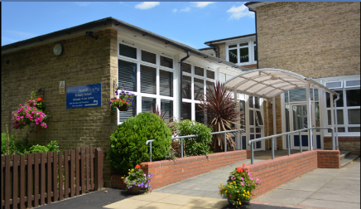
I’m going back to my school!

Slide 3
To stop people from sharing their germs and getting poorly, our school was closed.
I had to stay at home and stay safe.

Slide 4
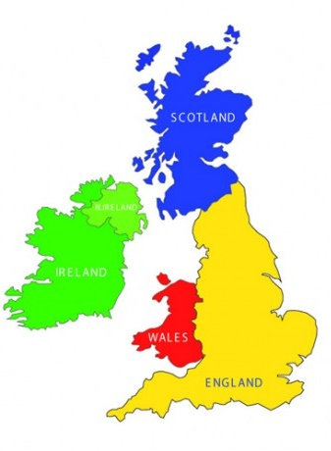
Now, the people in charge of our country say it is safe for me to go back to school.
When I go back to school some things will be the same and some things may be different.

Slide 5
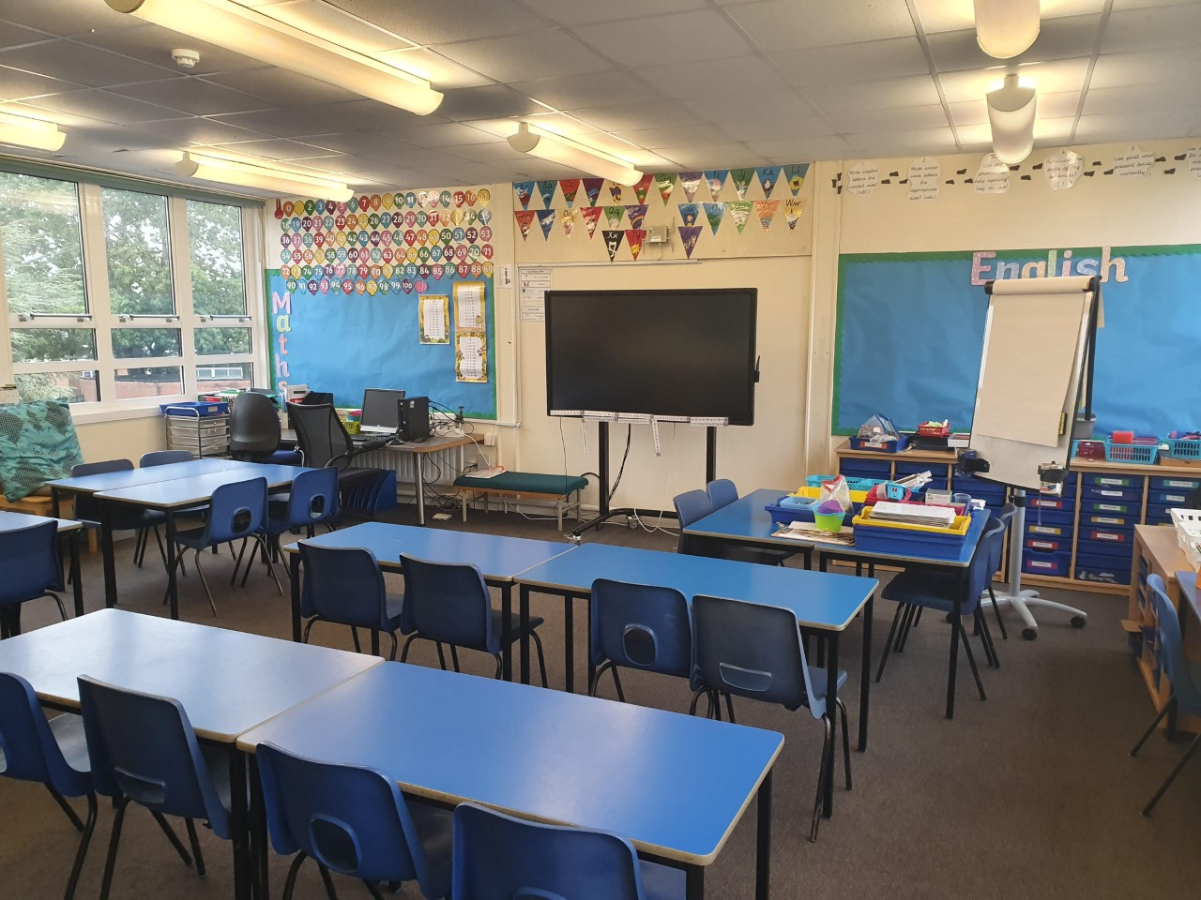
The school building will be the same.
This will be my new classroom

Slide 6
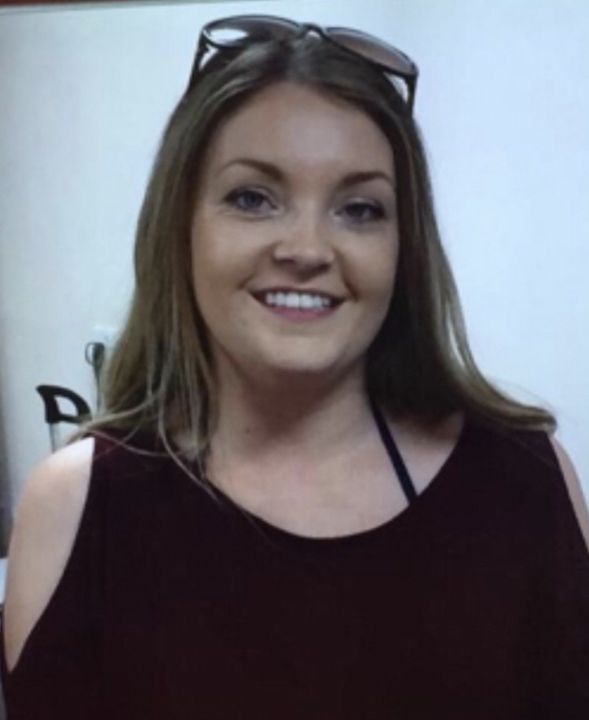
My new teacher
I will be in Sycamore class. I will be in Year 3.
My Teacher will be Mr Thomas.
My teaching Assistant will be Mrs Cloherty

Slide 7
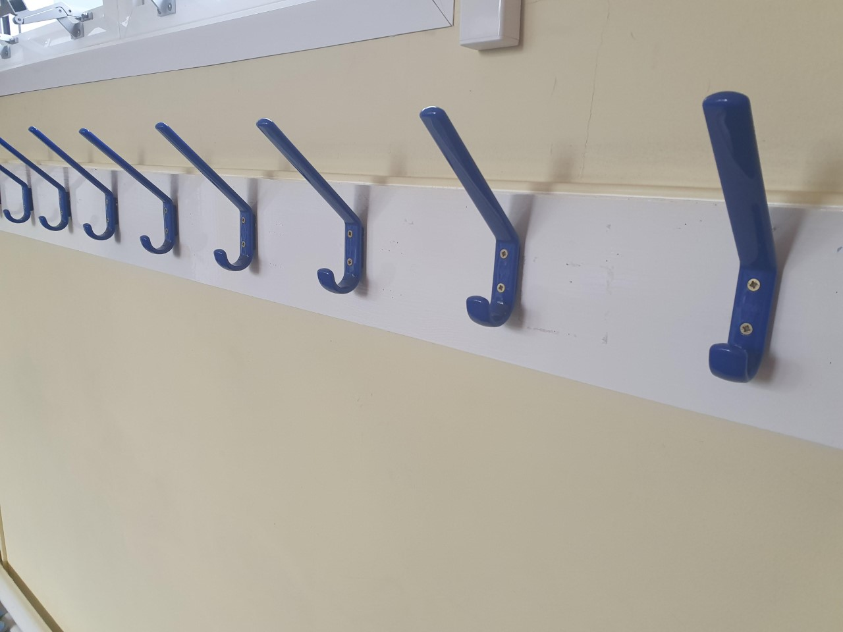
Information about my class…
I can put my things on my named peg outside my classroom.

Slide 8
First week back…
In our first week back I will:
Explore a new book
Learn about problems from a story and work in teams to design something to solve the problem
Practice our maths
My teacher will play games to get to know me
I can get to know my teacher
We will practice our routines

Slide 9
Our first English book will be…

Slide 10
We know you may be feeling a little nervous about coming back to school so we will be doing our best to help you feel settled.
When you do have a worry, there will always be a grown up you can talk to.

Slide 11
We’ve missed you and we’re really looking forward to seeing you again!

