Slide 1
Year 5 Home Learning
Week Beginning: 27th April 2020
cherrytree.class@fernhill.kite.academy

Slide 2
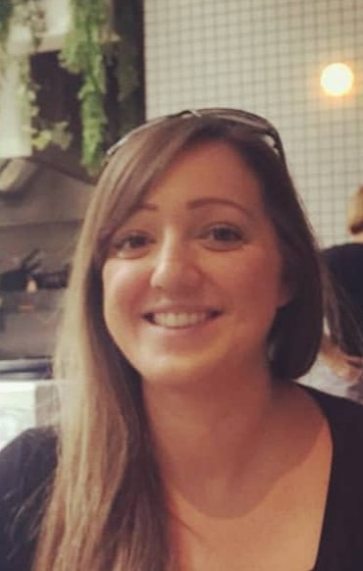
Hello! So nice to see you ☺
I hope you’re all doing well, staying safe and keeping busy! I’m having a few technical issues at the moment but I hope to be able to record my message for you next week!.
Just in case you’re missing me as much as I’m missing you… I thought I’d send you a little picture so you don’t forget me! I’ve got some exciting learning lined up for this week, it would be great if everyone could send me a picture of one thing they’ve done each week. You can send it to our class email: cherrytree.class@fernhill.kite.academy
I hope you enjoy the learning this week. Stay safe and I can’t wait to see what you’ve been up to!

Slide 3
How it works:
Please complete one English and one Maths task each day. (Approximately 30 minutes on each)
The topic for this week will be ‘Oceans’. Remember some of the activities may take more than a day to complete.

Slide 4
Maths focus: Decimals and Fractions
BBC bitesize videos: https://www.bbc.co.uk/bitesize/topics/zsjqtfr/articles/zsbd7p3
https://www.bbc.co.uk/bitesize/clips/zr6pvcw
White Rose Maths Home Learning Year 5 – Click on Week 1 to review: Decimals and Fractions
https://whiterosemaths.com/homelearning/year-5/
There are 5 lessons, please watch the clips first (if you have problems with the White Rose website videos, the BBC Bitesize clips are also useful), then click on ‘Get the Activity’ and you can check your answers afterwards.
Week 1
Monday - Lesson 1 – Decimals upto 2 dp
Tuesday – Lesson 2 – Decimals as fractions
Wednesday – Lesson 3 – Decimals as fractions
Thursday – Lesson 4 – Understanding thousandths
Friday – Lesson 5 – Thousandths as decimals

Slide 5
Key facts to support the children

Slide 7
Overview of English
This week you will be watching a short video about the ‘Dreamgiver’.
Monday and Tuesday you will practise some writing skills.
Wednesday you will watch the video, making note of key events.
Thursday you will re-tell the story using your success criteria
Friday you will finish writing your story and edit your work.
I’ve put lots of ideas in to help you stretch out your descriptions and add lots of details!
There are spelling activities throughout the week.

Slide 8
Overview of Topic
This week you will be focusing on Oceans.
There are lots of fun art and Science activities to do.
See the ‘topic sheet’ for details
(This will be sent to you via Marvellous Me or can be found on the school website.
ENJOY and don’t forget to send me examples of your work

Slide 9
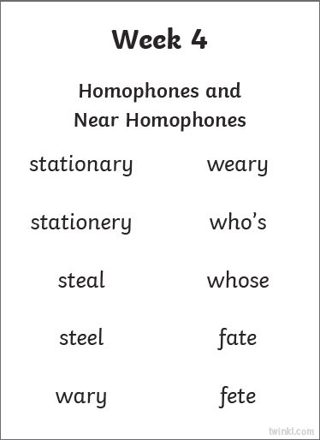
Monday I’m not too sure where you’re all up to on the spelling so I’ll start at week 4 (don’t worry too much if you’ve missed a week!)
Suggested Activities:
Look, say, cover, write, check
Rainbow writing
Pyramid writing
Find the meaning of the word
Add the value of the word
(vowels = 10 consonant = 5)

Slide 10
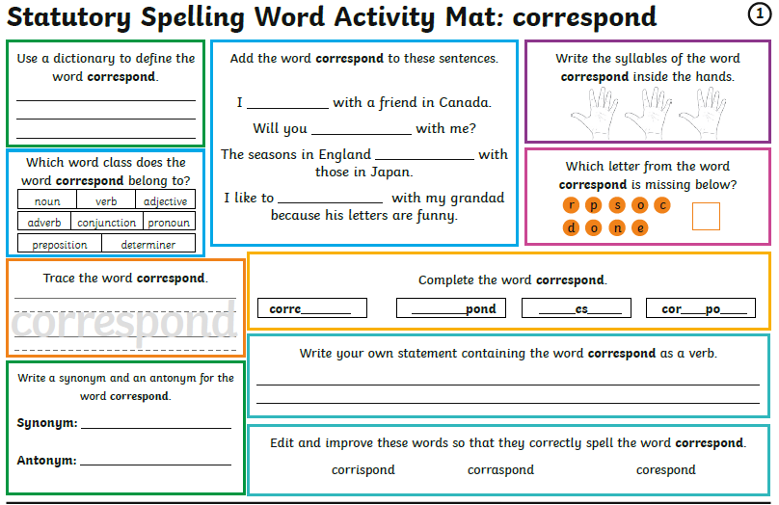
Monday I’m not too sure where you’re all up to on the spelling so I’ll start at week 6 (don’t worry too much if you’ve missed a week!) You don’t need t print these daily spelling mats, you can just copy from the screen.

Slide 11
Monday
Writing
Expanded Noun Phrases:
Watch the video clips and then complete the 3 activities.
https://www.bbc.co.uk/bitesize/articles/z4d6t39

Slide 12
Monday
https://whiterosemaths.com/homelearning/year-5/
Week 1 – Lesson 1 –Decimals upto 2 dp
Please watch the clip first (if you have problems with the White Rose website videos, the BBC Bitesize clips are also useful)
Click on ‘Get the Activity’
Check your answers afterwards.

Slide 13
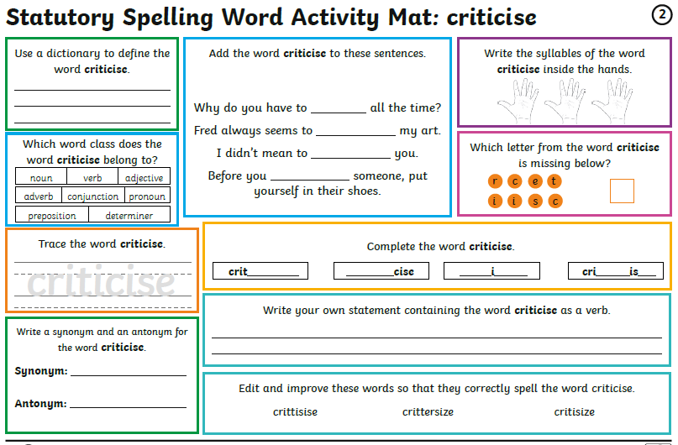
Tuesday

Slide 14
Tuesday
Writing
Similes and Metaphors:
Watch the video clips and then complete the 3 activities.
https://www.bbc.co.uk/bitesize/articles/zkygrj6

Slide 15
Tuesday
https://whiterosemaths.com/homelearning/year-5/
Lesson 2 – Decimals as fractions
Please watch the clip first (if you have problems with the White Rose website videos, the BBC Bitesize clips are also useful)
Click on ‘Get the Activity’
Check your answers afterwards.

Slide 16
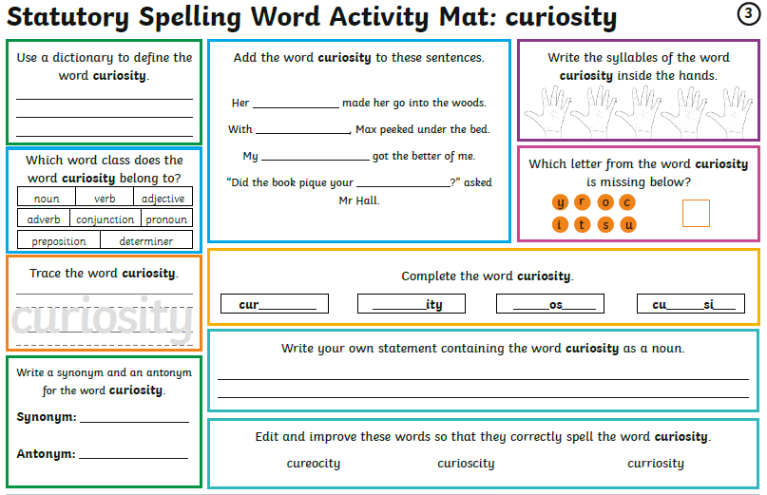
Wednesday

Slide 17
Writing opportunity: https://www.literacyshed.com/dreamgiver.html
The purpose of the writing: To entertain
Success Criteria:
I can include expanded noun phrases (translucent, glittering wings)
I can include similes and metaphors (like a dragonfly)
I can use a range of sentence structures

Slide 18
Writing opportunity:
I am learning to plan the vocabulary I will use in my writing.
Watch the clip: https://www.literacyshed.com/dreamgiver.html
Bullet point the key events
Bullet point the nouns (things) that you could describe e.g. moon, wind, creature, shutters…
Add adjectives (describing words) to your nouns
Which powerful verbs (doing words) could you use?
Add adverbs (describe ).
Mind map vocabulary you will use to describe the scene

Slide 19
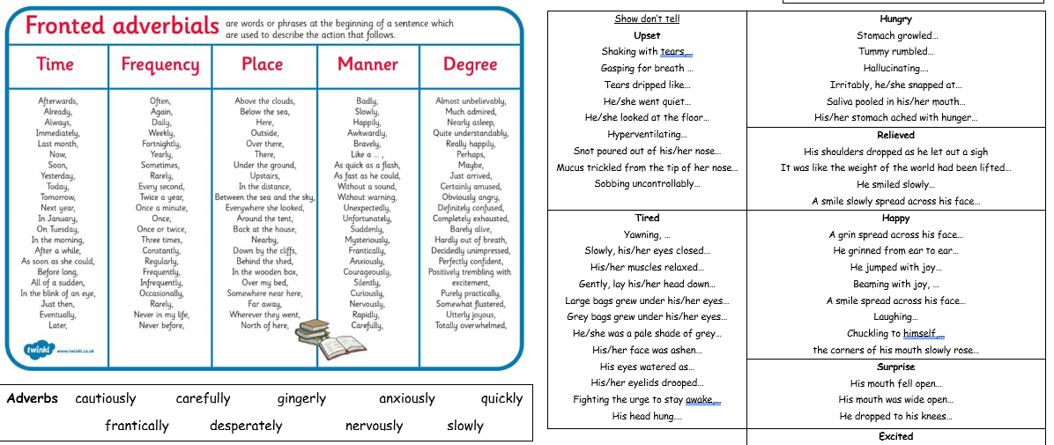

Slide 20
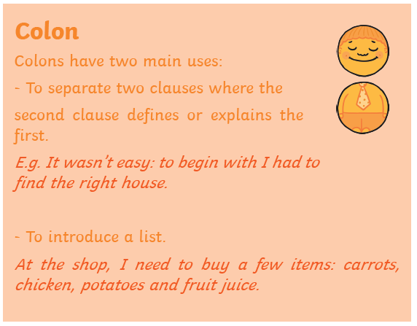
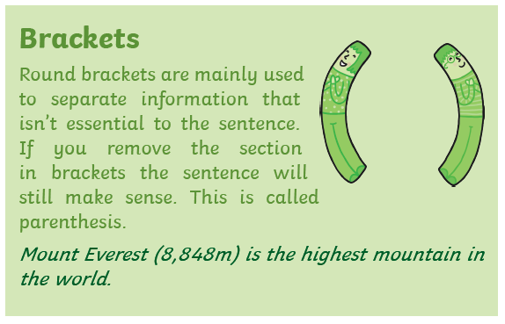
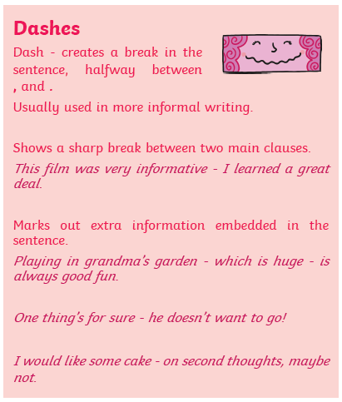

Slide 22
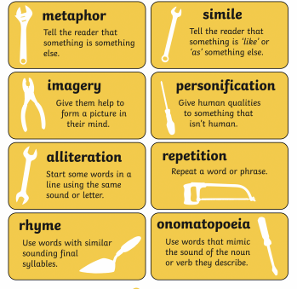

Slide 23
Wednesday
https://whiterosemaths.com/homelearning/year-5/
Week 1 – Lesson 3 –Decimals as fractions
Please watch the clip first (if you have problems with the White Rose website videos, the BBC Bitesize clips are also useful)
Click on ‘Get the Activity’
Check your answers afterwards.

Slide 24
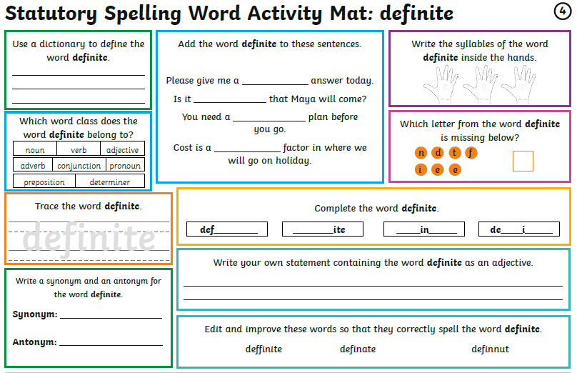
Thursday

Slide 25
Writing opportunity: https://www.literacyshed.com/dreamgiver.html
The purpose of the writing: To entertain
Success Criteria:
I can include expanded noun phrases (translucent, glittering wings)
I can include similes and metaphors (like a dragonfly)
I can use a range of sentence structures
For example: Creeeeeaaaakkkk! The dilapidated shutters were gently opened by the creature as he hovered above the window sill. Quietly fluttering, his translucent, glittering wings were like a dragonfly.

Slide 26
I can use a range of sentence structures
- Don’t forget to use a range of sentence openers, conjunctions and fronted adverbials (see slide 16)

Slide 27
Writing opportunity: Focus on including expanded noun phrases.
I am learning to write the opening.
Watch the clip again: https://www.literacyshed.com/dreamgiver.html
Using your notes from yesterday, watch the film up to 0.56 minutes and write your opening paragraph setting the scene with a clear description of the setting and introducing the creature.
Remember to include action with your description.
e.g.
As the creature’s translucent wings sprung to life, his thin, scrawny legs dangled in the still night air.
How could you reorder this sentence? Could you start with the verb ‘dangling’?

Slide 28
Modelled sentences to get you started…
Glittering stars were scattered across the pitch-black sky.
Silently watching the world, sparkling stars hovered over the quaint village as its residents slept soundly.
Silver, delicate clouds were drifting in the still night air.

Slide 29
Thursday
https://whiterosemaths.com/homelearning/year-5/
Week 1 – Lesson 4 –Understanding thousandths
Please watch the clip first (if you have problems with the White Rose website videos, the BBC Bitesize clips are also useful)
Click on ‘Get the Activity’
Check your answers afterwards.

Slide 30
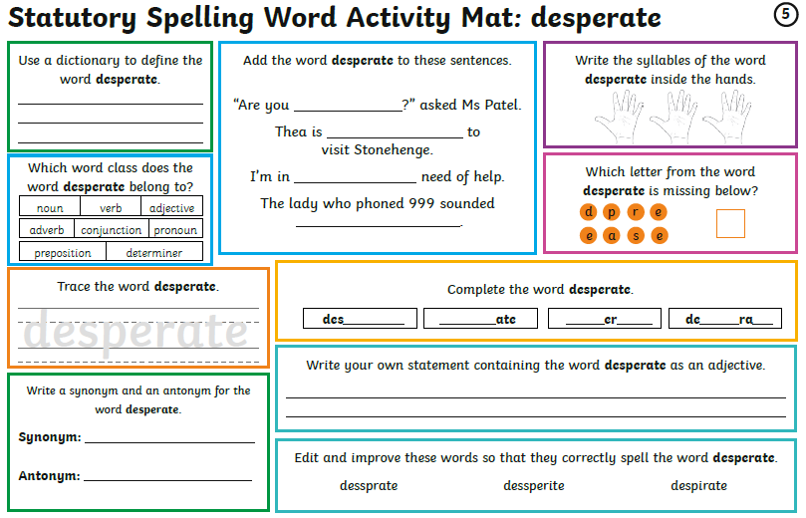
Friday

Slide 31
Writing opportunity: https://www.literacyshed.com/dreamgiver.html
The purpose of the writing: To entertain
Success Criteria:
I can include expanded noun phrases (translucent, glittering wings)
I can include similes and metaphors (like a dragonfly)
I can use a range of sentence structures

Slide 32
Writing opportunity: Focus on including the metaphors or similes.
I am learning to write a descriptive story.
Watch the clip again: https://www.literacyshed.com/dreamgiver.html
Using your notes, watch the film from 0.56- 2.24 minutes. Describe this scene. Think about the verbs and adverbs you choose to include. Remember to think about the small events which take place… describe each of these events:
The egg cracks
The liquid oozes out
The ballet shoes glow
A glowing ballerina appears
The creature gazes in awe
Ballerina swirls and twirls
Ballerina floats across the duvet
Child is sleeping peacefully
Ballerina balances and pirouettes
Creatures wings flutter as he carefully selects the next egg

Slide 34
Writing opportunity: Extension
I am learning to write a descriptive story.
Continue watching the film clip https://www.literacyshed.com/dreamgiver.html
and finish writing the story. Remember to re-read your writing and check for the success criteria. You could also edit your writing and publish it.
Please email me your writing (in a word document or photo), I would love to read your writing and maybe even publish it on the school website!

Slide 35
Friday
https://whiterosemaths.com/homelearning/year-5/
Week 1 – Lesson 5 –Thousandths as decimals
Please watch the clip first (if you have problems with the White Rose website videos, the BBC Bitesize clips are also useful)
Click on ‘Get the Activity’
Check your answers afterwards.

Slide 36
Have a great weekend! Don’t forget to send me some photos … I’d love to see what you’ve been up to!

