Slide 1
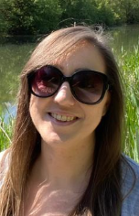
Year 6 Home Learning
Week Beginning: 22nd June2020
cherrytree.class@fernhill.kite.academy

Slide 2
How it works:
Please complete one English and one Maths task each day. (Approximately 30 minutes on each)
The topic for this week will be continuing ‘Not every superhero wears a cape’. Remember some of the activities may take more than a day to complete. Please choose 2 more activities from the list.

Slide 3
English - Yr 6 Monday – Comprehension Percy Jackson and the lightning thief https://www.bbc.co.uk/bitesize/articles/zj74kmn Tuesday – Writing Story writing: Character creation and complex sentences https://www.bbc.co.uk/bitesize/articles/zvmw7nb Wednesday – Writing Story writing: Synonyms and antonyms https://www.bbc.co.uk/bitesize/articles/z63ny9q Thursday – Writing Plan a superhero story. Choose either a story about a time when you saved the day or a story about how you got your powers. Friday – Writing Write a short superhero story

Slide 4
Overview of English: Reading
Enjoy reading a book and continue the challenge…

Slide 5
Maths focus: Fractions and Percentages
White Rose Maths Home Learning
Year 6 - Summer Term – Week 6 (w/c 1st June)
https://whiterosemaths.com/homelearning/year-6/
There are 5 lessons, please watch the clips first (if you have problems with the White Rose website videos, the BBC Bitesize clips are also useful), then click on ‘Get the Activity’ and you can check your answers afterwards.
BBC bitesize videos: https://www.bbc.co.uk/bitesize/clips/zq487ty
https://www.bbc.co.uk/bitesize/topics/z9sycdm/articles/zbc6382
Summer Term – Week 6 (w/c 1st June)
Monday - Lesson 1 – Fractions to Percentages
Tuesday – Lesson 2 – Equivalent Fractions, Decimals and Percentages
Wednesday – Lesson 3 – Order Fractions, Decimals and Percentages
Thursday – Lesson 4 – Percentages of amounts
Friday – Lesson 5 – Maths challenge
The school has a subscription
Videos are still available on their website
(follow the link as before)
but the worksheets are now included
in this PowerPoint.

Slide 6
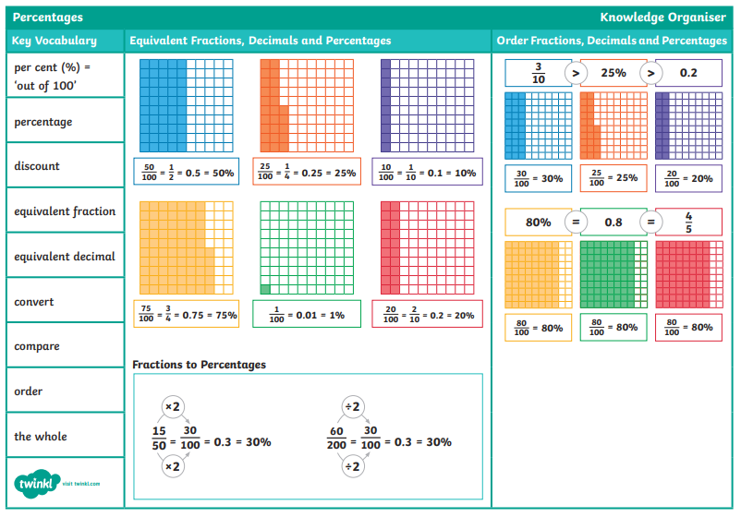

Slide 7
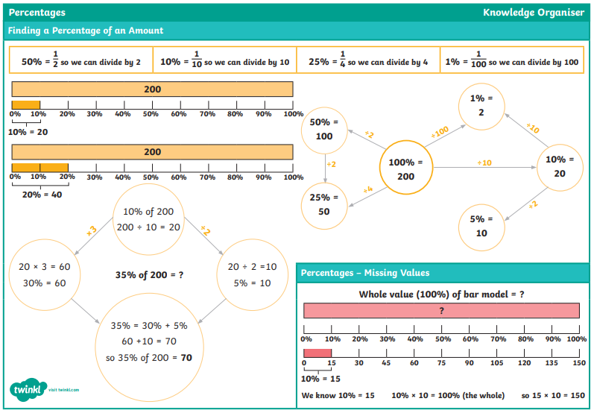

Slide 8
Overview of Topic
This week you will continue to explore the topic of ‘Not every superhero wears a cape’.
There are lots of fun art activities to do.
See the ‘topic sheet’ for details (This was sent to you last week via Marvellous Me)
ENJOY and don’t forget to send me examples of your work cherrytree.class@fernhill.kite.academy

Slide 9
Monday

Slide 10
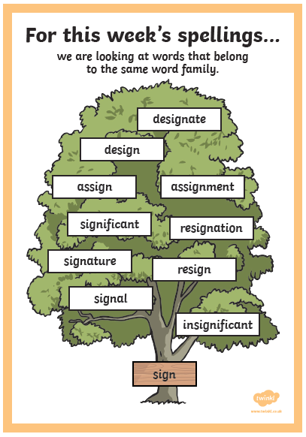
Monday Use a dictionary or online dictionary to find out what the words mean.
Suggested Activities:
Look, say, cover, write, check
Rainbow writing
Pyramid writing
Find the meaning of the word
Add the value of the word
(vowels = 10 consonant = 5)

Slide 12
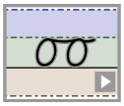
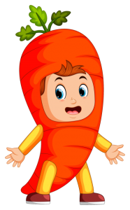
Handwriting It’s important to keep practising your handwriting… it’s a muscle like any other and needs to be exercised! This week we will focus on the letter formation: Watch the video then practice one line of this https://www.teachhandwriting.co.uk/cursive-joins-choice-2.html Then practice your cursive (joined up) handwriting by copying out the poem. https://www.poetry4kids.com/poems/today-i-wore-a-costume/
Today I Wore a Costume
Today I wore a costume so I looked just like a parrot. And yesterday I dressed up as a giant, talking carrot.
The day before, my costume was a life-sized Pikachu. And, earlier, a superhero, and a kangaroo.
Tomorrow I expect that I will be a dinosaur and tromp around the house so everyone can hear me roar.
It’s not because it’s Halloween. I won’t be trick-or-treating. No, I just like to photobomb Mom’s daily online meeting.
— Kenn Nesbitt

Slide 13
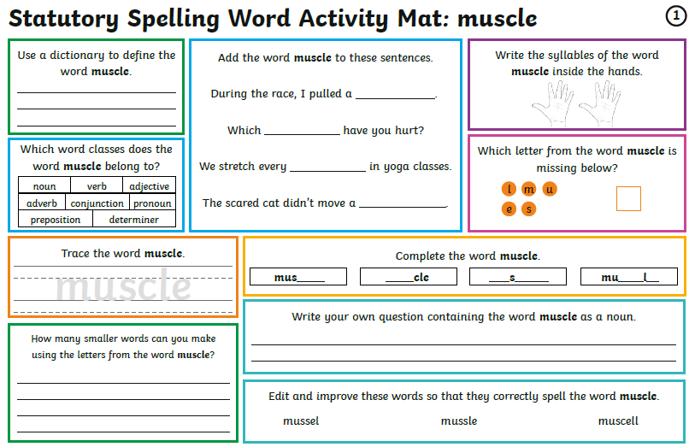
Monday Week 13 You don’t need to print these daily spelling mats, you can just copy from the screen.

Slide 14
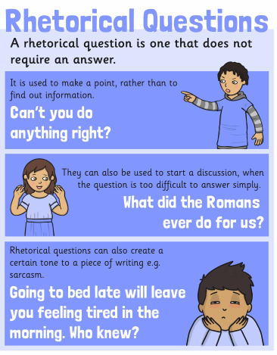
Monday – Comprehension Percy Jackson and the lightning thief https://www.bbc.co.uk/bitesize/articles/zj74kmn
Home learning focus
Using the novel Percy Jackson And The Lightning Thief you will learn about giving your opinion and summarising information.
This lesson includes:
two videos of actor and TV presenter Stephen Fry reading extracts from the book
three activities

Slide 15
Maths focus: Fractions and Percentages
White Rose Maths Home Learning
Year 6 - Summer Term – Week 6 (w/c 1st June)
https://whiterosemaths.com/homelearning/year-6/
There are 5 lessons, please watch the clips first (if you have problems with the White Rose website videos, the BBC Bitesize clips are also useful), then click on ‘Get the Activity’ and you can check your answers afterwards.
Summer Term – Week 6 (w/c 1st June)
Monday - Lesson 1 – Fractions to Percentages

Slide 16
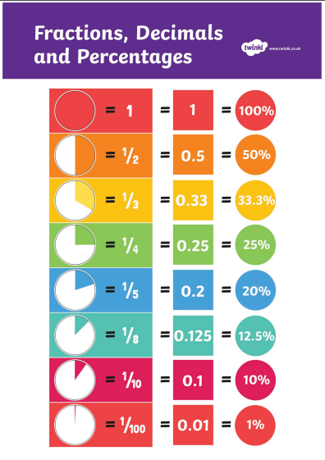
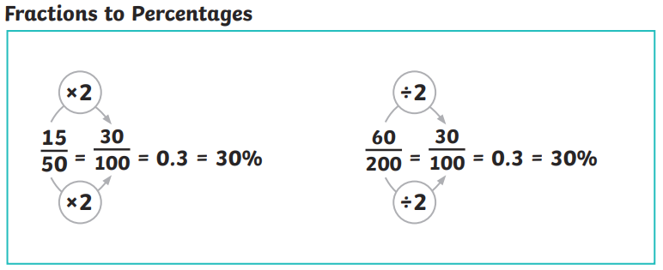
Remember to convert fractions to percentages it’s easiest to convert your fraction to a decimal first. E.g.
30 (30 hundredths) = 3 (3 tenths)
100 10
3 tenths (remember your place value chart)
0.3 (3 in the tenths column) multiply by 10 to find the % 30%
1 (1 whole) = 100% so…. 0.1 = 10%
0.2 = 20% 0.25 = 25%

Slide 19
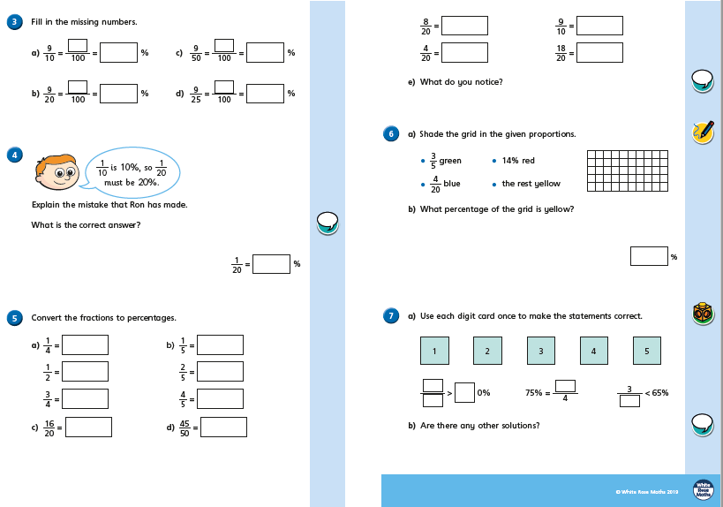

Slide 21
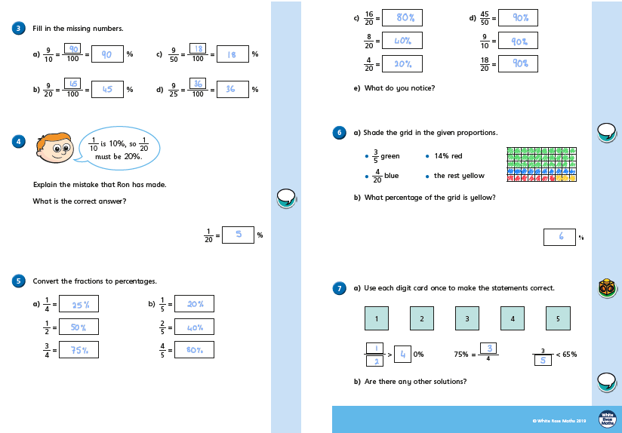

Slide 22
Tuesday

Slide 23
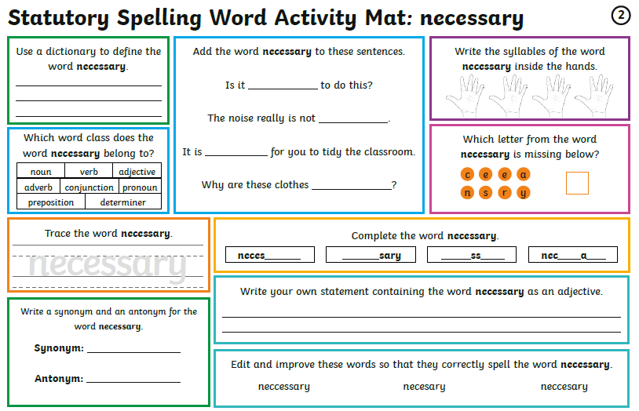
Tuesday You don’t need to print these daily spelling mats, you can just copy from the screen.

Slide 24
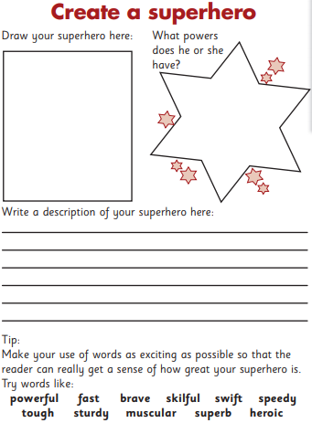
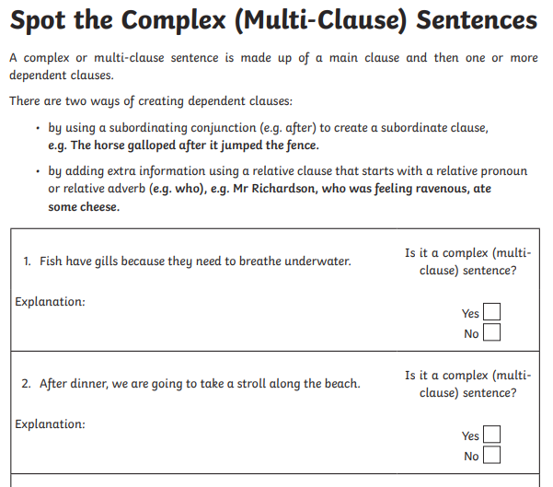
Tuesday – Writing Story writing: Character creation and complex sentences https://www.bbc.co.uk/bitesize/articles/zvmw7nb
Home learning focus
Learn how to create characters and complex sentences.
This lesson includes:
two videos
three activities
Create your own superhero
You can choose to do either the * or *** complex sentences sheet

Slide 25
Maths focus: Fractions and Percentages
White Rose Maths Home Learning
Year 6 - Summer Term – Week 6 (w/c 1st June)
https://whiterosemaths.com/homelearning/year-6/
There are 5 lessons, please watch the clips first (if you have problems with the White Rose website videos, the BBC Bitesize clips are also useful), then click on ‘Get the Activity’ and you can check your answers afterwards.
Summer Term – Week 6 (w/c 1st June)
Tuesday – Lesson 2 – Equivalent Fractions, Decimals and Percentages

Slide 28
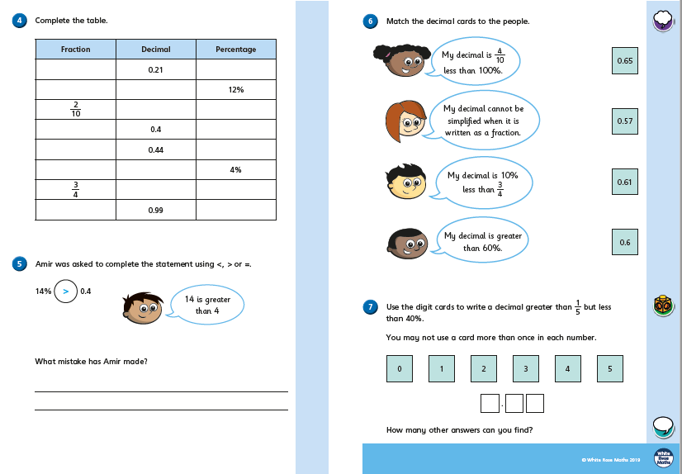

Slide 30
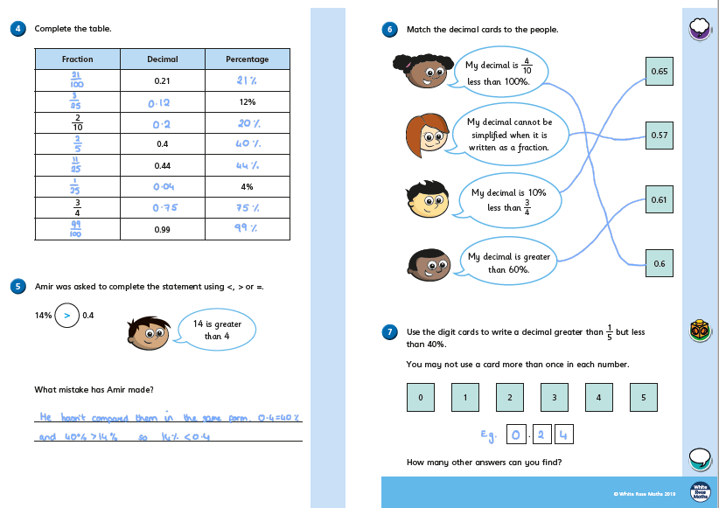

Slide 31
Wednesday

Slide 32
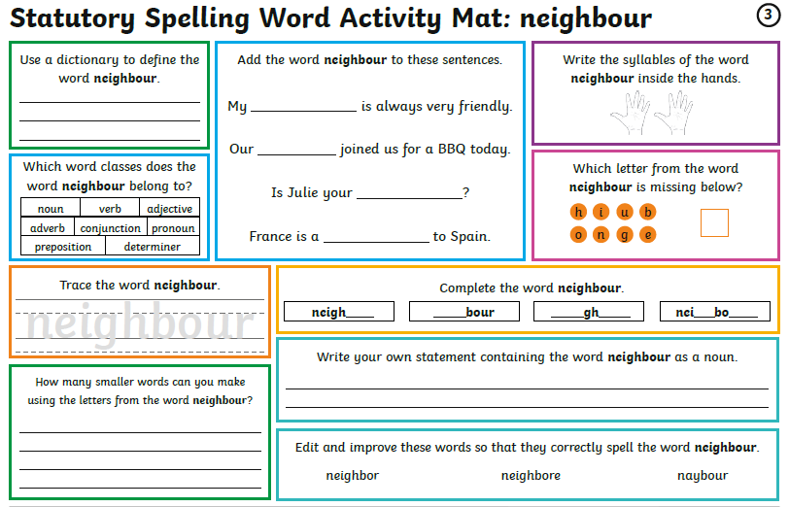
Wednesday You don’t need to print these daily spelling mats, you can just copy from the screen.

Slide 33
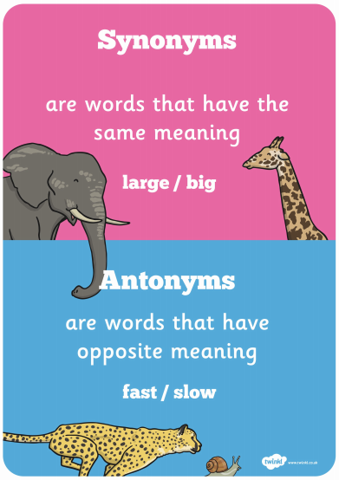
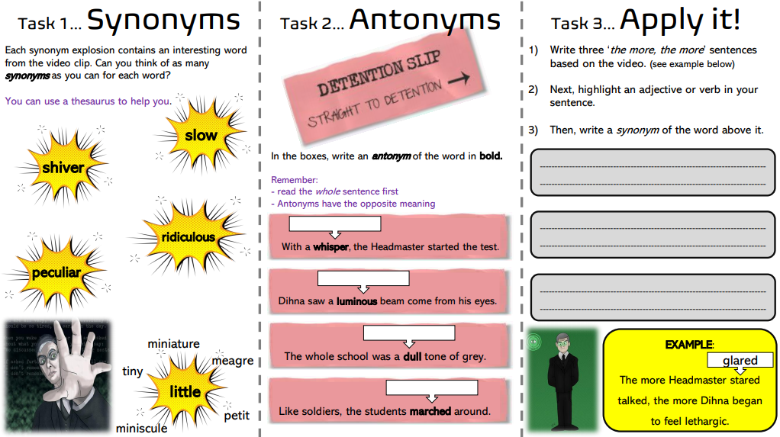
Wednesday – Writing Story writing: Synonyms and antonyms https://www.bbc.co.uk/bitesize/articles/z63ny9q
Home learning focus
Learn how to use synonyms and antonyms.
This lesson includes:
two videos
three activities

Slide 34
Maths focus: Fractions and Percentages
White Rose Maths Home Learning
Year 6 - Summer Term – Week 6 (w/c 1st June)
https://whiterosemaths.com/homelearning/year-6/
There are 5 lessons, please watch the clips first (if you have problems with the White Rose website videos, the BBC Bitesize clips are also useful), then click on ‘Get the Activity’ and you can check your answers afterwards.
Summer Term – Week 6 (w/c 1st June)
Wednesday – Lesson 3 – Order Fractions, Decimals and Percentages

Slide 37
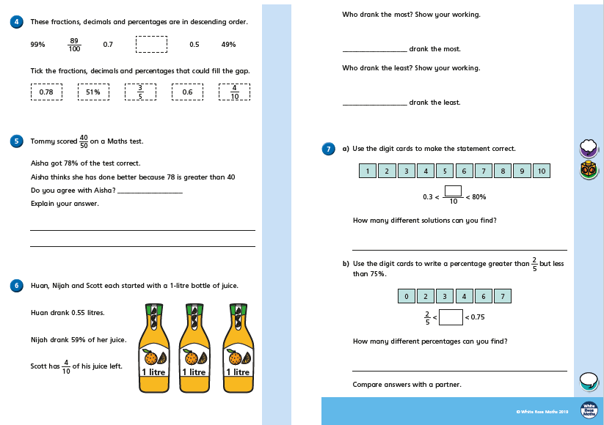

Slide 40
Thursday

Slide 41
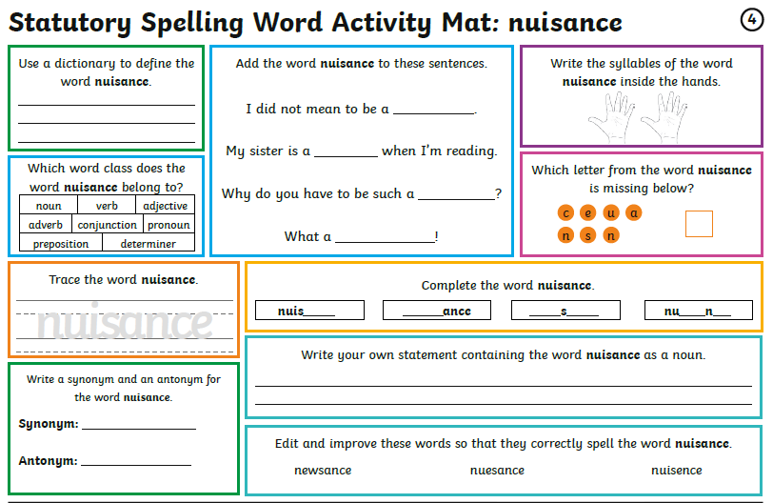
Thursday You don’t need to print these daily spelling mats, you can just copy from the screen.

Slide 42
Thursday – Writing Plan a superhero story. Choose either a story about a time when you saved the day or a story about how you got your powers.
Today we are going to:
Learn about story writing
Create a superhero (you can use the superhero you created on Tuesday)
Write our own short story

Slide 43
Who’s your favourite superhero?

Slide 44
Ideas to help you create your superhero. What does you superhero look like?

Slide 45
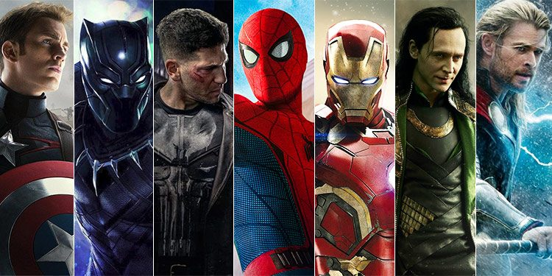
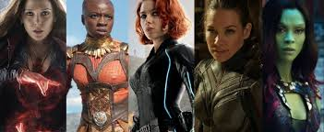

Slide 46
Setting Ideas Where will your superhero save the day?

Slide 47
Beginning (Exposition)How will you start your story?
Dialogue:
“The mutant gas is ready Doctor McEvil. Look what it’s done to one of your volunteers …”
“That is the most evil and beautiful thing I have ever seen! Mwhahaha, my plan is perfect, a mutant army of humans under my control so I can take over the world. Professor Scribe will never be able to stop me, mwhahaha!”
“Your wish is my command, Master …”
Description:
The lab was quiet, all eyes were on the sealed cage. A human volunteer, dedicated to Doctor McEvil’s cause, had been in the chamber for a few hours, exposed to the toxic mutant gas. A lab technician gasped as the human’s eyes opened, glowing fiery orange. He grinned, his teeth sharper and whiter than before, then showed his tongue, now forked like a snake’s. The only bigger smile in the stark white room was Doctor McEvil. The silence was broken by the sound of his evil laugh.
Action:
The glass vial shattered as the lab technician saw the mutated human in the cage. Its forked tongue splitting round the bars and twisting them. The metal bars shrieked as they buckled under the force. Doctor McEvil laughed loudly, as his dream became a reality. His mutant army would be unstoppable.

Slide 48
Event Ideas (Rising Action) Who is your superhero’s arch-enemy? Who is going to cause the conflict or dilemma?
Example Story:
Peter Parker is bitten by a radioactive spider. He develops super powers – Spider Sense, can climb walls, web shooters.

Slide 49
Conflict
Example Story:
The Green Goblin sets a trap for Spider-Man, once he’s out of the way, the Green Gobin can control the crime in the city.

Slide 50
Middle (Climax)
What Happens Next ...?
What are your superhero and arch-enemy doing?
Where are they?
How do they feel?
Remember, this is the peak of the story – all the action/excitement/danger should be here!
Example Story:
The Green Goblin’s trap works and he attacks Spider-Man!

Slide 51
Falling Action
How will the conflict/dilemma be resolved?
What effects did the middle (climax) of your story have on the characters?
Example Story:
Spider-Man escapes the trap, but he knows the Green Goblin will be back and this worries him.

Slide 52
End (Conclusion)
The conflict/dilemma needs to be resolved.
All loose ends are tied up.
Do you unmask the arch-enemy?
Will you use ‘Action’, ‘Dialogue’ or ‘Description’ to end your story?
Ending Examples:
The battle of Good vs Evil never really ends.
They were never seen again.
Things will never be the same.

Slide 53
Superhero Sounds! There are lots of action sounds to include in your superhero story ...

Slide 54
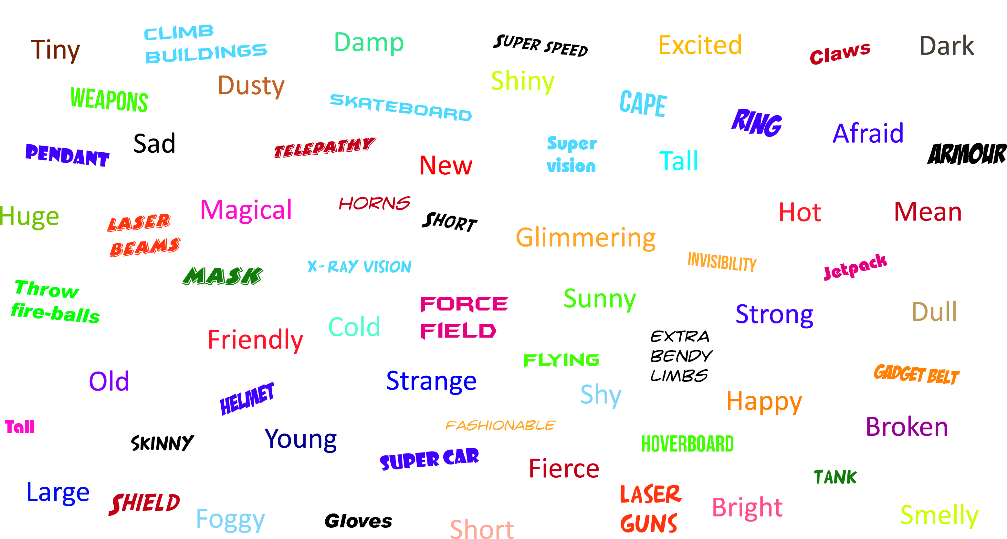
Descriptions
Things To Think About …
Settings Characters Emotions Super Powers Gadgets

Slide 55
Now use your ideas to write your own short superhero story ...

Slide 56
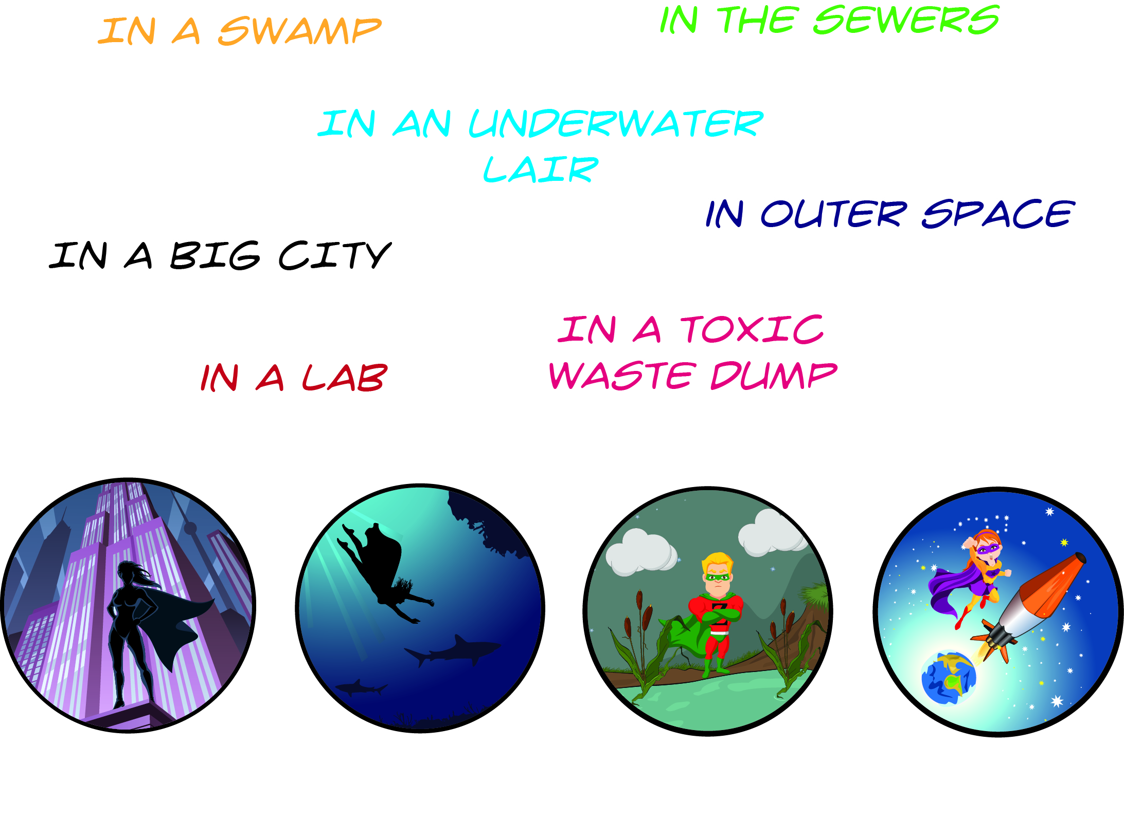
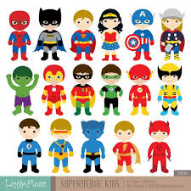
Plan
Opening: Describe the setting Light (moon or sun?) Nature – Weather? Animals? 5 senses (see, hear, taste, smell, touch) Similes, metaphors, personification
Build up: Introduce the character. Introduce the hero Describe the hero 5 senses (see, hear, taste, smell, touch) - What do they look like? Top down e.g. hair first or Bottom up e.g. shoes first - Can you include actions e.g. As he raced down the crowded street his crimson cape billowed behind him - How does the hero treat others e.g. she stopped in her tracks when she saw the new boy at school staring around bewildered. “Can I help?” she asked quietly as a sweet smile spread across her face.
Problem: Introduce the conflict (a mystery, dilemma or crisis) - What are your superhero and arch-enemy doing? Where are they? Have a conversation… does it show the characters’ personality or move the story forward?
Resolution: How is the conflict resolved? What dis the hero have to do? Remember to use powerful verbs and adjectives What effects did the middle (climax) of your story have on the characters?
Ending: Do you unmask the arch-enemy? Will you use ‘Action’, ‘Dialogue’ or ‘Description’ to end your story?

Slide 57
Maths focus: Fractions and Percentages
White Rose Maths Home Learning
Year 6 - Summer Term – Week 6 (w/c 1st June)
https://whiterosemaths.com/homelearning/year-6/
There are 5 lessons, please watch the clips first (if you have problems with the White Rose website videos, the BBC Bitesize clips are also useful), then click on ‘Get the Activity’ and you can check your answers afterwards.
Summer Term – Week 6 (w/c 1st June)
Thursday – Lesson 4 – Percentages of amounts

Slide 58
Remember,
100% is all the number
To find 10% of any number ÷10
Then x your answer
To find 5% find 10% then half it.
e.g.
45% of 90
10% of 90 = 9
(to find 40%) 9 x 4 = 36
(to find 5%) 9 ÷ 2 = 4.5
36 + 4.5 = 40.5

Slide 60
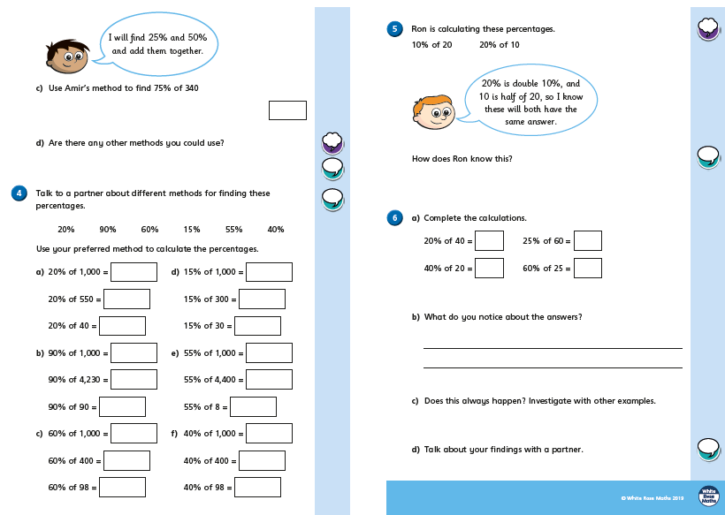

Slide 62
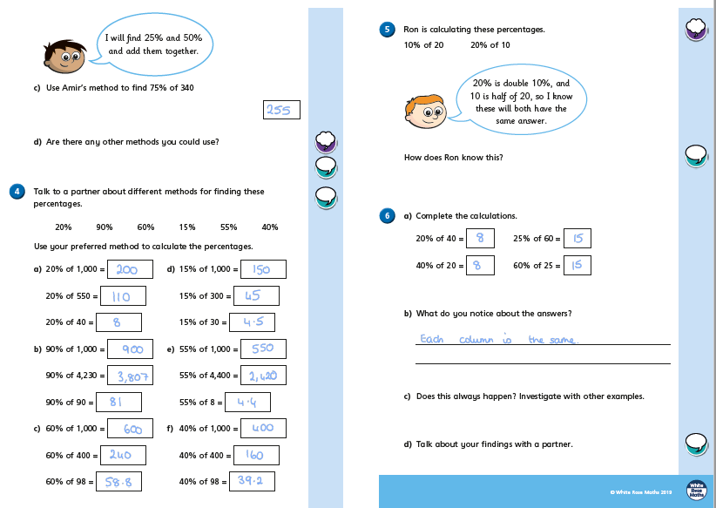

Slide 63
Friday

Slide 64
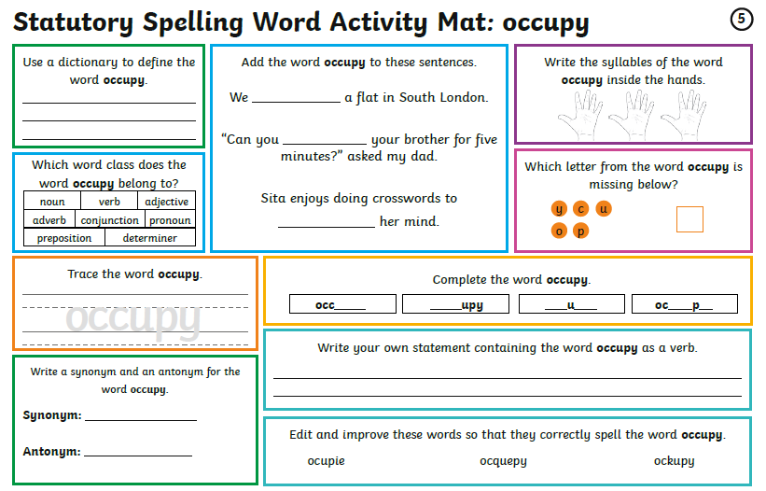
Friday You don’t need to print these daily spelling mats, you can just copy from the screen.

Slide 65
Friday – Writing Write a short superhero story

Slide 66
Plan
Opening: Describe the setting Light (moon or sun?) Nature – Weather? Animals? 5 senses (see, hear, taste, smell, touch) Similes, metaphors, personification
Build up: Introduce the character. Introduce the hero Describe the hero 5 senses (see, hear, taste, smell, touch) - What do they look like? Top down e.g. hair first or Bottom up e.g. shoes first - Can you include actions e.g. As he raced down the crowded street his crimson cape billowed behind him - How does the hero treat others e.g. she stopped in her tracks when she saw the new boy at school staring around bewildered. “Can I help?” she asked quietly as a sweet smile spread across her face.
Problem: Introduce the conflict (a mystery, dilemma or crisis) - What are your superhero and arch-enemy doing? Where are they? Have a conversation… does it show the characters’ personality or move the story forward?
Resolution: How is the conflict resolved? What dis the hero have to do? Remember to use powerful verbs and adjectives What effects did the middle (climax) of your story have on the characters?
Ending: Do you unmask the arch-enemy? Will you use ‘Action’, ‘Dialogue’ or ‘Description’ to end your story?
Use your plan from yesterday to write your super hero story.

Slide 67
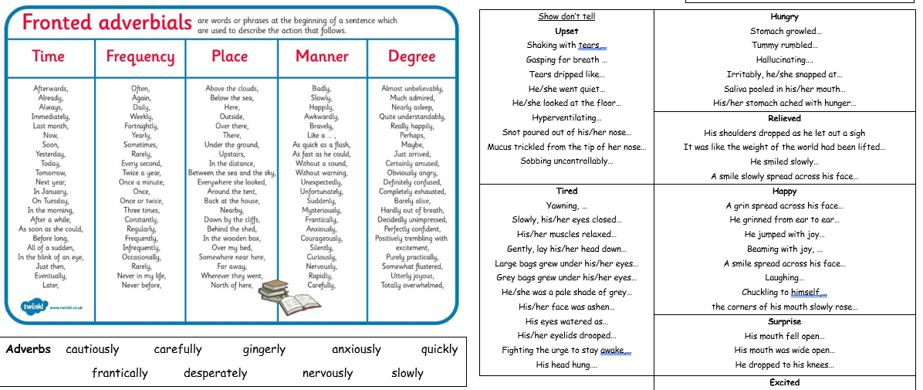

Slide 68
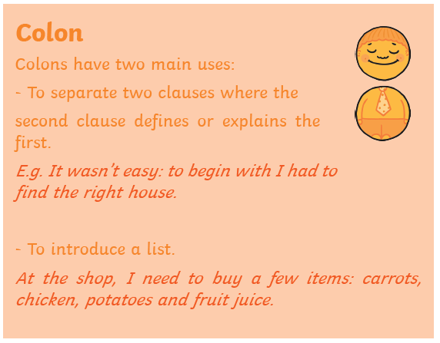
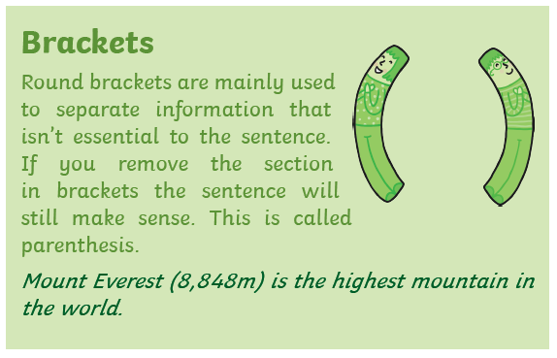
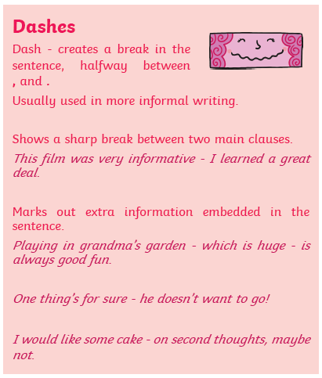

Slide 69
Beginning (Exposition)How will you start your story?
Dialogue:
“The mutant gas is ready Doctor McEvil. Look what it’s done to one of your volunteers …”
“That is the most evil and beautiful thing I have ever seen! Mwhahaha, my plan is perfect, a mutant army of humans under my control so I can take over the world. Professor Scribe will never be able to stop me, mwhahaha!”
“Your wish is my command, Master …”
Description:
The lab was quiet, all eyes were on the sealed cage. A human volunteer, dedicated to Doctor McEvil’s cause, had been in the chamber for a few hours, exposed to the toxic mutant gas. A lab technician gasped as the human’s eyes opened, glowing fiery orange. He grinned, his teeth sharper and whiter than before, then showed his tongue, now forked like a snake’s. The only bigger smile in the stark white room was Doctor McEvil. The silence was broken by the sound of his evil laugh.
Action:
The glass vial shattered as the lab technician saw the mutated human in the cage. Its forked tongue splitting round the bars and twisting them. The metal bars shrieked as they buckled under the force. Doctor McEvil laughed loudly, as his dream became a reality. His mutant army would be unstoppable.

Slide 70
Maths focus: Fractions and Percentages
White Rose Maths Home Learning
Year 6 - Summer Term – Week 6 (w/c 1st June)
https://whiterosemaths.com/homelearning/year-6/
There are 5 lessons, please watch the clips first (if you have problems with the White Rose website videos, the BBC Bitesize clips are also useful), then click on ‘Get the Activity’ and you can check your answers afterwards.
Summer Term – Week 6 (w/c 1st June)
Friday – Lesson 5 – Maths challenge
Get the activity from the website above
OR
You could go on IXL and practise a skill

Slide 71
Have a great weekend! Don’t forget to send me a picture of something you’re proud of.

