Slide 1
Home Learning
Week commencing 22nd June
Sycamore.class@fernhill.kite.academy

Slide 2
How it works:
Please complete one English and one Maths task each day. (Approximately 30 minutes on each). If your able to please send me examples of your learning.
The topic for this week is ‘Not All Heroes Wear Capes’. This is on the school web site and will be sent by marvellous me (some of the activities may take more than a day to complete). Feel free to pick and choose from this list, don’t feel you need to do them all.

Slide 3
Overview of Topic
This week you will be focusing on NOT ALL HEROES WEAR CAPES.
There are lots of fun art and science activities to do.
See the ‘topic sheet’ for details
This will be sent to you via Marvellous Me or can be found on the school website.
ENJOY and don’t forget to send me examples of your work
Feel free to pick and choose from this list, don’t feel you need to do them all

Slide 4
Recommended, Free Web Sites
Maths – White Rose Maths
Maths Games – Topmarks
Reading Books – Oxford Owls
Writing – The Literacy Shed
Science – Purple Mash
Worksheets for all subjects – Twinkl
All Subjects – Oak Academy and BBC Bitesize

Slide 5
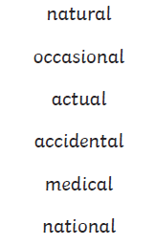
English Monday and spellings of the week
This week we are going to have a look at some common exception year 3 and 4 words that all end with the letters ‘al’.
These are quite tough words this week so I’d suggest reading them, having a look at the words and then have ago at spelling them. If they prove too difficult then we still need to practice spelling numbers from 1 to 20 to get even more confident.
Have a spelling practice of these words and re-write any words three times if you make a mistake..
CHALLENGE – Put any of these words into sentences.

Slide 6
English Monday = Handwriting https://www.youtube.com/watch?v=2NQ6uS8blwY
This week I would like you to start by practising your handwriting. Remember to write just four letters and then check back with the video, to make sure that you are forming your letters correctly.
No more than half a line of each letter in a day!
Remember that all of the letters must rest on the line and you should try to make them exactly the same size as each other.
This week let’s concentrate on m, n, o, p and j.

Slide 7
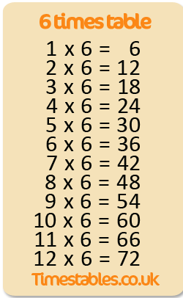
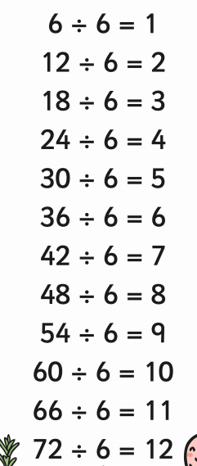
Maths Monday
Children need to become as quick as possible at recalling times tables. With that in mind lets practice again writing a list of multiplication and division facts for the 6 times tables.
Don’t forget to practice on
TT rockstars as well.

Slide 8
English Tuesday – inverted commas (speech marks)
Remember:
When you are writing, inverted commas (also called speech marks) go before and after any words that a character says (known as direct speech).
For example: "I'm hungry," complained Goldilocks.
If another character replies, the rule is to use another set of inverted commas and put the new person speaking on a new line.
For example:
"There’s some porridge on the stove,” said her mum.
"But I've already had some porridge today!” exclaimed Goldilocks.
Any punctuation goes inside the inverted commas at the end of what the character is saying.
Your challenge today is to write a short conversation between yourself and your best friend about what you have been doing during lockdown. Or you could complete the task on next page. If you need to remind yourself further about inverted commas have a look at this fun video and link:-
https://www.bbc.co.uk/bitesize/articles/zjm6pg8
Notes:
https://www.youtube.com/watch?v=nYTrIcn4rjg

Slide 9
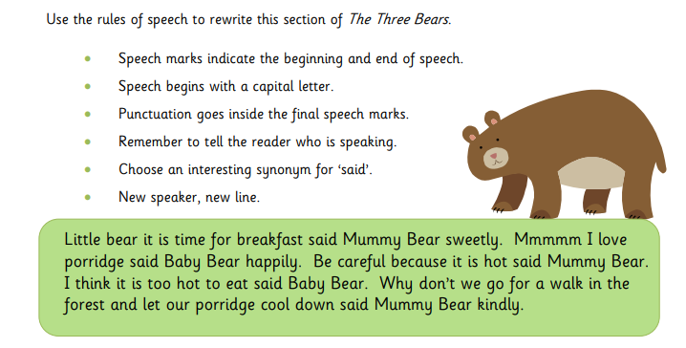
English – Tuesday continued
If you didn’t want to write a conversation with your friend using inverted commas then have a go at re-writing the below passage from Goldilocks remembering the rules for using inverted commas.

Slide 10
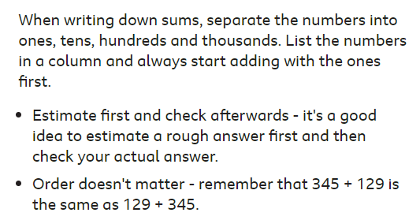
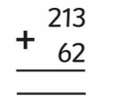
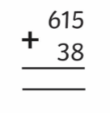
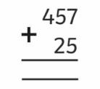
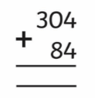
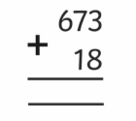
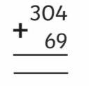
Maths Tuesday
Now have a go at these:- (remember you might need to exchange numbers when adding certain sums).
This link has some good videos to help:-
https://www.bbc.co.uk/bitesize/topics/zy2mn39/articles/z3kmrwx

Slide 11
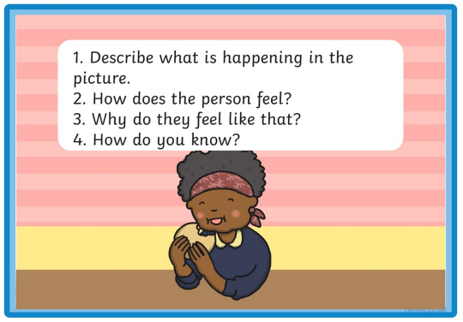
Wednesday English
Using inference to be a reading detective
When we read stories, watch films or TV shows, look at pictures or play video games, we use lots of different skills to work out what is happening. One of these skills is called inference.
Inferring is a bit like being a detective. You have to find the clues to work out the hidden information
Have a look at this link for more information and ideas
https://www.bbc.co.uk/bitesize/articles/zfn6pg8
Activity
To answer inference questions, you have to examine the whole scene.
Look at these ‘Inference Picture Cards’ and read the questions and look carefully at the whole picture to infer the answers.
Notes:
https://www.youtube.com/watch?v=5Qx5hf1zLmk

Slide 12
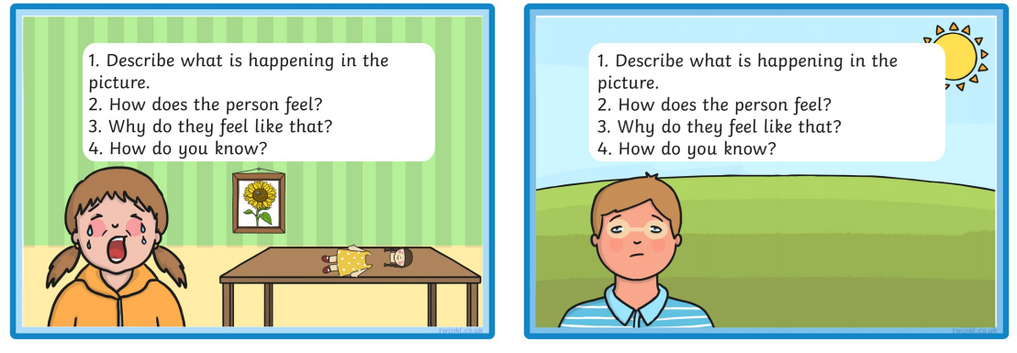
English Wednesday - continued
CHALLENGE – Can you draw your own scene and answer the same inference questions?

Slide 13
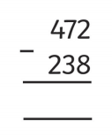
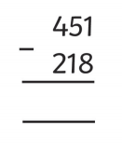
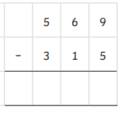
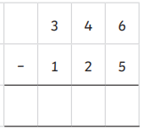
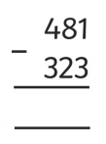
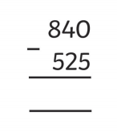
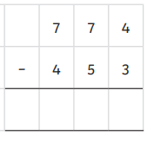
Maths Wednesday
If the numbers are too high or too difficult to subtract in your head, write them down in columns. Separate the numbers into ones, tens, hundreds and thousands. List the numbers in a column and always start with the ones first.
Estimate first and check afterwards - it's a good idea to estimate a rough answer first. And always check your actual answer.
Subtraction is the opposite to addition. So subtraction can always be checked by adding. Check that 182 - 37 = 145 by doing the sum: 145 + 37 = 182
Now have a go at these:- (remember you might need to exchange numbers when adding certain sums).
This link has some good videos to help:-
https://www.bbc.co.uk/bitesize/topics/zy2mn39/articles/zc78srd

Slide 14
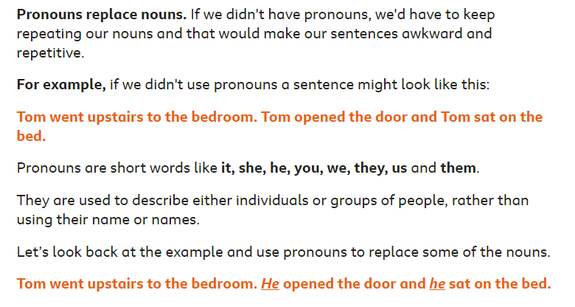
English Thursday
Identifying Pronouns
.
If you have internet access at home look at this and complete the quiz:
https://www.bbc.co.uk/bitesize/articles/zhp3bdm
Then complete activity on next page

Slide 15
English – Thursday continued
Activity

Slide 16
Maths Thursday
.
Place Value
We use place value headings like 10, 100, 1000. These help us do sums and see which numbers are bigger than others.
A number is made of one or more digits. The number 6379, for example, is made of the digits 6, 3, 7 and 9.
6 thousands, 3 hundreds, 7 tens and 9 ones
If you have internet access Please watch the following videos and take the quiz (If you don’t move onto the following underneath) :-
https://www.bbc.co.uk/bitesize/topics/zsjqtfr/articles/z9w3g82
Then ask children to break down the following 3 digit numbers into Hundreds, Tens and Ones :-
645 ( 6 Hundreds, 4 tens, 5 ones) 801 399 766
Then ask children (in readiness for year 4) to break down the following 4 digit numbers into Thousands, Hundreds, Tens and Ones :-
5237 4672 1091

Slide 17
English Friday
The two types of nouns
Common nouns
These are the names of things, like places or objects.
Examples are: monster, tree, boat, chair, banana
Proper nouns
These are the names of a particular person, place or thing.
They always begin with a capital letter.
Examples are: London, Scotland, India, David, Samaira
For example: A monster called Leroy lives in that tree.
'Leroy' is a proper noun and 'monster' and 'tree' are common nouns.
If you have internet access take a look at the following videos and quizzes:
https://www.bbc.co.uk/bitesize/articles/zjrdwty
And/or complete challenges on next two slides.

Slide 18
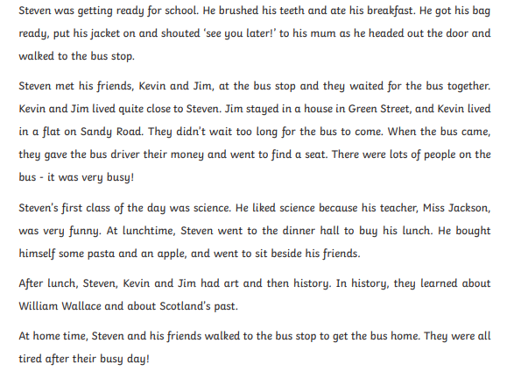
ENGLISH FRIDAY - continued
Read through this short story and make a note of all the nouns you can find. REMEMBER it’s a person, a place or a thing. ANSWERS ARE ON NEXT SLIDE – BUT NO CHEATING!!!

Slide 19
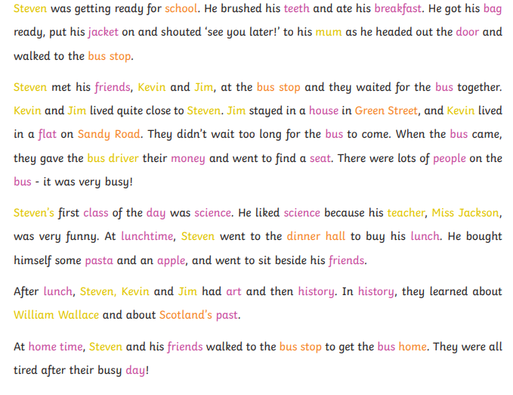
English Friday - continued
How many nouns did you find?
The people are highlighted in yellow, places are orange and the things are pink!!

Slide 20
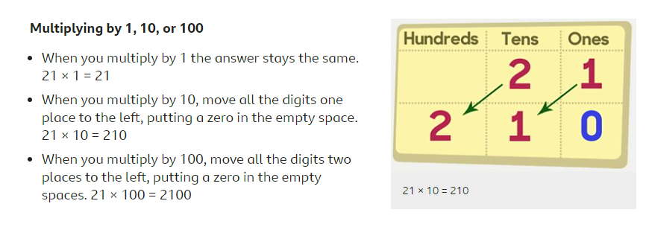
Maths Friday
If possible take a look at the below link and watch the videos
https://www.bbc.co.uk/bitesize/topics/z36tyrd/articles/z2fkwxs
Now have a go at these:-
6 x 1 = 7 X 10 = 3 x 10 = 9 x 100 =
37 x 1 = 34 x 10 = 29 X 10 = 14 X 100 =

Slide 21
Maths Friday continued
Now have a go at these :-
6 ÷ 1 = 110 ÷ 10 = 440 ÷ 10 = 900 ÷ 100 =
37 ÷ 1 = 70 ÷ 10 = 290 ÷ 10 = 120 ÷ 100 =

