Slide 1
Home Learning
Week commencing 18th May
Sycamore.class@fernhill.kite.academy

Slide 2
How it works:
Please complete one English and one Maths task each day. (Approximately 30 minutes on each). If your able to please send me examples of your learning.
The topic for this week is still ‘Flight’. This is on the school web site and will be sent by marvellous me (some of the activities may take more than a day to complete). Feel free to pick and choose from this list, don’t feel you need to do them all.

Slide 3
Overview of Topic
This week you will be focusing on FLIGHT.
There are lots of fun art and science activities to do.
See the ‘topic sheet’ for details
This will be sent to you via Marvellous Me or can be found on the school website.
ENJOY and don’t forget to send me examples of your work
Feel free to pick and choose from this list, don’t feel you need to do them all

Slide 4
Recommended, Free Web Sites
Maths – White Rose Maths
Maths Games – Topmarks
Reading Books – Oxford Owls
Writing – The Literacy Shed
Science – Purple Mash
Worksheets for all subjects - Twinkl

Slide 5
English Monday and spellings of the week
This week we are going to have a look
at words that contain contractions.
Remember that all the words here have an apostrophe
showing missing letters.
We use the contracted form of words, when we want
our writing to show more informal. I might use these
sorts of words in a diary, but I would not use them
in a letter to the Queen.
doesn’t
can’t
won’t
don’t
isn’t
couldn’t
wouldn’t
shouldn’t
there’s
Have a spelling practice of these contracted words and re-write any words three times if you make a mistake.
If children get them all right – google the year 3 and 4 common exception words and choose four or five words from there.

Slide 6
English Monday = Handwriting https://www.youtube.com/watch?v=2NQ6uS8blwY
This week I would like you to start by practising your handwriting. Remember to write just four letters and then check back with the video, to make sure that you are forming your letters correctly.
No more than half a line of each letter in a day!
Remember that all of the letters must rest on the line and you should try to make them exactly the same size as each other.
This week let’s concentrate on c, a, o, e and f.

Slide 7
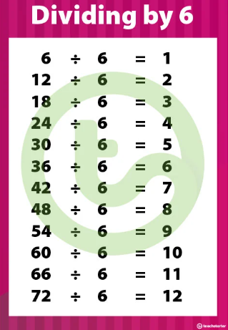
Maths Monday
Can you write a list of multiplication and division facts for the 6 times tables? This is a times table that will be looked at in year 4.

Slide 8
English Tuesday
This week we’re going to continue having another look at the short film called ‘For The Birds’. Please click on the image or links to re-watch the film.
https://www.youtube.com/watch?v=nYTrIcn4rjg
https://www.literacyshed.com/for-the-birds.html
Notes:
https://www.youtube.com/watch?v=nYTrIcn4rjg

Slide 9
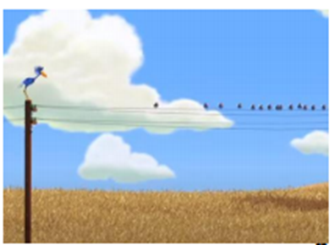
Tuesday English - continued
After we had got to the stage last week where the little birds were being quite horrible to the big blue bird called Peck. Today we are going to practice at least two or three sentences using speech marks (also called inverted commas) which is something we need to practice in year 3. First of all Peck is going to say a few words and then the little birds could say something back as they have a conversation.
Remember capital letters and full stops
Put speech marks at the start and end of the actual words spoken.
Put punctuation marks such as full stops inside the speech marks.
Start a new line whenever someone new speaks

Slide 10
Maths - Tuesday
Using addition, subtraction or a combination of the two how many ways can you make 37? For example:-
30 + 7 = 37 20 + 17 = 37 36 + 1 = 37
40 – 3 = 37 100 – 63 = 37 38 – 1 = 37
TOUGH CHALLENGE !!
This bottom one is very tough so i’ll give you a clue – it might not be possible! But if it isn’t possible can you tell me why?

Slide 11
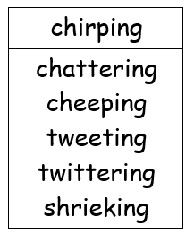
English Wednesday
Today we’ll try to write two or three sentences including onomatope. Onomatopoeia is a word that names a sound, but also sounds like that sound. For example: boom, honk, pop, crack. Try for two sentences about the birds and then a sentence or two about another animal or subject.

Slide 12
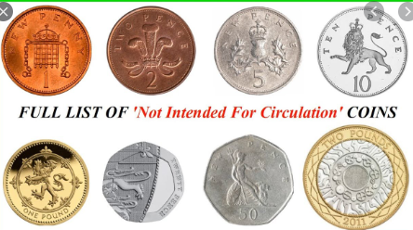
Maths Wednesday
In year 3 children need to be familiar with money and practice finding different totals. They also need to practice working out how much change they may receive after they’ve bought something.

Slide 13
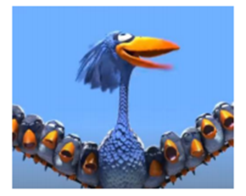
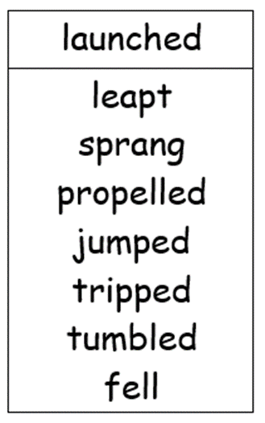
English Thursday
Today we’re going to move the story of the birds on and we’re going to concentrate on descriptive action words and exclamatory sentences. We’ll write at least three sentneces about the part of the film where the big blue bird called Peck started moving closer and closer to the floor.
Now write your sentence. Make sure you check capital letters and full stops.

Slide 14
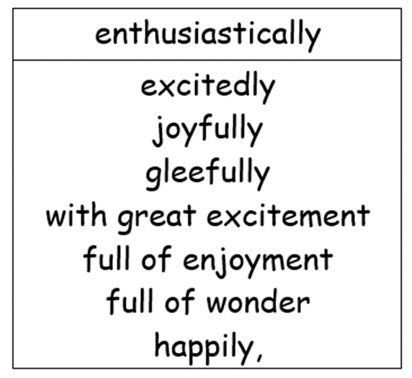
English Thursday Continued
Sentence number 2 is going to be an exclamatory sentence with describing words explaining how Peck started flapping his wings.
Now write your sentence. Make sure you check capital letters and full stops.

Slide 15
English Thursday - continued
Our last sentence today is also going to be a descriptive explanatory sentence where Peck gets closer and closer to the floor!
Now write your sentence. Make sure you check capital letters and full stops.

Slide 16
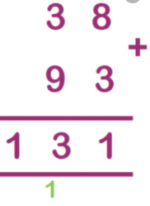
Maths Thursday
Today lets again practice column addition and subtraction going up to 1000. Make sure children line up the ones, tens and hundreds in the right column and if possible have a good understanding of exchanging numbers when adding and carrying number when subtracting. You can write down or generate your own numbers. You could use an online number generator 1 to 9 such as this one:-
http://numbergenerator.org/randomnumbergenerator/1-9
Please aim to complete four or five addition and four or five subtraction sums.

Slide 17
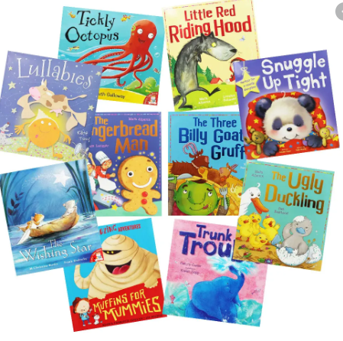
English Friday
In year 3 its important the children know and understand many of the different terms we use in English. These terms will continue to be used throughout primary school.
Today lets have another look inside a book (one of our favourite books ideally) and pick out and list at least three nouns, three verbs, three adjectives and three adverbs.
A noun is a kind of word that is usually the name of something such as a person, place, thing. Could also be a quality or idea.
A verb is a main part of speech that is often used to describe or indicate an action (sometimes known as doing words) such walk, sit, stop, jog, call-etc.
An adjective is a word that describes a noun. Adjectives include words that describe what something looks like and what it feels like to touch, taste, or smell.
An adverb is a word that modifies a verb, adjective, or other adverb. To put it another way, an adverb describes actions, and it describes other descriptive words. E.g. very tall, quickly, loudly.
CHALLENGE – Can you put any of the adverbs or adjectives you found into a sentence?

Slide 18
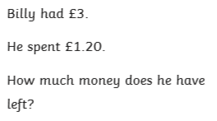
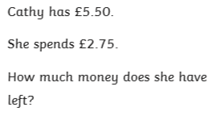
Maths Friday
Three money questions today – children may need a hand!

