Slide 1
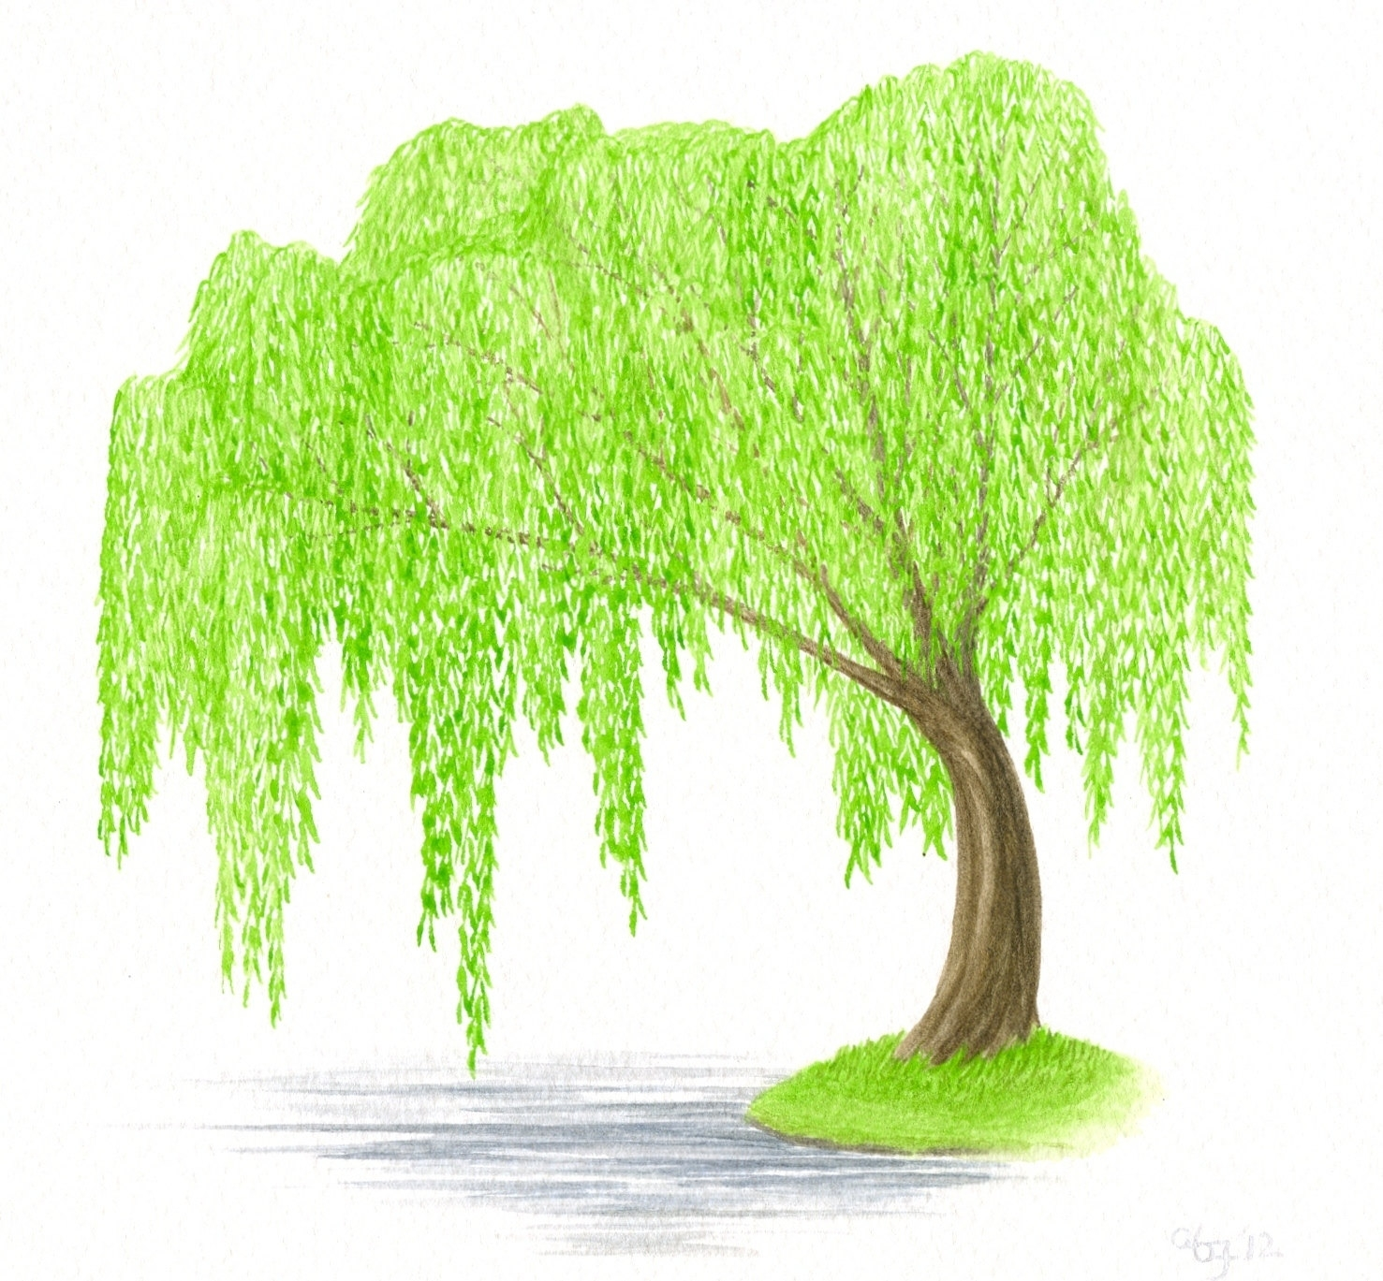
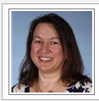


Willow Class willow.class@fernhill.kite.academy
18th – 22nd May

Slide 2
Handwriting

Slide 3
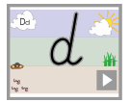
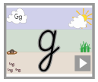
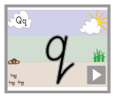
Daily handwriting. https://www.teachhandwriting.co.uk/cursive-letters-beginners-choice-2.html
This week I would like you to start each writing session by practising your handwriting.
Remember to write just three letters and then check back with the video, to make sure that you are forming your letters correctly.
No more than half a line of each letter in a day!
Remember that all of the letters must rest on the line and you should try to make them exactly the same size as each other.
The link will shows videos of how each letter is drawn. There are also some worksheets that you can print off, or simply practise them in your books.

Slide 4
Spelling

Slide 5
Spelling
Year 2.
Please learn to spell these words.
Megan’s
Ravi’s
the girl’s
the man’s
the child’s
the woman’s
the school’s
a dog’s
a teacher’s
the boy’s
This week we are going to have another look at words that contain the apostrophe to show possession.
Remember we have used this in class. When we add an ‘s to a word it shows that something belongs to somebody.
So Peck’s toes. - Is a shorter way of saying the toes that belong to Peck.
Jack’s book – is a short way of saying the book that belongs to Jack.
Remember we do not use an apostrophe to show that there is more that one thing.

Slide 6
Reading

Slide 7
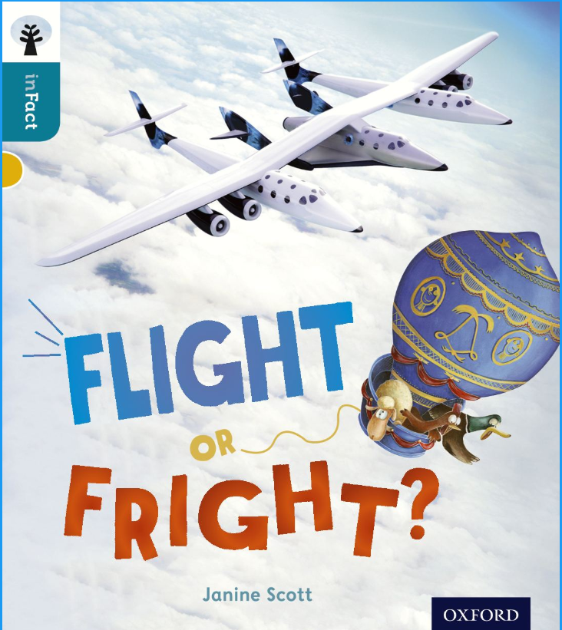
Reading
The e-book can be found at https://www.oxfordowl.co.uk
Click on my class login in.
Username: willow.fernhill
Password: Fernhill
Go to my bookshelf and then type in the name of the book.

Slide 8
Monday 18th May
Writing activities.

Slide 9
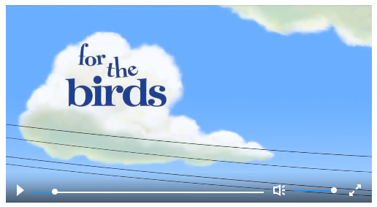
This week’s writing activities
Over the next two weeks I am going to challenge you to write a class story.
We are going to base it on another short film called for the birds.
Every day I would like you to work on a small part of the story (or plot point)
At the end of the day I would like you to email me your work and I will choose my favourite section to add to the story. (If I have enough work sent through I will create a year 1 story and a year 2 story)
After we have completed all of the plot points – there will be nine in total – I will put the story together and send it to you all, so that we can illustrate it.
https://www.literacyshed.com/for-the-birds.html

Slide 10
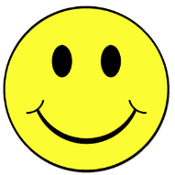
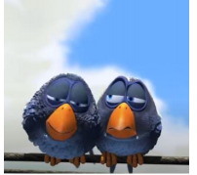
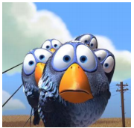
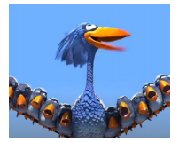
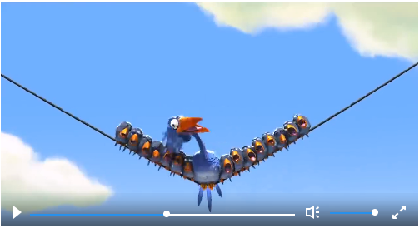
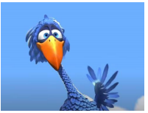
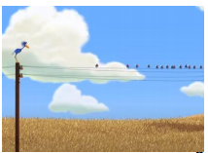
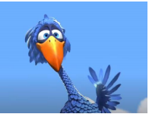
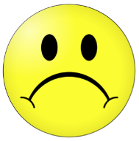
Our story this week is called ‘For the birds’.
Each day we are going to write a tiny part of the story.
This is where we left our story at the end of last week.
This week we are going to carry on the story, starting at plot point 6.
?
Plot point 5
Room for one more
1:27- 1:45
?
Plot point 6
Handing around
1:46 – 2:10
?
Plot point 1
Budge over
0:24 – 0:42
?
Plot point 2
Who is that
0:43 – 0:58
?
Plot point 3
Hi
0:59 – 1:14
?
Plot point 4
Stay away
1:15 – 1:26
?
Plot point 7
?
Plot point 8
?
Plot point 9
When we talk about the birds in the story we are going to use the name
Peck
We are also going to use the pronouns he and them.
https://www.literacyshed.com/for-the-birds.html

Slide 11

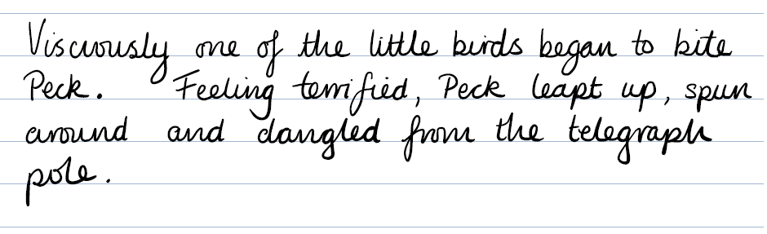
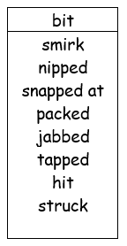
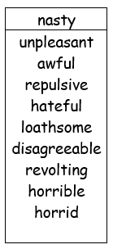
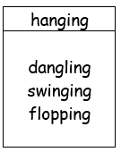
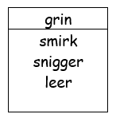
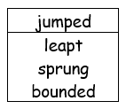
Film clip 1:46 – 2:10
I want this sentence to be a negative sentence, where I am going to show how Peck is feeling.
Now have a go at writing your sentence.
Remember to stay in this part of the story!

Slide 12
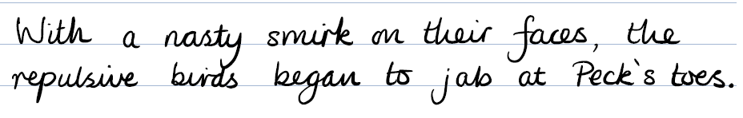
Film clip 1:46 – 2:10
I want this sentence to be a negative sentence.
Here I want to show how unkind the birds are, so I am going to choose my words carefully.
Year 2 – did you notice that I have used an ‘s to show that the toes belong to Peck?
Now have a go at writing your sentence.
Remember to stay in this part of the story!

Slide 13
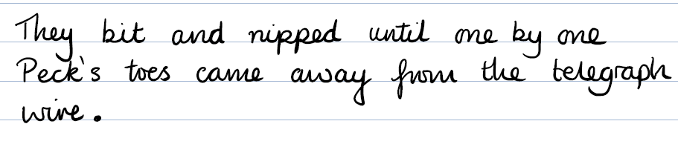
Film clip 1:46 – 2:10
I want this sentence to be a negative sentence, where I am going to show how Peck is feeling.
Now have a go at writing your sentence.
Remember to stay in this part of the story!

Slide 14
Monday 18th May
Mathematics activities

Slide 15
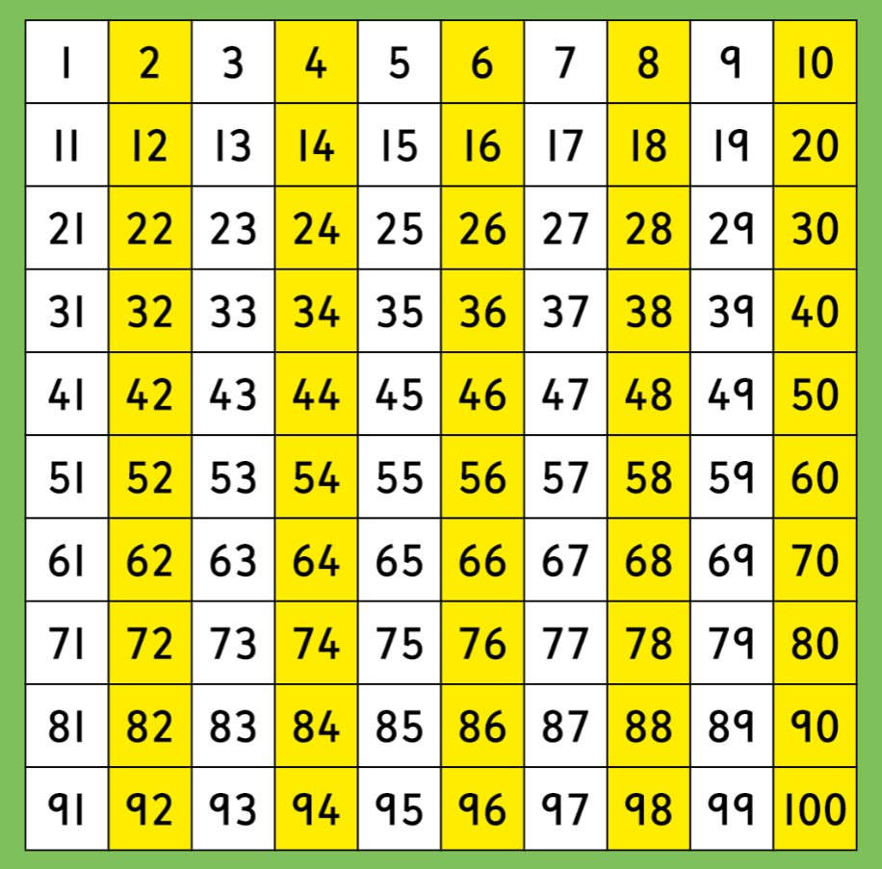
Use the 100 square to help you practise counting in 2s
Can you count forwards?
Can you count backwards?

Slide 16
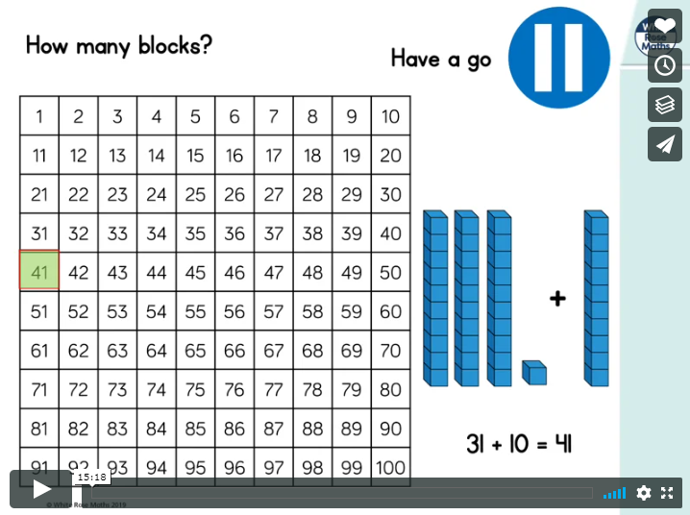
https://vimeo.com/415461655
Please click on this link to take you to today’s video.
Adding and subtracting 10s

Slide 17
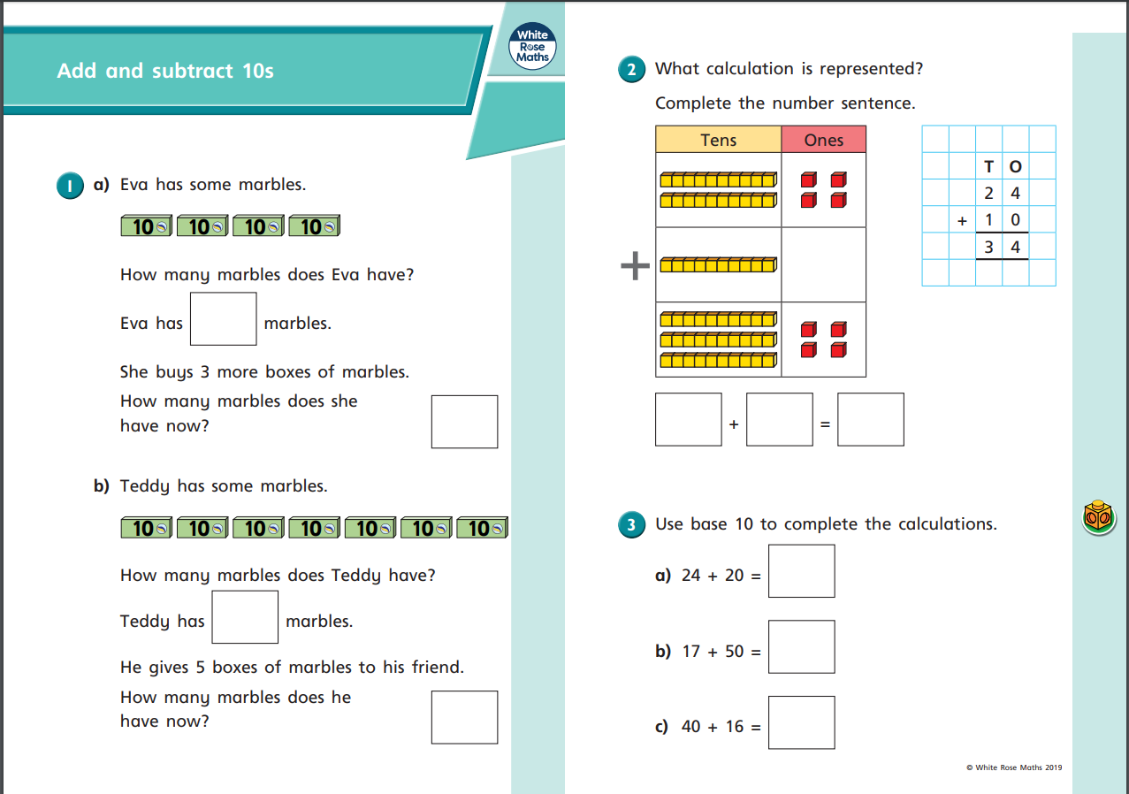

Slide 18
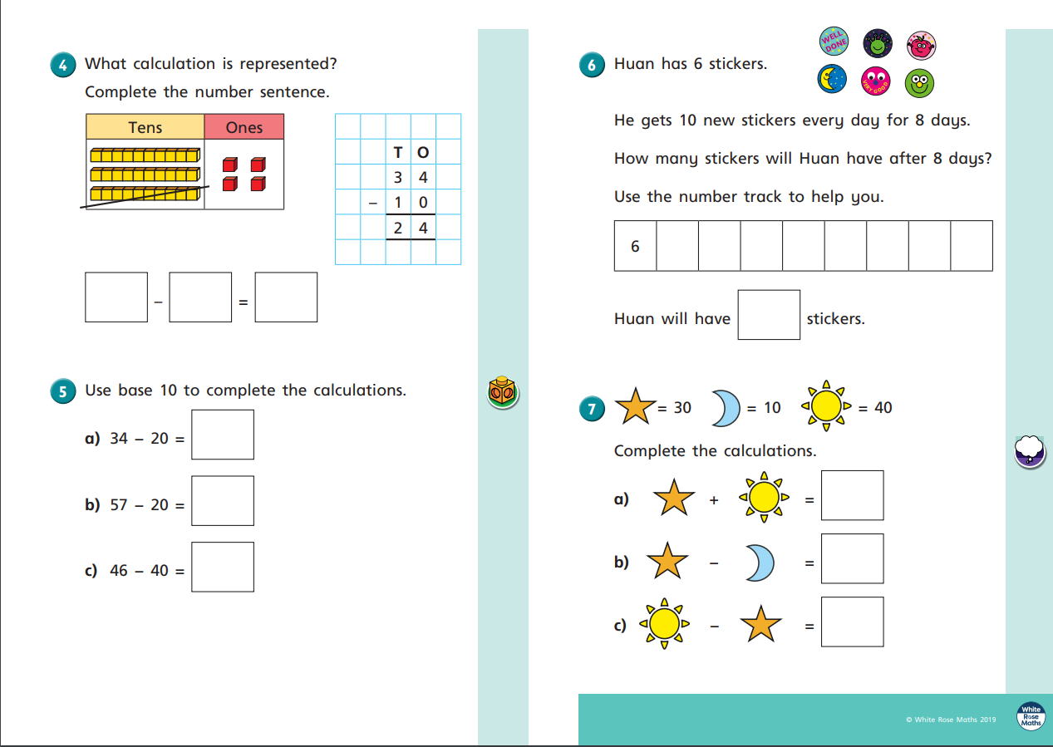

Slide 19
Tuesday 19th May
Writing activities.

Slide 20
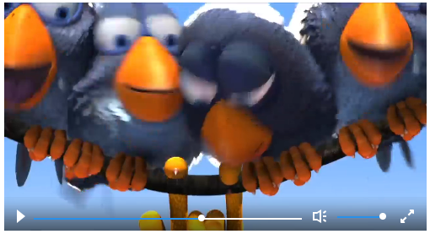
Our story this week is called ‘For the birds’.
Each day we are going to write a tiny part of the story.
Today we are going to be working on plot point 7. Peck is now holding on by a single toe!
?
Plot point 5
Room for one more
1:27- 1:45
?
Plot point 6
Handing around
1:46 – 2:10
?
Plot point 7
Oh No!
2:11 – 2:25
?
Plot point 1
Budge over
0:24 – 0:42
?
Plot point 2
Who is that
0:43 – 0:58
?
Plot point 3
Hi
0:59 – 1:14
?
Plot point 4
Stay away
1:15 – 1:26
?
Plot point 8
?
Plot point 9
When we talk about the birds in the story we are going to use the name
Peck
We are also going to use the pronouns he and them.
https://www.literacyshed.com/for-the-birds.html

Slide 21

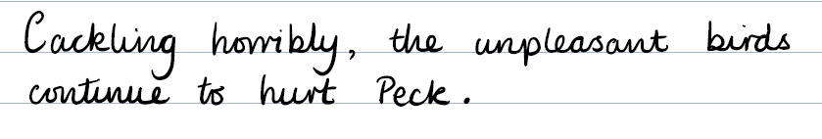
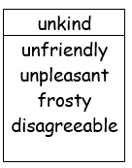
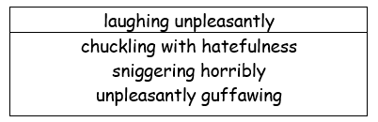
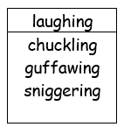
Film clip 2:11 – 2:25
In this sentence I want to use some adverbs to show how unkind the birds are being. It is still going to be a negative sentence, because there are being really horrible to Peck. The birds are laughing I want to choose some words that will tell me how they are laughing.
Now have a go at writing your sentence.
Remember to stay in this part of the story!

Slide 22

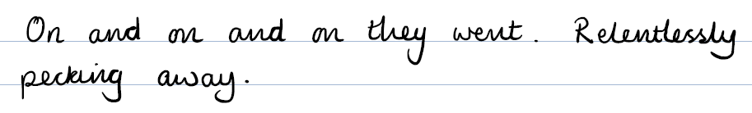
Film clip 2:11 – 2:25
In this sentence I want to show that the tiny birds kept going and going and going. So I have chosen to repeat the word on. I’ve used it three times to show that the birds weren’t stopping.
Now have a go at writing your sentence.
Remember to stay in this part of the story!

Slide 23


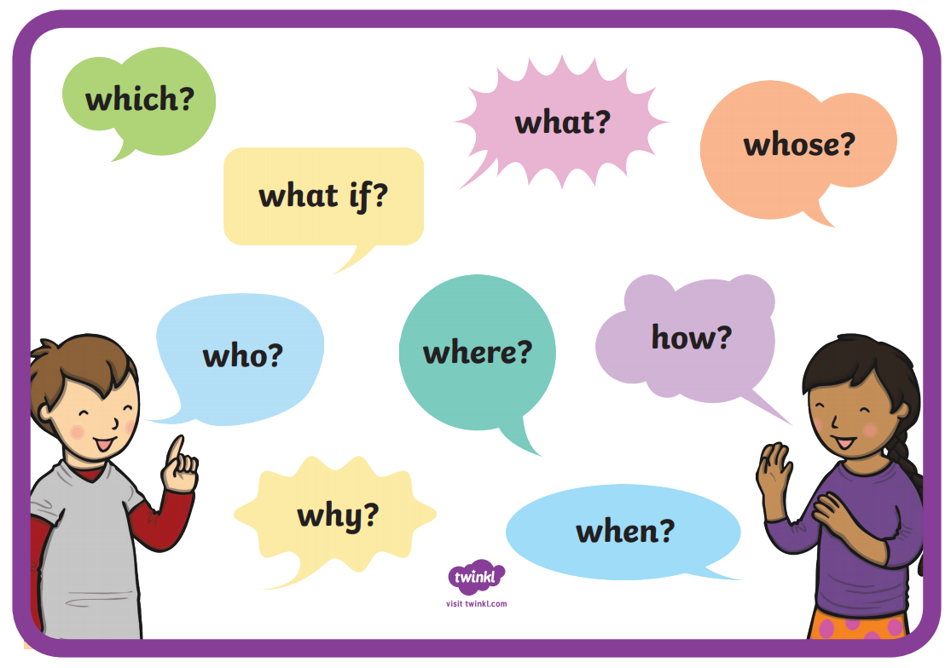
Film clip 2:11 – 2:25
I would like this sentence to be a question sentence.
It might be a question where Peck or the birds are thinking about what will happen next.
Remember you must have a question mark (?) at the end of a question.
Now have a go at writing your sentence.
Remember to stay in this part of the story!

Slide 24
Tuesday 19th May
Mathematics activities

Slide 25
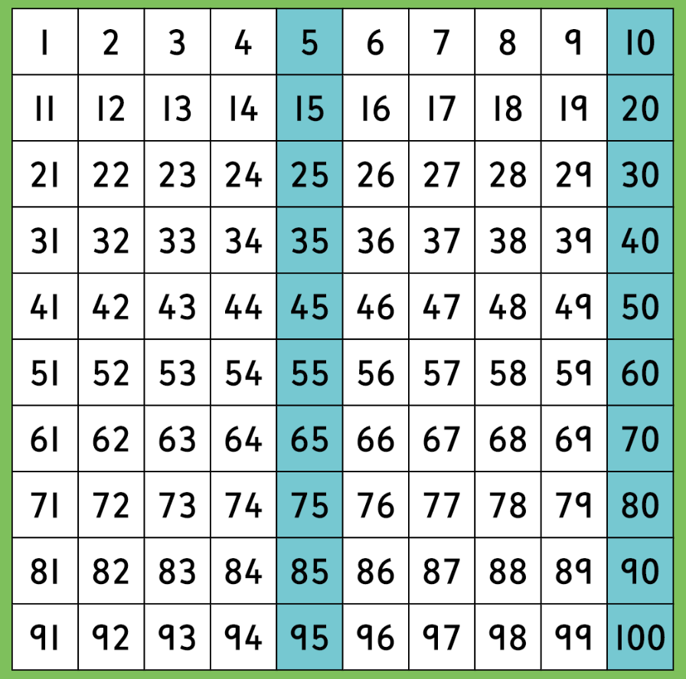
Practise counting in 5s
Can you count forwards?
Can you count backwards?
What do you notice about the digits that the multiples of 5 end in?

Slide 26
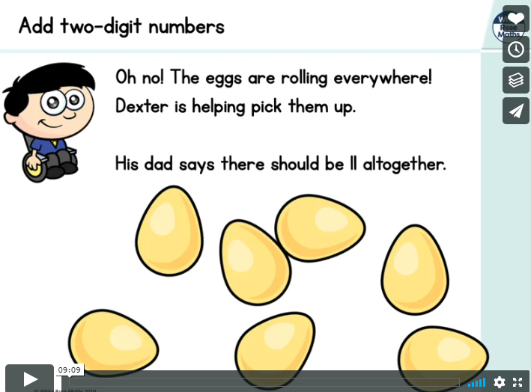
https://vimeo.com/415826239
Please click on this link to take you to today’s video.
Adding two digit numbers

Slide 27
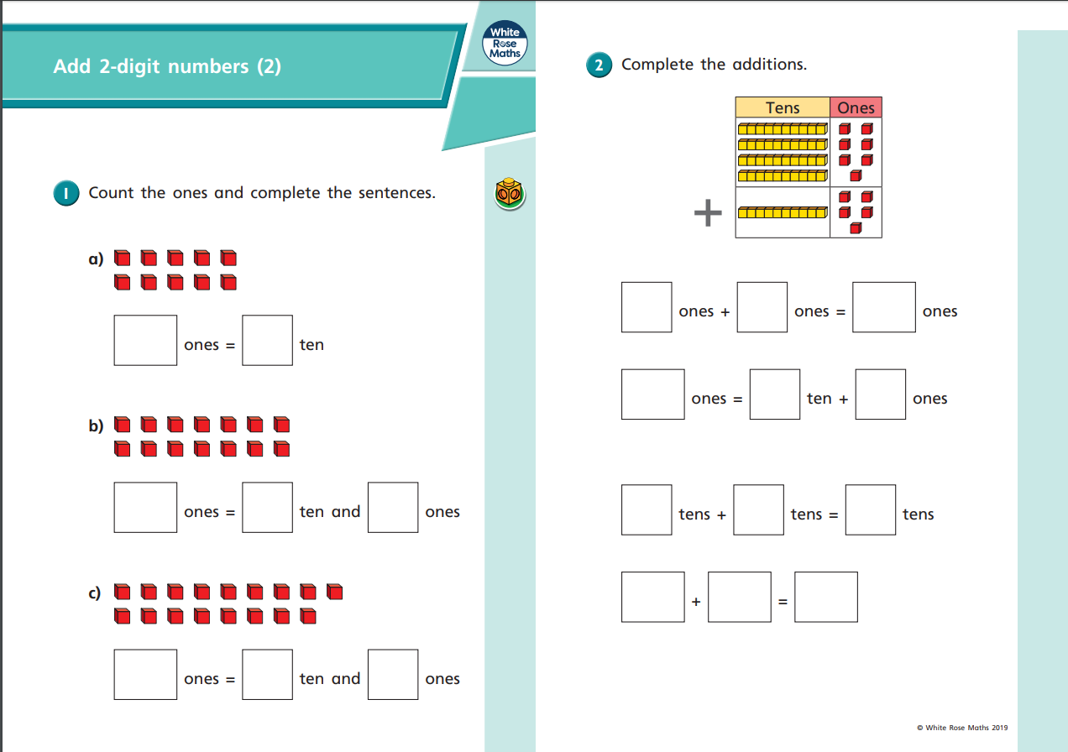

Slide 28
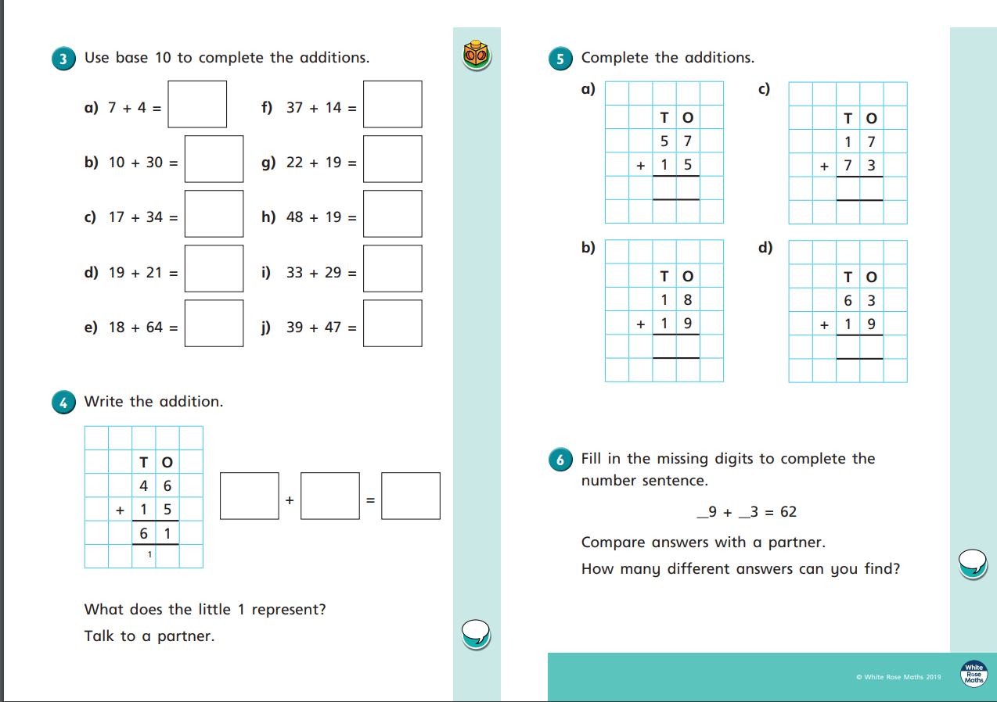

Slide 29
Wednesday 20th May
Writing activities.

Slide 30
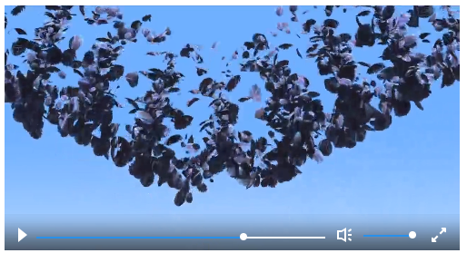
Our story this week is called ‘For the birds’.
Each day we are going to write a tiny part of the story.
We’re beginning to get close to the end of out story. Only two more plot points to go.
?
Plot point 5
Room for one more
1:27- 1:45
?
Plot point 6
Handing around
1:46 – 2:10
?
Plot point 7
Oh No!
2:11 – 2:25
?
Plot point 8
Ping
2:26 – 2:40
?
Plot point 1
Budge over
0:24 – 0:42
?
Plot point 2
Who is that
0:43 – 0:58
?
Plot point 3
Hi
0:59 – 1:14
?
Plot point 4
Stay away
1:15 – 1:26
?
Plot point 9
When we talk about the birds in the story we are going to use the name
Peck
We are also going to use the pronouns he and them.
https://www.literacyshed.com/for-the-birds.html

Slide 31
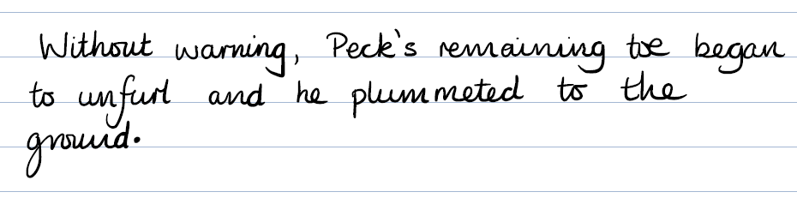
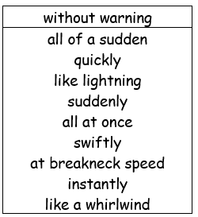
Film clip 2:26 – 2:40
In this sentence I would like to choose some words to show, how quickly Peck’s toe came away from the telegraph pole. Remember I am going to also choose words that have a negative sound.
Now have a go at writing your sentence.
Remember to stay in this part of the story!

Slide 32

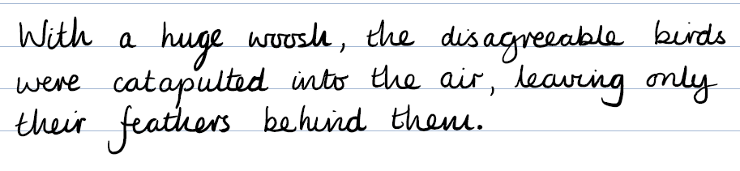
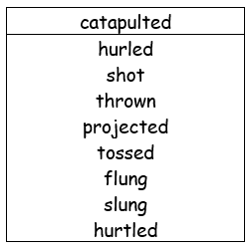
Film clip 2:26 – 2:40
I want to have some action in this sentence, showing how quickly the birds were thrown into the air.
Now have a go at writing your sentence.
Remember to stay in this part of the story!

Slide 33
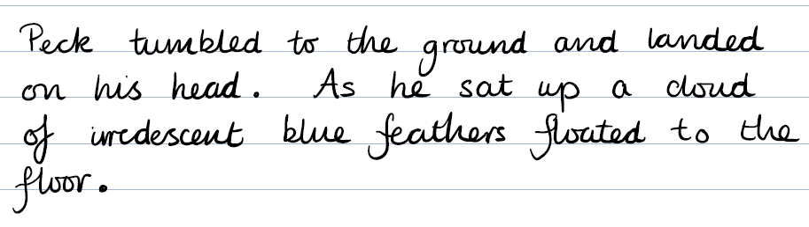
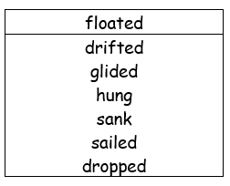
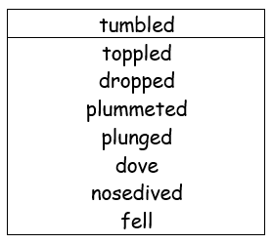
Film clip 2:26 – 2:40
This is another sentence where I want to show lots of action.
I have chosen the words tumbled and floated to show how things are moving.
Now have a go at writing your sentence.
Remember to stay in this part of the story!

Slide 34
Wednesday 20th May
Mathematics activities

Slide 35
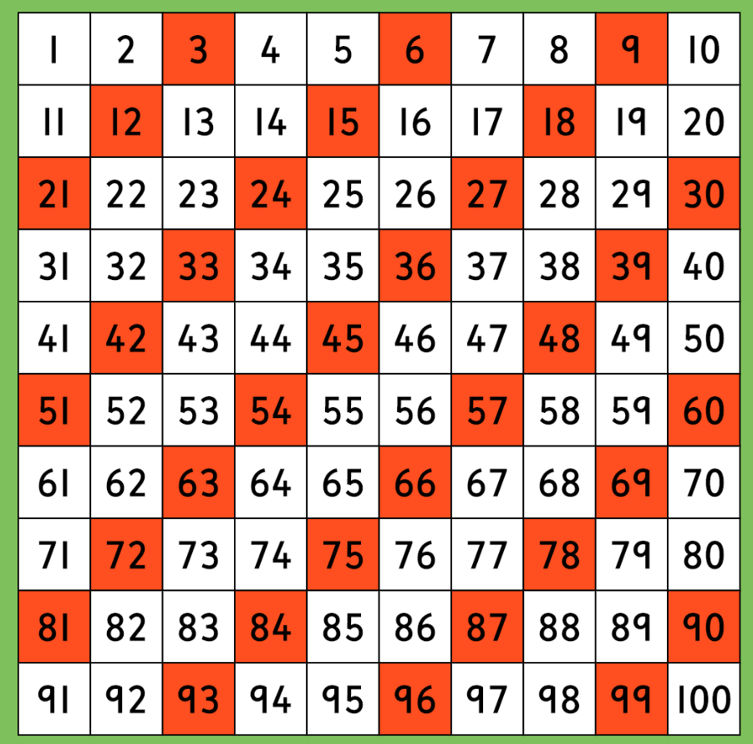
Practise counting in 3s.
What do you notice?

Slide 36
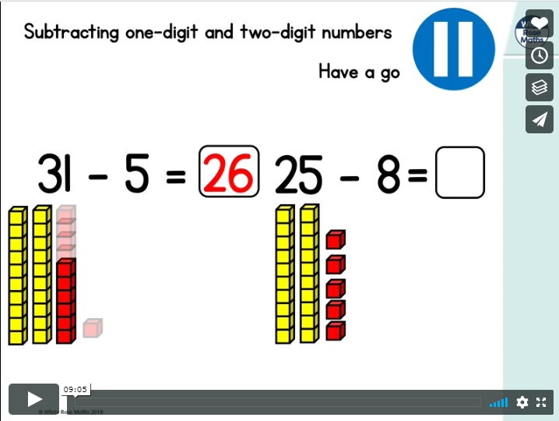
https://vimeo.com/415699365
Please click on this link to take you to today’s video.
Subtract two digit numbers.

Slide 37
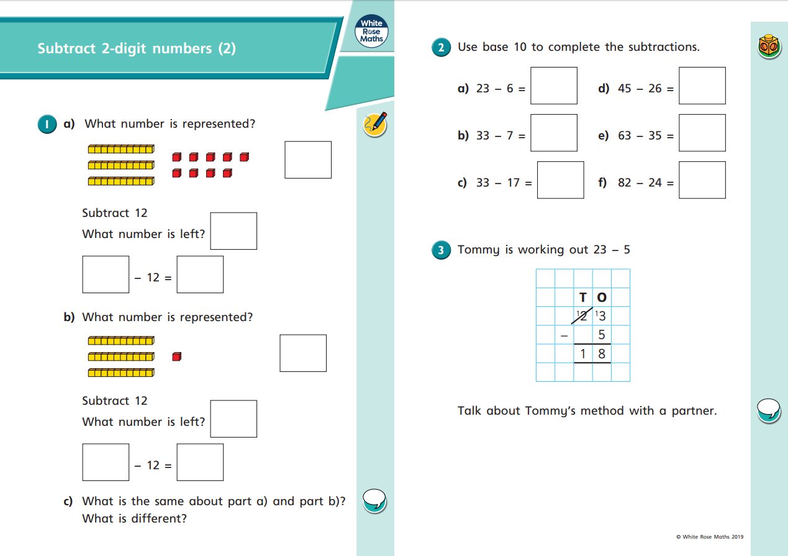

Slide 38


Slide 39
Thursday 21st May
Writing activities.

Slide 40

Our story this week is called ‘For the birds’.
Each day we are going to write a tiny part of the story.
These will be our last couple of sentences of the story.
?
Plot point 5
Room for one more
1:27- 1:45
?
Plot point 6
Handing around
1:46 – 2:10
?
Plot point 7
Oh No!
2:11 – 2:25
?
Plot point 8
Ping
2:26 – 2:40
?
Plot point 9
The last laugh
2:41 – end
?
Plot point 1
Budge over
0:24 – 0:42
?
Plot point 2
Who is that
0:43 – 0:58
?
Plot point 3
Hi
0:59 – 1:14
?
Plot point 4
Stay away
1:15 – 1:26
When we talk about the birds in the story we are going to use the name
Peck
We are also going to use the pronouns he and them.
https://www.literacyshed.com/for-the-birds.html

Slide 41




Film clip 2:41 – End
The final part of the story becomes very positive for Peck, because the birds are no longer making fun of him. In fact they are getting a taste of their own medicine.
Now have a go at writing your sentence.
Remember to stay in this part of the story!

Slide 42


Film clip 2:41 – End
In this sentence I want to tell the reader that it was only a short space of time before the rest of the birds came tumbling down.
This is my sentence.
Now have a go at writing your sentence.
Remember to stay in this part of the story!

Slide 43

Film clip 2:41 – End
I would like to have a question as my last sentence.
I want to really let the reader know that Peck was now the one who was happy at the end.
Now have a go at writing your sentence.
Remember to stay in this part of the story!

Slide 44
Thursday 21st May
Mathematics activities

Slide 45
Practise counting in 3s.
What do you notice?

Slide 46

https://vimeo.com/415699539
Please click on this link to take you to today’s video.
Bonds to 100

Slide 47


Slide 48


Slide 49
Friday 22nd May
Writing activities.

Slide 50





Editing Stations.
Here is your chance to improve your work.
Spend 5 minutes at each of these editing stations.

Slide 51

Here are some of the things that you could use to help you check your spellings.
Word mats
The words on the word lists.
Dictionaries.
Spelling Square
Today I would like you to find three spelling mistakes and correct them in your work.

Slide 52
Year 1.
Check that you have included these things in your writing.
A capital letter at the beginning of a sentence.
A full stop at the end of a sentence.
A question mark at the end of a question sentence.
A capital letter for a name.
Punctuation Place
Year 2
Check that you have also included these things.
An exclamation mark for an exclamatory sentence.
Commas (,) for list sentences.
‘ to show missing letters (e.g. don’t)
‘s to show if something belongs to someone (e.g. Peck’s wings)
Today I would like you to find 3 places in your work where you have missed some punctuation.

Slide 53

At Grammar Green I would like you to read through your work using your inner ears.
Have you missed any words out?
Have you put in too many words?
Does your work sound okay?
Grammar Green
Read through your work with your inner ears. If you spot any mistakes, make changes now.
Make sure you stop after 5 minutes.

Slide 54
Choose one of your sentences.
Re- write this sentence thinking about these things.
Have you used your best handwriting?
Are all of your letters sitting on the line?
Are all of your letters the correct shape and size?
Are your ascenders and descenders clear?
Re-write Road
Choose your favourite sentence to re-write in your best handwriting.

Slide 55
Here’s your chance to add some more information.
Add some more information
Add an adjective.
Add an adverb
Add another sentence.
Addition Avenue
Today find one more plot point and add another sentence to it.

Slide 56
Friday 22nd May
Mathematics activities

Slide 57
Practise counting in 3s.
What do you notice?

Slide 58


https://ttrockstars.com/
Today I would like you to practise your multiplication tables.
Use the TTRS website.
Your login should be inside the front of your book.
There are some question on the next page if you can’t get on to the website.

Slide 59



