Slide 1
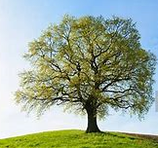
Oak Class
Home Learning
15th June 2020

Slide 2
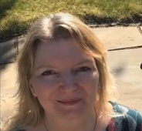
Hello Oak Class!
I hope you enjoy this week’s story.
If you are not joining us back in school, it would be wonderful to hear from you about one thing which you are proud of learning, or making, this week.
Please use our class email: Oak.Class@ fernhill.kite.academy
I’m looking forward to sending you a Marvellous Me to celebrate all your hard work.
Miss Parlane

Slide 3
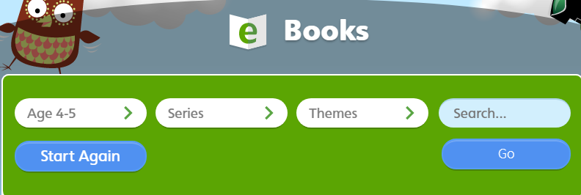
Daily Reading
Have a look at https://www.oxfordowl.co.uk and choose a free online book to read.
Class login. User name: oak.fernhill
Password: Fernhill
Select age 4-5
When you read, remember to use your phonics.
Look for ‘special friends’? If Yes – say the ‘special friends’ sound.
Then ‘Fred talk’ the word, ‘say the word’.
Please always ensure that your child is supervised whilst on the internet.

Slide 4
Topic
Our current topic is ‘Not Every Superhero Wears A Cape’
See the topic information sheet on our school website.
It provides activities for 2 weeks.
Please take a look and choose 3 activities to do each week.
The Home Learning sheet includes lots of links to YouTube.
Please always ensure that your child is supervised whilst on the internet.

Slide 5
Oak Class
Home Learning
Marvellous
Monday

Slide 6
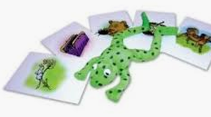


Phonics – Reading
Monday 15th June 2020
Please work on set 1 sound ‘c’ today set 2 ‘ou’
Ruth Miskin Training https://www.youtube.com/channel/UCo7fbLgY2oA_cFCIg9GdxtQ
If you can, work through ‘Word time’ and ‘Spelling’ too.
If your child is confident reading and writing set 1 sounds, you can start to work through set 2 sounds
Key words
go no
Remember to do some reading today. https://www.oxfordowl.co.uk
Please always ensure that your child is supervised whilst on the internet.

Slide 7






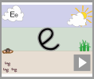
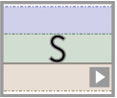
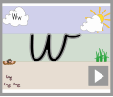
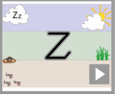

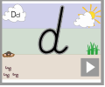
Monday 15th June 2020 English
Today we are learning to write slowly to form our letters clearly
https://www.teachhandwriting.co.uk/pre-handwriting-patterns.html
Have a look at these two words. Choose one of the words and practise writing each of the letters.
Try to write slowly.
Please write each letter three times and then check back with the video, to make sure that you are forming your letters correctly.
https://www.teachhandwriting.co.uk/cursive-letters-beginners-choice-2.html

Slide 8
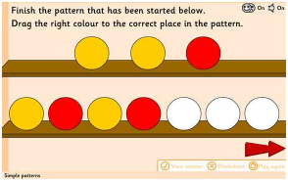
Finish the pattern
https://www.topmarks.co.uk/maths-games/3-5-years/shape-position-and-movement

Slide 9
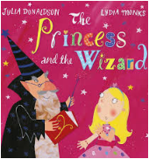
Monday 15th June 2020 Maths
Today we are learning to explore patterns and learn the days of the week.
In the story the wizard has a challenge for the princess every day.
Your challenge today is to order a special pattern – your week.
Start by singing the days of the week songs.
https://www.youtube.com/watch?v=loINl3Ln6Ck Starting with Sunday
https://www.youtube.com/watch?v=mXMofxtDPUQ Starting with Monday
There are activities to fill in the missing days of the week on the next pages.
You know you have done a good job if you can say the days of the week in the correct order.

Slide 10
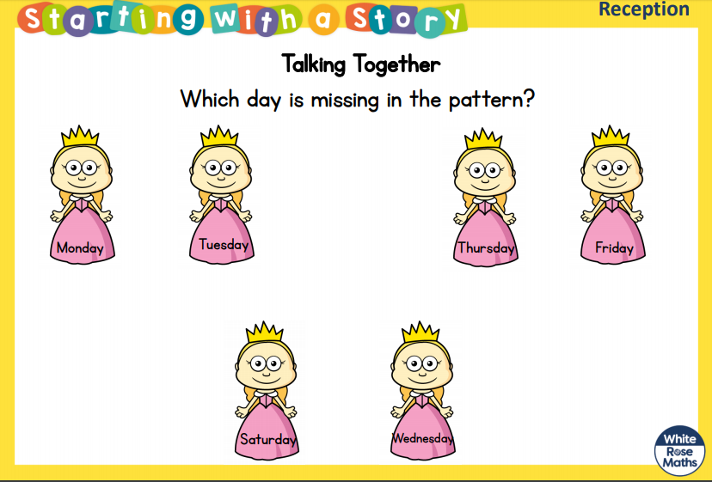
Monday 15th June 2020 Maths

Slide 11
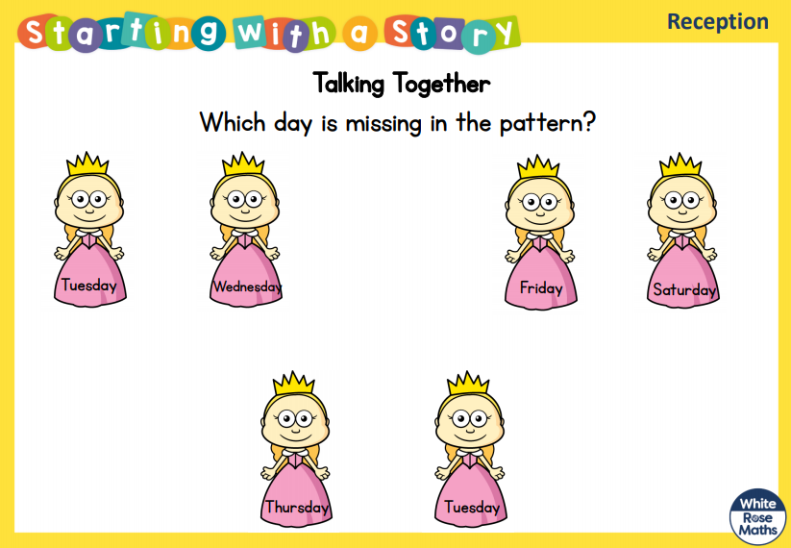
Monday 15th June 2020 Maths

Slide 12
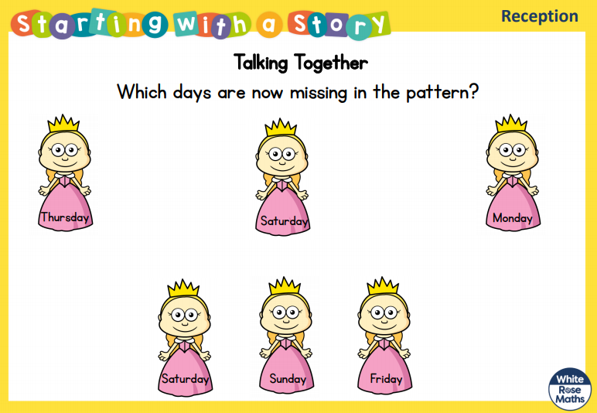
Monday 15th June 2020 Maths

Slide 13
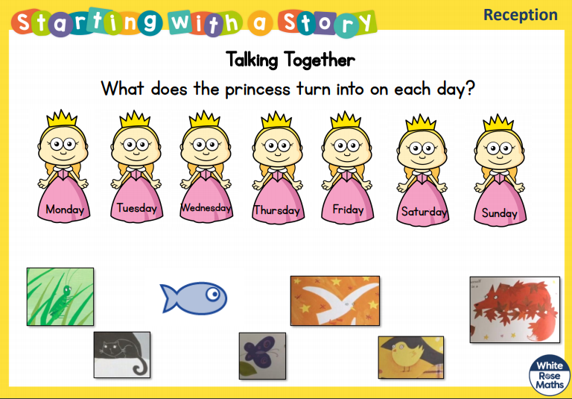
Monday 15th June 2020 Maths

Slide 14
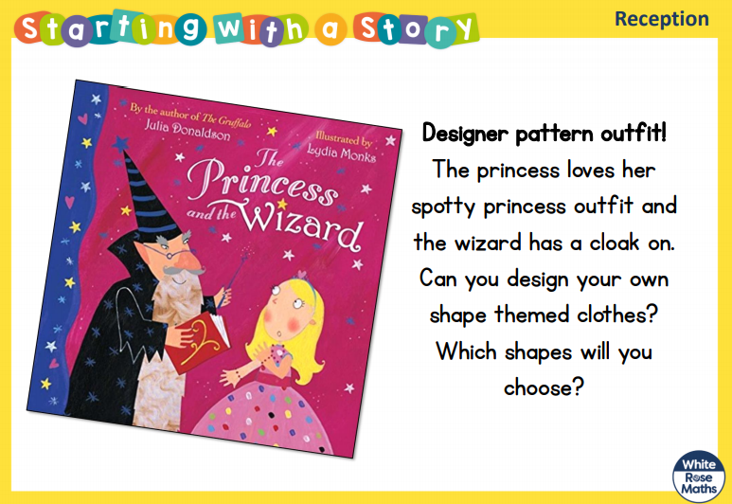
Monday 15th June 2020 Maths
Can you say the names of the shapes you use and describe them.
How many sides and corners do they have?

Slide 15
Oak Class
Home Learning
Terrific
Tuesday

Slide 16
Phonics – Reading
Tuesday 16th June 2020
Practice set 1 sound ‘k’ today set 2 ‘oy’
Ruth Miskin Training https://www.youtube.com/channel/UCo7fbLgY2oA_cFCIg9GdxtQ
If you can, work through ‘Word time’ and ‘Spelling’ too.
If your child is confident reading and writing set 1 sounds, you can start to work through set 2 sounds
Key words
so are
Remember to do some reading today. https://www.oxfordowl.co.uk
Please always ensure that your child is supervised whilst on the internet.

Slide 17
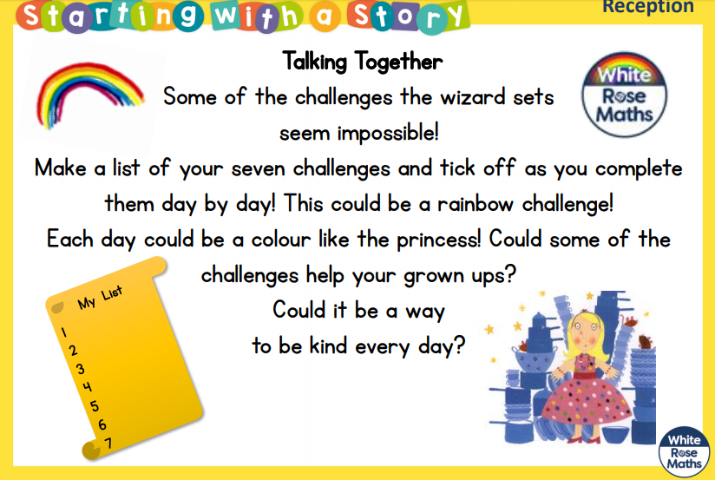
Tuesday 16th June 2020 English
Today we are learning to finish a sentence.
Please listen to the story of ‘’ written by Julie Donaldson and illustrated by Lydia Monks
https://www.youtube.com/watch?v=babXCIRMjQM
Do you recognise the names of the Author?
How about the Illustrator?
In the story the wizard sets the princess a challenge every day.
Today I would like you to make a list of 7 challenges you could do.
Try to write some down. Finish the sentence: I will _________
Here are a few ideas
I will tidy up.
I will draw a rainbow
I will hop on the spot for 20 seconds.
I will learn to read and write 2 keys words today.
You know you have done a good job if you have used your phonics to ‘Fred Talk’ your words before you write them.
Please always ensure that your child is supervised whilst on the internet.

Slide 18
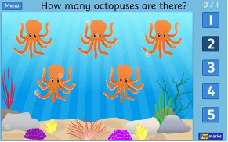
Counting objects
https://www.topmarks.co.uk/learning-to-count/underwater-counting

Slide 19
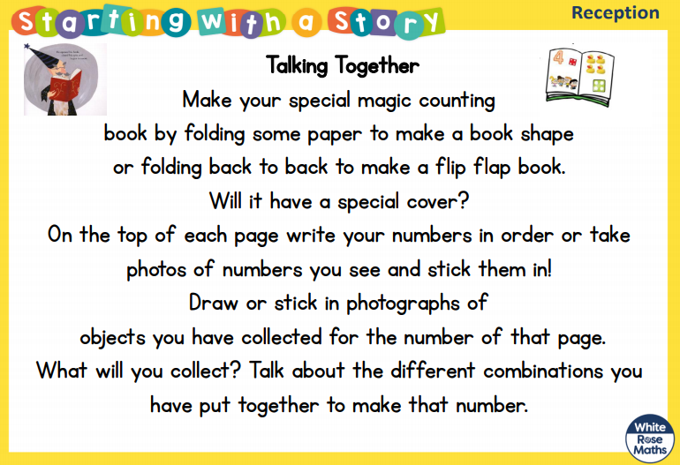
Tuesday 16th June 2020 Maths
Today we are learning to record numbers.
You know you have done a good job if you have a book with numbers and drawings showing that amount of objects.
The wizard loves counting!
Today I would like you to make your own special wizard counting book!
There is a game for you to try on the next page

Slide 20
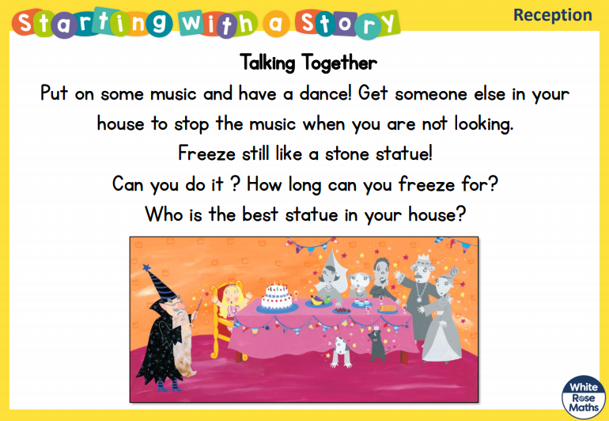
Tuesday 16th June 2020 Maths

Slide 21
Oak Class
Home Learning
Wonderful
Wednesday

Slide 22
Phonics – Reading
Wednesday 17th June 2020
Practice set 1 sound ‘u’ today set 2 ‘ay’
Ruth Miskin Training https://www.youtube.com/channel/UCo7fbLgY2oA_cFCIg9GdxtQ
If you can, work through ‘Word time’ and ‘Spelling’ too.
If your child is confident reading and writing set 1 sounds, you can start to work through set 2 sounds
Key words
was my
Remember to do some reading today. https://www.oxfordowl.co.uk
Please always ensure that your child is supervised whilst on the internet.

Slide 23
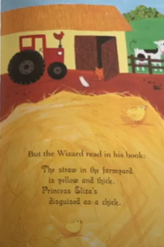
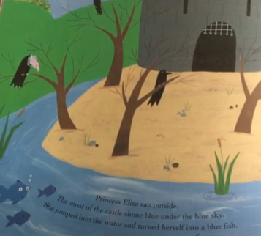
Wednesday 17th June 2020 English
Today we are learning to use describing words
Please listen to the story of ‘The Princess and the Wizard written by Julie Donaldson and illustrated by Lydia Monks
https://www.youtube.com/watch?v=babXCIRMjQM
As you listen I would like you to think about all the different settings where the princess hides. The story mentions lots of different colours.
Today I would like you to draw pictures some of the different settings.
Remember to add some labels to describe each setting.
You know you have done a good job if you have said and written some describing words in your labels.
Please always ensure that your child is supervised whilst on the internet.

Slide 24
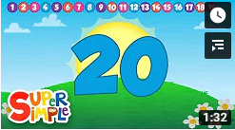
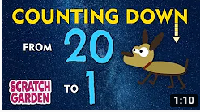
Counting up to 20 and counting from 20 to 0.
https://www.youtube.com/watch?v=Aq4UAss33qA
https://www.youtube.com/watch?v=fS60rraBhz4

Slide 25
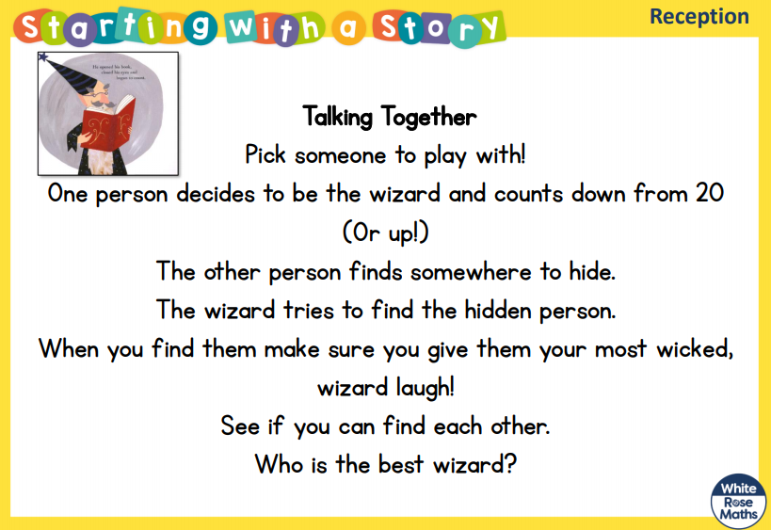
Wednesday 17th June 2020 Maths
Today we are learning to count to 20.
You know you have done a good job if you have carefully counted down from 20 (or up to 20).
The wizard just keeps on counting! Today you will play some magic counting games!
The first game is ‘Hide and Wizard!’
It’s a bit like hide and seek!

Slide 26
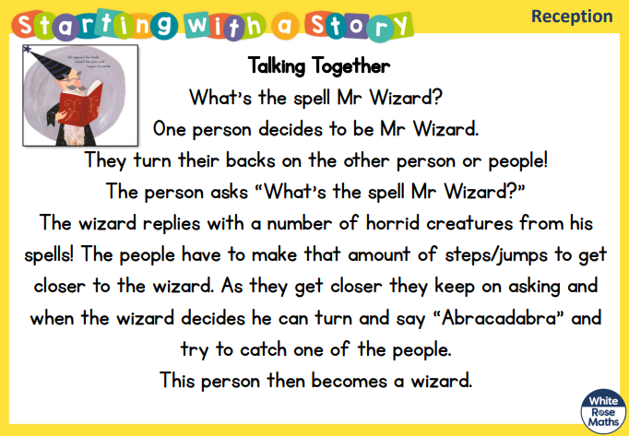
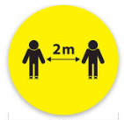
Wednesday 17th June 2020 Maths
Today we are learning to count to 20.
You know you have done a good job if you have carefully counted down from 20 (or up to 20).
The second game is ‘What’s the spell Mr Wizard!’ It’s a bit like What’s the time Mr Wolf!
Remember to keep your safe
distance if you are playing
with friends
There are some ideas for spells on the next page!

Slide 27
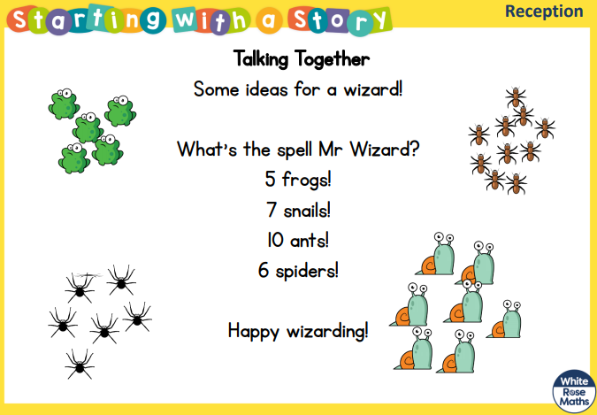
Wednesday 17th June 2020 Maths
Today we are learning to count to 20.
You know you have done a good job if you have carefully counted down from 20 (or up to 20).
Here are some ideas for ‘What’s the spell Mr Wizard?’
Remember to keep your safe distance if you are playing with friends.

Slide 28

Oak Class
Home Learning
Thankful
Thursday

Slide 29
Phonics – Reading
Thursday 18th June 2020
Practice set 1 sound ‘b’ today set 2 ‘ee’
Ruth Miskin Training https://www.youtube.com/channel/UCo7fbLgY2oA_cFCIg9GdxtQ
If you can, work through ‘Word time’ and ‘Spelling’ too.
If your child is confident reading and writing set 1 sounds, you can start to work through set 2 sounds
Key words
out one
Remember to do some reading today. https://www.oxfordowl.co.uk
Please always ensure that your child is supervised whilst on the internet.

Slide 30
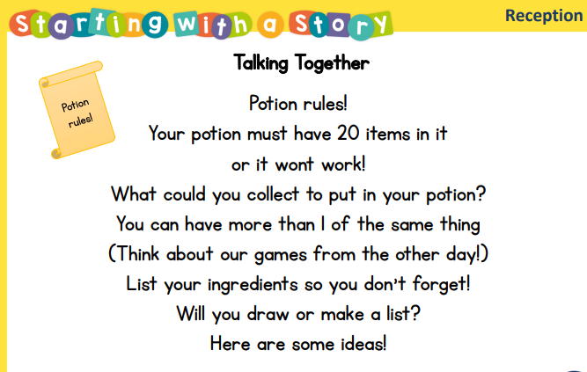
Thursday 18th June 2020 English
Today we are learning to write a list.
Today I would like you to create a potion to stop the wizard from casting anymore spells.
You know you have done a good job if you have created list of ingredients.
There are some ideas on the next page.

Slide 31
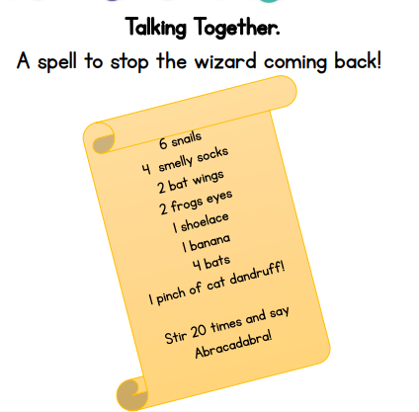
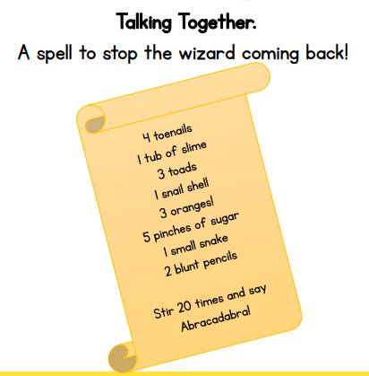

Slide 32
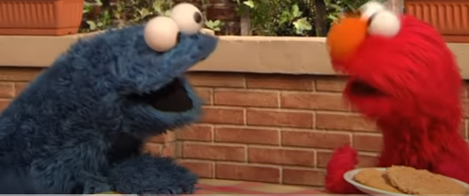
Introduction to sharing equally
https://www.youtube.com/watch?v=KTFJ9gjfAXg

Slide 33
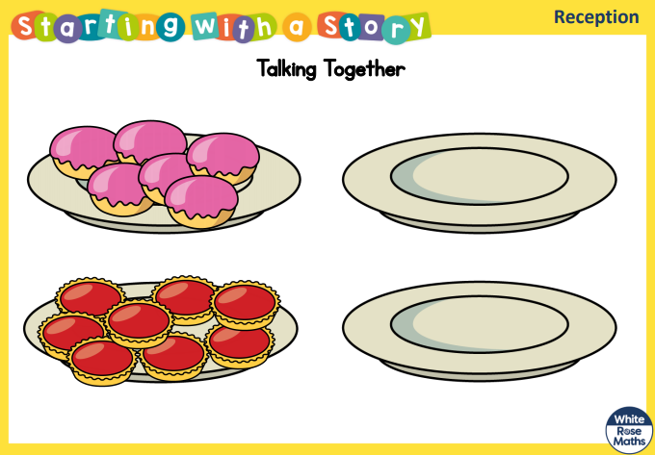
Thursday 18th June 2020 Maths
Today we are learning to solve problems by halving.
The wizard has been doubling everything so there’s far too much food at the princesses party!
Today I would like you to help to halve what is on the plates so we are not too greedy.
Hint.
Halving means to share equally.
Count the food first and write how many there are altogether.
Then draw 2 empty plates and share the food equally between the 2 plates to work out half of the total amount.
There are some more for you to try on the next page.

Slide 34
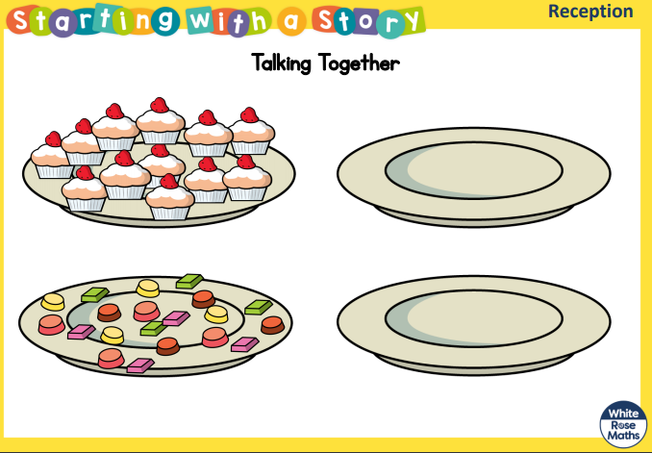
Thursday 18th June 2020 Maths
Today we are learning solve problems by halving. .
You know you have done counted his friends and decided if you can share this number equally between 2 plates.
Here are some more plates of food for you to count and then share equally between 2 plates.

Slide 35
Oak Class
Home Learning
Fantastic
Friday

Slide 36
Phonics – Reading
Friday 19th June 2020
Practice set 1 sound ‘f’ today set 2 ‘igh’
Ruth Miskin Training https://www.youtube.com/channel/UCo7fbLgY2oA_cFCIg9GdxtQ
If you can, work through ‘Word time’ and ‘Spelling’ too.
If your child is confident reading and writing set 1 sounds, you can start to work through set 2 sounds
Key words
the they
Remember to do some reading today. https://www.oxfordowl.co.uk
Please always ensure that your child is supervised whilst on the internet.

Slide 37

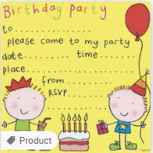
Friday 19th June 2020 English
Today we are learning to write a sentence.
You have been reading the story of ‘The Princess and the Wizard’
Can you remember what happens in the beginning, in the middle and at the end of this story?
Did it have a happy ending?
Today I’d like you to create an invitation to Princess Eliza’s birthday party.
Your invitation must include ‘please come to my party’.
Your invitation should have a picture or map to show people where to come.
You could include:
Who you are inviting
Where the party is
The time the party starts and finishes
Some games you might play at the party
What food you might eat at the party.
From (and your name)
You know you have done a good job if you have used your phonics and left spaces between words.
Don’t forget to use your phonics
Remember:
Say your sentence first, count the words on your fingers as you say it.
Repeat your sentence.
Now write your first word, (remembering to ‘Fred talk’ each word).
Leave a finger space before you write your next word.

Slide 38
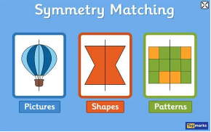
Symmetry Game
https://www.topmarks.co.uk/symmetry/symmetry-matching

Slide 39
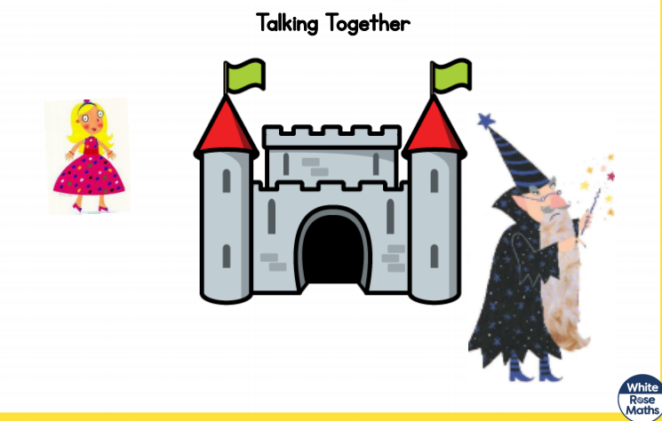
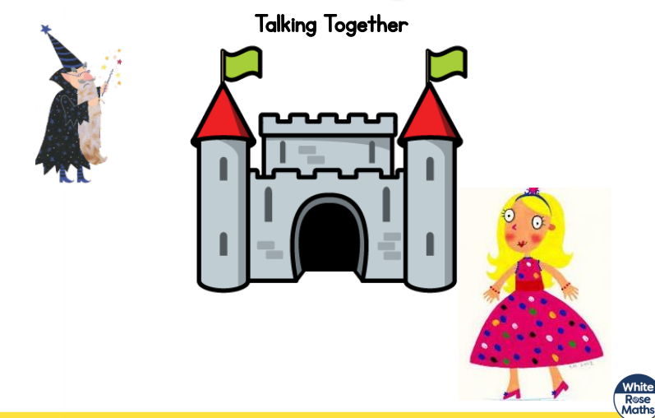
Friday 19th June 2020 Maths
Today we are learning to talk about position and distance. We will also look at pattern.
Today I would like you to look at the pictures and decide who is closest to us, the princess or the wizard.
You know you have done a good job if you have used some words like: closest, nearer, far away
There is another activity on the next page.

Slide 40
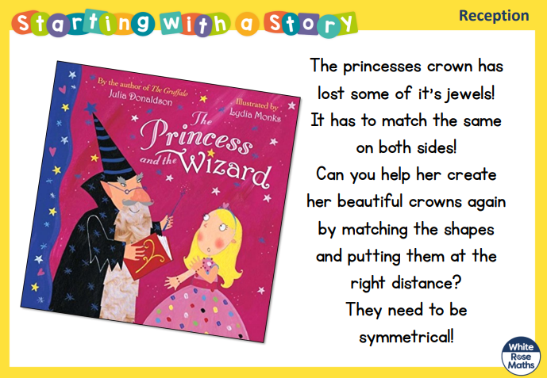



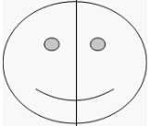
Friday 19th June 2020 Maths
Today we are learning to create a symmetrical pattern.
There are some crowns for you to complete on the next few pages.

Slide 41
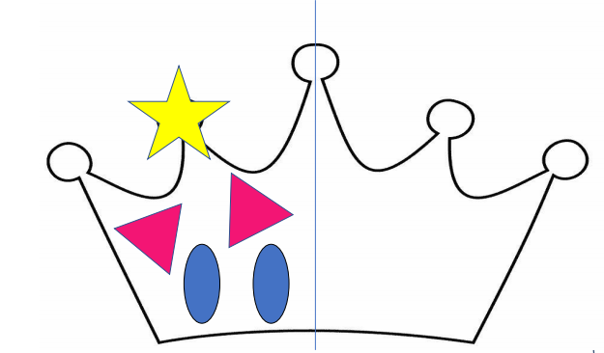
Friday 19th June 2020 Maths
Today we are learning to create a symmetrical pattern
.
You know you have done a good job if you have looked at the position of the shapes to complete a symmetrical pattern.

Slide 42
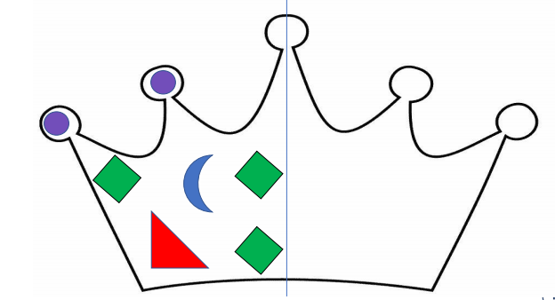
Friday 19th June 2020 Maths
Today we are learning to create a symmetrical pattern
You know you have done a good job if you have looked at the position of the shapes to complete a symmetrical pattern.

Slide 43
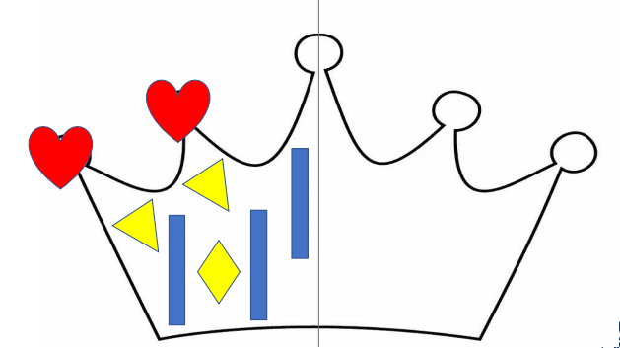
Friday 19th June 2020 Maths
Today we are learning to create a symmetrical pattern
You know you have done a good job if you have looked at the position of the shapes to complete a symmetrical pattern.

