Slide 1
Year 4 Chestnut Home Learning
Week commencing 15.06.20

Slide 2
Welcome back!
I hope you all had a fantastic weekend!
This week I have set bitesize links. Please watch the short videos and complete the activities. If you can not print an activity off you can work from the screen or move on to the next activity.
A lot of the work this week is revision, if you would like a challenge please take a look at cherrytree powerpoint on the school website
Enjoy and don’t forget to let me know how you got on!
Please let me know if the new home learning does not suit you or even if you like it better than the old style!

Slide 3
Bonus sessions Geography
Why not have a go at these session throughout the week:
Day 1: :Geography Introduction to maps
https://www.bbc.co.uk/bitesize/articles/zkngrj6
Day 2:: Contours, keys and symbols
https://www.bbc.co.uk/bitesize/articles/zjdm6v4
Day 3: Time zones
https://www.bbc.co.uk/bitesize/articles/z4jbrj6

Slide 4
mONDAY
Spelling mat
Maths activity
English

Slide 5
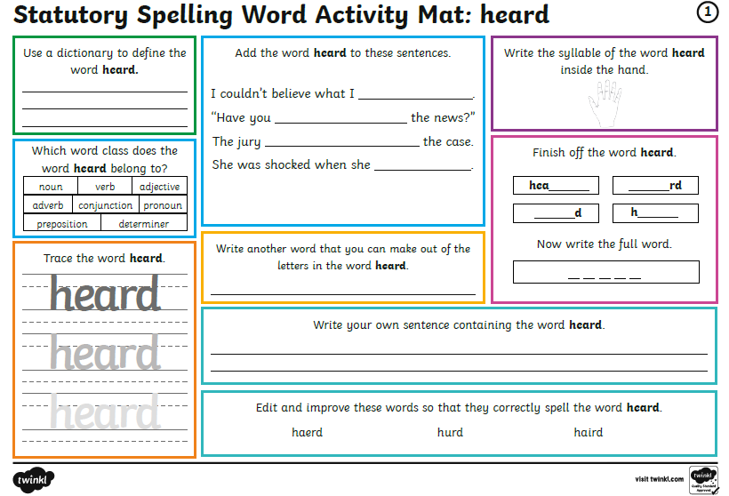
Spelling mat (you can work from the screen)

Slide 6
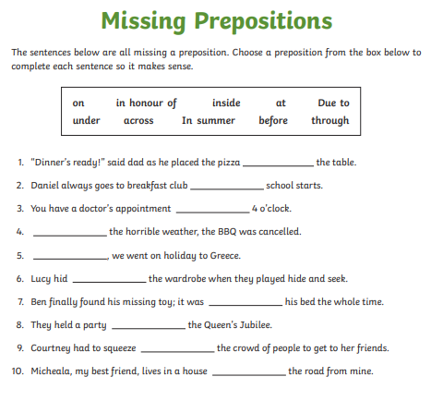
Identifying and using preposition
https://www.bbc.co.uk/bitesize/articles/zh8nscw

Slide 7
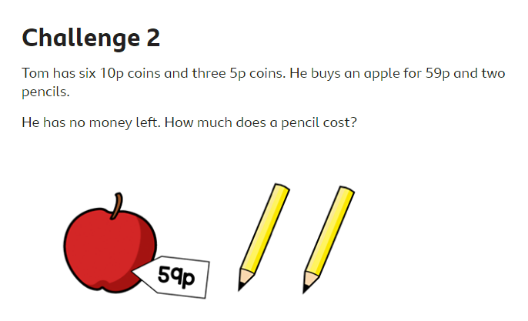
Monday: Maths challenges. https://www.bbc.co.uk/bitesize/articles/zv8v382

Slide 8
TUESDAY
Spelling mat
Maths activity
English

Slide 9
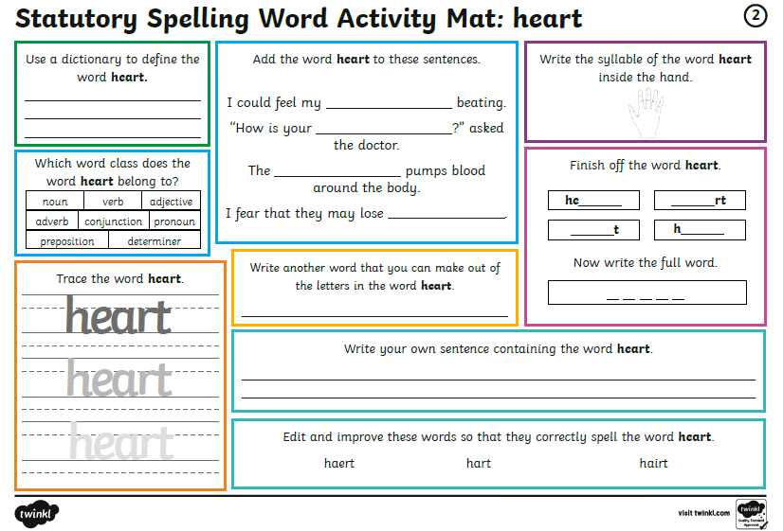
Spelling mat (you can work from the screen)

Slide 10
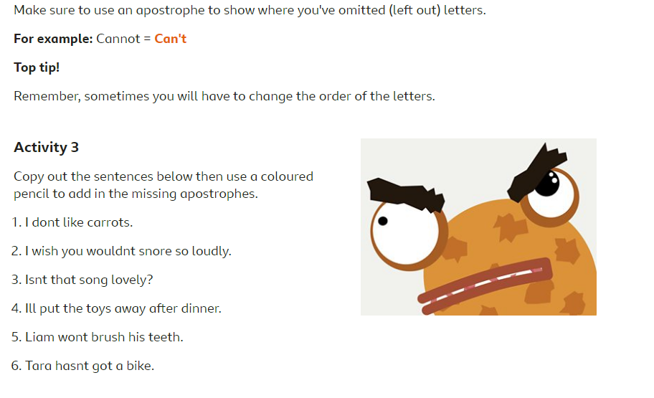
Tuesday: Using apostrophes to combine words. https://www.bbc.co.uk/bitesize/articles/zhgfy9q

Slide 11
Tuesday: Add two 3 or 4 digit numbers together https://www.bbc.co.uk/bitesize/articles/z6vr47h

Slide 12
wednesDAY
Spelling mat
Maths activity
English

Slide 13
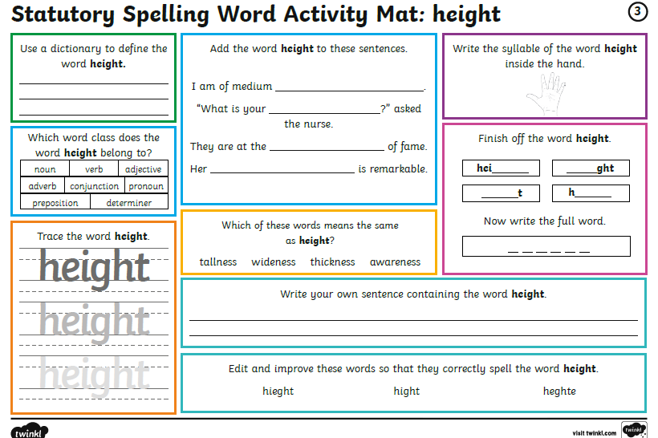
Spelling mat (you can work from the screen)

Slide 14
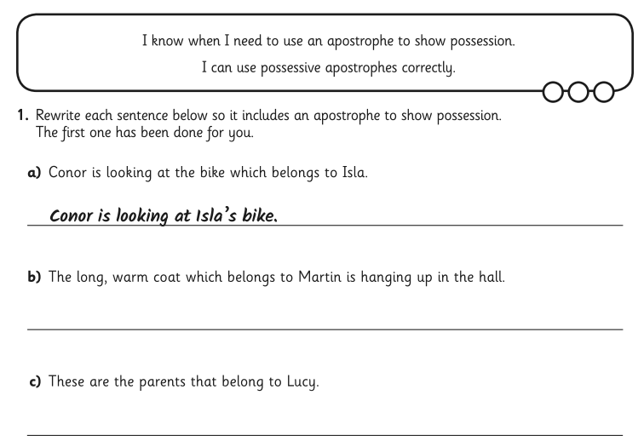
Wednesday: Using apostrophes to show possession https://www.bbc.co.uk/bitesize/articles/zmt2mfr

Slide 15
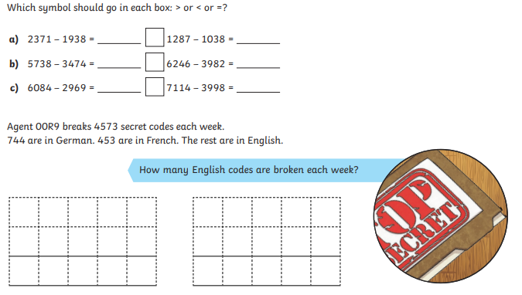
Wednesday: Subtract 3 or 4 digit numbers https://www.bbc.co.uk/bitesize/articles/zrtsy9q

Slide 16
thursDAY
Spelling mat
Maths activity
English

Slide 17
Spelling mat (you can work from the screen)

Slide 18
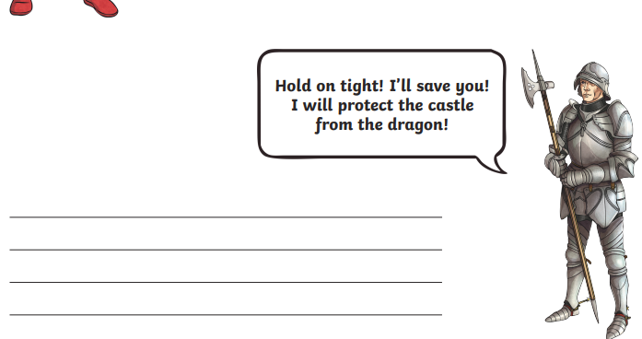
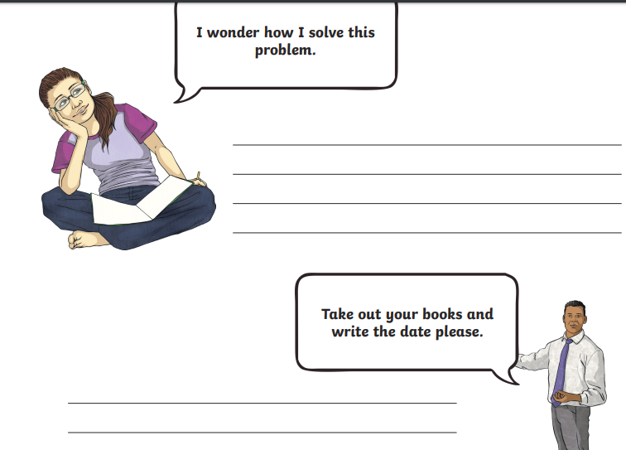
Thursday: Using inverted commas to show speech https://www.bbc.co.uk/bitesize/articles/z4rbgwx

Slide 19
Thursday: Efficient addition and subtraction https://www.bbc.co.uk/bitesize/articles/zvxpscw

Slide 20
friDAY
Spelling mat
Maths activity
English

Slide 21
Spelling mat (you can work from the screen)

Slide 22
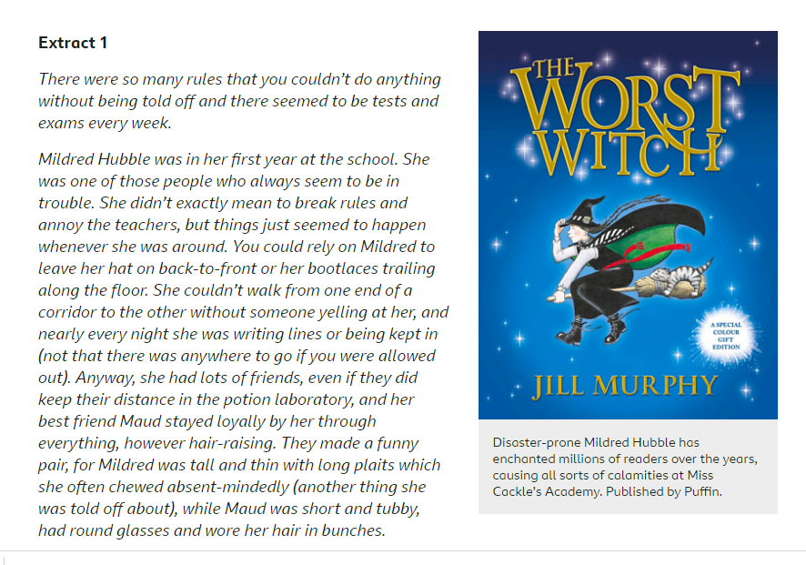
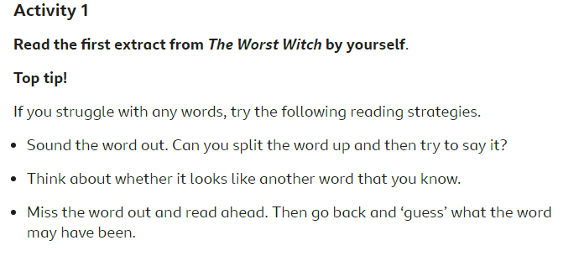
Friday: The Worst Witch Reading skills https://www.bbc.co.uk/bitesize/articles/z7rrcqt
Activity on next slide…

Slide 23
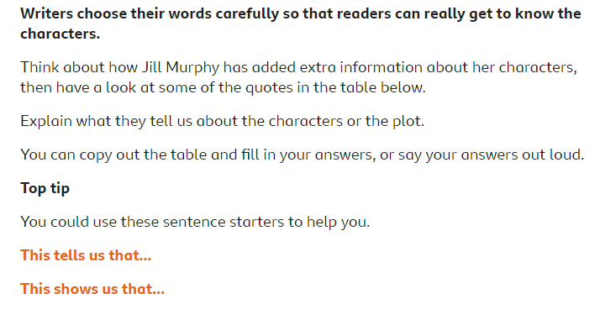

Slide 24
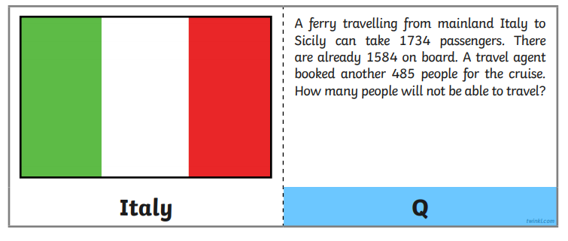
Friday: Addition and subtraction problems https://www.bbc.co.uk/bitesize/articles/zf3r47h

Slide 25
Have a great weekend!
Let me know how you got on
Chestnut.class@fernhill.kite.academy

