Slide 1
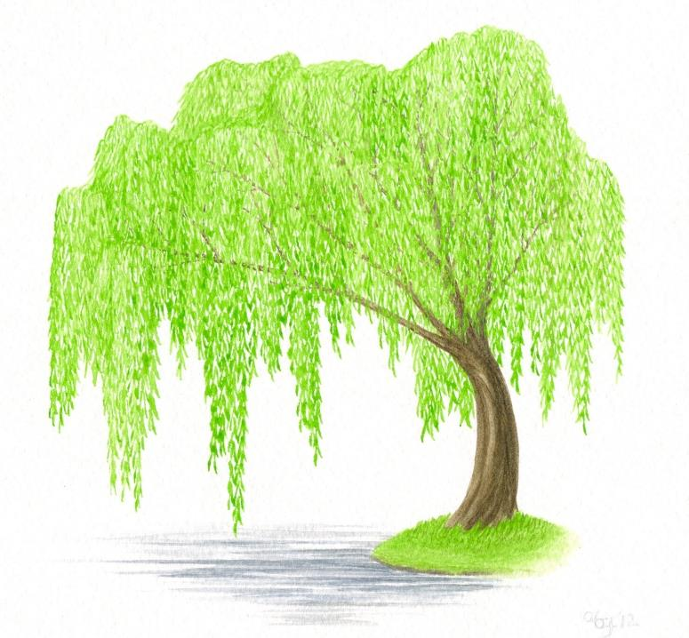
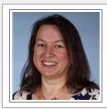
Willow Class willow.class@fernhill.kite.academy
15th – 19th June 2020

Slide 2
Daily handwriting. https://www.teachandwriting.co.uk/cursive-letters-beginners-choice-2.html
This week I would like you to start each writing session by practising your handwriting.
Remember to write just three letters and then check back with the video, to make sure that you are forming your letters correctly.
No more than half a line of each letter in a day!
Remember that all of the letters must rest on the line and you should try to make them exactly the same size as each other.
The link will shows videos of how each letter is drawn. There are also some worksheets that you can print off, or simply practise them in your books.

Slide 3
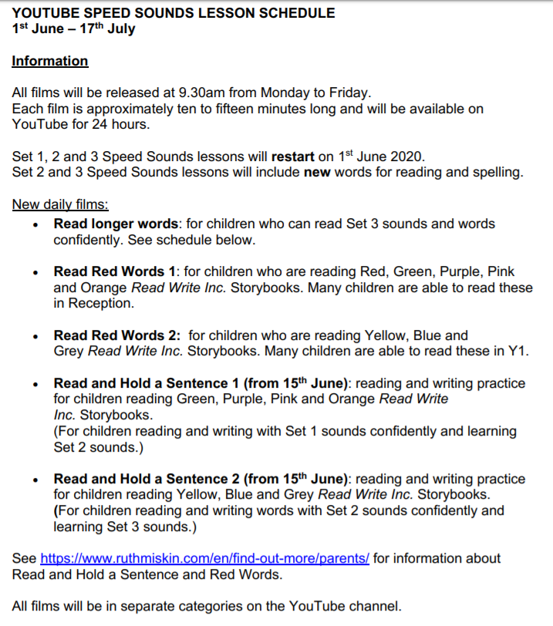
Spelling Year 1.
https://www.youtube.com/playlist?list=PLDe74j1F52zRJc5SKIq2QA85oScvky-PP
Please watch set 3 videos
Speed sounds
Spelling

Slide 4
Monday 15th June

Slide 5
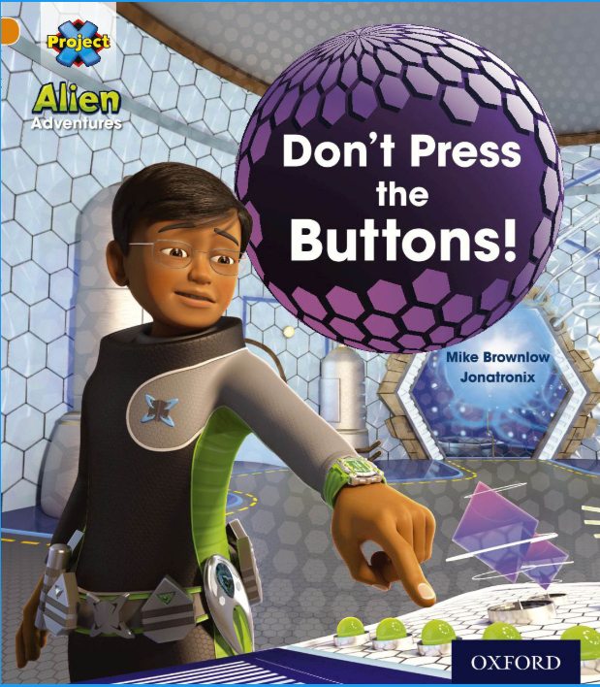
Read page 4 – 7 and use the sentences starters to help you talk about the book. There is no need to write the answers down.
Feelings
I feel …
Setting
The setting of this story is…
Language
The effective language is …

Slide 6
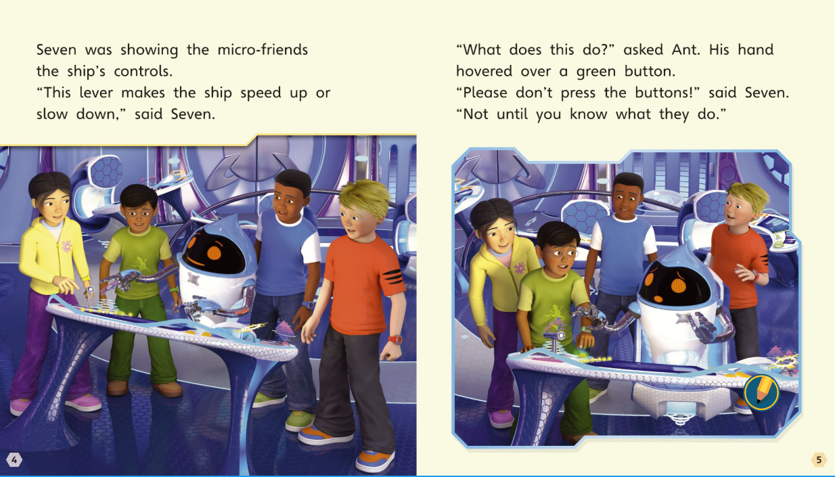

Slide 8
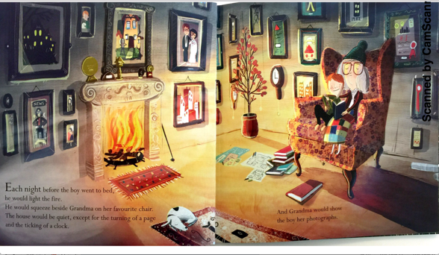
Writing
My sentence
As dusk fell, Grandma and Tom cuddled and chatted about old memories.
At twilight,
Every night,
As the sun went down,
As the moon rose,
As it became dark,
After bath time,
As the sun sets,
That evening,
cuddled
hugged
chatted
snuggle
spoke
whispered
stroked
Now write your own sentence(s).

Slide 9
Think about something or someone that you really love and gather some adjectives that you could use to describe this.
Here are some of the words that I have thought of.
loving
caring
affectionate
kind
caring
thoughtful
endearing
You could also use some of these words to make it even more…
very
extremly
excceptionally
really
hugely
In my sentence I am going to use some repetition.
Grandma and Tom had a special relationship.
Grandma and Tom had a very special relationship. Grandmas and Tom had a very special relationship indeed.
Now write your own sentence(s).

Slide 10
No I would like you to think of some of the sounds that you might hear, if you were there.
The breathing of the dog,
The crackling of the fire,
The ticking of the clock
The turning of the page
The beating of Grandma’s heart,
This is my sentence:
The house would be quiet, except for the turning of the page and the ticking of the clock.
Now write your own sentence(s).

Slide 11
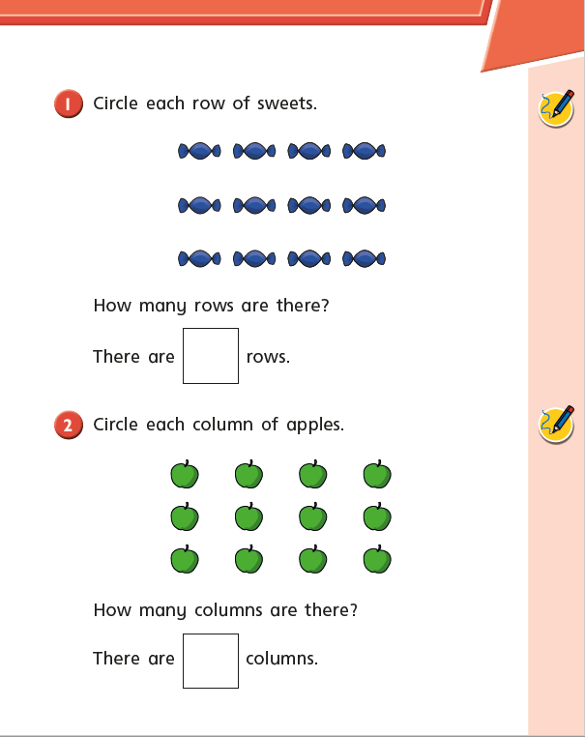
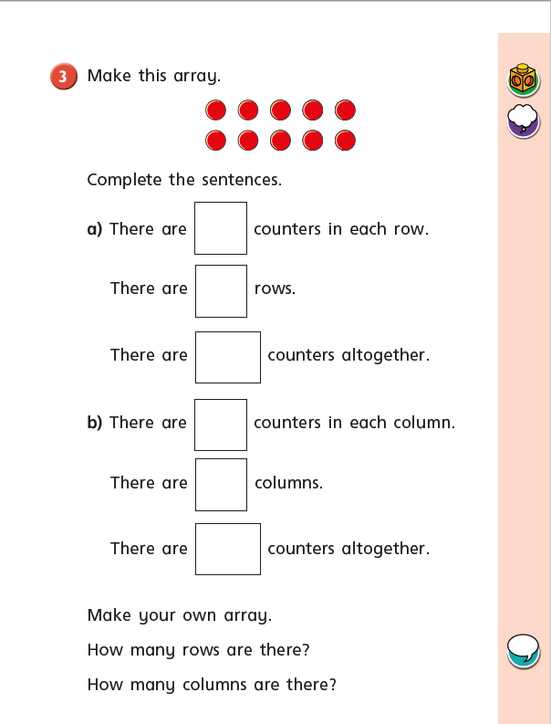

Slide 12
Tuesday 16th June

Slide 13
Read pages 8 – 11 and use the sentence starters to help you talk about what you have read. There is no need to write the answers down.
Asking
Some powerful dialogue…
Text Layout
The pictures and text are set out like this because…
Language
The interesting adjectives are…

Slide 14
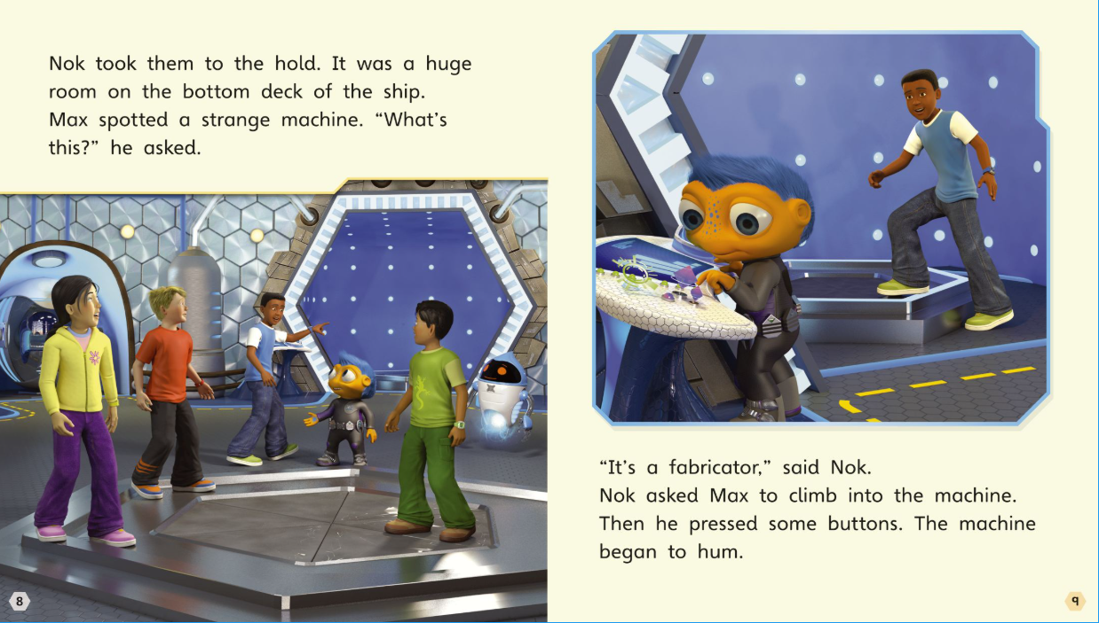

Slide 15
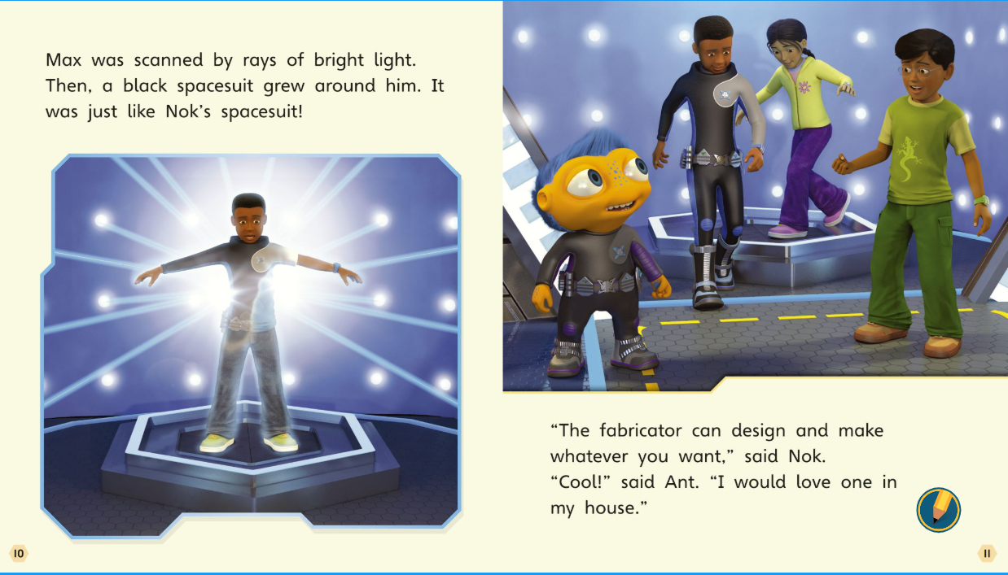

Slide 16
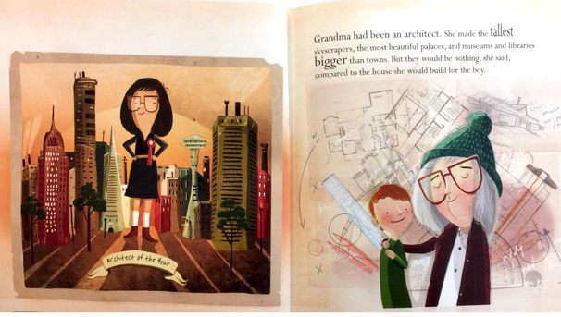
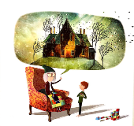
Have a look at some of the buildings in the picture . Can you think of their names? Can you think of any other buildings.
Here are some that I have thought of;
hotel, tower block, church, mosque, tree house, shed, super marker, hut, temple, caravan, bungalow, glates, empire state building, the gherkin, school.
I am going to write a list sentence. I’ve put add instead of a comma before the last building on the list.
Grandma had been an architect. She made the tallest skyscrapers, the widest libraries and the largest schools.
Now write your own sentence(s).

Slide 17
I would like to use some alliteration in this part of my story.
I am going to think about some of the parts of the house and think about the words that I could use to describe.
Window – wide, wonderful, welcoming, wooden,
Roof – rustic, rugged, red, rigid, rickety, rotten.
Door – damaged, deep , dark, dusty, delightful.
Can you think of some other parts of the building?
Here is my sentence
For Tom, she would make a house with welcoming windows, a red roof and a dramatic door.
Now write your own sentence(s).

Slide 18
What do you think Grandma and Tom might be saying in the picture.
Can you come up with a small conversation.
Remember that you need to use speech marks at the beginning and end of where a person is talking.
Here is my conversation.
“I would like to build you a beautiful house so you will always remember me,” said Grandma.
“ I would love that Grandma, that would be so special,” said Tom.
Now write your own sentence(s).

Slide 19
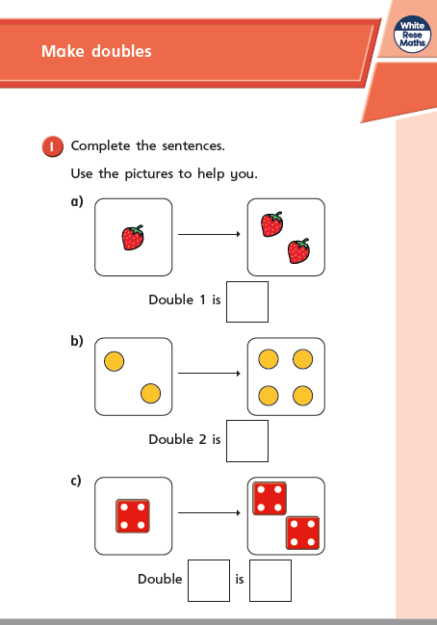
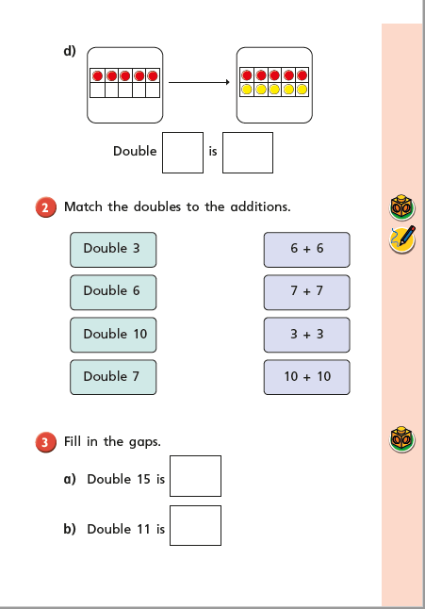

Slide 20
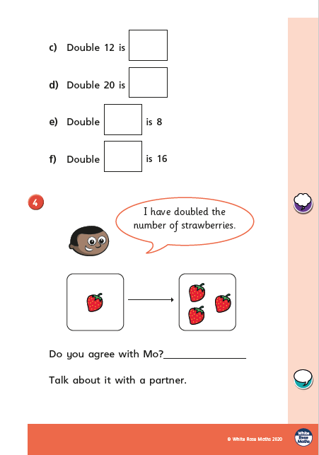

Slide 21
Wednesday 17th June

Slide 22
Read pages 12 – 15 and use the sentence starters to help you talk about what you have read. There is no need to write your answers down.
Noticing
The characters notice…
Relationships
The characters who are friends are…
Personal opinion
I liked/didn’t like…

Slide 23
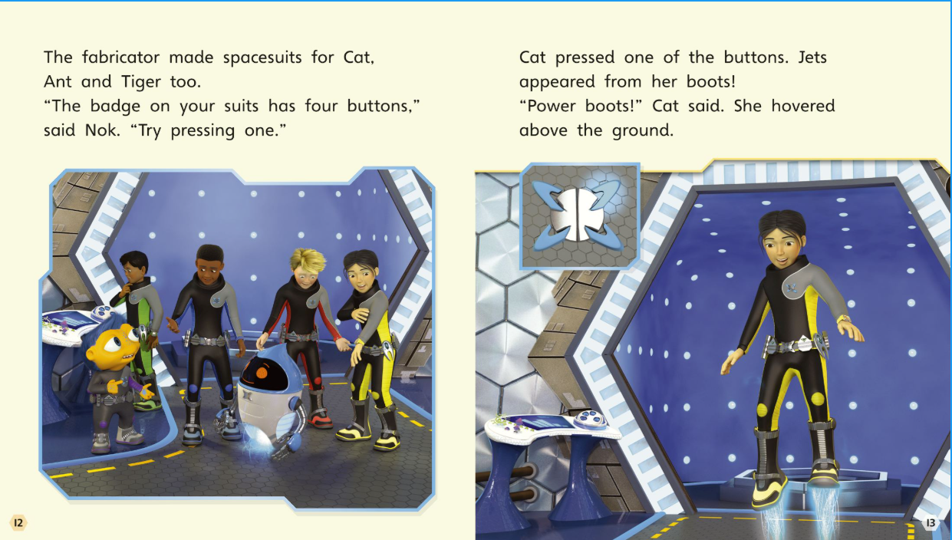

Slide 24
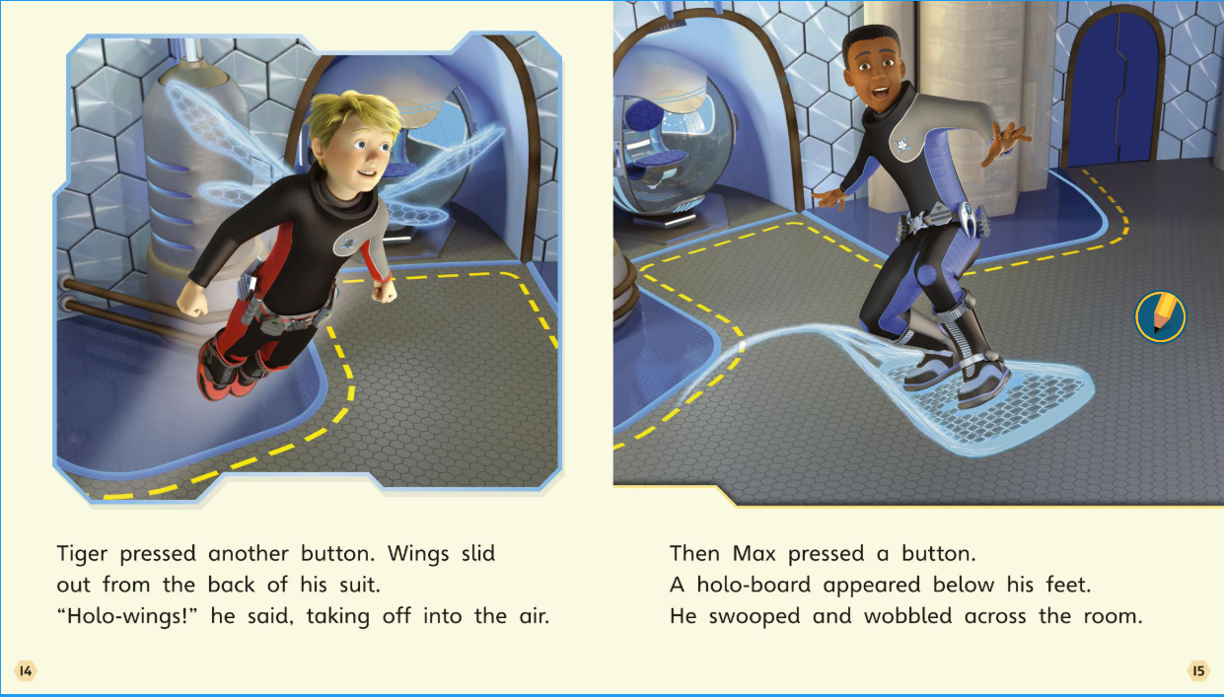

Slide 25
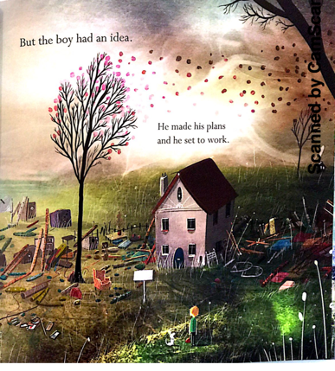
Unfortunately, Grandma is no longer there and the house has fallen into ruins.
Think back to the first picture and gather some words that are negative.
Here are the ones that I can think of.
broken photograph,
a clock that stops ticking
a dusty chair, a cracked mirror
a lonely dog
discarded trophies
a withered plant.
This sentence is going to tell me what Tom sees now.
Tom looked at old photographs, the broken clock and the empty chair.
Now write your own sentence(s).

Slide 26
Now I would like you to think about all of the things that Tom might have been doing with his Grandma.
Here are some of the things that I can think of.
played cards
read stories
watched television
played games
baked cakes
This sentence is going to tell you what he was remembering.
Tom stood in deep thought of back when they listened to stories and played cards together. Now the room was messy and lonely.
Now write your own sentence(s).

Slide 27
Here I would like you to think about some things that are really cold.
Can you think of some similes that might describe how Tom was feeling about the house.
…as cold as ice…
…as cold as deepest winter…
…snow covered…
…like a frozen lake…
… like a frost covered path…
This sentence is going to tell me what Tom sees now.
Without Grandma the house was as cold as deepest winter.
Now write your own sentence(s) that compares Grandmas house to a cold scene.

Slide 28
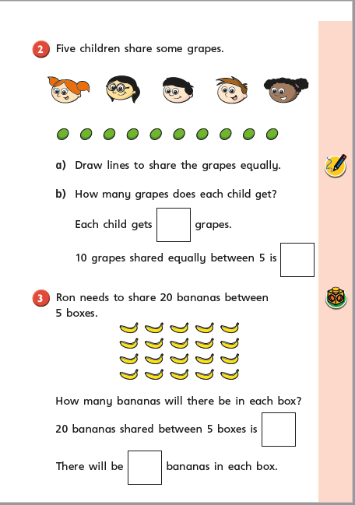
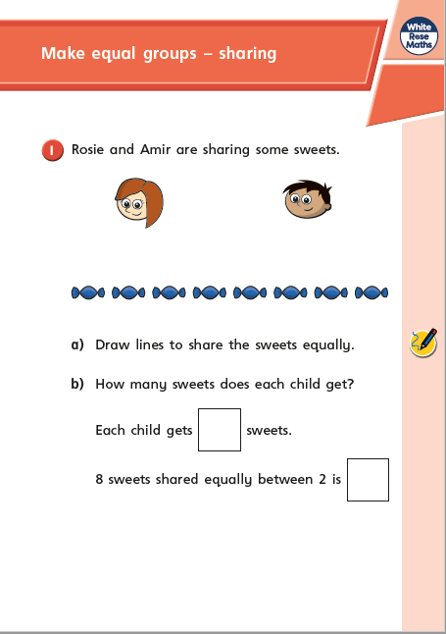

Slide 29
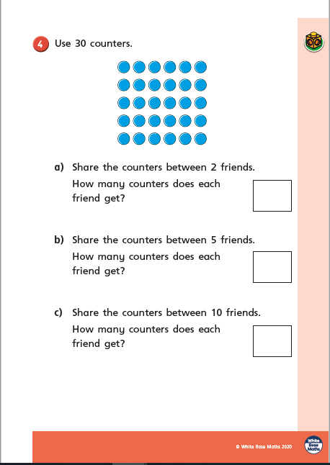

Slide 30
Thursday 18th June

Slide 31
Read pages 16 – 19 and use the sentence starters to help you talk about the pages that you have read. There is no need to write the answers down.
Touching
The surrounding might feel as if…
Facts and opinions
If I reviewed this book I would say…
Inference
This picture tells us more about…

Slide 32
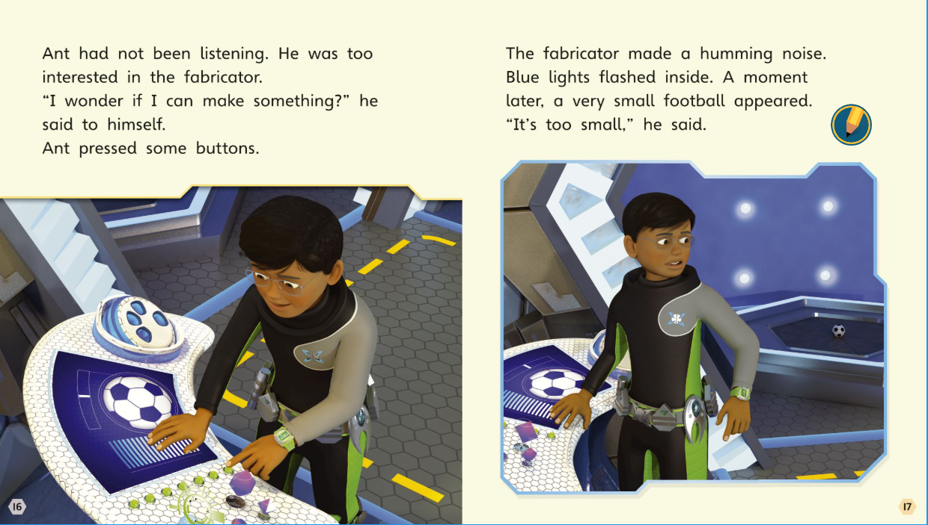

Slide 33
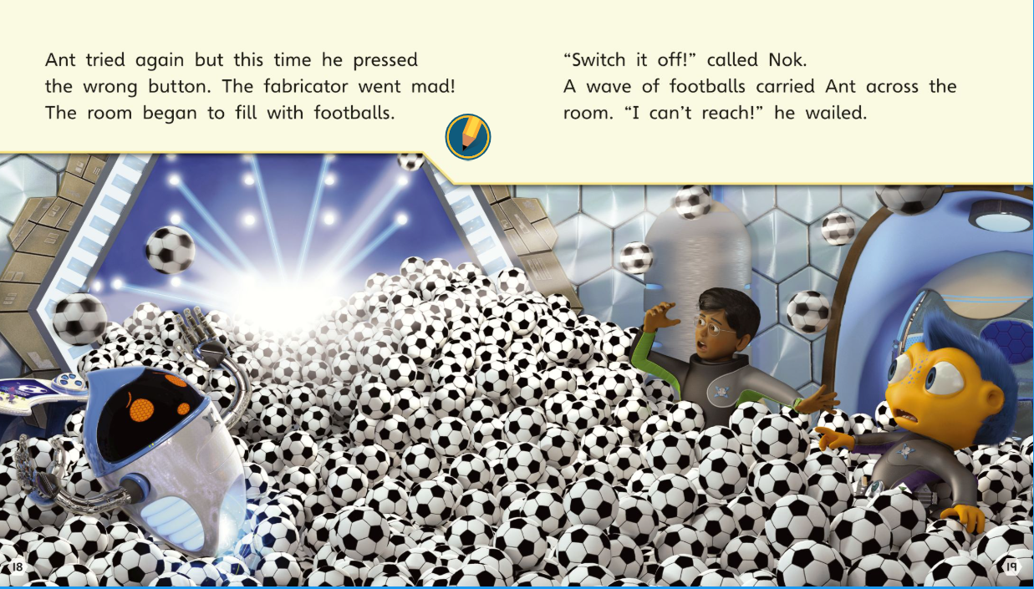

Slide 34
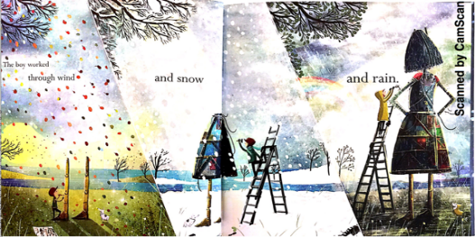
In this next session of our story, the boy is going to rebuild the house. It takes him a long time.
If he starts in Autumn and Winter can you think of some of the sounds that the wind might be making.
Here are some of the sounds that I think the wind might make.
…howled, twisted, whispered, raged, twirled, tumbled, rattled, fluttered, blew…
These are my sentences:
In memory of his Grandma, he made plans and set to work.
With determination, Tom worked as the wind twisted and howled around him.
In your sentence I would like you to include two words to describe the sounds that the wind makes.

Slide 35
In this next session of our story, the boy is going to rebuild the house. It takes him a long time.
I would like you to think about what things Tom might see now that it is the middle of winter.
…ice covered branches, bare trees, blanket of snow, frozen lake, crisp snow, velvet snow.
I am going to describe the winter scene.
Tom could see ice lacquered branches and crisp, velvet snow.
In your sentence I would like you to include an expanded noun phrase to describe the scene.

Slide 36
In this next session of our story, the boy is going to rebuild the house. It takes him a long time.
How do you think Tom might me feeling in the middle of winter.
Here are some of the words that I can think of.
…drenched, soaked, soggy, damp.
Here are some words that might describe what the wind was doing.
… pelted, hammered, chucked, drizzled…
I am going to use an exclamatory sentence to describe how horrible the weather is.
The rain pelted down. How damp he was!
I would like you to write a sentence describing what the rain was doing and an exclamatory sentence describing Tom.

Slide 37
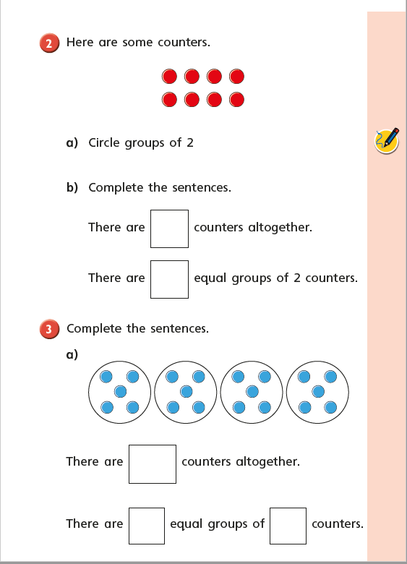

Slide 38
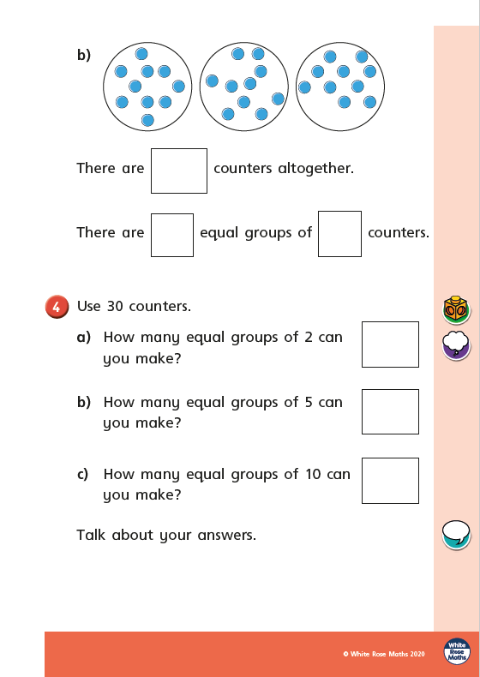

Slide 39
Friday 19th June

Slide 40
Read pages 20 – 23 and use the sentence starters to help you write about the book. There is no need to write the answers down.
Action
The main action in this story is when…
Problem
The problem in the story is…
Predictions
My idea for what happens next is…

Slide 41
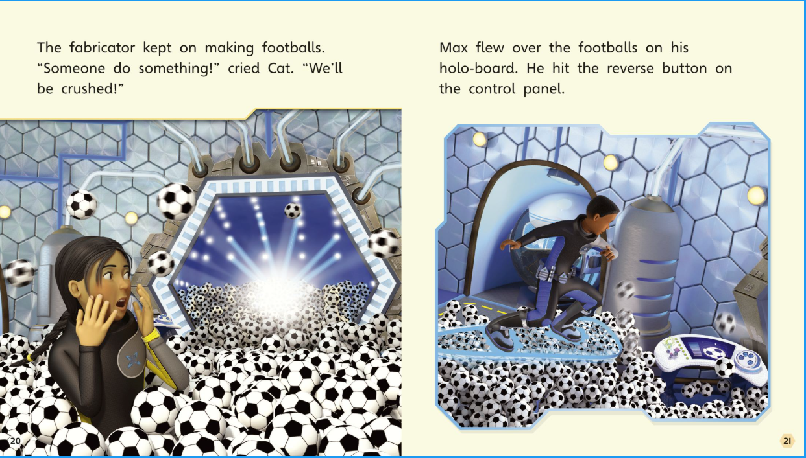

Slide 42
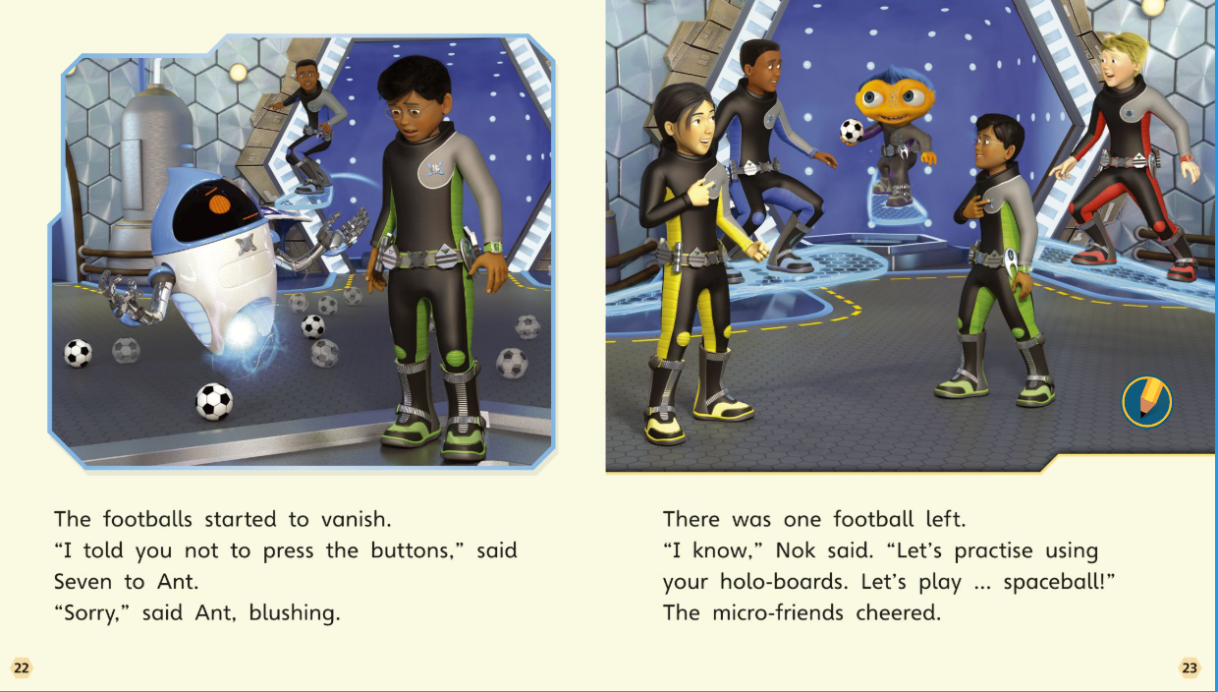

Slide 43
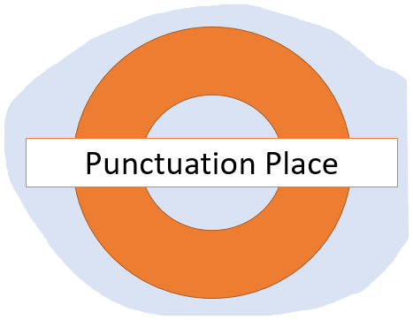
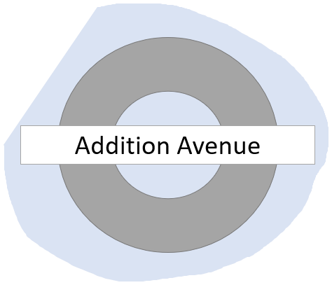
Editing Stations.
Here is your chance to improve your work.
Spend 5 minutes at each of these editing stations.

Slide 44
Here are some of the things that you could use to help you check your spellings.
Word mats
The words on the word lists.
Dictionaries.
Spelling Square
Today I would like you to find three spelling mistakes and correct them in your work.

Slide 45
Year 1.
Check that you have included these things in your writing.
A capital letter at the beginning of a sentence.
A full stop at the end of a sentence.
A question mark at the end of a question sentence.
A capital letter for a name.
Punctuation Place
Year 2
Check that you have also included these things.
An exclamation mark for an exclamatory sentence.
Commas (,) for list sentences.
‘ to show missing letters (e.g. don’t)
‘s to show if something belongs to someone (e.g. Peck’s wings)
Today I would like you to find 3 places in your work where you have missed some punctuation.

Slide 46
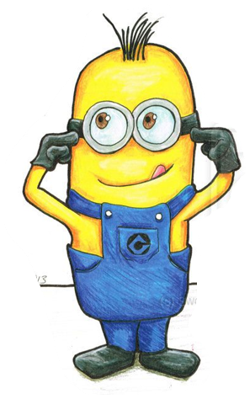
At Grammar Green I would like you to read through your work using your inner ears.
Have you missed any words out?
Have you put in too many words?
Does your work sound okay?
Grammar Green
Read through your work with your inner ears. If you spot any mistakes, make changes now.
Make sure you stop after 5 minutes.

Slide 47
Choose one of your sentences.
Re- write this sentence thinking about these things.
Have you used your best handwriting?
Are all of your letters sitting on the line?
Are all of your letters the correct shape and size?
Are your ascenders and descenders clear?
Re-write Road
Choose your favourite sentence to re-write in your best handwriting.

Slide 48
Here’s your chance to add some more information.
Add some more information
Add an adjective.
Add an adverb
Add another sentence.
Addition Avenue
Today find one more plot point and add another sentence to it.

