Slide 1
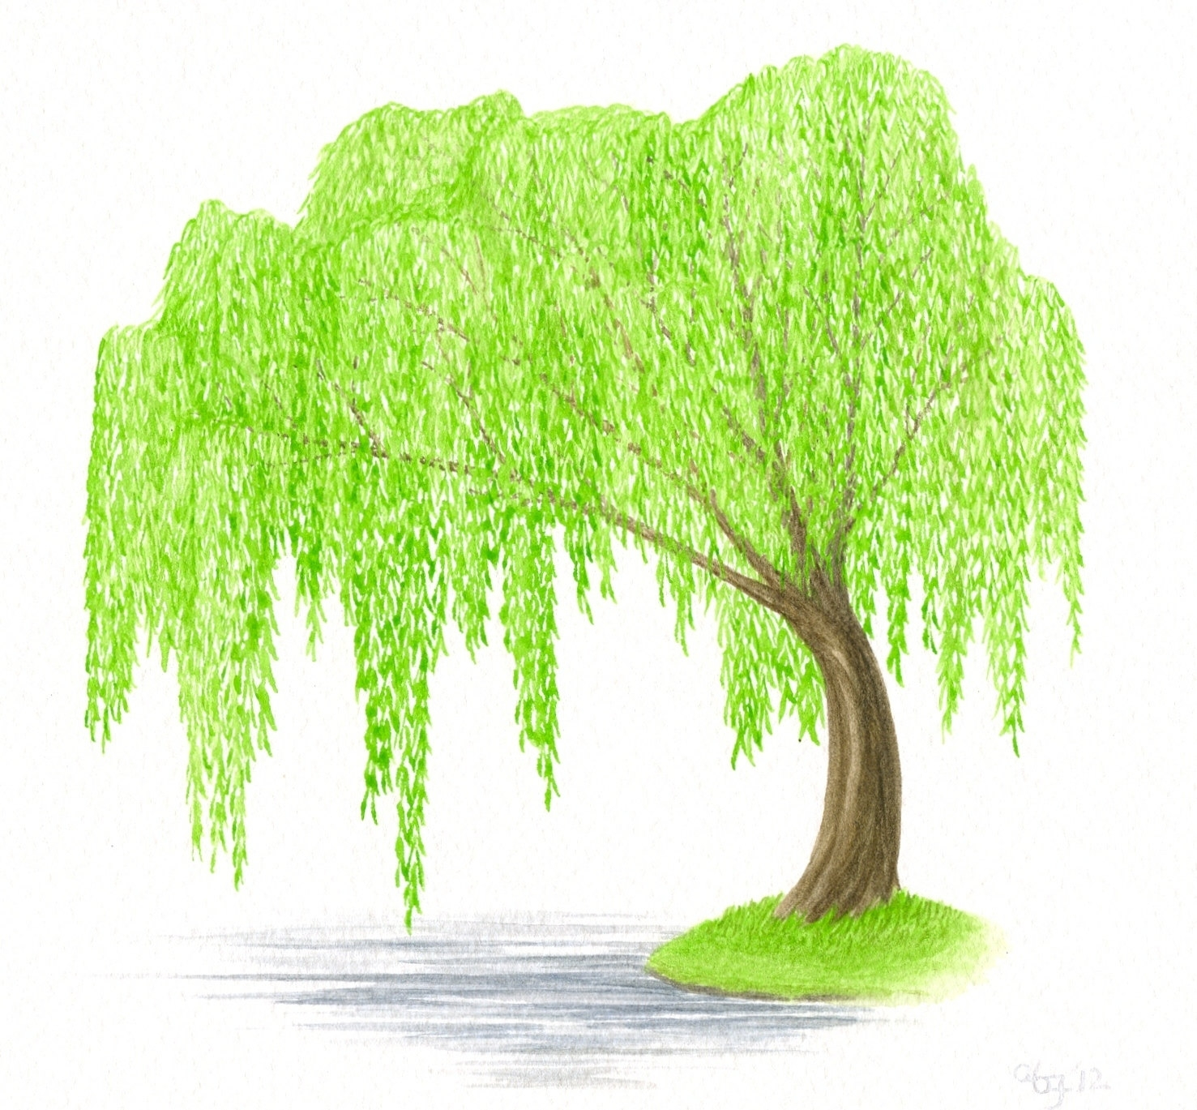
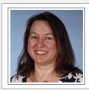
Willow Class willow.class@fernhill.kite.academy
13th July – 17th July

Slide 2
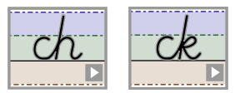
Handwriting
https://www.teachhandwriting.co.uk/cursive-joins-choice-2.html

Slide 3
Phonics and Spelling
This week I would like you to make sure that you can spell the days of the week and the months of the year.

Slide 4
Reading
This week I would like you to choose to read either one of your own books or one from Oxford Owls to read.
Remember to write down what you have enjoyed reading each day.
The e-books can be found at https://www.oxfordowl.co.uk
Click on my class login in.
Username: willow.fernhill
Password: Fernhill
Go to the book shelf and choose a book that you think you will enjoy reading.

Slide 5
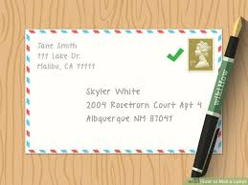
Writing
This week I would like you to write a letter to your new teacher.
Your new teacher will be Mrs Bradshaw. Don’t forget to find and watch the video that she has recorded for you.
You can either post the letter to school, or bring it with you when you return to school in September.

Slide 6
Monday
My letter is going to have four sections.
Jot down some of the ideas that you are going to use in each section so that you can write them during the week. Remember today you are just recording ideas. You do not need to write in sentences.
Today I would like you to plan out your letter.
Tell your new teacher about some of the things that you have been doing whilst you have been learning at home.
Tell your new teacher a little bit about you and your family.
Introduce yourself.
Tell your new teacher about some of the things that you have enjoyed learning at school.
Tell your teacher about what you are looking forward to next year.

Slide 7
Tuesday
Write your first section today.
You need to write at least 3 sentences and up to 9 sentences to tell your new teacher all about you.
Think about:
your family
Your pets
Where you live
Things that you enjoy doing at home.

Slide 8
Wednesday
I would like you to write your second section today.
You need to write at least 3 sentences and up to 9 sentences to tell your new teacher all the things that you have enjoyed learning about while you have been at home.
Think about:
the home learning that you have completed
Some of the other things that you have enjoyed. E.g. cooking with your family, gardening, going on walks, making things.

Slide 9
Thursday
I would like you to write your third section today.
You need to write at least 3 sentences and up to 9 sentences to tell your new teacher all the things that you enjoy doing at school. (Some of you will have to think back a really long way!)
Think about:
Where you enjoy learning
The subjects that you were taught
Playtimes and lunch times
Your friends.

Slide 10
Friday
I would like you to write your final section
You need to write at least 3 sentences and up to 9 sentences to tell your new teacher about all the things that you are looking forward to next year.
When you have finished your writing. You could send it into the school office, or bring it to school in September and give it to your teacher when you meet them.

Slide 11
Maths

Slide 12
Monday
https://whiterosemaths.com/homelearning/year-2/

Slide 13
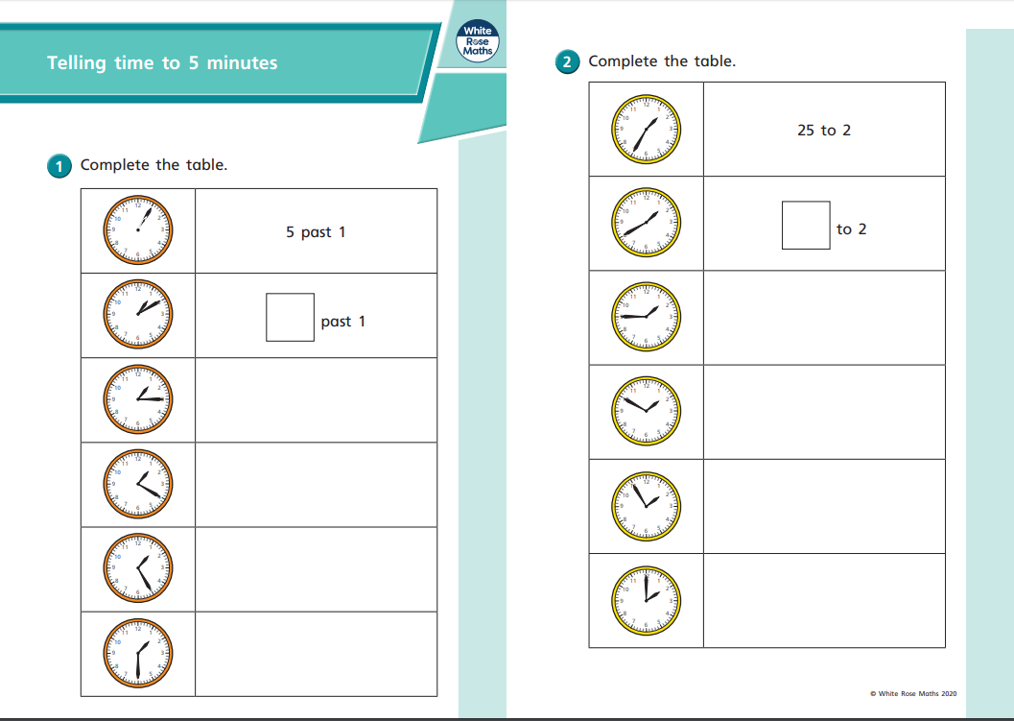

Slide 14
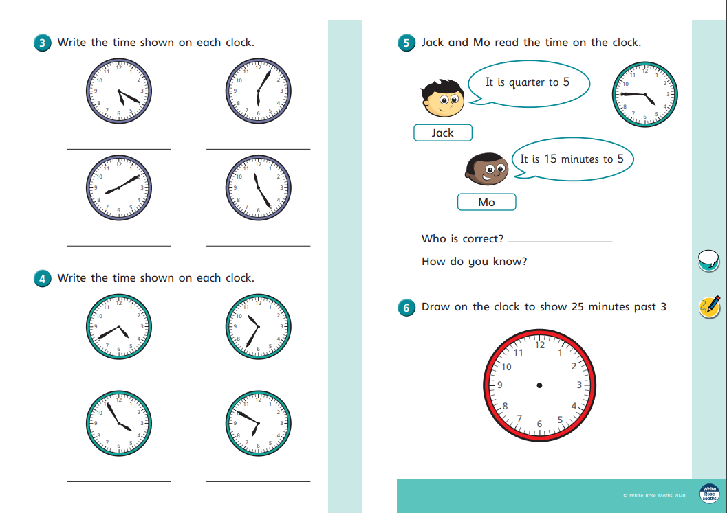

Slide 15
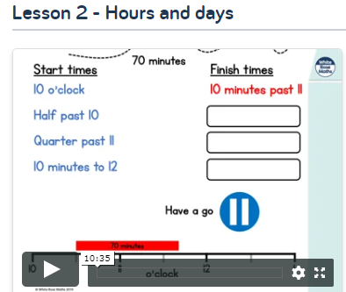
Tuesday
https://whiterosemaths.com/homelearning/year-2/

Slide 16
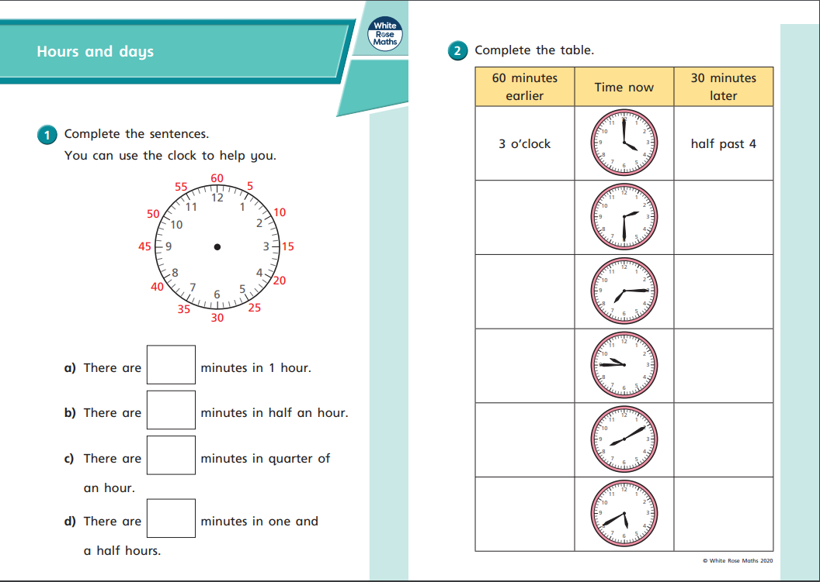

Slide 18
Wednesday
https://whiterosemaths.com/homelearning/year-2/

Slide 20
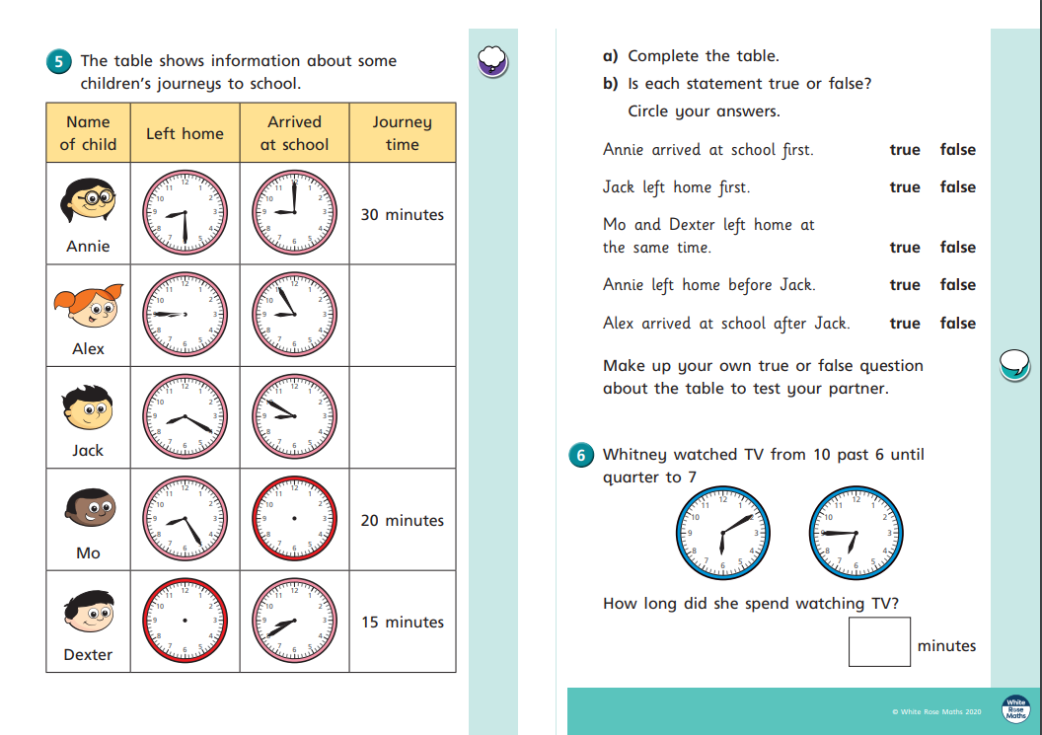

Slide 21
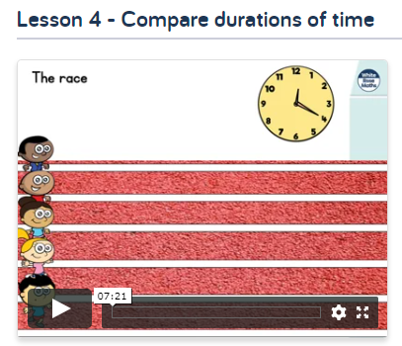
Thursday
https://whiterosemaths.com/homelearning/year-2/

Slide 23
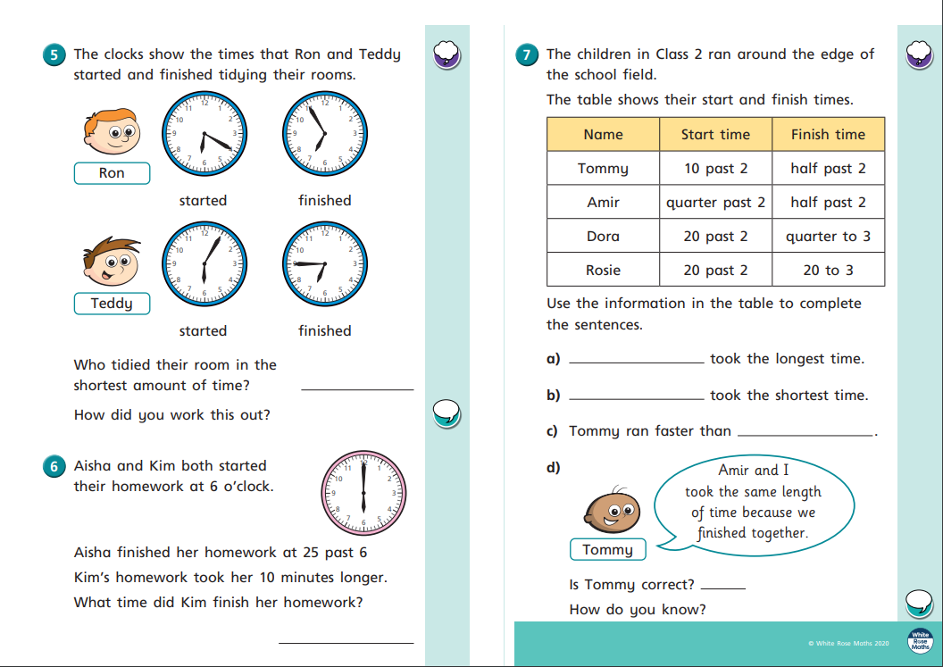

Slide 24
Friday
https://whiterosemaths.com/homelearning/year-2/

