Slide 1
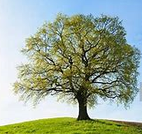
Oak Class
Home Learning
11th May 2020

Slide 2

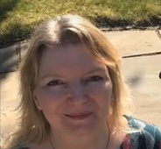
Hello Oak Class!
I’m missing you all.
It would be great to hear from you every week, with details of one thing which you are
proud of learning or making.
Please use our class email: Oak.Class@ fernhill.kite.academy
I’m looking forward to sending you a Marvellous Me to celebrate all your hard work.
Miss Parlane

Slide 3
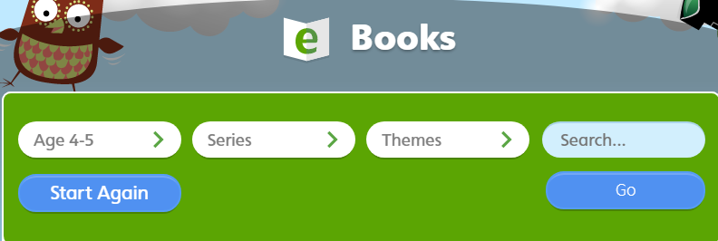
Daily Reading
Have a look at https://www.oxfordowl.co.uk and choose a free online book to read.
Class login. User name: oak.fernhill
Password: Fernhill
Select age 4-5
When you read, remember to use your phonics.
Look for ‘special friends’? If Yes – say the ‘special friends’ sound.
Then ‘Fred talk’ the word, ‘say the word’.
Please always ensure that your child is supervised whilst on the internet.

Slide 4
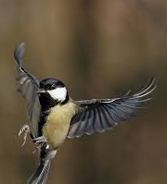
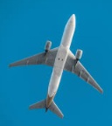
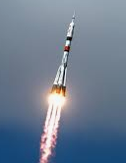
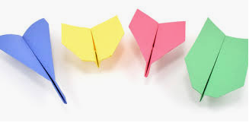
Topic
Our current topic is Flight.
See the topic information sheet on our school website.
It provides activities for 2 weeks.
Please take a look and choose 3 activities to do.
The Flight Home Learning sheet includes lots of links to YouTube.
Please always ensure that your child is supervised whilst on the internet.

Slide 5
Oak Class
Home Learning
Marvellous
Monday

Slide 6
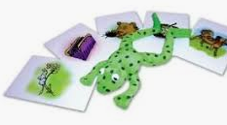


Phonics – Reading
Monday 11th May 2020
Please work on set 1 sound ‘x’ today
Ruth Miskin Training https://www.youtube.com/channel/UCo7fbLgY2oA_cFCIg9GdxtQ
If you can, work through ‘Word time’ and ‘Spelling’ too.
If your child is confident reading and writing set 1 sounds, you can start to work through set 2 sounds which are restarting on Monday 11th May on the RWI website.
Remember to do some reading today. https://www.oxfordowl.co.uk
Please always ensure that your child is supervised whilst on the internet.

Slide 7

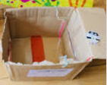


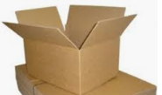
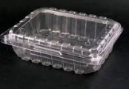
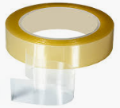
Monday 11th May 2020 English
Today we are learning to write labels.
In Maths today, you will be making a trap for Evil Pea!
Please draw and label a picture of your trap.
You could label shapes, colours or features. lid
card
Then copy and finish the following sentence.
I made a __________ .
Here are some words to help you.
door window card plastic tape
You know you have done a good job if you have written labels for different parts of your trap.
Don’t forget to use your phonics
‘Fred talk’ and say the word

Slide 8
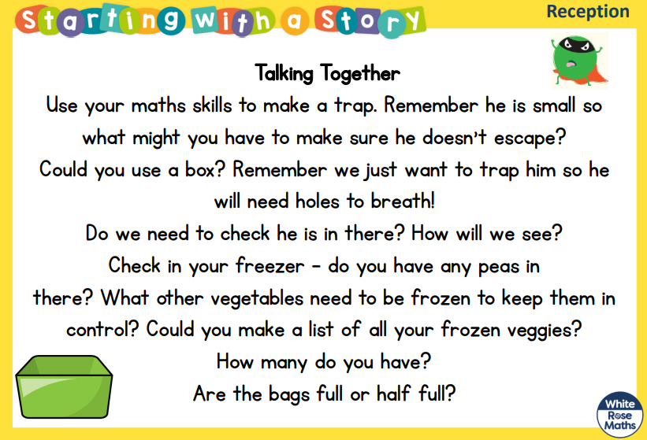
Monday 11th May 2020 Maths
Today we are learning to name 2D and 3D shapes
Your task is to make a trap for Evil Pea!
Evil Pea is a villain in a story called ‘Supertato’ by Sue Hendra and Paul Linnet.
You could listen to or read the story: https://www.youtube.com/watch?v=QlaMeNmTG6c
First look at the next slide to recap 2D and 3D shapes names.
Then talk about Evil Pea. What shape and size is he?
What could you use to make a trap?
Do you have some things in your recycling you could use?
Can you describe your trap using shape names?
Talk about sides and corners too.
Evil Pea will still need to be able to breath! What could you add?
You know you have done a good job if you have used some of the words shown on the next slide to describe your trap.
Please always ensure that your child is supervised whilst on the internet.

Slide 9
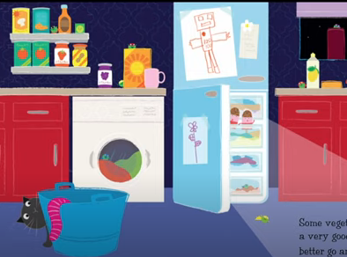
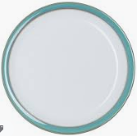

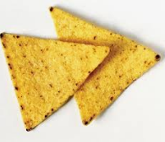

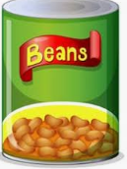

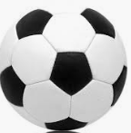

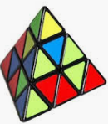
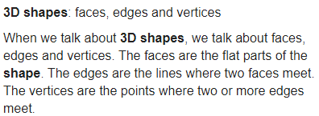
Monday 11th May 2020 Maths
Here are some words to help you with your activity today
Listen to the 2D shape song: https://www.bbc.co.uk/bitesize/clips/zhnvcdm
circle square triangle rectangle
corner side
Listen to the 3D shape song: https://www.bbc.co.uk/bitesize/clips/zps34wx
sphere cube cuboid cylinder pyramid cone
Have you learnt some new shape names?
Now look back at the previous slide for your activity.

Slide 10
Oak Class
Home Learning
Terrific
Tuesday

Slide 11
Phonics – Reading
Tuesday 12th May 2020
Practice set 1 sound ‘sh’ today
Ruth Miskin Training https://www.youtube.com/channel/UCo7fbLgY2oA_cFCIg9GdxtQ
If you can, work through ‘Word time’ and ‘Spelling’ too.
Remember to do some reading today. https://www.oxfordowl.co.uk
Please always ensure that your child is supervised whilst on the internet.

Slide 12
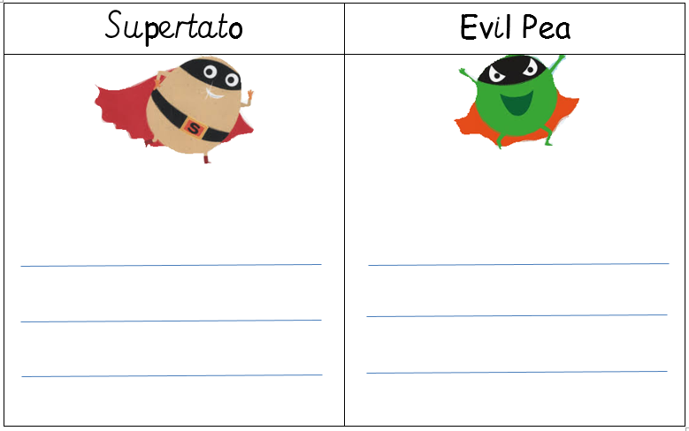
Tuesday 12th May 2020 English
Today we are learning to use your phonics to write words
Please listen to or read the story of ‘Supertato’ by Sue Hendra and Paul Linnet.
https://www.youtube.com/watch?v=QlaMeNmTG6c
If you are can’t listen to the story that is OK. The hero is called Supertato. The villain is called Evil Pea.
Take a look at the two characters
What is the same or similar?
What is different?
Draw a picture of each character and write some
words underneath to describe each character.
Remember to say the word you want to write and
then ‘Fred Talk’ the word and use your sound mat.
You know you have done a good job if you say the sounds in your word and write some of the sounds correctly.
Sue Hendra shows how to draw Supertato at https://www.worldbookday.com/videos/how-to-draw-supertato-by-sue-hendra-paul-linnet/
Don’t forget to use your phonics
Please always ensure that your child is supervised whilst on the internet.

Slide 13
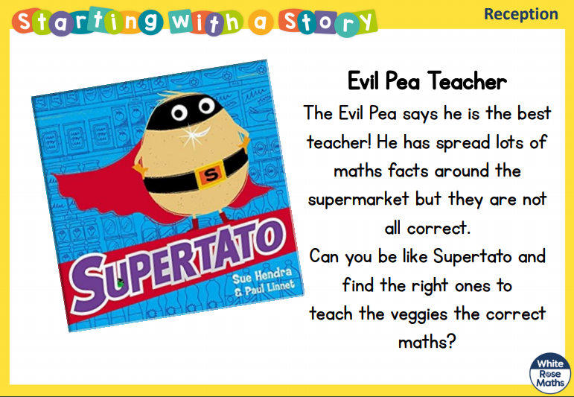
Tuesday 12th May 2020 Maths
Today we are learning to solve mathematical problems
Today you need to find ways to check if the answer to a maths problem is correct.
Evil Pea has written lots of maths facts – they are on the next slide
Copy the facts on to small pieces of paper, your grown up could do this.
Read the fact together.
You need to work out which facts are correct.
You could make two groups: Correct Wrong
Think of ways to help you work out the answer.
You could use a number line, cubes, look at shapes information from yesterday.
You know you have done a good job if you have found ways to work out the correct answer.
You might like to make up some of your own number fact cards for someone else to solve.

Slide 14
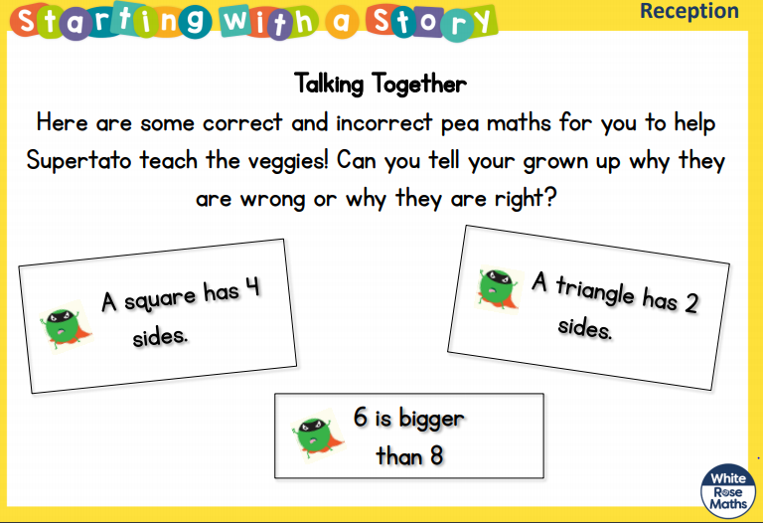
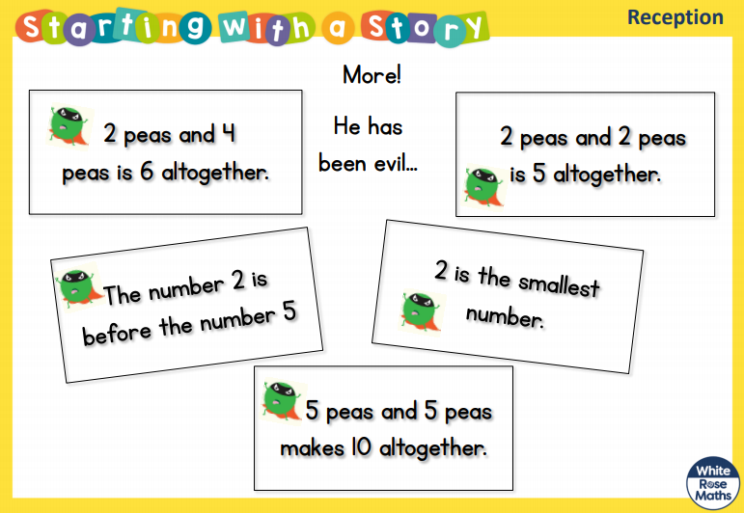
Tuesday 12th May 2020 Maths
Resources for today

Slide 15
Oak Class
Home Learning
Wonderful
Wednesday

Slide 16
Phonics – Reading
Wednesday 13th May 2020
Practice set 1 sound ‘th’ today
Ruth Miskin Training https://www.youtube.com/channel/UCo7fbLgY2oA_cFCIg9GdxtQ
If you can, work through ‘Word time’ and ‘Spelling’ too.
Remember to do some reading today. https://www.oxfordowl.co.uk
Please always ensure that your child is supervised whilst on the internet.

Slide 17
Wednesday 13th May 2020 English
Today we are learning to write words
Today I would like you to write a list of superhero powers.
First make a superhero using some old vegetables which you can’t eat.
Or you could use natural objects or draw a picture.
It could be Supertato or your own superhero.
Talk about your superhero or other superheroes you have seen in books or in films.
What super powers do they have?
Give your superhero a name.
Write a list of special powers your superhero has.
You know you have done a good job if you have written at least 3 things in your list.
Don’t forget to use your phonics

Slide 18
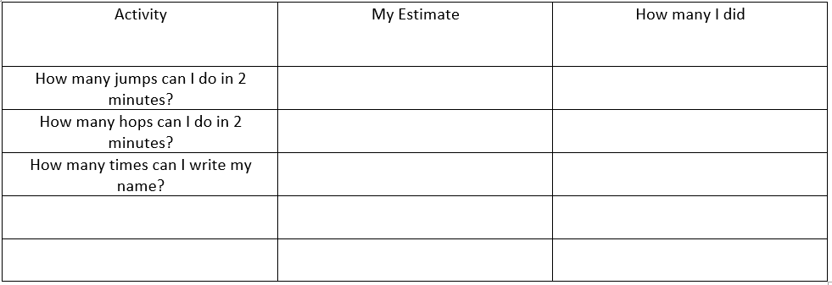
Wednesday 13th May 2020 Maths
Today we are learning to use language related to time and measure short periods of time.
Today you will think about how long 2 minutes is.
Ask your grown up to set a timer for 2 minutes on their phone, use the second hand on a watch, or an online timer.
First sit quietly and wait for the 2 minutes to finish. How long did it feel?
I have given you 3 challenges to try for 2 minutes.
Copy the table and challenges shown below. You can add your own challenge too.
Estimate (guess) how many jumps or hops you will do in 2 minutes and write down your estimate.
Then do your challenge and count how many you do.
Now write the answer (your grown up can help you). How close was your guess?
You know you have done a good job if you have said some of these words: minutes, time, clock. long time, quickly

Slide 19

Oak Class
Home Learning
Thankful
Thursday

Slide 20
Phonics – Reading
Thursday 14th May 2020
Practice set 1 sound ‘ch’ today
Ruth Miskin Training https://www.youtube.com/channel/UCo7fbLgY2oA_cFCIg9GdxtQ
If you can, work through ‘Word time’ and ‘Spelling’ too.
Remember to do some reading today. https://www.oxfordowl.co.uk
Please always ensure that your child is supervised whilst on the internet.

Slide 21
Thursday 14th May 2020 English
Today we are learning to talk about events in a story.
On Tuesday you listened to the story of Supertato.
Can you remember what happened in the story?
Who were the main characters?
How did the story start?
What did the Evil Pea do? (The problem which needed to be solved.)
What did Supertato do at the end of the story?
Please draw 3 pictures to show these different parts of the story. This is called a story map.
You can draw more pictures to help you retell more of the story if you like.
Can you tell someone your story using your story map?
Please copy and finish the sentence
He set a .
He was .
You know you have done a good job if you have told someone the story of Supertato.
Don’t forget to use your phonics

Slide 22
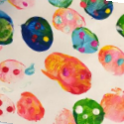

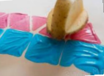
Thursday 14th May 2020 Maths
Today we are learning to create and describe a pattern.
Today your task is to create a repeating pattern. This is called an AB pattern
It could be by colour size shape
Can you describe what a repeating pattern is?
Make your own pattern.
Use half an old potato to print a pattern.
Please ask a grown up to help you cut the potato.
Can you describe how to cut the potato again to create a different shape to use as well?
Tell your grown up about your pattern.
You could try to fit your shapes together in a different way to make a different pattern.
You know you have done a good job if you have created and described your pattern.
If you don’t have paint, you could use mud to print.
If you don’t have a potato, you could find some leaves or sticks to use, next time you go for a walk with your family. Then arrange the natural objects to make an AB pattern.

Slide 23
Oak Class
Home Learning
Fantastic
Friday

Slide 24
Phonics – Reading
Friday 15th May 2020
Practice set 1 sound ‘qu’ today
Ruth Miskin Training https://www.youtube.com/channel/UCo7fbLgY2oA_cFCIg9GdxtQ
If you can, work through ‘Word time’ and ‘Spelling’ too.
Remember to do some reading today. https://www.oxfordowl.co.uk
Please always ensure that your child is supervised whilst on the internet.

Slide 25

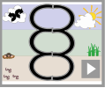
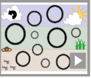
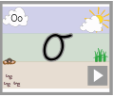
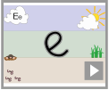
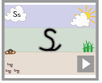
Friday 15th May 2020 English
Today we are learning to write slowly to form our letters clearly
https://www.teachhandwriting.co.uk/pre-handwriting-patterns.html
Please practise these writing patterns today.
Now practise these letters.
Try to write slowly. Please write just three letters and then check back with the video, to make sure that you are forming your letters correctly.
https://www.teachhandwriting.co.uk/cursive-letters-beginners-choice-2.html
Remember all of these letters belong to the same family

Slide 26

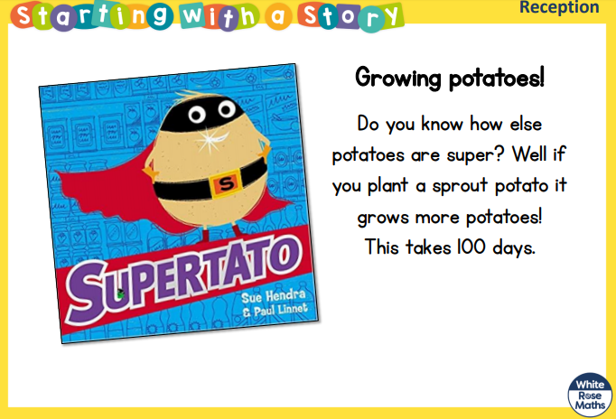
Friday 15th May 2020 Maths
Today we are learning to recognise numbers up to 20.
Today your task is to look at a numeral and say which number it is.
Can you grow shoots on a carrot top? Put a carrot top in a saucer of water and see what happens over time.
Print the number square on the next page. Or draw your own number square, up to 30 should be enough.
Colour in a number every day to see how many days it takes for your carrot to grow shoots.
Adults please encourage your child to tell you the number they are colouring.
Which number is 1 more? This is the number you will need to colour tomorrow.
You know you have done a good job if you can look at the numeral and tell your grown up which number it is.
You could use the number square to play a game.
Call out a number below 20
Can your child find you the number and colour it in?
Continue until all numbers 1 to 20 are coloured in.

Slide 27
