Slide 1


Year 4 Home Learning
Week commencing 11th May
Chestnut.class@fernhill.kite.academy
Click on the speaker

Slide 2

How it works:
Please complete one English and one Maths task each day. (Approximately 30 minutes on each)
The topic for this week will be ‘Flight’. Remember some of the activities may take more than a day to complete.

Slide 3

Overview of Maths
White Rose Maths
Year 4 – Click on Week 1 summer (please ignore the link with this week’s date) to review: Decimals
https://whiterosemaths.com/homelearning/year-4/
For each lesson – Watch the video clip and then complete the activity.
You could print the activity out or you could write down the answers in your book. (After your child has completed the activity you can ‘get the answers’ to check that they have understood)
Monday - Week 1 Summer - Lesson 1 – Make a Whole
Tuesday – Lesson 2 – Write Decimals
Wednesday – Lesson 3 – Compare Decimals
Thursday – Lesson 4 – Ordering Decimals
Friday – Lesson 5 – Maths Challenge
Number Fluency: Throughout the week you may wish to do the following:
Times Table Rock Stars

Slide 4
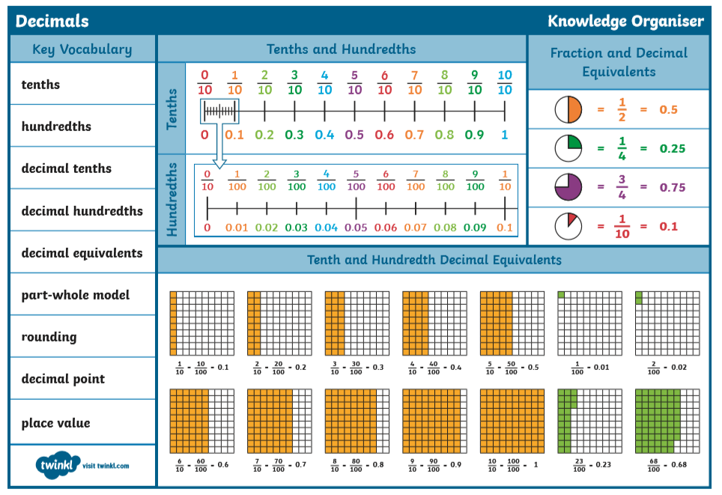
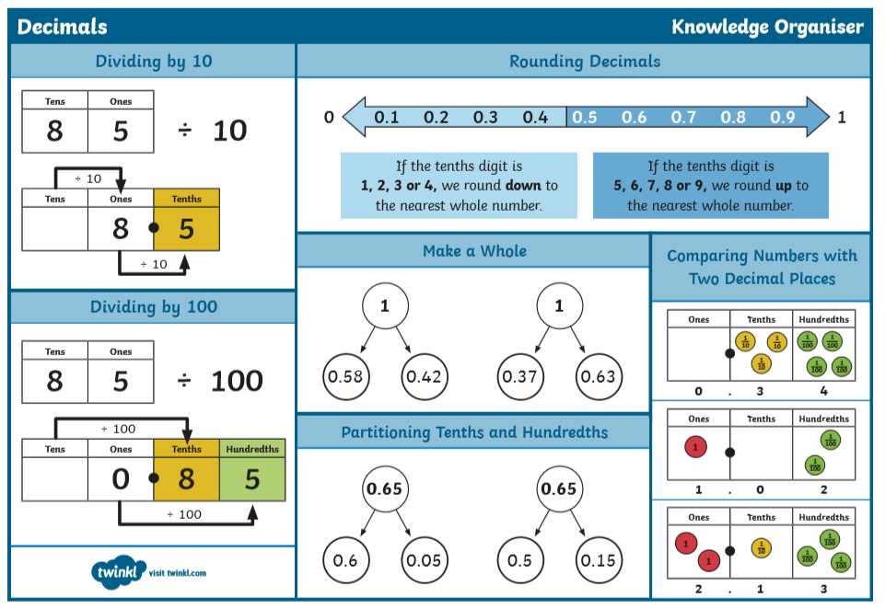
Maths support sheets

Slide 5
Overview of English
Grammar activities:
(Please ignore the date on these activities)
Monday: Using setting descriptions. https://www.bbc.co.uk/bitesize/articles/z4brcqt
Tuesday: Using an ellipses. https://www.bbc.co.uk/bitesize/articles/z73sf4j
Writing opportunity:
A Mysterious Shadow
https://www.pobble365.com/a-mysterious-shadow/
Wednesday: A Mysterious Shadow:
Question Time and Sick Sentences
Thursday: A Mysterious Shadow:
Sentence Challenge. Plan your story based on the picture using your success criteria
Friday: A Mysterious Shadow:
Finish writing your story and edit your work.
There are spelling activities throughout the week.

Slide 6
Overview of Topic
This week you will be focusing on Flights.
There are lots of fun art and Science activities to do.
See the ‘topic sheet’ for details
(This will be sent to you via Marvellous Me or can be found on the school website.
ENJOY and don’t forget to send me examples of your work

Slide 7
Spelling and Reading
Spelling: Complete one of the Statutory Spelling Word activity mats each day.
(You could just copy from the screen)
Reading:
Continue reading your book and your reading journal. Read another chapter and pick from the following activities:
• Write down any unfamiliar vocabulary and find out what they mean. Can you use these words in a sentence?
• Write a diary entry as if you are one of the characters. How would you describe what has happened to you? How do you feel? Do you have any questions you would like answered?
• Pick an object, person or place from this chapter and draw what you think it should look like. Add labels with quotes from the text.

Slide 8


Handwriting
It’s important to keep practising your handwriting… it’s a muscle like any other and needs to be exercised!
This week we will focus on the letter formation:
Watch the video then practice one line of this https://www.teachhandwriting.co.uk/cursive-joins-choice-2.html
Then practice your cursive (joined up) handwriting by copying out the poem. https://www.poetry4kids.com/poems/good-morning-dear-students/
Good Morning, Dear Students
From the book When the Teacher Isn't Looking
“Good morning, dear students,” the principal said.
“Please put down your pencils and go back to bed.
Today we will spend the day playing outside,
then take the whole school on a carnival ride.
“We’ll learn to eat candy while watching TV,
then listen to records and swing from a tree.
We’ll also be learning to draw on the walls,
to scream in the classrooms and run in the halls.
“So bring in your skateboard, your scooter, your bike.
It’s time to be different and do what you like.
The teachers are going to give you a rest.
You don’t have to study. There won’t be a test.
“And if you’d prefer for a bit of a change,
feel free to go wild and act really strange.
Go put on a clown suit and dye your hair green,
and copy your face on the Xerox machine.
“Tomorrow it’s back to the regular grind.
Today, just go crazy. We really don’t mind.
So tear up your homework. We’ll give you an A.
Oh wait. I’m just kidding. It’s April Fools’ Day.”
— Kenn Nesbitt

Slide 9
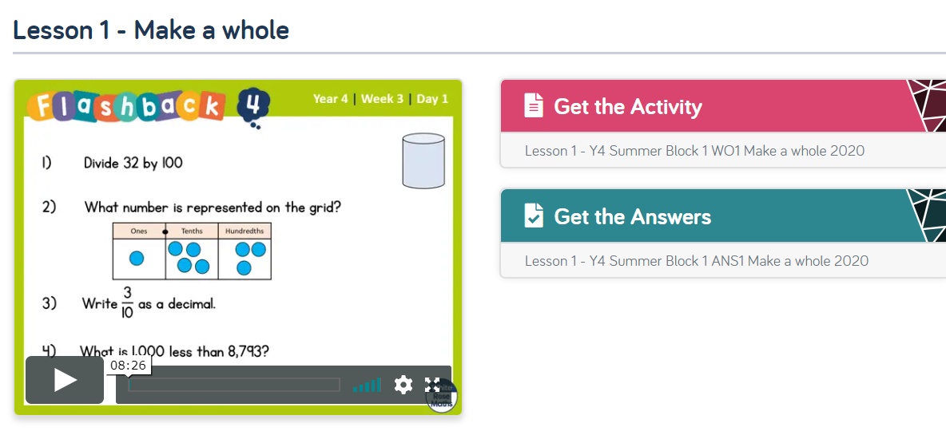
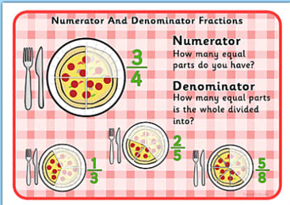
Monday
White Rose Maths Home Learning Year 4 – Click on Week 1 (please ignore the link with this week’s date) to review: Decimals and Fractions
https://whiterosemaths.com/homelearning/year-4/

Slide 10
Monday
https://www.bbc.co.uk/bitesize/articles/zv4j7nb
Learn how to use paragraphs
This lesson includes:
- videos
- three activities
Watch the video clips and then complete the 3 activities.

Slide 11
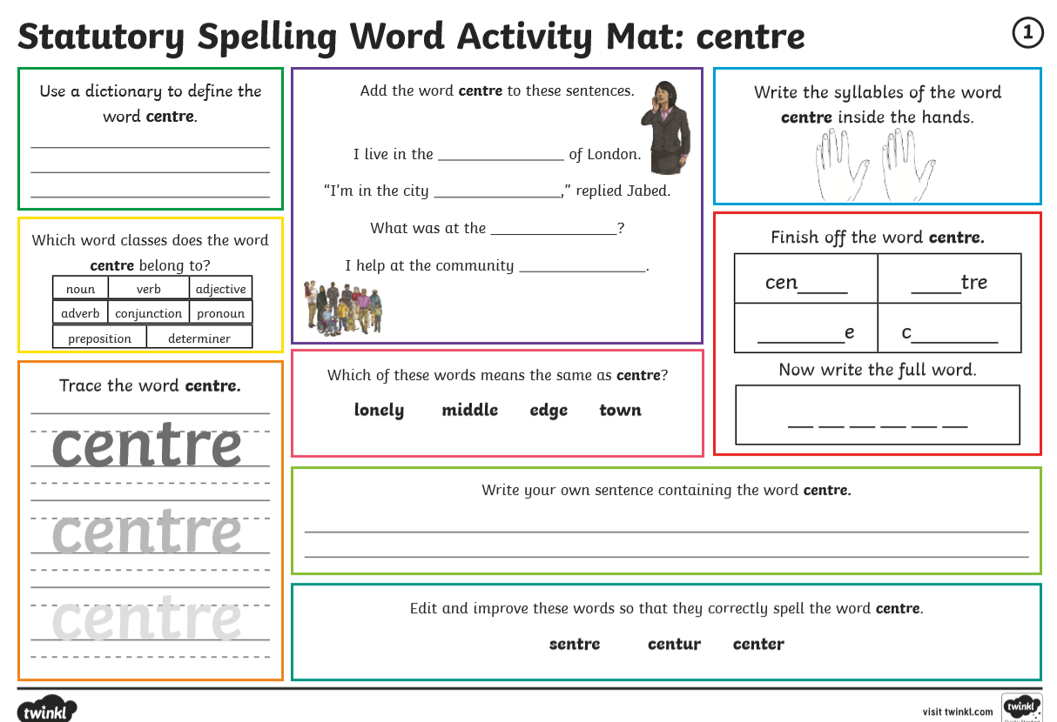
Monday

Slide 12
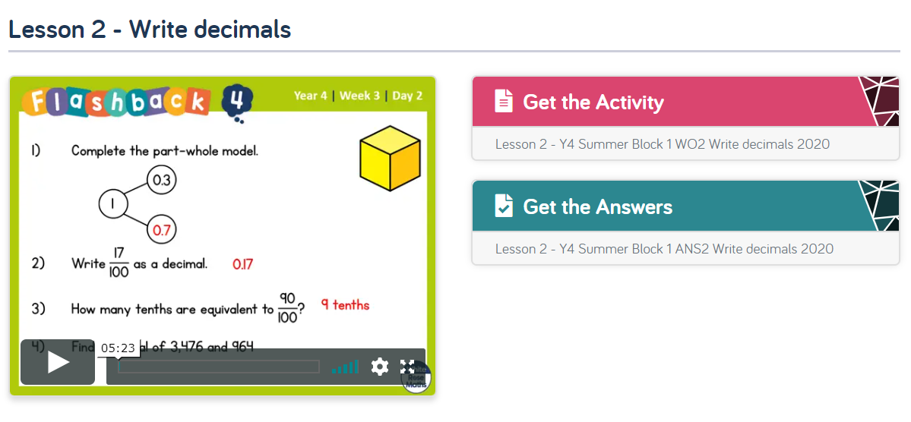
Tuesday
White Rose Maths Home Learning Year 4 – Click on Summer Week 1 (please ignore the link with this week’s date) to review: Decimals
https://whiterosemaths.com/homelearning/year-4/

Slide 13
Tuesday
Using Fronted Adverbials:
Watch the video clips and then complete the activities (you might not complete them all.)
https://www.bbc.co.uk/bitesize/articles/z7v4kmn

Slide 14
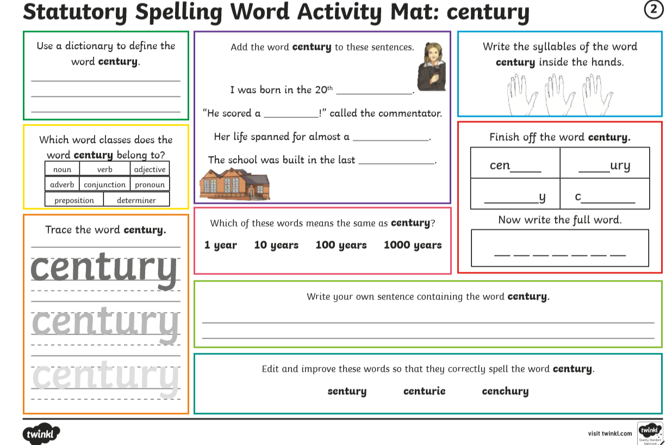
Tuesday

Slide 15
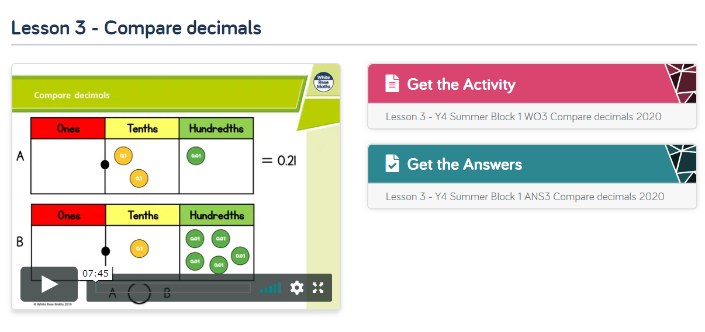
Wednesday
White Rose Maths Home Learning Year 4 – Click on Summer Week 1 (please ignore the link with this week’s date) to review: Decimals
https://whiterosemaths.com/homelearning/year-4/

Slide 16
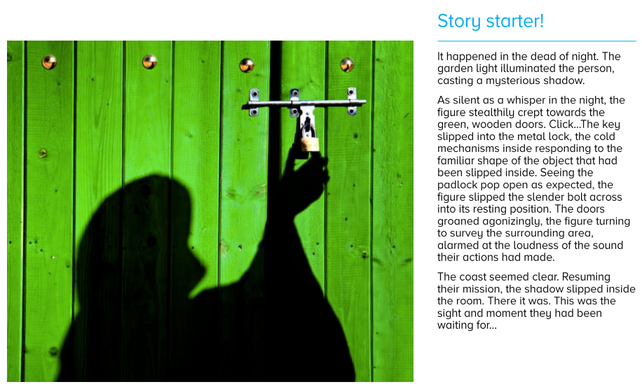
Wednesday
English: Introduction to writing stimulus
Answer the questions on the next slide.
Then improve the sentences on slide 21.

Slide 17
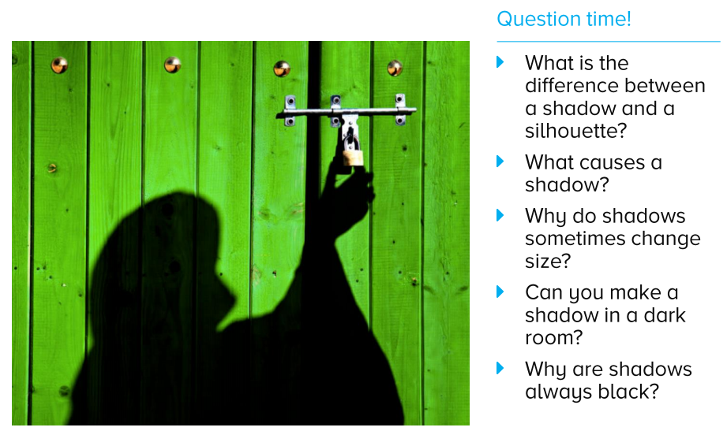

Slide 18
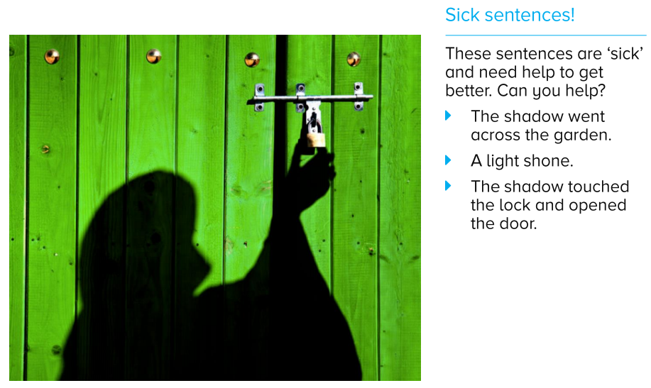
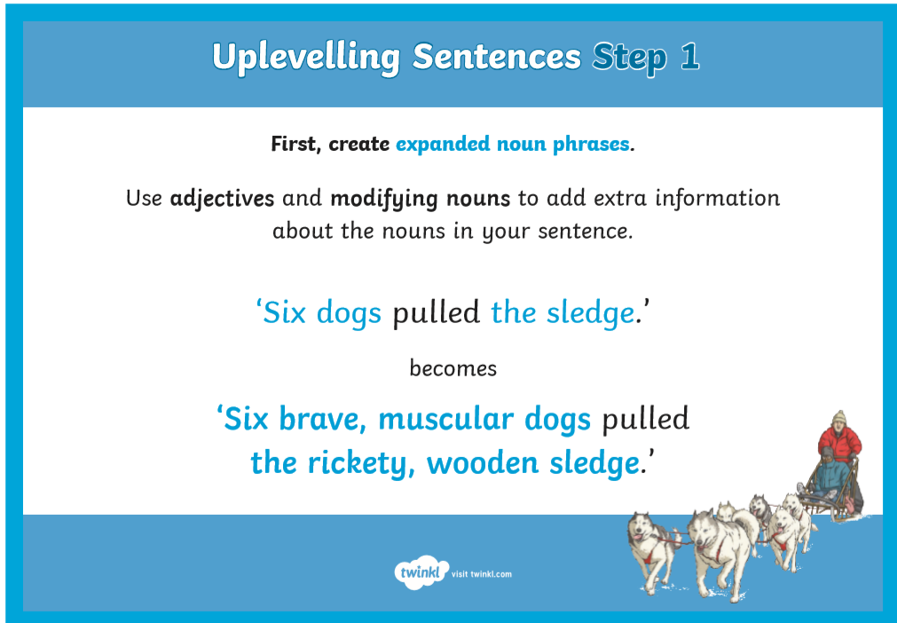
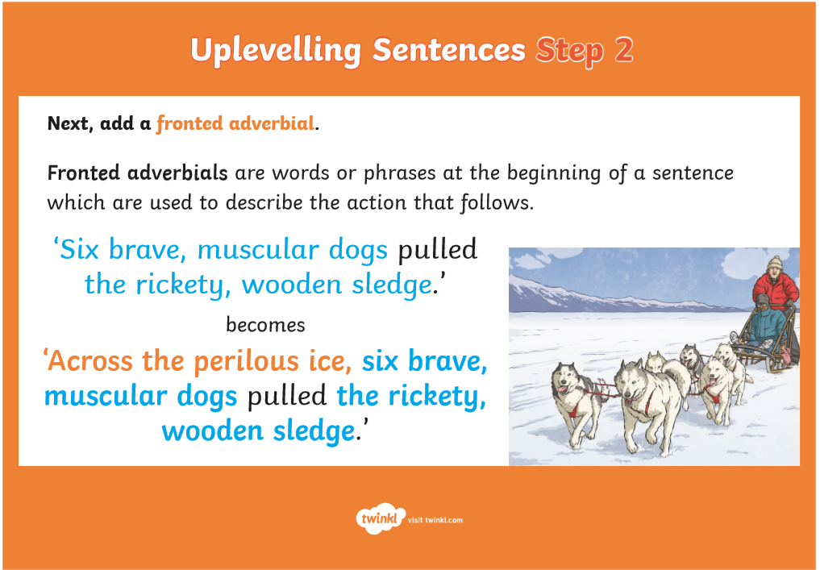
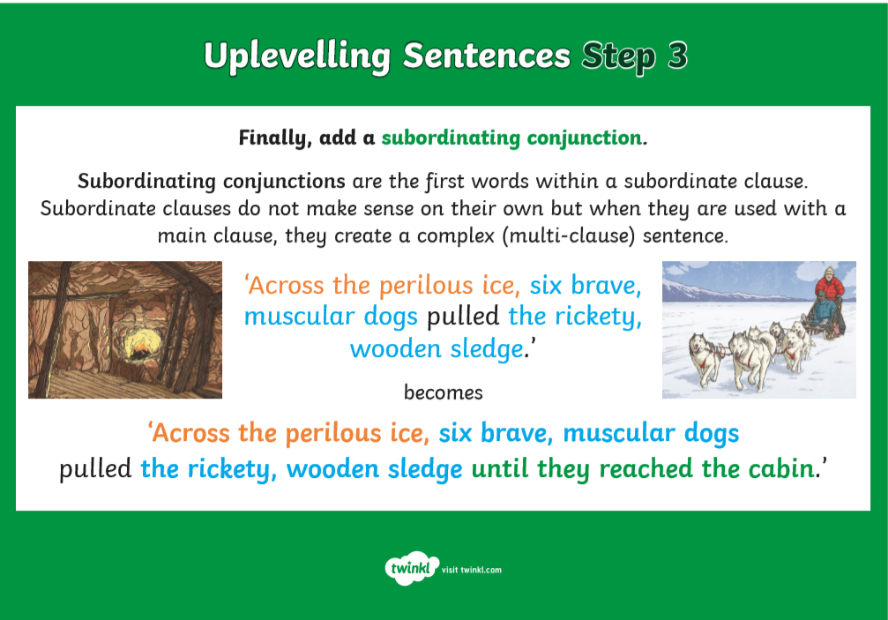

Slide 19
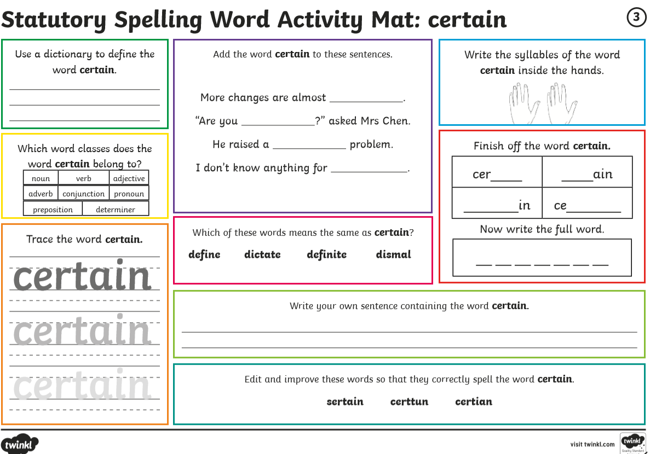
Wednesday

Slide 20
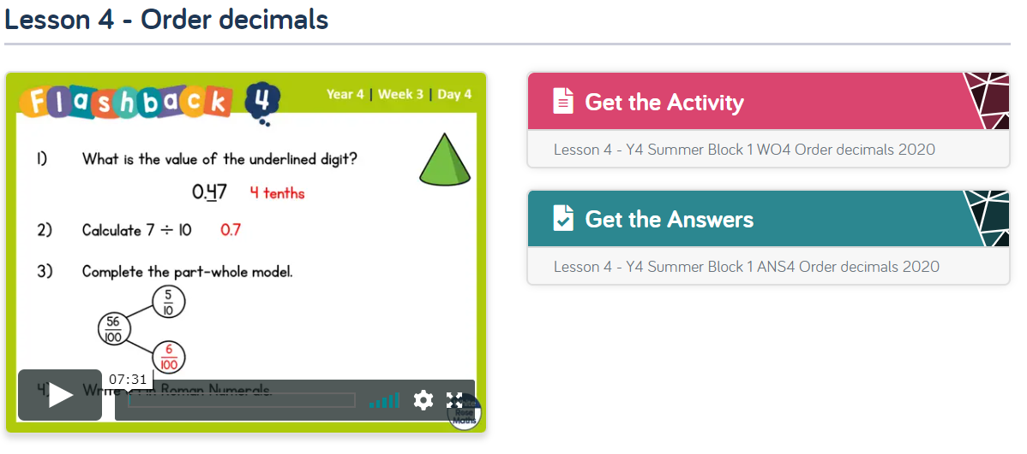
Thursday
White Rose Maths Home Learning Year 4 – Click on Summer Week 1 (please ignore the link with this week’s date) to review: Decimals
https://whiterosemaths.com/homelearning/year-4/

Slide 21
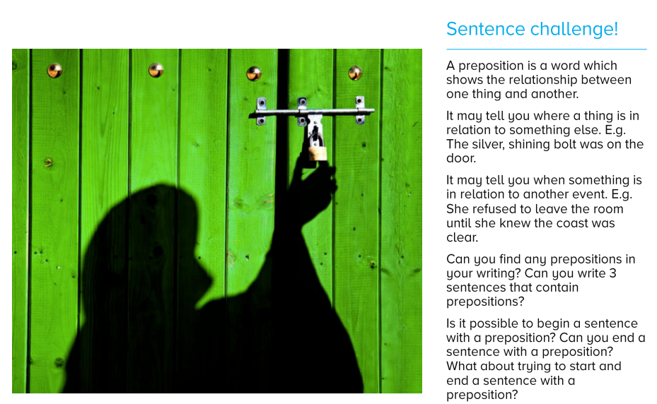
Thursday

Slide 22

Plan
Opening: Describe the setting – describe the inside of the shed Clouds, Light (moon), Wind What does the item look like? (you could put 2 things together) 5 senses (see, hear, taste, smell, touch) Similes, metaphors, personification
Build up: Introduce the item more... What does it do? Introduce the item – what does it do? What sounds does it make? Show Don’t Tell how the person feels – 5 senses (see, hear, taste, smell, touch) Do they want to take the mystery object/person with them? What is there mission?
Problem: How has it started to go wrong? Did someone follow them? Has the door slammed shut? How is the mission going wrong? Are they trapped? Are they being chased? How does your character feel?
Resolution: How is the problem resolved?
Ending: Do they live ‘happily ever after?’ Are they stuck forever? Was the mission a success?
English: Plan your story

Slide 23
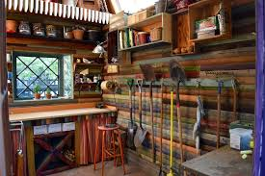
English: Write the opening of your story
Plan
Opening: Describe the setting – describe the inside of the shed Clouds Light (moon) Wind What does the item look like? (you could put 2 things together) 5 senses (see, hear, taste, smell, touch) Similes, metaphors, personification
Success Criteria
I can use descriptive language (5 senses, personification, similes and metaphors)
I can use a range of sentences (simple, co-ordinating and subordinating conjunctions, fronted adverbials)
I can use a range of punctuation (! ? ‘ , “” … () - : ;)

Slide 25
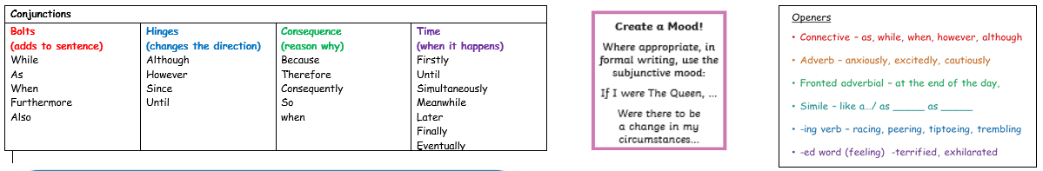
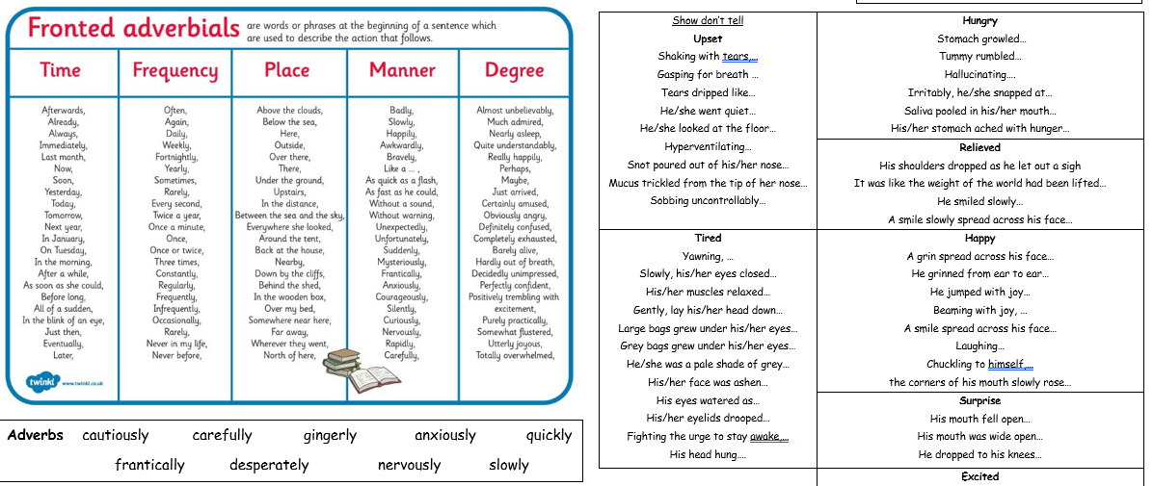

Slide 26
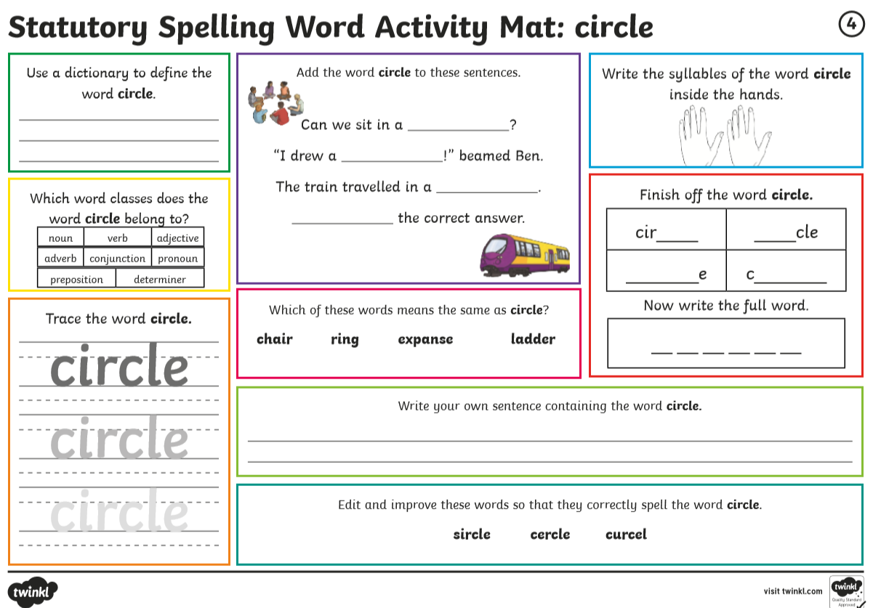
Thursday

Slide 27
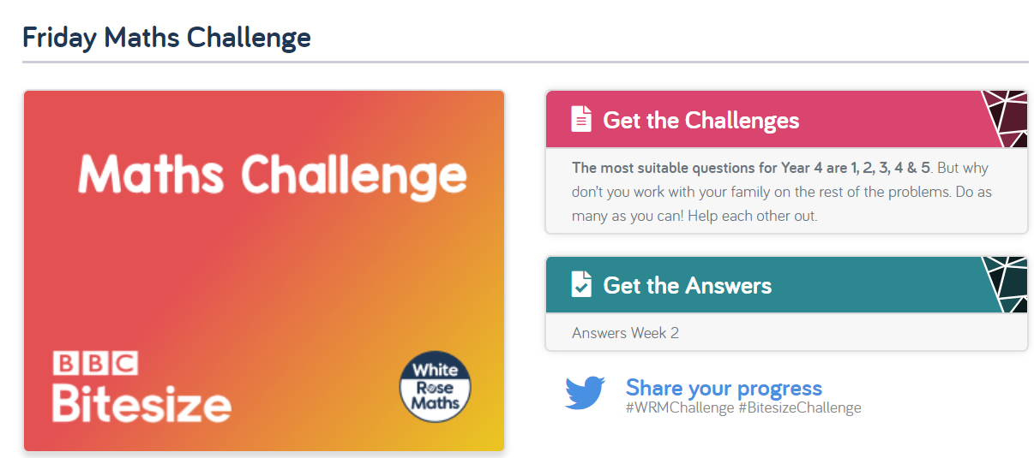
Friday
White Rose Maths Home Learning Year 4 – Click on Summer Week 1 (please ignore the link with this week’s date) to review: Decimals
https://whiterosemaths.com/homelearning/year-4/

Slide 28
Plan
Opening: Describe the setting – describe the inside of the shed Clouds, Light (moon), Wind What does the item look like? (you could put 2 things together) 5 senses (see, hear, taste, smell, touch) Similes, metaphors, personification
Build up: Introduce the item more... What does it do? Introduce the item – what does it do? What sounds does it make? Show Don’t Tell how the person feels – 5 senses (see, hear, taste, smell, touch) Do they want to take the mystery object/person with them? What is there mission?
Problem: How has it started to go wrong? Did someone follow them? Has the door slammed shut? How is the mission going wrong? Are they trapped? Are they being chased? How does your character feel?
Resolution: How is the problem resolved?
Ending: Do they live ‘happily ever after?’ Are they stuck forever? Was the mission a success?
English: Review your plan

Slide 29

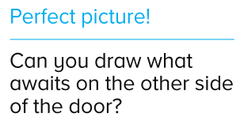
Plan
Build up: Introduce the item more... What does it do? Introduce the item – what does it do? What sounds does it make? Show Don’t Tell how the person feels – 5 senses (see, hear, taste, smell, touch) Do they want to take the mystery object/person with them? What is there mission?
English: Write your build up
You could put parts of an animal with an everyday electrical item to create the object inside the shed…
Success Criteria
I can use descriptive language (5 senses, personification, similes and metaphors)
I can use a range of sentences (simple, co-ordinating and subordinating conjunctions, fronted adverbials)
I can use a range of punctuation (! ? ‘ , “” … () - : ;)

Slide 30
Plan
Problem: How has it started to go wrong? Did someone follow them? Has the door slammed shut? How is the mission going wrong? Are they trapped? Are they being chased? How does your character feel?
Resolution: How is the problem resolved?
Ending: Do they live ‘happily ever after?’ Are they stuck forever? Was the mission a success?
English: Write the problem, resolution and ending
Success Criteria
I can use descriptive language (5 senses, personification, similes and metaphors)
I can use a range of sentences (simple, co-ordinating and subordinating conjunctions, fronted adverbials)
I can use a range of punctuation (! ? ‘ , “” … () - : ;)

Slide 31
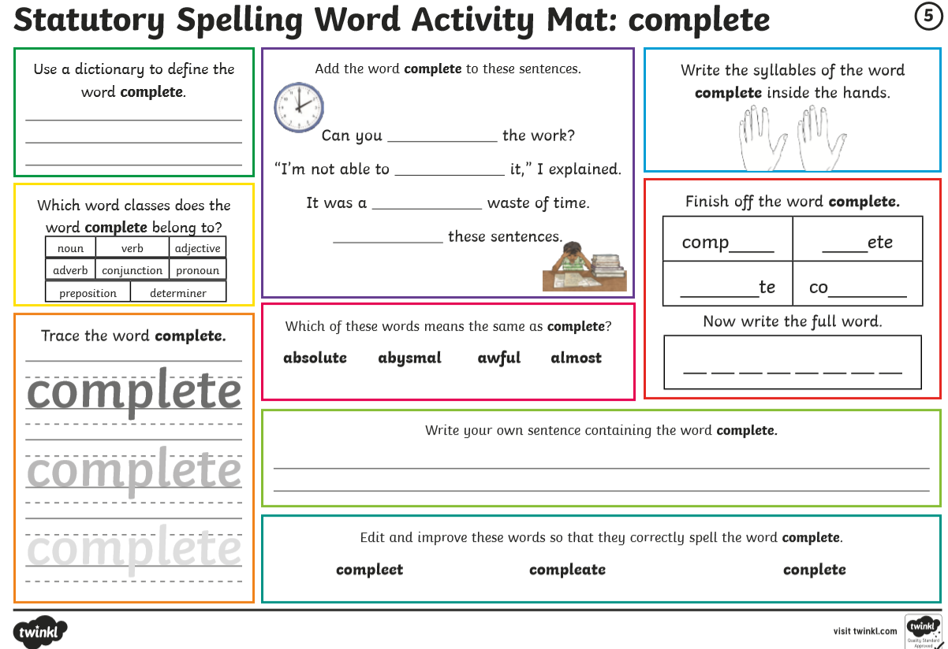
Friday

