Slide 1
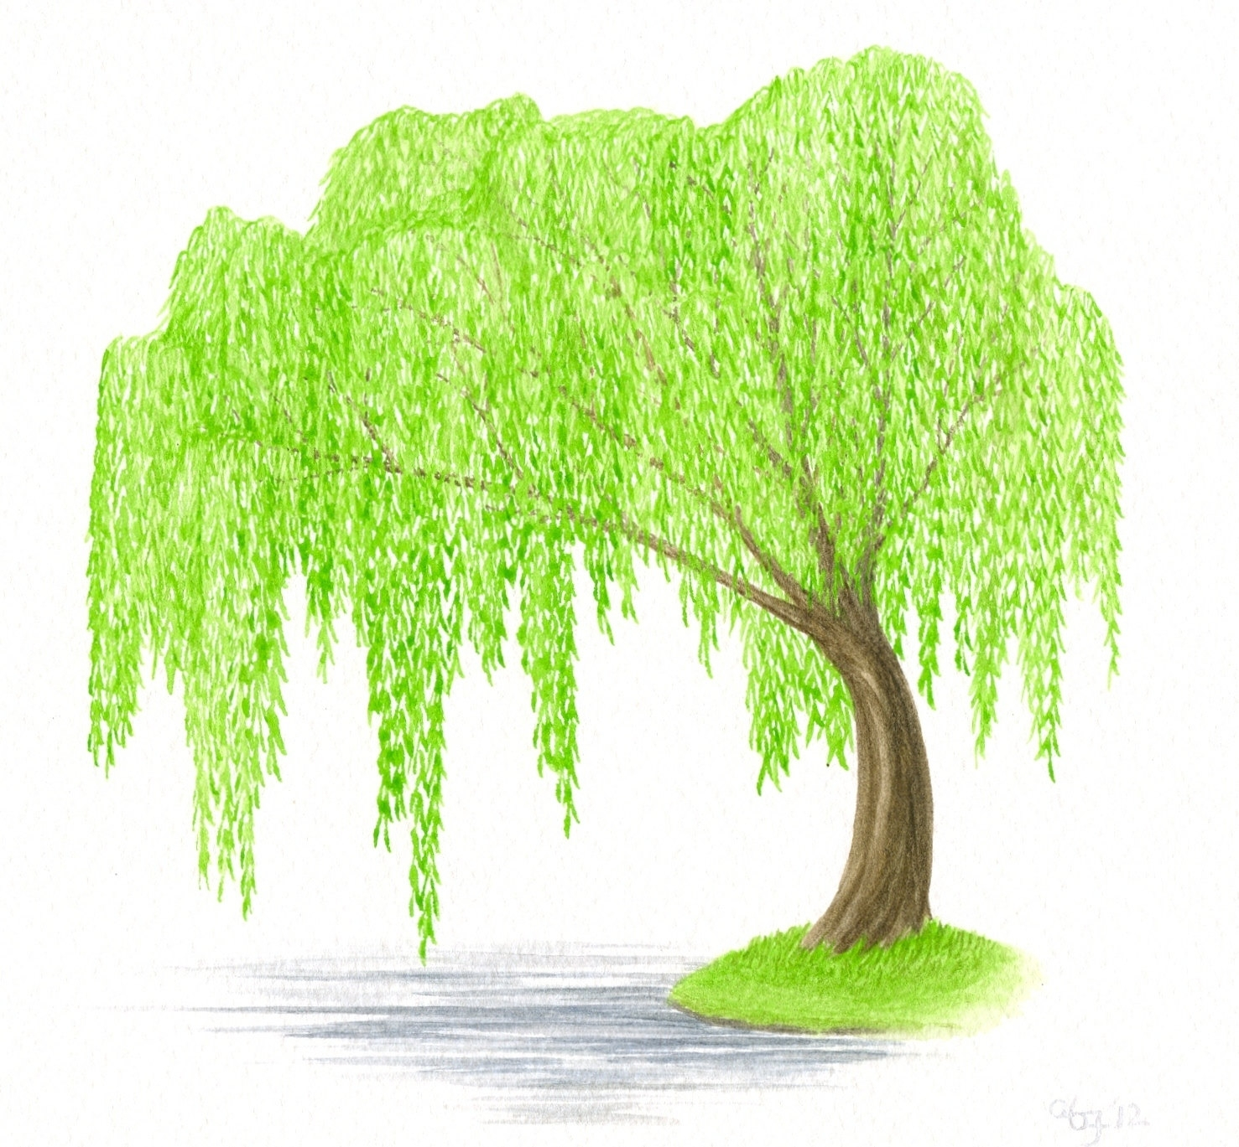
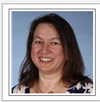

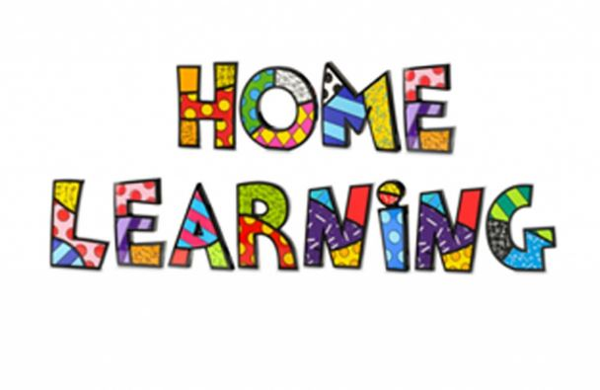
Willow Class
11th – 16th May 2020

Slide 2
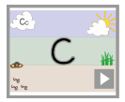
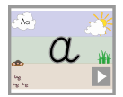
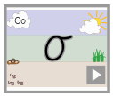
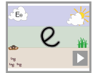
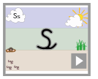
Daily handwriting. https://www.teachhandwriting.co.uk/cursive-letters-beginners-choice-2.html
This week I would like you to start each writing session by practising your handwriting.
Remember to write just three letters and then check back with the video, to make sure that you are forming your letters correctly.
No more than half a line of each letter in a day!
Remember that all of the letters must rest on the line and you should try to make them exactly the same size as each other.
The link will shows videos of how each letter is drawn. There are also some worksheets that you can print off, or simply practise them in your books.

Slide 3
Spelling
Year 2.
Please learn to spell these words.
can’t
didn’t
hasn’t
couldn’t
wouldn’t
shouldn’t
it’s
wasn’t
This week we are going to have another look at words that contain contractions.
Remember that all the words here show a missing letter
We use the contracted forms of words, when we want our writing to sound more informal.
I might use these sorts of words in a diary, but I would not use them in a letter to the Queen.

Slide 4
Monday 11th May
Writing activities.

Slide 5

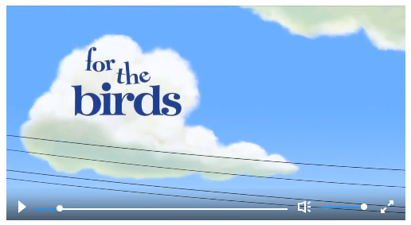
This week’s writing activities
Over the next two weeks I am going to challenge you to write a class story.
We are going to base it on another short film called for the birds.
Every day I would like you to work on a small part of the story (or plot point)
At the end of the day I would like you to email me your work and I will choose my favourite section to add to the story. (If I have enough work sent through I will create a year 1 story and a year 2 story)
After we have completed all of the plot points – there will be nine in total – I will put the story together and send it to you all, so that we can illustrate it.
https://www.literacyshed.com/for-the-birds.html

Slide 6
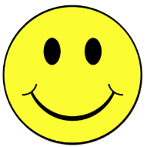
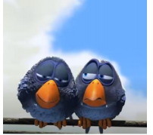
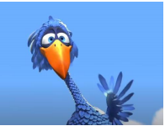
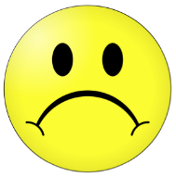
Our story this week is called ‘For the birds’.
Each day we are going to write a tiny part of the story.
?
Plot point 2
Who is that
0:43 – 0:58
?
Plot point 3
Hi
0:59 – 1:14
?
Plot point 4
Stay away
1:15 – 1:26
?
Plot point 5
Room for one more
1:27- 1:45
?
Plot point 1
Budge over
0:24 – 0:42
?
Plot point 6
?
Plot point 7
?
Plot point 8
?
Plot point 9
When we talk about the birds in the story we are going to use the name
Peck
We are also going to use the pronouns he and them.
https://www.literacyshed.com/for-the-birds.html

Slide 7
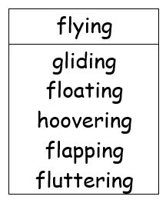

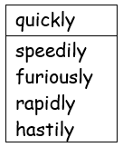
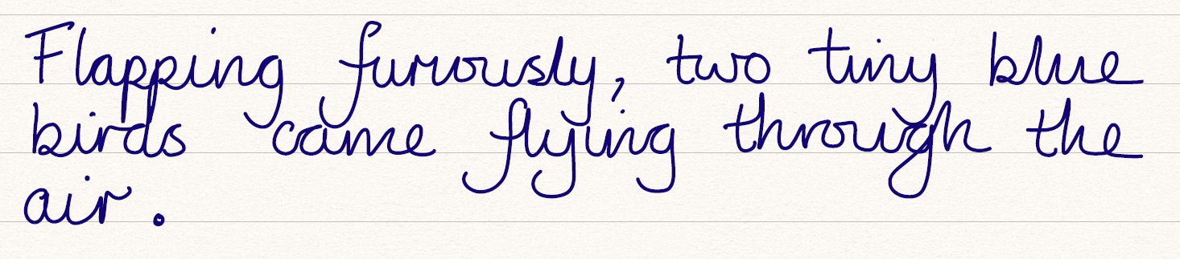
In my first sentences I want to describe the way that the birds are flying.
Now write your sentence. Make sure you check you have a capital letter and a full stop.

Slide 8

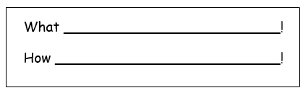
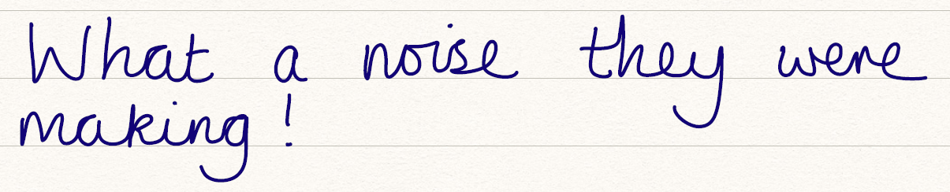
My next sentence is going to be an exclamatory sentence.
Now write your sentence. Make sure you check you have a capital letter and a full stop.

Slide 9
Monday 11th May
Mathematics

Slide 10
Mathematics
Useful Websites
https://whiterosemaths.com/homelearning/
https://www.bbc.co.uk/bitesize/dailylessons
https://ttrockstars.com/login
Remember to click play on the power point and make the screen larger.
You can go back and watch the power point video as many times as you need.
Don’t forget to mark your answers when you have finished. If you have one you could use a green marking pen. Or any other colour that you have not been writing in.
Please note we are working 1 week behind.
We are working on Summer term week 3 w/c 4th May on the website

Slide 11
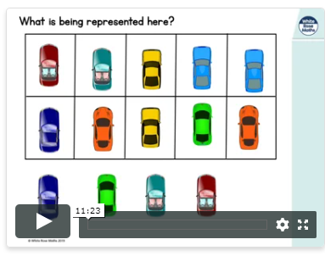
https://whiterosemaths.com/homelearning/year-2/
Year 2
Summer Term
Week 3
Lesson 1 – Fact families addition and subtraction bonds to 20.

Slide 12
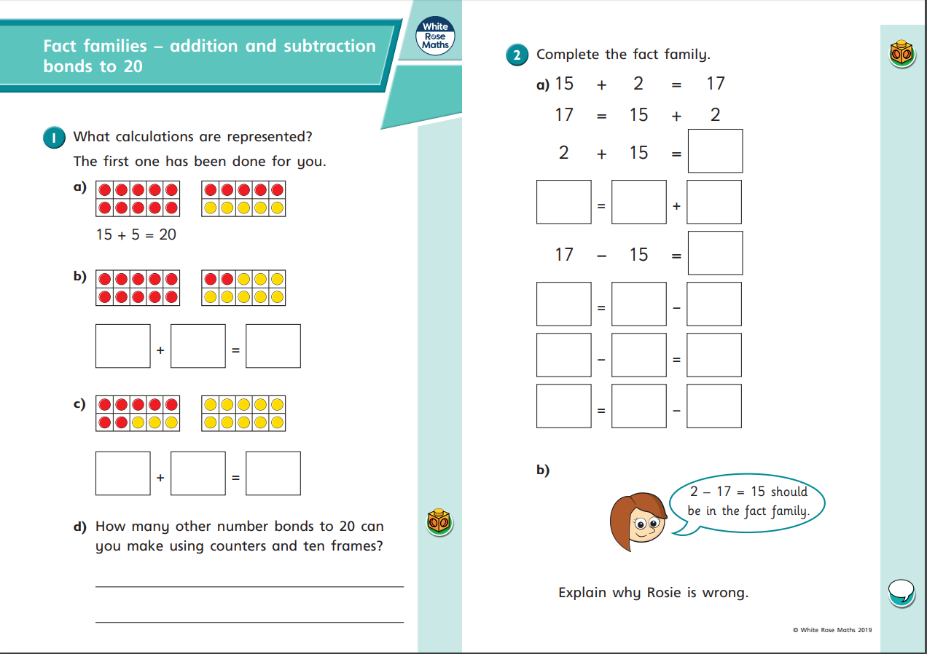

Slide 13
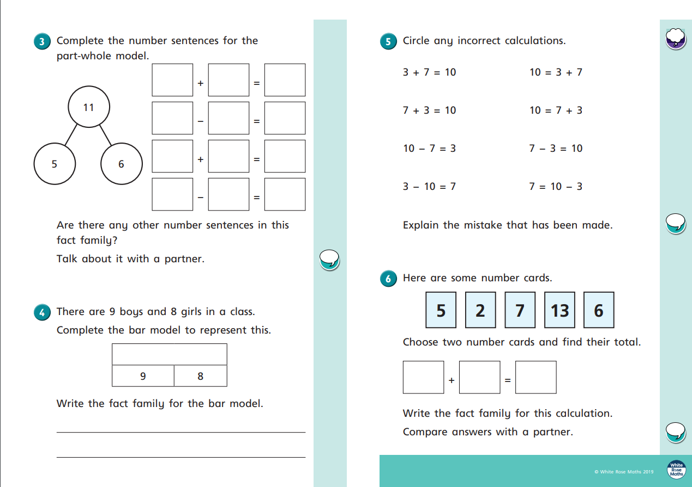

Slide 14
Tuesday 12th May
Writing activities.

Slide 15
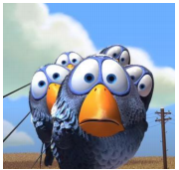
Our story this week is called ‘For the birds’.
Each day we are going to write a tiny part of the story.
?
Plot point 2
Who is that
0:43 – 0:58
?
Plot point 3
Hi
0:59 – 1:14
?
Plot point 4
Stay away
1:15 – 1:26
?
Plot point 5
Room for one more
1:27- 1:45
?
Plot point 1
Budge over
0:24 – 0:42
?
Plot point 6
?
Plot point 7
?
Plot point 8
?
Plot point 9
When we talk about the birds in the story we are going to use the name
Peck
We are also going to use the pronouns he and them.
https://www.literacyshed.com/for-the-birds.html

Slide 16
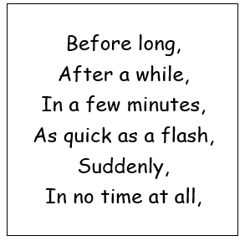
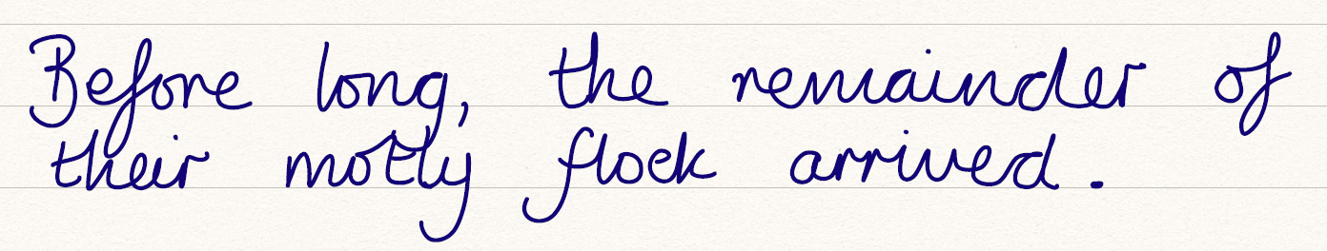
In this sentences I want to tell the reader when the rest of the birds arrived.
Now write your sentence. Make sure you check you have a capital letter and a full stop.

Slide 17

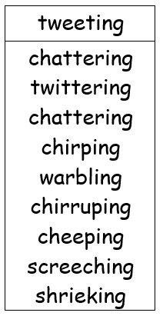
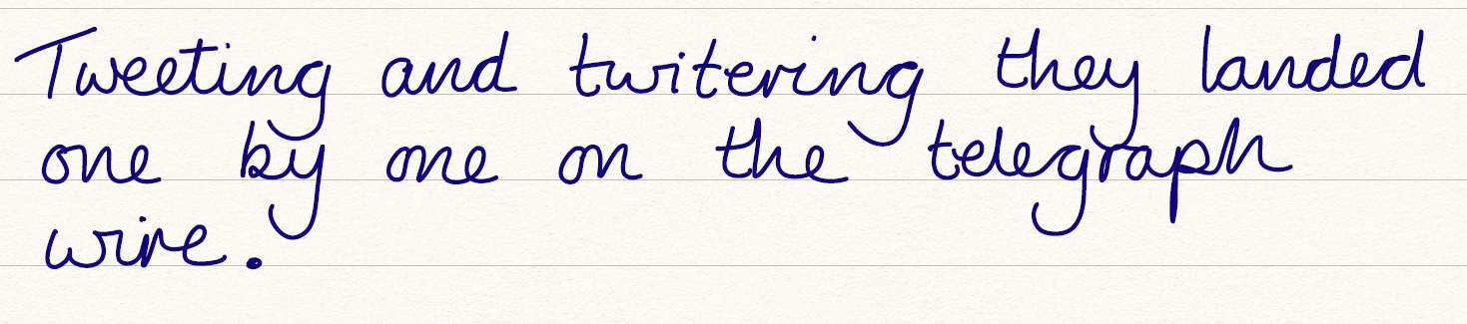
My next sentences is going to tell the reader about the sounds that the tiny blue birds were making.
Now write your sentence. Make sure you check you have a capital letter and a full stop.

Slide 18
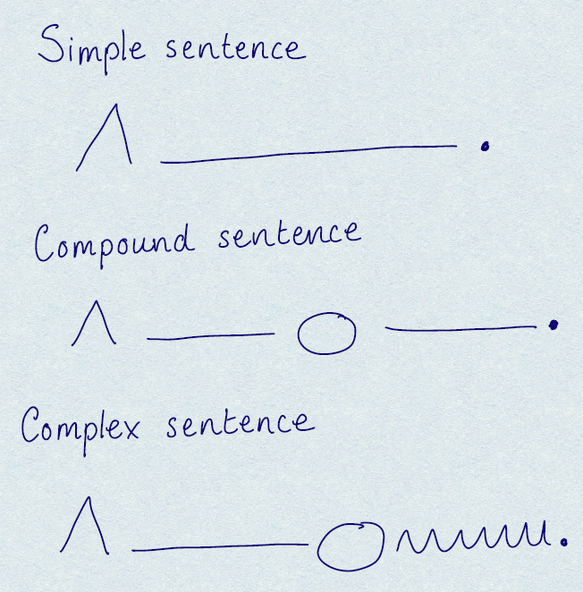

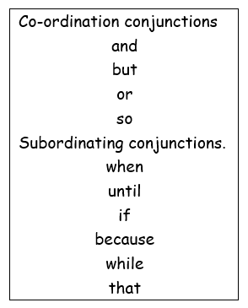
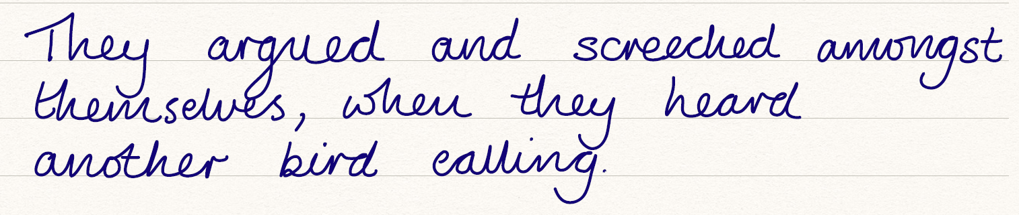
I want to try and use a conjunction in the next sentence.
Now write your sentence. Make sure you check you have a capital letter and a full stop.

Slide 19
Tuesday 12th May
Mathematics

Slide 20
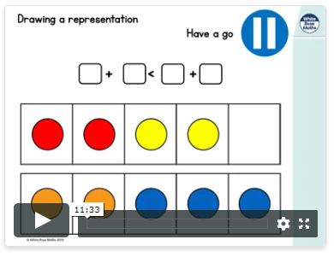
https://whiterosemaths.com/homelearning/year-2/
Year 2
Summer Term
Week 3
Lesson 2 – Compare number sentences.

Slide 21
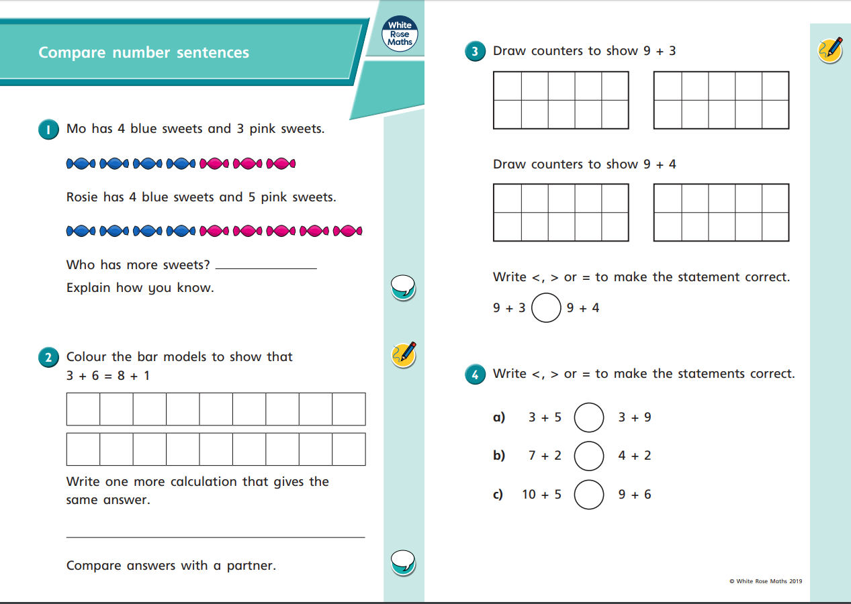

Slide 22
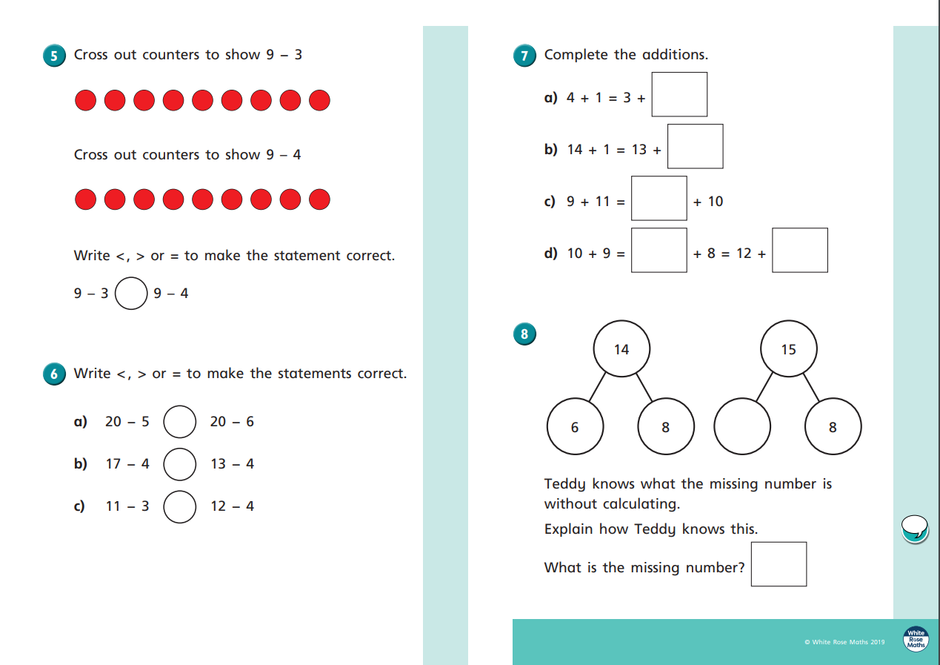

Slide 23
Wednesday 13th May
Writing activities.

Slide 24
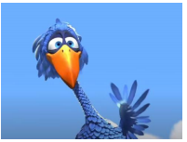
Our story this week is called ‘For the birds’.
Each day we are going to write a tiny part of the story.
?
Plot point 2
Who is that
0:43 – 0:58
?
Plot point 3
Hi
0:59 – 1:14
?
Plot point 4
Stay away
1:15 – 1:26
?
Plot point 5
Room for one more
1:27- 1:45
?
Plot point 1
Budge over
0:24 – 0:42
?
Plot point 6
?
Plot point 7
?
Plot point 8
?
Plot point 9
When we talk about the birds in the story we are going to use the name
Peck
We are also going to use the pronouns he and them.
https://www.literacyshed.com/for-the-birds.html

Slide 25
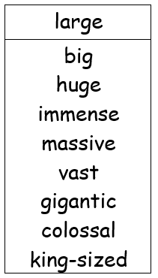

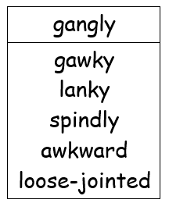
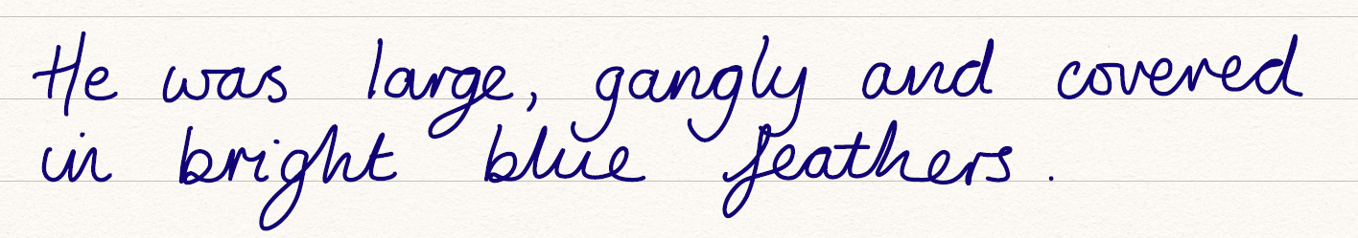
I want to describe Peck in this sentences. I am going to try and use a list sentences to do this.
Remember to think of some amazing words to describe him.
Now write your sentence. Make sure you check you have a capital letter and a full stop.

Slide 26
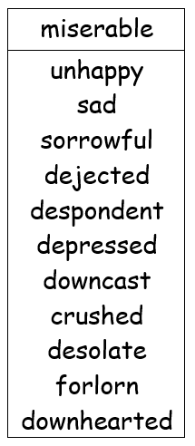

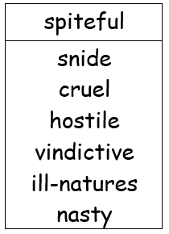
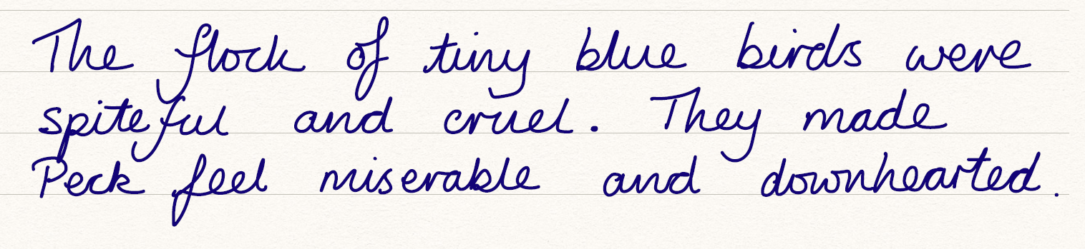
I want this sentence to be full of feeling. I am going to use some words that are quiet negative, because I want to let the reader know how the birds are making Peck feel.
Now write your sentence. Make sure you check you have a capital letter and a full stop.

Slide 27

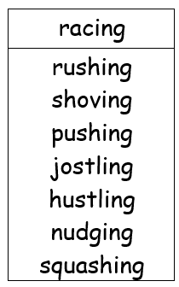
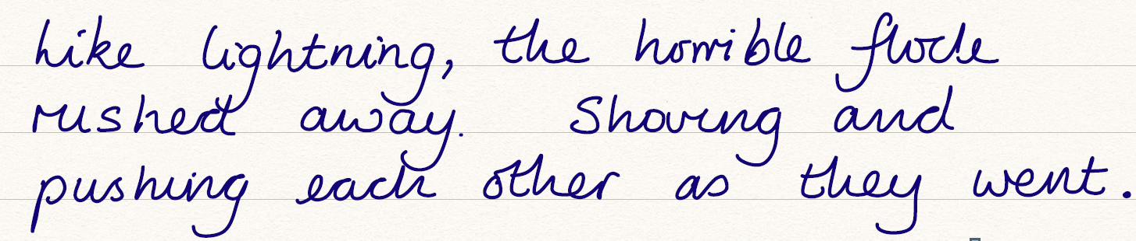
I would like this sentence to be full of action to describe how the birds quickly move away from Peck.
Now write your sentence. Make sure you check you have a capital letter and a full stop.

Slide 28
Wednesday 13th May
Mathematics

Slide 29
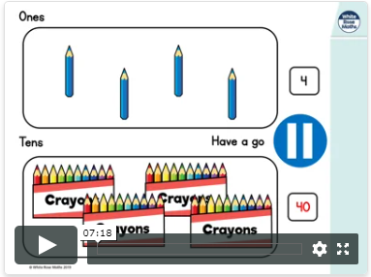
https://whiterosemaths.com/homelearning/year-2/
Year 2
Summer Term
Week 3
Lesson 3 – Related facts.

Slide 30
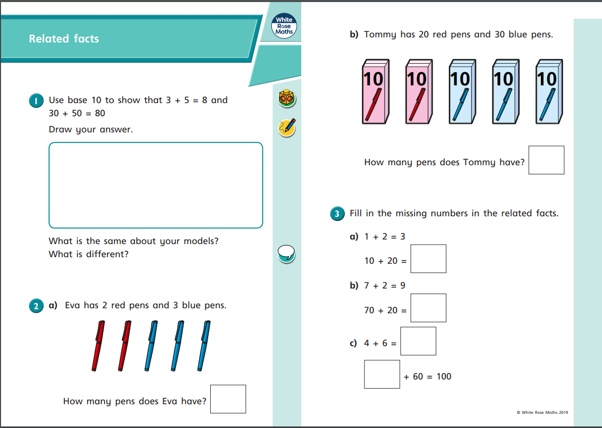

Slide 31
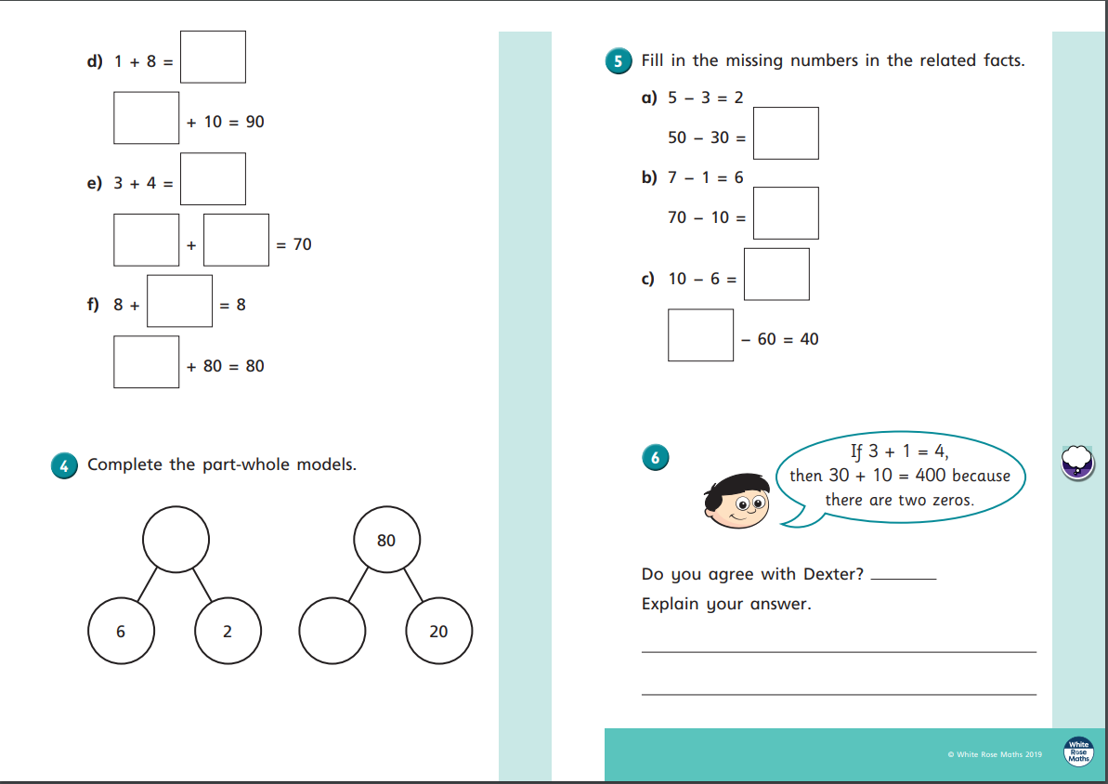

Slide 32
Thursday 14th May
Writing activities.

Slide 33
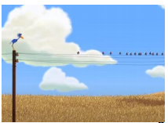
Our story this week is called ‘For the birds’.
Each day we are going to write a tiny part of the story.
?
Plot point 2
Who is that
0:43 – 0:58
?
Plot point 3
Hi
0:59 – 1:14
?
Plot point 4
Stay away
1:15 – 1:26
?
Plot point 5
Room for one more
1:27- 1:45
?
Plot point 1
Budge over
0:24 – 0:42
?
Plot point 6
?
Plot point 7
?
Plot point 8
?
Plot point 9
When we talk about the birds in the story we are going to use the name
Peck
We are also going to use the pronouns he and them.
https://www.literacyshed.com/for-the-birds.html

Slide 34
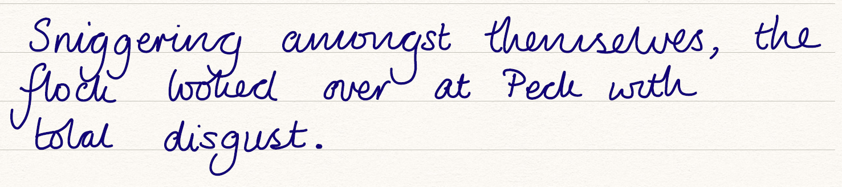
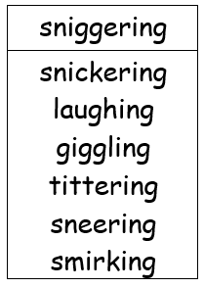
Again this is going to be a negative sentences. The birds are being quit horrible to Peck, so I want to choose words to show that.
Now write your sentence. Make sure you check you have a capital letter and a full stop.

Slide 35

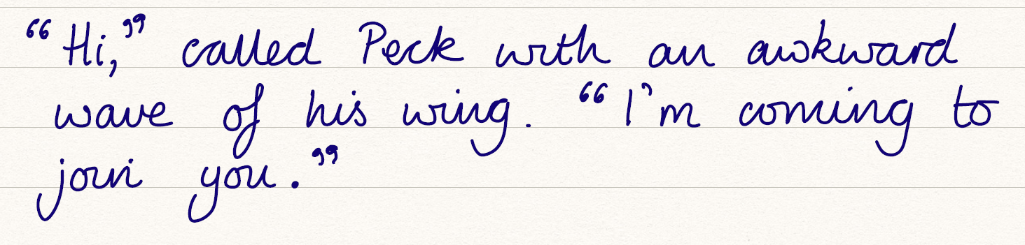
I want to include some speech in this sentence. So Peck is going to say a few words.
Now write your sentence. Make sure you check you have a capital letter and a full stop.

Slide 36

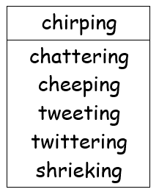
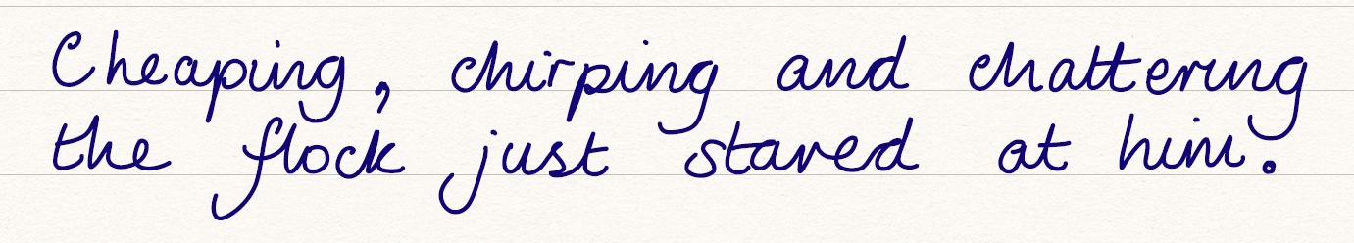
I’ve decided to use some onomatope in these sentences. I’ve used three words that all start with ‘ch’ to tell you what the birds were saying.
Now write your sentence. Make sure you check you have a capital letter and a full stop.

Slide 37
Thursday 14th May
Mathematics

Slide 38

https://whiterosemaths.com/homelearning/year-2/
Year 2
Summer Term
Week 3
Lesson 4 – Add and subtract ones.

Slide 39


Slide 40


Slide 41
Friday 15th May
Writing activities.

Slide 42

Our story this week is called ‘For the birds’.
Each day we are going to write a tiny part of the story.
?
Plot point 2
Who is that
0:43 – 0:58
?
Plot point 3
Hi
0:59 – 1:14
?
Plot point 4
Stay away
1:15 – 1:26
?
Plot point 5
Room for one more
1:27- 1:45
?
Plot point 1
Budge over
0:24 – 0:42
?
Plot point 6
?
Plot point 7
?
Plot point 8
?
Plot point 9
When we talk about the birds in the story we are going to use the name
Peck
We are also going to use the pronouns he and them.
https://www.literacyshed.com/for-the-birds.html

Slide 43


My next sentence is going to be an exclamatory sentence.
Now write your sentence. Make sure you check you have a capital letter and a full stop.

Slide 44


My next sentence is going to be an exclamatory sentence.
Now write your sentence. Make sure you check you have a capital letter and a full stop.

Slide 45


My next sentence is going to be an exclamatory sentence.
Now write your sentence. Make sure you check you have a capital letter and a full stop.

Slide 46
^{Friday 14th May}
Mathematics

Slide 47

Today I would like you to practise your multiplication tables.
Where will we come in next week’s Kite tables challenge?
https://ttrockstars.com/
Last week, we came 35th out of 50 classes in the kite academy.
Can we do better next week?
All you need to do is log in and give it a go.

