Slide 1
Year 5 Home Learning
Week Beginning: 11th May 2020
cherrytree.class@fernhill.kite.academy

Slide 2
How it works:
Please complete one English and one Maths task each day. (Approximately 30 minutes on each)
The topic for this week will be ‘Flight’. Remember some of the activities may take more than a day to complete. Please choose 2 more activities from the list.

Slide 3
Overview of English: Writing
Grammar activities:
(Please ignore the date on these activities)
Monday: Using setting descriptions. https://www.bbc.co.uk/bitesize/articles/z4brcqt
Tuesday: Using an ellipses. https://www.bbc.co.uk/bitesize/articles/z73sf4j
Writing opportunity:
A Mysterious Shadow
https://www.pobble365.com/a-mysterious-shadow/
Wednesday: A Mysterious Shadow:
Question Time and Sick Sentences
Thursday: A Mysterious Shadow:
Sentence Challenge. Plan your story based on the picture using your success criteria
Friday: A Mysterious Shadow:
Finish writing your story and edit your work.
There are spelling activities throughout the week.

Slide 4
Overview of English: Reading
Continue reading your book and your reading journal. Read another chapter and pick from the following activities:
Write down any unfamiliar vocabulary and find out what they mean.
Can you use these words in a sentence?
Write a diary entry as if you are one of the characters. How would you
describe what has happened to you? How do you feel? Do you
have any questions you would like answered?
Pick an object, person or place from this chapter and draw what you
think it should look like. Add labels with quotes from the text.

Slide 5
Maths focus: Adding and Subtracting Decimals
White Rose Maths Home Learning
Year 5- Summer Term – Week 1 (w/c 20 April)
Adding and Subtracting Decimals
https://whiterosemaths.com/homelearning/year-5/
There are 5 lessons, please watch the clips first (if you have problems with the White Rose website videos, the BBC Bitesize clips are also useful), then click on ‘Get the Activity’ and you can check your answers afterwards.
BBC bitesize videos:
https://www.bbc.co.uk/bitesize/topics/zsjqtfr/articles/zsbd7p3
Summer Term – Week 1 (w/c 20 April)
Monday - Lesson 1 – Adding Decimals within 1
Tuesday – Lesson 2 – Subtracting Decimals within 1
Wednesday – Lesson 3 – Complements to 1
Thursday – Lesson 4 – Adding decimals – crossing the whole
Friday – Lesson 5 – Maths challenge

Slide 6
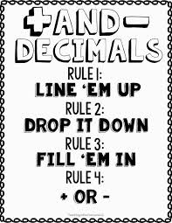

Slide 7
Examples…
Link to a song to help you add and subtract decimals…
https://www.youtube.com/watch?v=n-OcbG1FlBQ

Slide 8
Overview of Topic
This week you will be exploring the topic of Flight.
There are lots of fun art and Science activities to do.
See the ‘topic sheet’ for details (This was sent to you last week via Marvellous Me)
ENJOY and don’t forget to send me examples of your work to cherrytree.class@fernhill.kite.academy

Slide 9
Monday

Slide 10
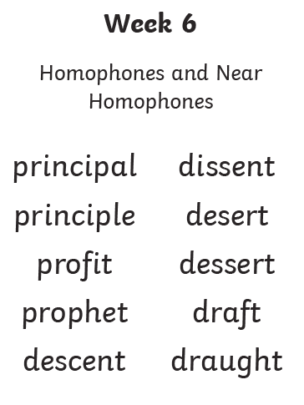
Monday Use a dictionary or online dictionary to find out what the words mean.
Suggested Activities:
Look, say, cover, write, check
Rainbow writing
Pyramid writing
Find the meaning of the word
Add the value of the word
(vowels = 10 consonant = 5)

Slide 11
Homophones and Near Homophones
This week we are going to look at some more tricky homophones and near homophones.
Can you remember what homophones are?
Homophones (or near homophones) are words that sound the same but have different spellings and meanings.

Slide 12
Handwriting It’s important to keep practising your handwriting… it’s a muscle like any other and needs to be exercised! This week we will focus on the letter formation: Watch the video then practice one line of this https://www.teachhandwriting.co.uk/cursive-joins-choice-2.html Then practice your cursive (joined up) handwriting by copying out the poem. https://www.poetry4kids.com/poems/good-morning-dear-students/
Good Morning, Dear Students
From the book When the Teacher Isn't Looking
“Good morning, dear students,” the principal said. “Please put down your pencils and go back to bed. Today we will spend the day playing outside, then take the whole school on a carnival ride.
“We’ll learn to eat candy while watching TV, then listen to records and swing from a tree. We’ll also be learning to draw on the walls, to scream in the classrooms and run in the halls.
“So bring in your skateboard, your scooter, your bike. It’s time to be different and do what you like. The teachers are going to give you a rest. You don’t have to study. There won’t be a test.
“And if you’d prefer for a bit of a change, feel free to go wild and act really strange. Go put on a clown suit and dye your hair green, and copy your face on the Xerox machine.
“Tomorrow it’s back to the regular grind. Today, just go crazy. We really don’t mind. So tear up your homework. We’ll give you an A. Oh wait. I’m just kidding. It’s April Fools’ Day.”
— Kenn Nesbitt

Slide 13
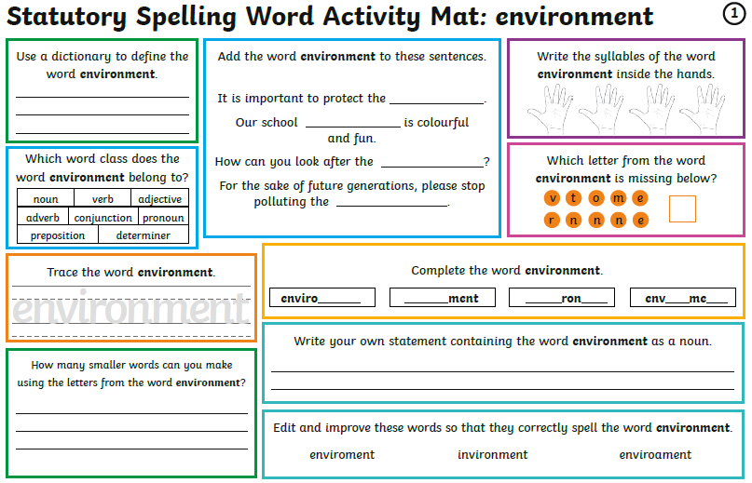
Monday Week 8 You don’t need to print these daily spelling mats, you can just copy from the screen.

Slide 14
English: Using setting descriptions
https://www.bbc.co.uk/bitesize/articles/z4brcqt
Home learning focus
Learn how to investigate setting descriptions and context in your writing.
This lesson includes:
- two videos
- three activities
Watch the video clips and then complete the 3 activities.

Slide 15
Year 5- Summer Term – Week 1 (w/c 20 April)
Adding and Subtracting Decimals
https://whiterosemaths.com/homelearning/year-5/
Monday - Lesson 1 – Adding Decimals within 1
There are 5 lessons, please watch the clips first (if you have problems with the White Rose website videos, the BBC Bitesize clips are also useful), then click on ‘Get the Activity’ and you can check your answers afterwards.

Slide 16
Tuesday

Slide 17
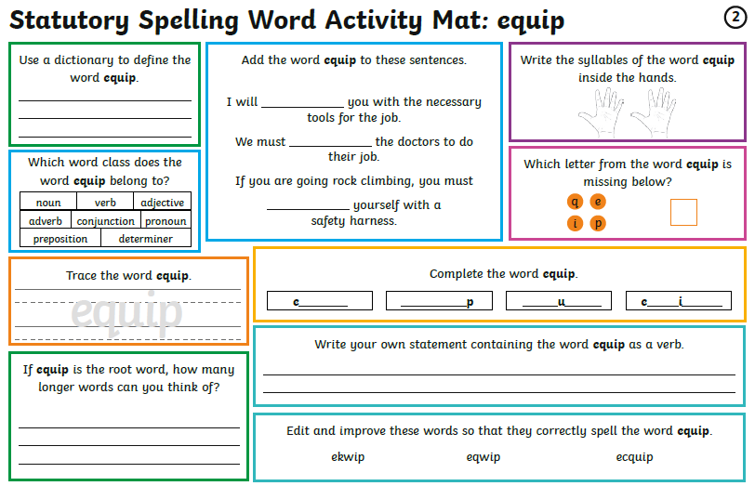
Tuesday You don’t need to print these daily spelling mats, you can just copy from the screen.

Slide 18
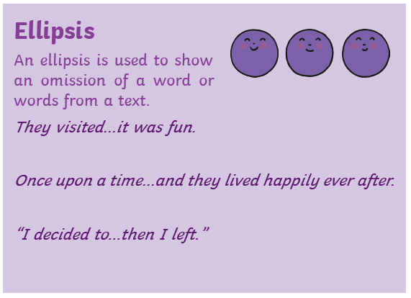
English: Using an ellipses
https://www.bbc.co.uk/bitesize/articles/z73sf4j
Learn about identifying and understanding how to use an ellipsis.
In this lesson there are:
- two videos
- three activities
Watch the video clips and then complete the 3 activities.

Slide 19
Year 5- Summer Term – Week 1 (w/c 20 April)
Adding and Subtracting Decimals
https://whiterosemaths.com/homelearning/year-5/
Tuesday – Lesson 2 – Subtracting Decimals within 1
There are 5 lessons, please watch the clips first (if you have problems with the White Rose website videos, the BBC Bitesize clips are also useful), then click on ‘Get the Activity’ and you can check your answers afterwards.

Slide 20
Wednesday

Slide 21
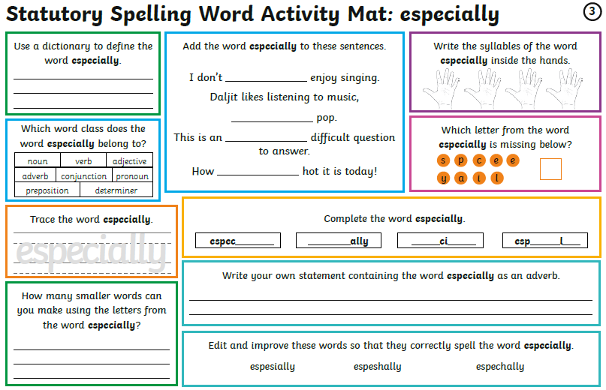
Wednesday You don’t need to print these daily spelling mats, you can just copy from the screen.

Slide 22
English: Introduction to writing stimulus
Answer the questions on the next slide.
Then improve the sentences on slide 21.

Slide 25
Year 5- Summer Term – Week 1 (w/c 20 April)
Adding and Subtracting Decimals
https://whiterosemaths.com/homelearning/year-5/
Wednesday – Lesson 3 – Complements to 1
There are 5 lessons, please watch the clips first (if you have problems with the White Rose website videos, the BBC Bitesize clips are also useful), then click on ‘Get the Activity’ and you can check your answers afterwards.

Slide 26
Thursday

Slide 27
Thursday You don’t need to print these daily spelling mats, you can just copy from the screen.

Slide 28
English

Slide 29
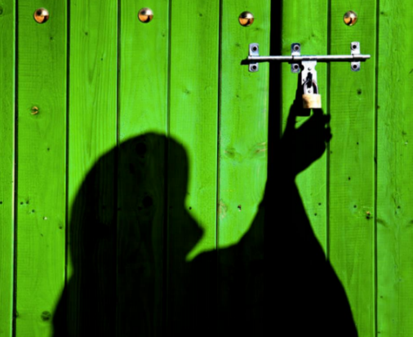
Plan
Opening: Describe the setting – describe the inside of the shed Clouds, Light (moon), Wind What does the item look like? (you could put 2 things together) 5 senses (see, hear, taste, smell, touch) Similes, metaphors, personification
Build up: Introduce the item more... What does it do? Introduce the item – what does it do? What sounds does it make? Show Don’t Tell how the person feels – 5 senses (see, hear, taste, smell, touch) Do they want to take the mystery object/person with them? What is there mission?
Problem: How has it started to go wrong? Did someone follow them? Has the door slammed shut? How is the mission going wrong? Are they trapped? Are they being chased? How does your character feel?
Resolution: How is the problem resolved?
Ending: Do they live ‘happily ever after?’ Are they stuck forever? Was the mission a success?
English: Plan your story

Slide 30
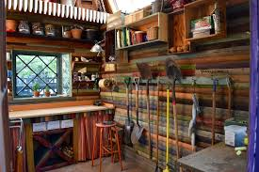
English: Write the opening of your story
Plan
Opening: Describe the setting – describe the inside of the shed Clouds Light (moon) Wind What does the item look like? (you could put 2 things together) 5 senses (see, hear, taste, smell, touch) Similes, metaphors, personification
Success Criteria
I can use descriptive language (5 senses, personification, similes and metaphors)
I can use a range of sentences (simple, co-ordinating and subordinating conjunctions, fronted adverbials)
I can use a range of punctuation (! ? ‘ , “” … () - : ;)

Slide 32
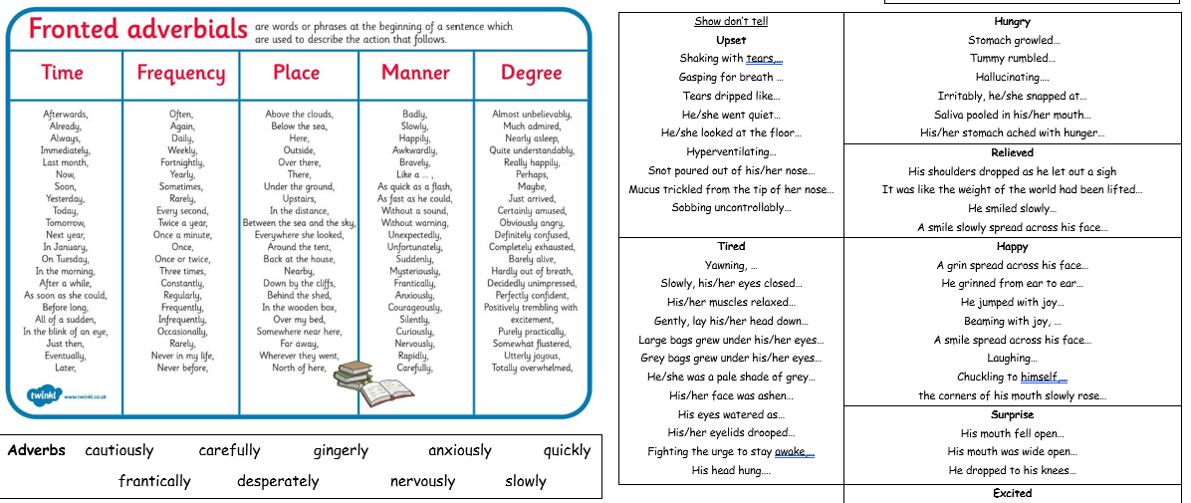

Slide 33
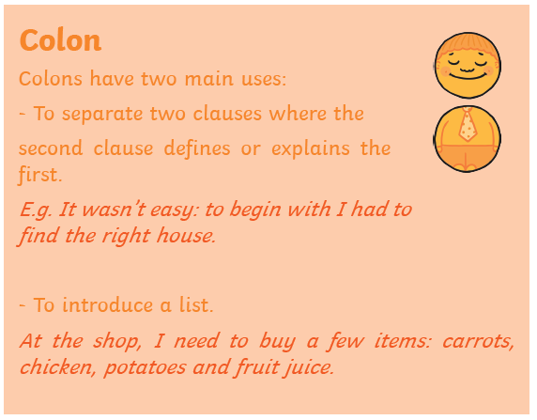
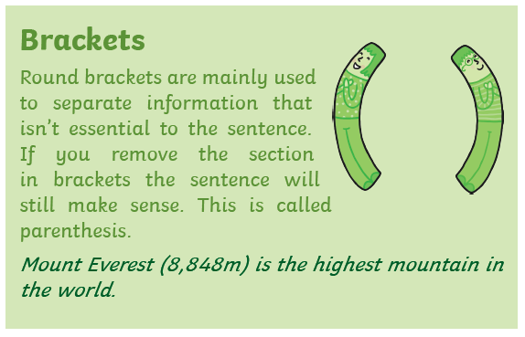
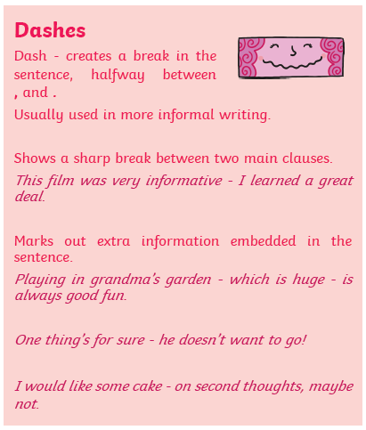

Slide 35
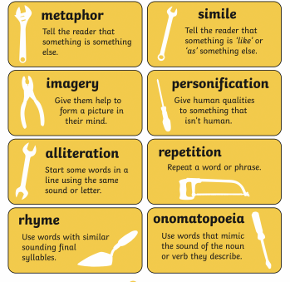

Slide 36
Year 5- Summer Term – Week 1 (w/c 20 April)
Adding and Subtracting Decimals
https://whiterosemaths.com/homelearning/year-5/
Thursday – Lesson 4 – Adding decimals – crossing the whole
There are 5 lessons, please watch the clips first (if you have problems with the White Rose website videos, the BBC Bitesize clips are also useful), then click on ‘Get the Activity’ and you can check your answers afterwards.

Slide 37
Friday

Slide 38
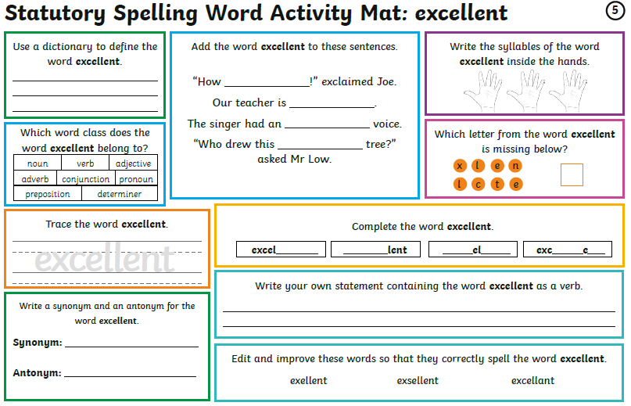
Friday You don’t need to print these daily spelling mats, you can just copy from the screen.

Slide 39
Plan
Opening: Describe the setting – describe the inside of the shed Clouds, Light (moon), Wind What does the item look like? (you could put 2 things together) 5 senses (see, hear, taste, smell, touch) Similes, metaphors, personification
Build up: Introduce the item more... What does it do? Introduce the item – what does it do? What sounds does it make? Show Don’t Tell how the person feels – 5 senses (see, hear, taste, smell, touch) Do they want to take the mystery object/person with them? What is there mission?
Problem: How has it started to go wrong? Did someone follow them? Has the door slammed shut? How is the mission going wrong? Are they trapped? Are they being chased? How does your character feel?
Resolution: How is the problem resolved?
Ending: Do they live ‘happily ever after?’ Are they stuck forever? Was the mission a success?
English: Review your plan

Slide 40
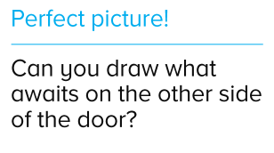
Plan
Build up: Introduce the item more... What does it do? Introduce the item – what does it do? What sounds does it make? Show Don’t Tell how the person feels – 5 senses (see, hear, taste, smell, touch) Do they want to take the mystery object/person with them? What is there mission?
English: Write your build up
You could put parts of an animal with an everyday electrical item to create the object inside the shed…
Success Criteria
I can use descriptive language (5 senses, personification, similes and metaphors)
I can use a range of sentences (simple, co-ordinating and subordinating conjunctions, fronted adverbials)
I can use a range of punctuation (! ? ‘ , “” … () - : ;)

Slide 41
Plan
Problem: How has it started to go wrong? Did someone follow them? Has the door slammed shut? How is the mission going wrong? Are they trapped? Are they being chased? How does your character feel?
Resolution: How is the problem resolved?
Ending: Do they live ‘happily ever after?’ Are they stuck forever? Was the mission a success?
English: Write the problem, resolution and ending
Success Criteria
I can use descriptive language (5 senses, personification, similes and metaphors)
I can use a range of sentences (simple, co-ordinating and subordinating conjunctions, fronted adverbials)
I can use a range of punctuation (! ? ‘ , “” … () - : ;)

Slide 42
Year 5- Summer Term – Week 1 (w/c 20 April)
Adding and Subtracting Decimals
https://whiterosemaths.com/homelearning/year-5/
Friday – Lesson 5 – Maths challenge
There are 5 lessons, please watch the clips first (if you have problems with the White Rose website videos, the BBC Bitesize clips are also useful), then click on ‘Get the Activity’ and you can check your answers afterwards.

