Slide 1
Wednesday

Slide 2
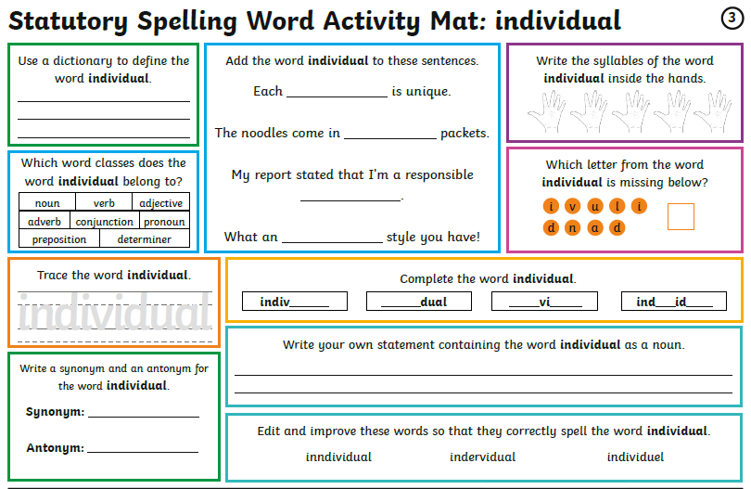
Wednesday You don’t need to print these daily spelling mats, you can just copy from the screen.

Slide 3
English:
Writing Opportunity
Wednesday: Plan an alternative version of Red Reding Hood

Slide 4
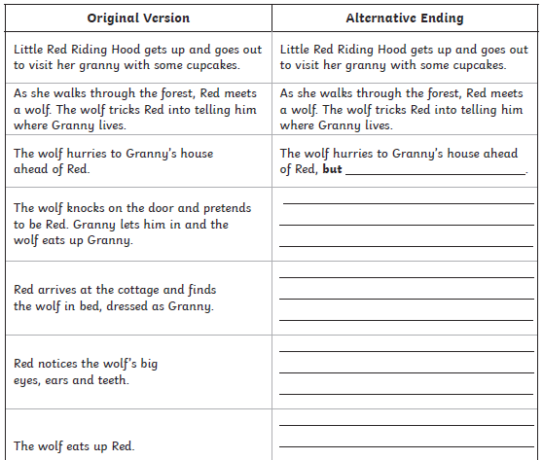
Write your answers in your book:
Choose between the easier version below or a harder version
(on the new few slides)

Slide 5
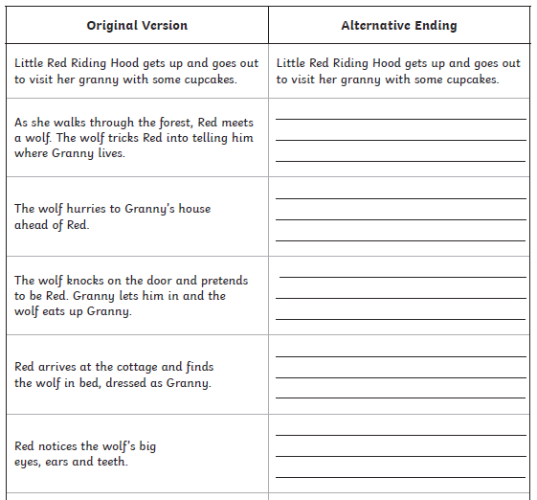
Harder version
Write your answers in your book:
You can just change the events in the story or you could go even further and change:
The setting/house
(Jungle, Abandoned mansion, Castle
In the mountains, Fairground - the house could be the haunted house ride)
The character/s
(Your main character could be a boy)

Slide 6
Maths focus: Division
White Rose Maths Home Learning
Year 5- Summer Term – Week 3 (w/c 4th May)
https://whiterosemaths.com/homelearning/year-5/
There are 5 lessons, please watch the clips first (if you have problems with the White Rose website videos, the BBC Bitesize clips are also useful), then click on ‘Get the Activity’ and you can check your answers afterwards.
Year 5- Summer Term – Week 3 (w/c 4th May)
Wednesday – Lesson 3 – Divide with remainders

Slide 9
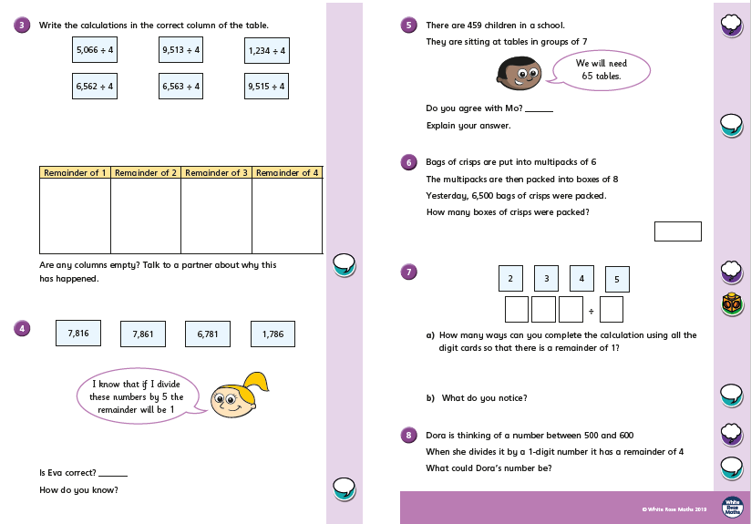

Slide 12
Thursday

Slide 13
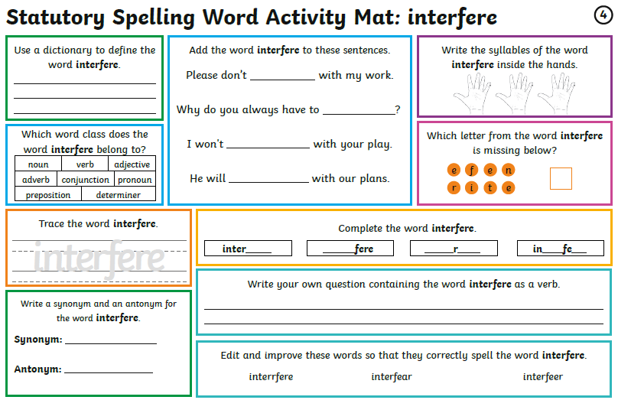
Thursday You don’t need to print these daily spelling mats, you can just copy from the screen.

Slide 14
English
Thursday:
- Adventurous Adverbs practice sentences
- Write your setting description

Slide 16
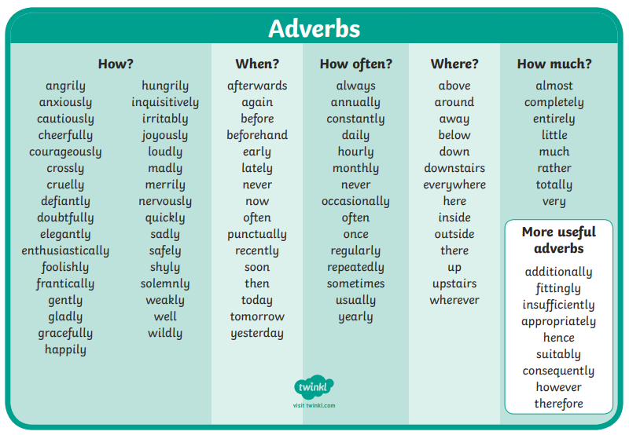
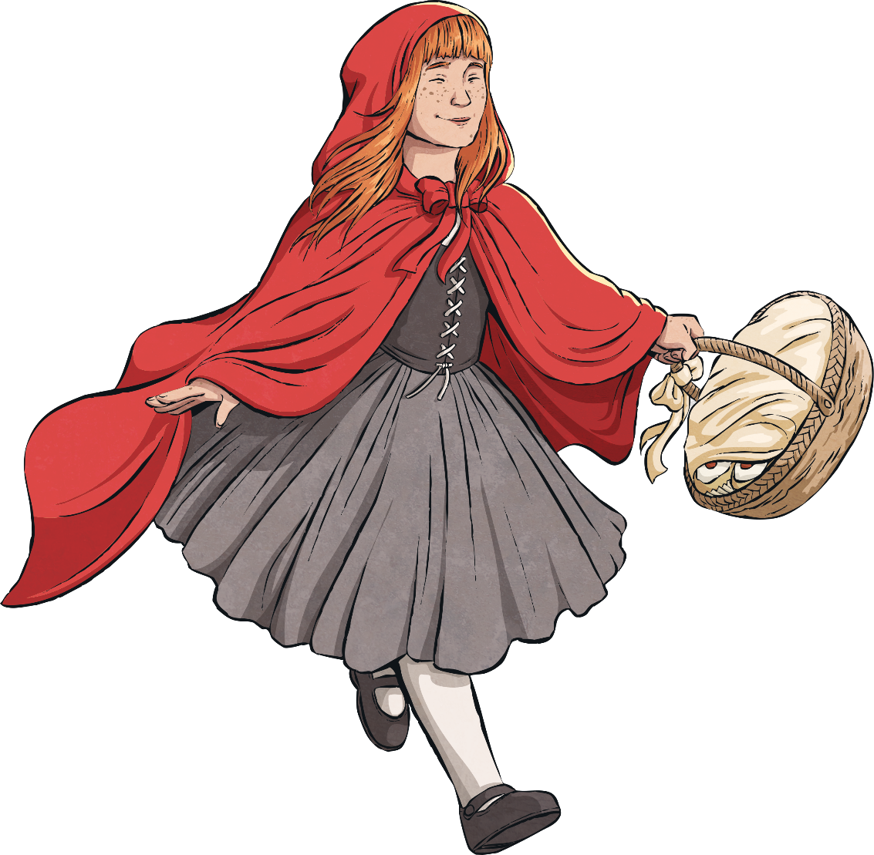
Adventurous Adverbs
Use the following pictures and verbs to experiment with adventurous adverbs!
Can you think of any of your own to add?

Slide 17
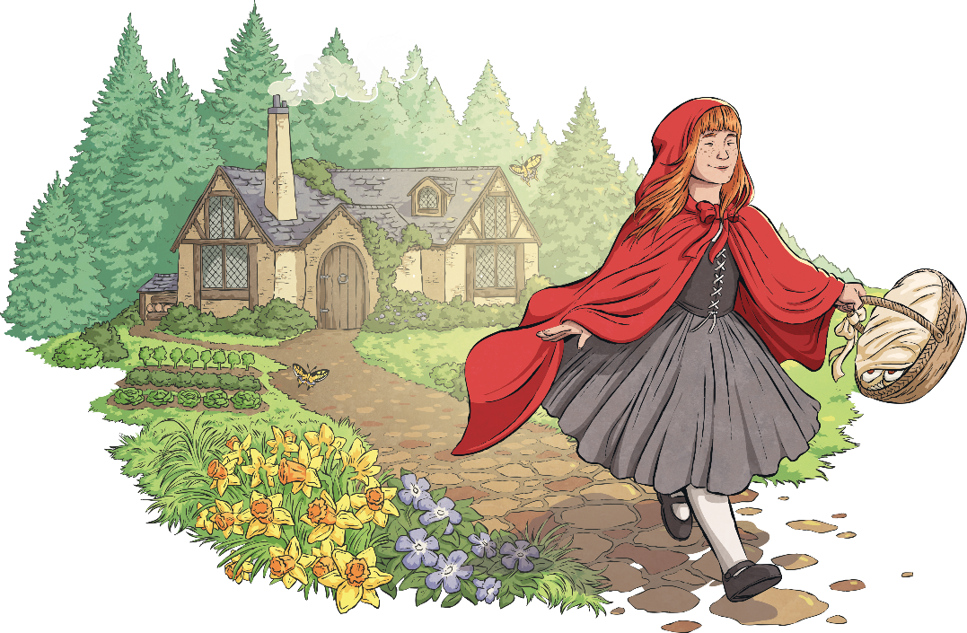
Adventurous Adverbs
Repeat for the following slides
Write all your examples in your book in a sentence…
e.g. Little Red Riding Hood skipped joyfully down the path.
Adverbs for ‘how’
Challenge: Can you also include adjectives and conjunctions?
The quaint cottage stood proudly in the middle of the forest whilst the dainty flowers surround it danced in the warm glow of the sunlight.
awkwardly
zealously
skipped
beautifully
worriedly
carefully
wistfully
stood
cautiously
viciously
daintily
urgently
fluttered
swung
freely
timidly
gracefully
swayed
rustled
stylishly
happily
recklessly
idly
leisurely
noisily
quietly
joyfully
kindly
miserably
oddly
proudly
Read ‘Twist the Text: The Little Red Riding Hood Collection’ at twinkl.com/originals

Slide 18
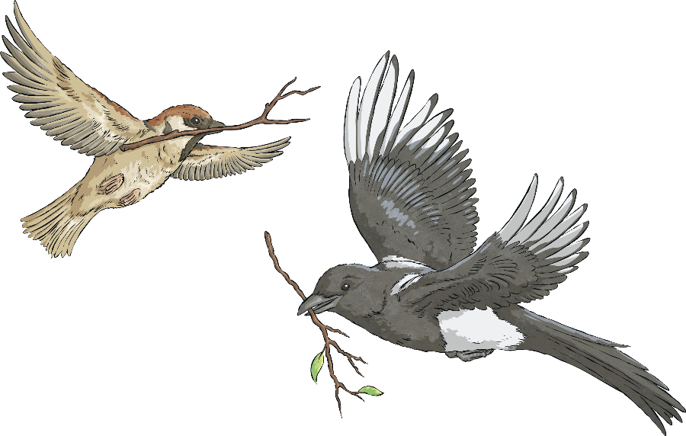
Adventurous Adverbs
Adverbs for ‘how’
awkwardly
zealously
beautifully
flapped
worriedly
carefully
sang
wistfullu
cautiously
viciously
daintily
urgently
freely
glided
timidly
gracefully
stylishly
gripped
happily
recklessly
idly
leisurely
noisily
quietly
joyfully
kindly
miserably
oddly
proudly
Read ‘Twist the Text: The Little Red Riding Hood Collection’ at twinkl.com/originals

Slide 19
Adventurous Adverbs
Adverbs for ‘how’
awkwardly
kindly
urgently
beautifully
lazily
viciously
sneered
confidently
mischievously
wistfully
cruelly
noisily
worriedly
growled
dangerously
oddly
zealously
fairly
proudly
grinned
gracefully
quietly
hungrily
recklessly
idly
suspiciously
waited
joyfully
timidly
Read ‘Twist the Text: The Little Red Riding Hood Collection’ at twinkl.com/originals

Slide 20
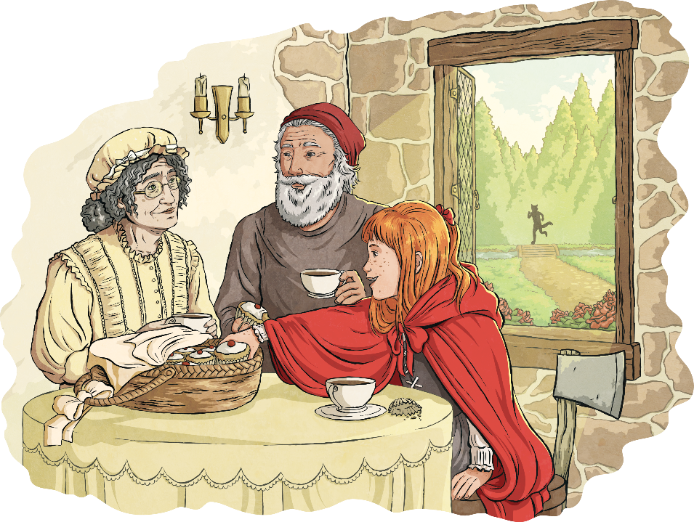
Adventurous Adverbs
Adverbs for ‘how’
awkwardly
zealously
beautifully
smiled
worriedly
carefully
hurried
wistfullu
cautiously
viciously
daintily
urgently
freely
timidly
gracefully
munched
stylishly
laughed
happily
recklessly
idly
leisurely
noisily
quietly
joyfully
kindly
miserably
oddly
proudly
Read ‘Twist the Text: The Little Red Riding Hood Collection’ at twinkl.com/originals

Slide 21
Remember to include these adverbs in your writing…
it makes it more entertaining for the reader!
You can also use the word banks on the next two slides.

Slide 22
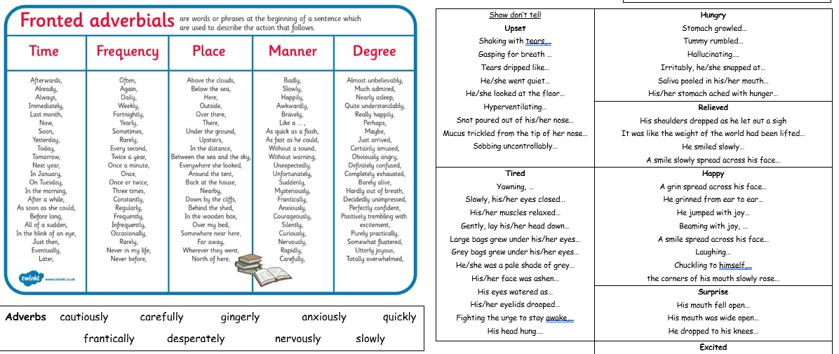

Slide 23
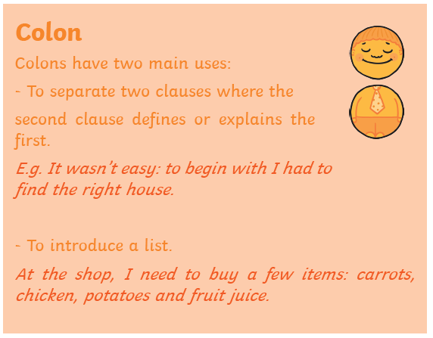
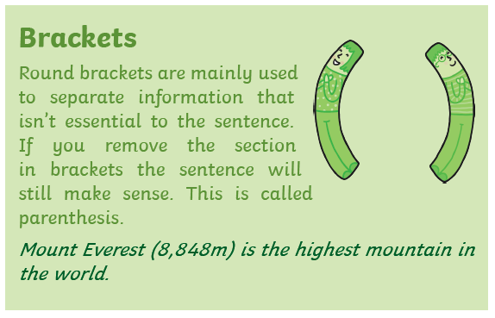
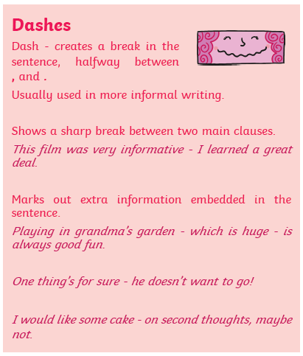

Slide 24
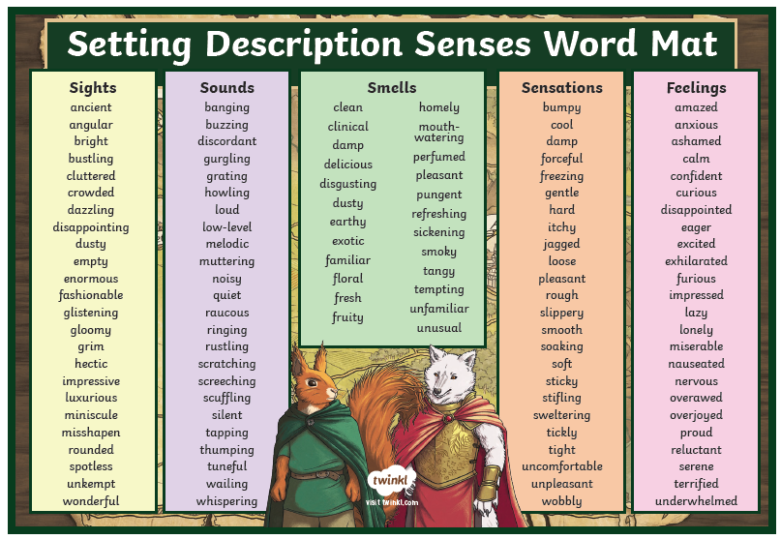

Slide 25
Write your setting description:
Use the pictures below to help create an image for the reader
I am learning to…
Use a range of sentence openers
Use interesting adverbs
Use the 5 senses

Slide 26
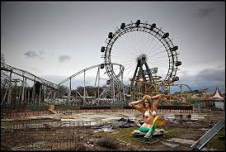
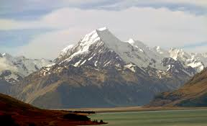

Slide 27
Examples of setting descriptions
Excerpt from My Swordhand is Singing by Marcus Sedgewick.
The hut stood in a strange position. The river Chust, from which the village took its name forked in two here, as it snaked through the woods. With deep banks, the rivers had spent ten thousand years eating its way gently down into the thick soft dark forest soil. Its verges were moss laden blankets that dripped leaf mould into the slow brown water. But at a certain point, in its ancient history, the river had met some solid rock hidden in the soil, and had split in two. It was in the head of this fork that the hut stood.
Excerpt from The Graveyard Book by Neil Gaiman
The boy walked back down the south-west side of the hill, avoiding the old chapel; he did not want to see the place the Silas wasn’t. Bod stopped beside a grave that looked the way he felt; it was beneath an oak that had once been struck by lightning, and now was just a black trunk, like a sharp talon coming out of the hill; the grave itself was water-stained and cracked, and above it was a memorial stone on which a headless angel hung, its robes looking like a huge and ugly tree-fungus.
Excerpt from Over Sea, Under Stone by Susan Cooper
Trewissick seemed to be sleeping beneath its grey, slate-tiled roofs, along the narrow winding streets down the hill. Silent behind their lace-curtained windows, the little square houses let the roar of the car bounce back from their whitewashed walls. Then Great Uncle Merry swung the wheel round, and suddenly they were driving along the edge of the harbour, past water rippling and flashing golden in the afternoon sun.

Slide 28
Write your setting description I am learning to…
Use a range of sentence openers
Use interesting adverbs
Use the 5 senses

Slide 29
Maths focus: Perimeter
White Rose Maths Home Learning
Year 5- Summer Term – Week 3 (w/c 4th May)
https://whiterosemaths.com/homelearning/year-5/
There are 5 lessons, please watch the clips first (if you have problems with the White Rose website videos, the BBC Bitesize clips are also useful), then click on ‘Get the Activity’ and you can check your answers afterwards.
Year 5- Summer Term – Week 3 (w/c 4th May)
Thursday – Lesson 4 – Calculate perimeter

Slide 30
Top Tip:
Use colour coding. One colour for the lengths and a different colour for the widths

Slide 32
