Slide 1
Year 5 Home Learning
Week Beginning: 8th June 2020
chestnut.class@fernhill.kite.academy

Slide 2
How it works:
Please complete one English and one Maths task each day. (Approximately 30 minutes on each)
The topic for this week will continue to be ‘Fairy Tales’. Remember some of the activities may take more than a day to complete. Please choose 2 more activities from the list.

Slide 3
Overview of English: writing
Monday: Read the original story of Red Riding Hood and create a story map of the main events
Tuesday: Read the Twisted Tale of Red Riding Hood with an alternative ending and identify the similarities and differences
Writing Opportunity
Wednesday: Plan an alternative version of Red Reding Hood
Thursday: Adventurous Adverbs, then write your setting description
Friday: Finish writing your alternative version of Red Riding Hood

Slide 4
Overview of English: Reading
Enjoy reading a book.

Slide 5
Overview of Topic
This week you will be continuing to explore the topic of Fairy Tales.
There are lots of fun art and Science activities to do.
See the ‘topic sheet’ for details (This was sent to you last week via Marvellous Me)
ENJOY and don’t forget to send me examples of your work to chestnut.class@fernhill.kite.academy

Slide 6
Maths focus: Multiplication, Division and Perimeter
White Rose Maths Home Learning
Year 5- Summer Term – Week 3 (w/c 4th May)
https://whiterosemaths.com/homelearning/year-5/
There are 5 lessons, please watch the clips first (if you have problems with the White Rose website videos, the BBC Bitesize clips are also useful), then click on ‘Get the Activity’ and you can check your answers afterwards.
Alternative videos: https://www.bbc.co.uk/bitesize/articles/z4chnrd
https://www.bbc.co.uk/bitesize/clips/zd3r87h
https://www.bbc.co.uk/bitesize/topics/zvmxsbk/articles/zsr4k7h
Year 5- Summer Term – Week 3 (w/c 4th May)
Monday - Lesson 1 – Multiply 2 digit numbers
Tuesday – Lesson 2 – Multiply 4 digits by 2 digits
Wednesday – Lesson 3 – Divide with remainders
Thursday – Lesson 4 – Calculate perimeter
Friday – Lesson 5 –Maths challenge

Slide 7
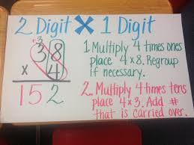
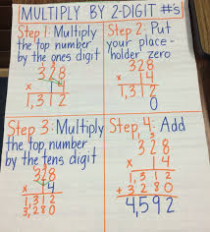

Slide 8
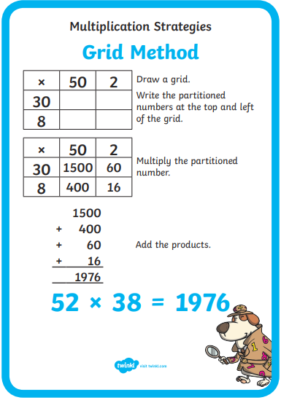
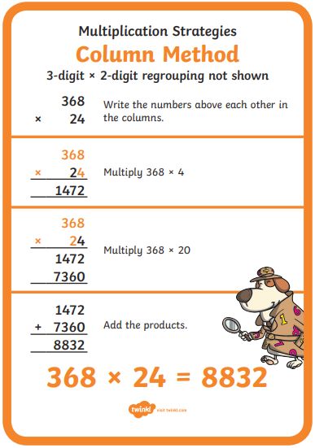

Slide 9
Monday

Slide 10
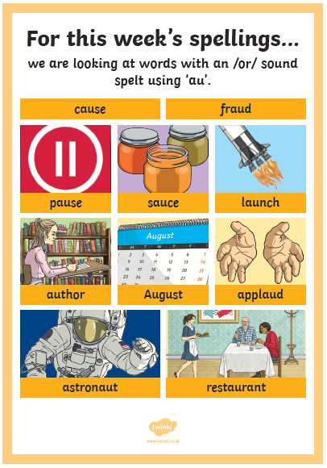
Monday Use a dictionary or online dictionary to find out what the words mean.
Suggested Activities:
Look, say, cover, write, check
Rainbow writing
Pyramid writing
Find the meaning of the word
Add the value of the word
(vowels = 10 consonant = 5)

Slide 11
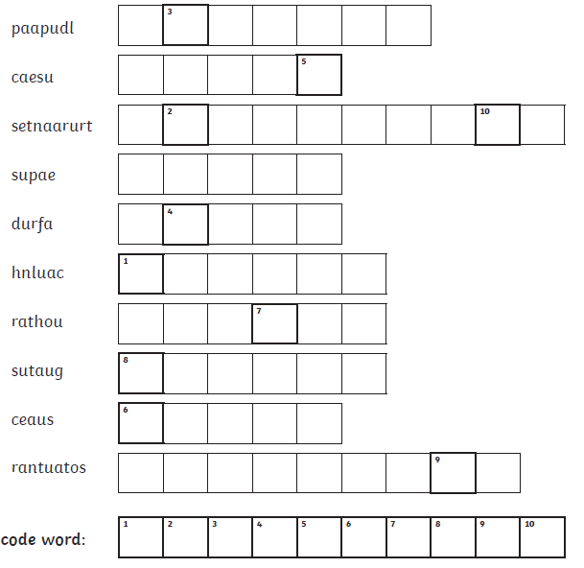

Slide 12
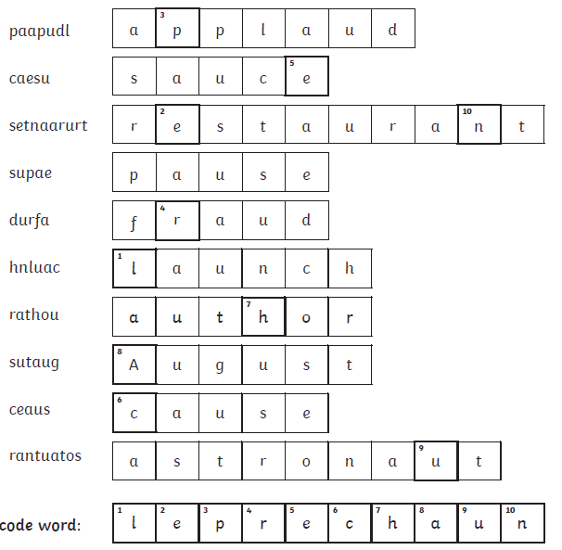
Answers

Slide 13
Handwriting It’s important to keep practising your handwriting… it’s a muscle like any other and needs to be exercised! This week we will focus on the letter formation: Watch the video then practice one line of this https://www.teachhandwriting.co.uk/cursive-joins-choice-2.html Then practice your cursive (joined up) handwriting by copying out the poem. https://www.poetry4kids.com/poems/zoom-gloom/
Zoom Gloom
Distance learning. What a bore. Our school’s been closed a month or more. I’m stuck at home. I’m in my room, and meeting with my class on Zoom.
There’s no more lunchroom. No PE. Just studying and tests for me. There’s no more recess. No more ball. Just staring at my bedroom wall.
The playground’s closed—the swings, the slide— and everybody’s stuck inside. We can’t go out and play with friends. I hope that, pretty soon, this ends.
I know it’s only for a while, but here’s a thought that makes me smile: Although it might not sound so cool, I just can’t wait to go to school.
— Kenn Nesbitt

Slide 14
Monday Week 11 You don’t need to print these daily spelling mats, you can just copy from the screen.

Slide 15
English:
Monday: Read the original story of Red Riding Hood and create a story map of the main events

Slide 16
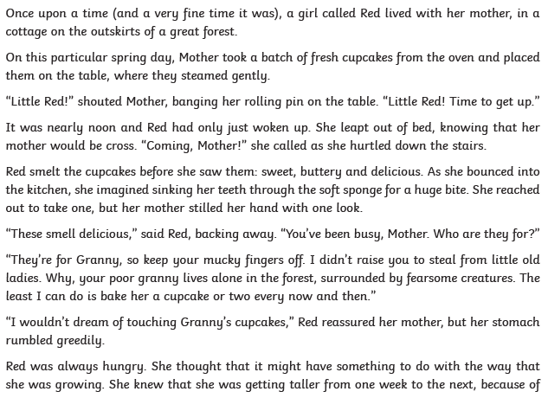

Slide 17
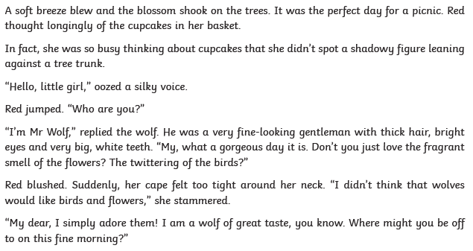

Slide 18
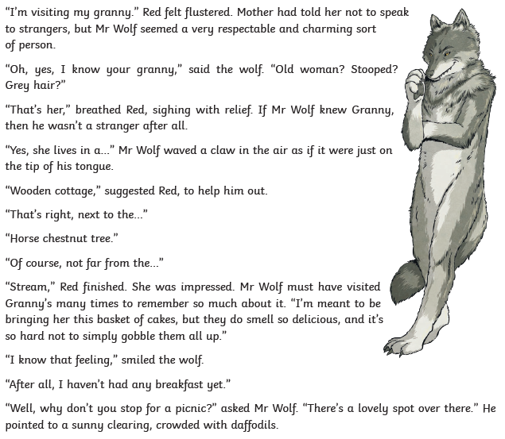

Slide 19
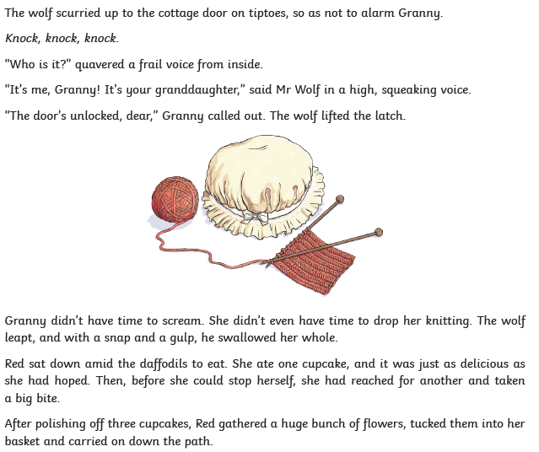

Slide 20
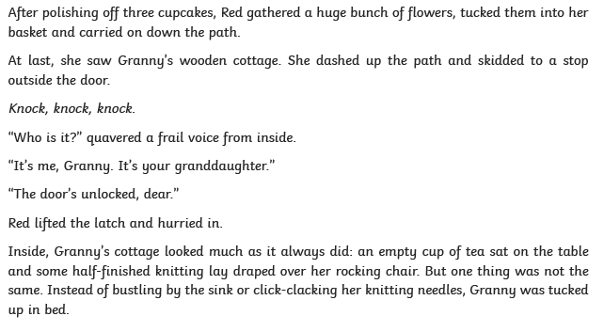

Slide 21
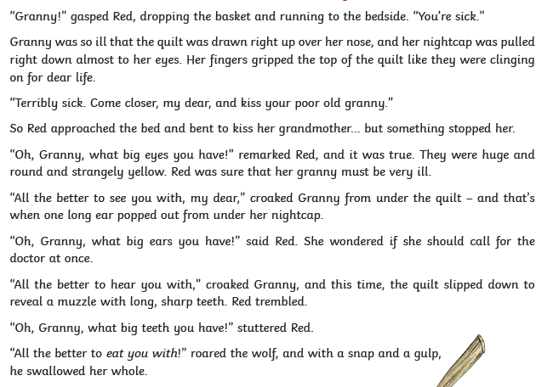

Slide 22
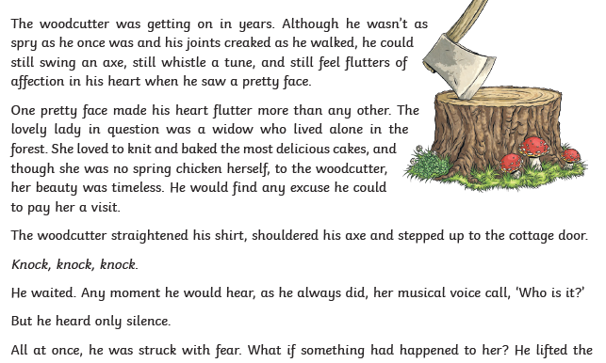

Slide 23
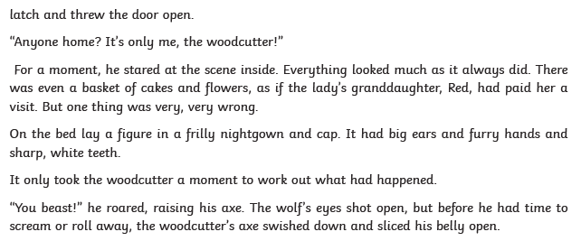
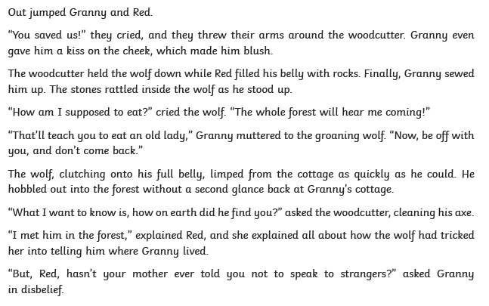

Slide 24
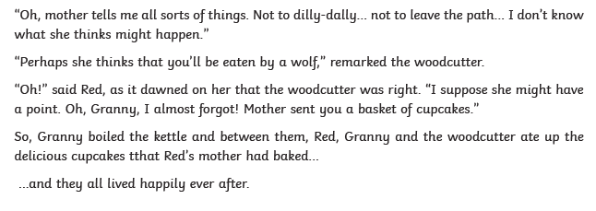
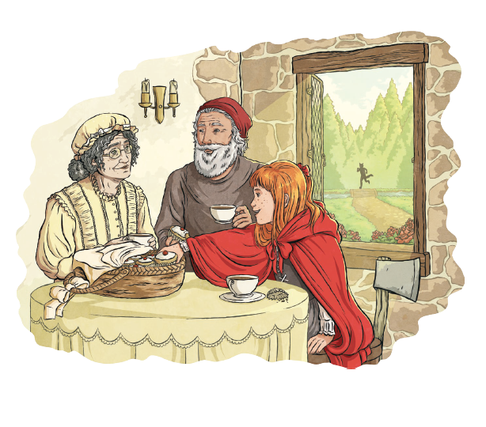

Slide 25
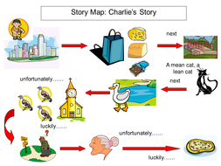
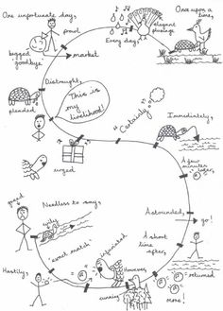
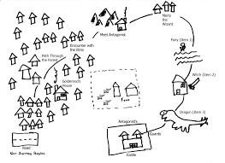
English:
Monday: Now you’ve read the original story of Red Riding Hood…
Create a story map of the main events, you could include key vocabulary too…
Here are some examples of a story map →
If you don’t want to draw it see the other examples on the next slide.

Slide 26
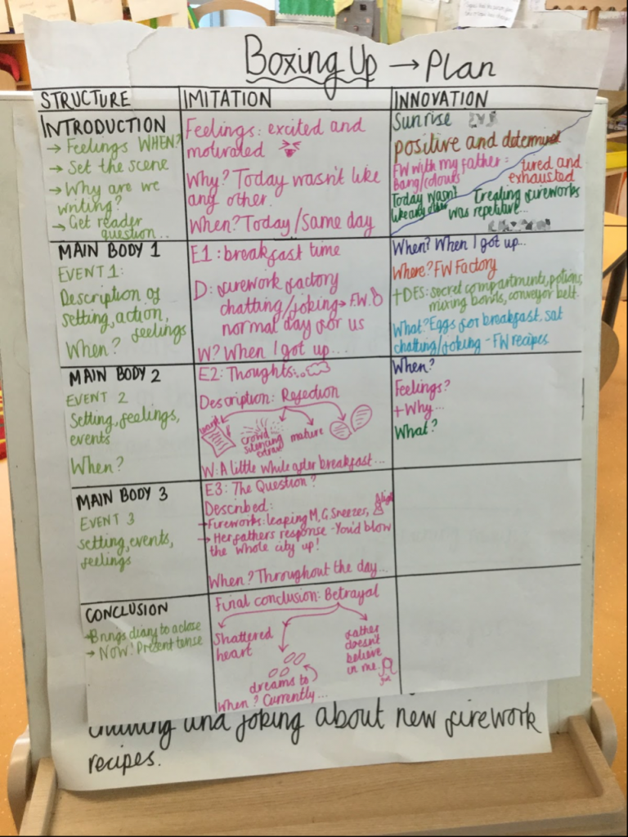
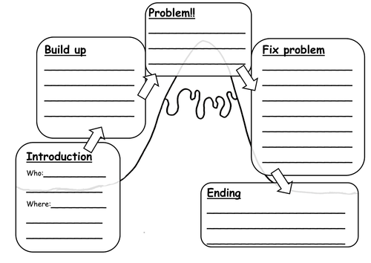
(If you don’t want to draw it)
Box up the story (examples →)
You could include key vocabulary too…

Slide 27
Maths focus: Multiplication
White Rose Maths Home Learning
Year 5- Summer Term – Week 3 (w/c 4th May)
https://whiterosemaths.com/homelearning/year-5/
There are 5 lessons, please watch the clips first (if you have problems with the White Rose website videos, the BBC Bitesize clips are also useful), then click on ‘Get the Activity’ and you can check your answers afterwards.
Year 5- Summer Term – Week 3 (w/c 4th May)
Monday - Lesson 1 – Multiply 2 digit numbers

Slide 30
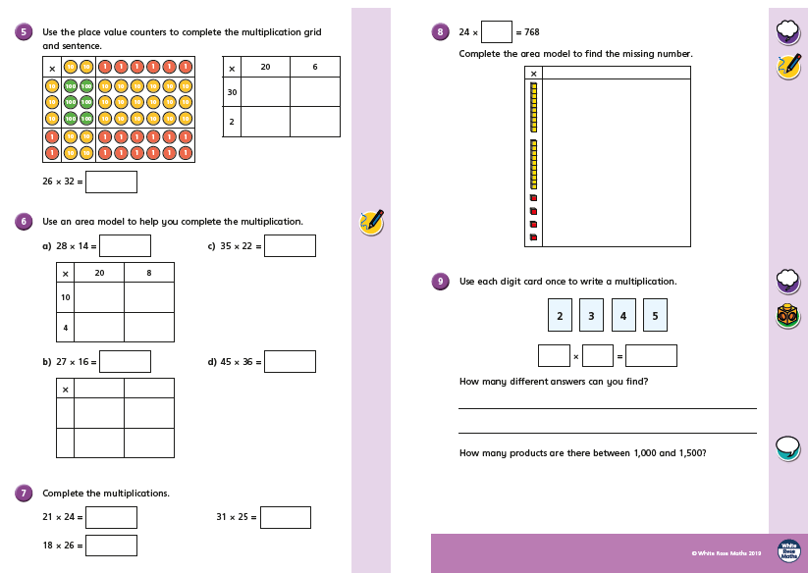

Slide 31
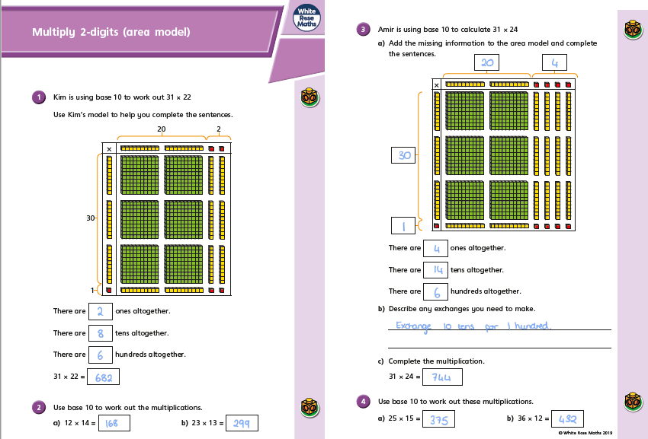

Slide 32
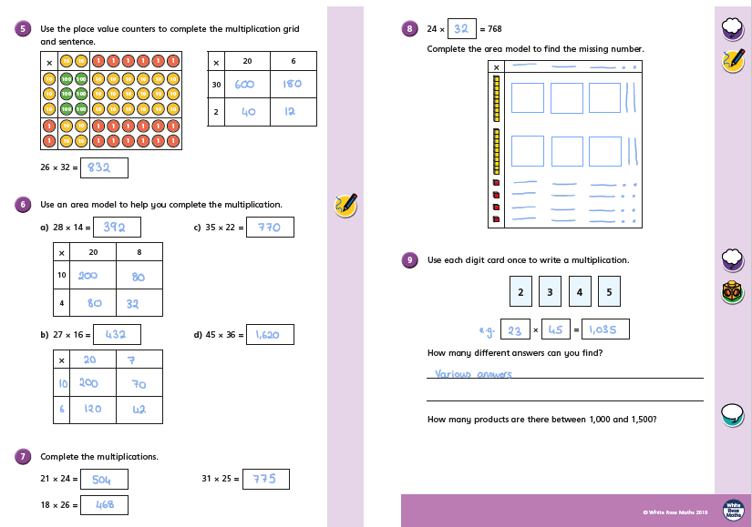

Slide 33
Please see Part 2 for Tuesday

