Slide 1
Friday

Slide 2
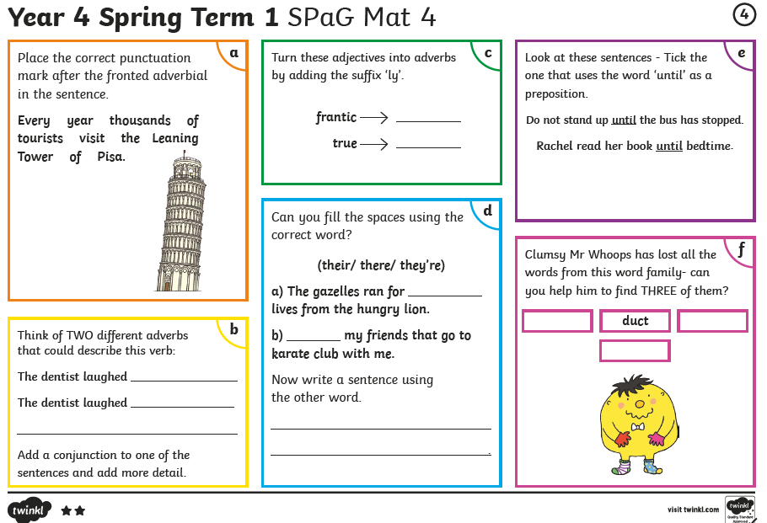
Friday You don’t need to print these daily spelling mats, you can just copy from the screen.

Slide 3
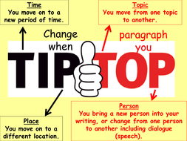
English
Friday: Finish writing your alternative version of Red Riding Hood.
Don’t forget to check your plan – Think about what you changed!

Slide 4
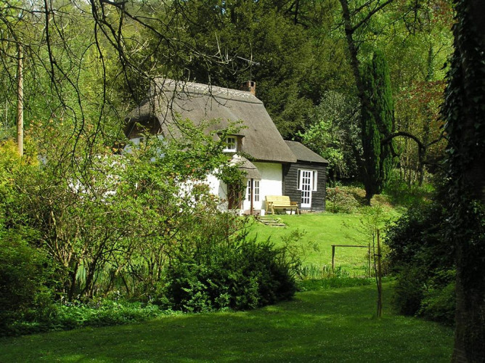
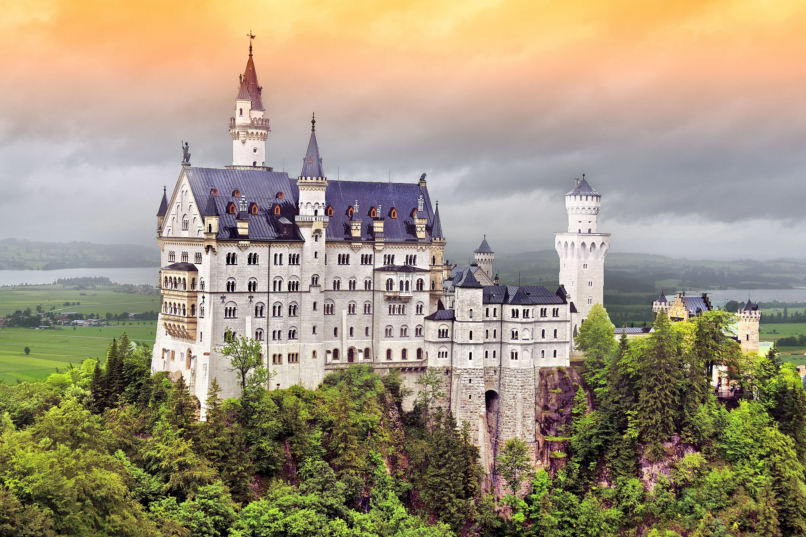
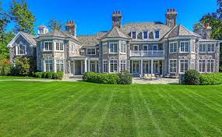
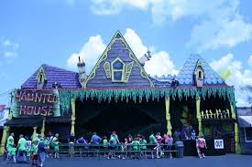
Castle
Cottage
Haunted House ride
Mansion

Slide 5
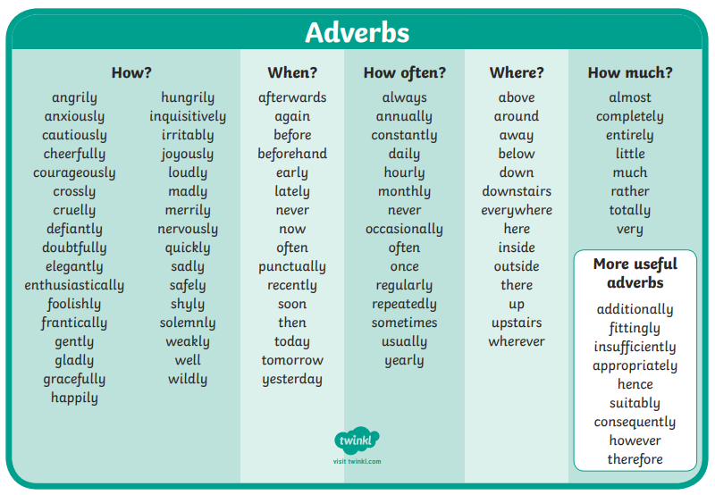
Remember to include these adverbs in your writing…
it makes it more entertaining for the reader!
You can also use the word banks on the next two slides.

Slide 6
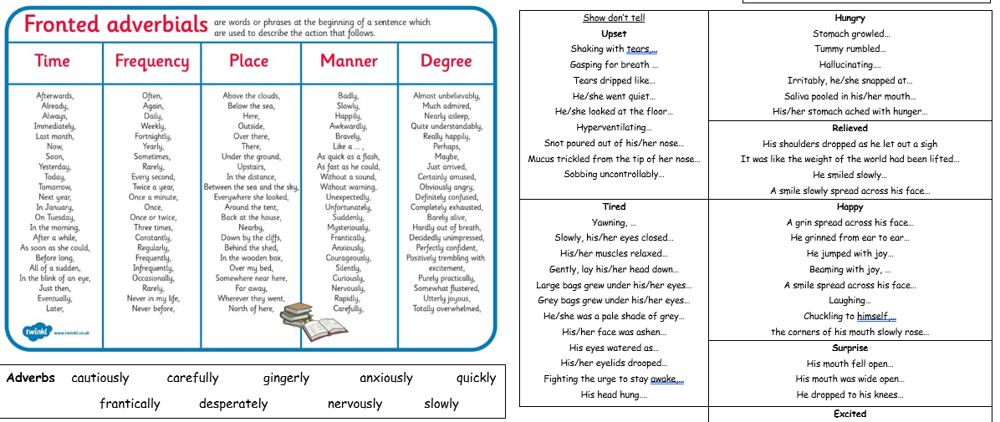

Slide 7
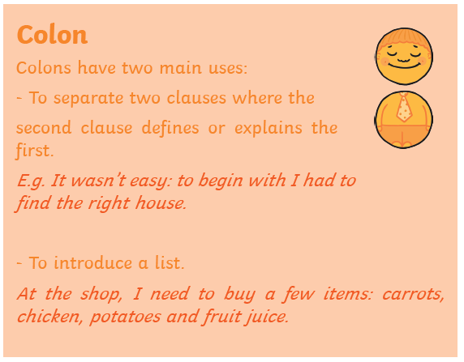
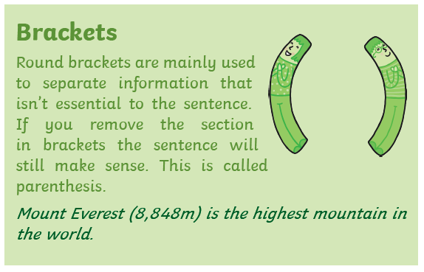
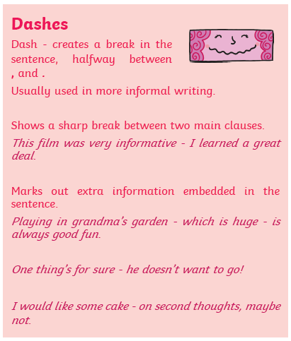

Slide 8
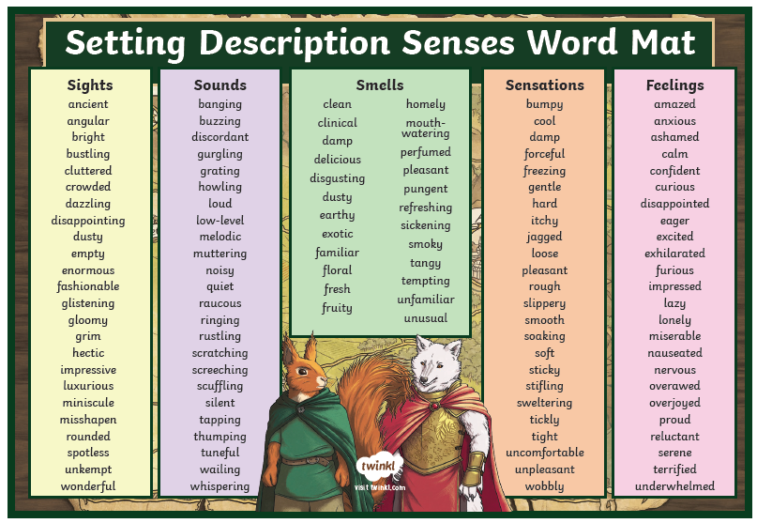

Slide 9
Write your setting description I am learning to…
Use a range of sentence openers
Use interesting adverbs
Use a range of conjunctions

Slide 10
Maths focus: Multiplication, Division and Perimeter
White Rose Maths Home Learning
Year 4- Summer Term – Week 3 (w/c 4th May)
https://whiterosemaths.com/homelearning/year-4/
There are 5 lessons, please watch the clips first (if you have problems with the White Rose website videos, the BBC Bitesize clips are also useful), then click on ‘Get the Activity’ and you can check your answers afterwards.
Year 4- Summer Term – Week 3 (w/c 4th May)
Friday – Lesson 5 –Maths challenge

Slide 11
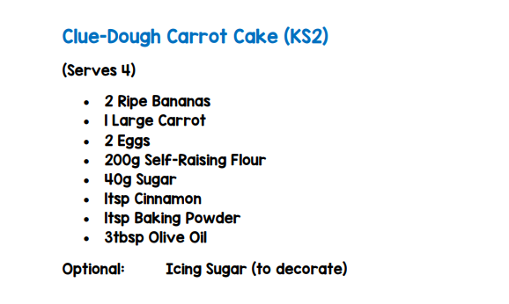
With an adult practise measuring accurately.

Slide 12
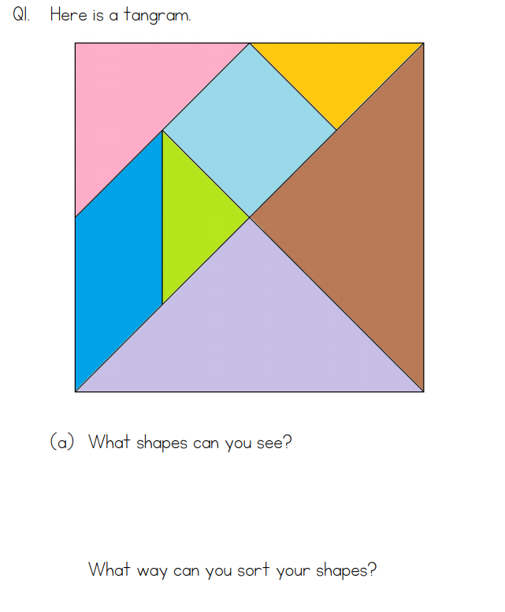

Slide 13
Have a great weekend! Don’t forget to send me a picture of something you’re proud of.

