Slide 1
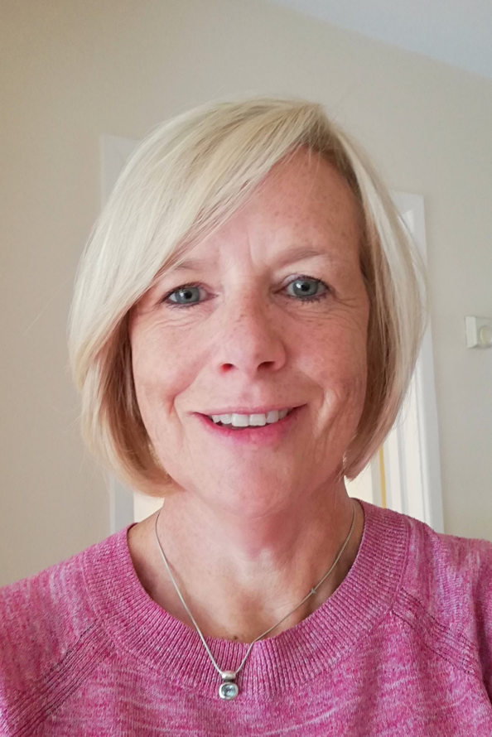
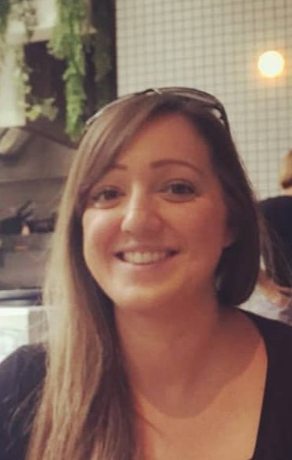
Welcome to Fernhill Primary School Meet the Teachers Year 4 Mrs Kerr & Miss Ayre (Teachers)

Slide 2
Meet the teacher…
Class Teacher: Mrs Kerr
A little about me:
I am currently working in a different Kite School , teaching Year 3 and am really looking forward to coming to Fernhill in September where I will be teaching Chestnut Class for part of the week. I am passionate about History so I am very excited about teaching some of the amazing topics we have coming up next year. When I’m not at School I enjoy running and have taken part in some 5K and 10K races. Unfortunately I am not very fast but I am always pleased to get over the finish line! I will also be doing lots of reading over the Summer as this is another of my favourite hobbies.
I’m really looking forward to meeting you all.

Slide 3
Meet the teacher…
Class Teacher: Miss Ayre
A little about me:
Last year, I joined the Fernhill family as the Year Six class teacher and Special Educational Needs Coordinator (SENCo). I have worked in Years 2, 4 and 6 throughout my teaching career. Next year, I will teach Chestnut class for part of the week and the rest of the week I will be carrying out my role as SENCo supporting pupils and staff across the whole school.
As some of you will know, I ran the Glee club last year because I love signing and dancing. I used to belong to a choir and enjoyed being part of a dance school when I was younger. In my free time I love baking and take part in adult tap lessons. More recently, I’ve also taken up walking as I’m sure most of you have enjoyed your daily exercise! I also love doing art and crafting.
I can’t wait to be your teacher next year and look forward to
getting to know you all.

Slide 4
Welcome to Fernhill Primary School Other adults working with Year 4
Teaching Assistant: Mrs Andrews

Slide 5
What to expect in Year 4:
Curriculum overviews can be found on our school website.
Multiplication test –
What is the Year 4 multiplication tables check?
The multiplication tables check is an online test for pupils in Year 4. Pupils are asked to answer 25 questions on times tables from two to 12. They are given six seconds per question, with three seconds rest between each question, so the test should last less than five minutes.
Questions about the six, seven, eight, nine, and 12 times tables are likely to come up most often, as these are the hardest for most children to learn. It’s a good idea to focus on these tricky times tables with your child.
First and foremost, the check is about finding out which children are struggling with their times tables so that they can get extra support. It is not a judgement on what your child can do, but a way for the school to know how their teaching is going and to adjust their focus if needed.
When is the check going to happen?
The test takes place in June.

Slide 6
How can you help? Preview Learning and Homework
Preview learning – a heads up on what the learning will be in the coming week to give your child a head start. This will be sent out each Friday. Please try and do the preview learning with your child as it will give your son or daughter a huge boost to their learning.
Times tables practise (Times Tables Rock Stars)

Slide 7
More ways to support your child
Encouraging your child to read is one of the best things you can do:
Hearing stories helps vocabulary grow.
The more words your child knows, the more they understand in science, history, geography and maths.
The more stories your child hears, the easier writing becomes.
In addition to this, help with spelling practise (there are a lot of spelling games available)
Please take a look at the school website for further information
https://www.fernhillprimary.kite.academy/curriculum/curriculum-policies/

Slide 8
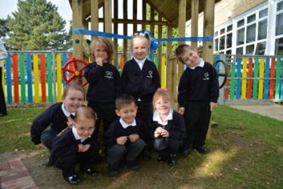
Reminder about uniform
School shoes only. Black trainers are not permitted.
Only stud earrings in school and your child must be able to remove their own earrings for each PE lesson.
PE Kits: Stay in weekly and should include white plain t-shirt/house t-shirt & black shorts.
All children participate in PE unless there is a medical reason not to.

Slide 9
Trips & Workshops
We think trips and activities are very important and do our best to get out and about as often as possible.
We will be following government guidelines when trips are possible.

Slide 10
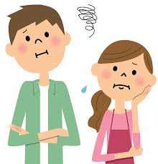
A worry or concern?
Always come and talk to us if you have a worry or a concern. This can be either face to face, on the phone or via a note in your child’s reading diary.
We’re usually available straight after school, except on Mondays (staff meetings) or if we are running a club. Please note Mrs Kerr will not be in school on a Thursday or Friday.
For longer appointments, please call the school office to arrange an appointment.

Slide 11
And finally….
Dear Chestnut Class,
We’re sorry we can’t see most of you in person now but we’re looking forward to meeting you in September. Until then, follow the link to stories we have recorded just for you.
https://kiteacademy.sharepoint.com/:v:/s/homelearning/EXDw8CB1MYhGqYI0MVorhngBg9vVZoDmgC3pB-Tev6KVIw?e=kUTftl

