Slide 1
Year 5 Chestnut Home Learning
Week commencing 06.07.20

Slide 2
Welcome back!
I hope you all had a fantastic weekend!
This week I have set bitesize links. Please watch the short videos and complete the activities. If you can not print an activity off you can work from the screen or move on to the next activity.
A lot of the work this week is revision, if you would like a challenge please take a look at cherrytree powerpoint on the school website
Enjoy and don’t forget to let me know how you got on!
Please let me know if the new home learning does not suit you or even if you like it better than the old style!

Slide 3
Bonus sessions computing
Why not have a go at these session throughout the week:
Day 1: how do we get computers to do what we want?
https://www.bbc.co.uk/bitesize/articles/z4gsy9q
Day 2: How does the internet and search engines work?
https://www.bbc.co.uk/bitesize/articles/zbk6pg8
Day 3: what are malware and viruses?
https://www.bbc.co.uk/bitesize/articles/zsj6wnb

Slide 4
mONDAY
Spelling mat
Maths activity
English

Slide 5
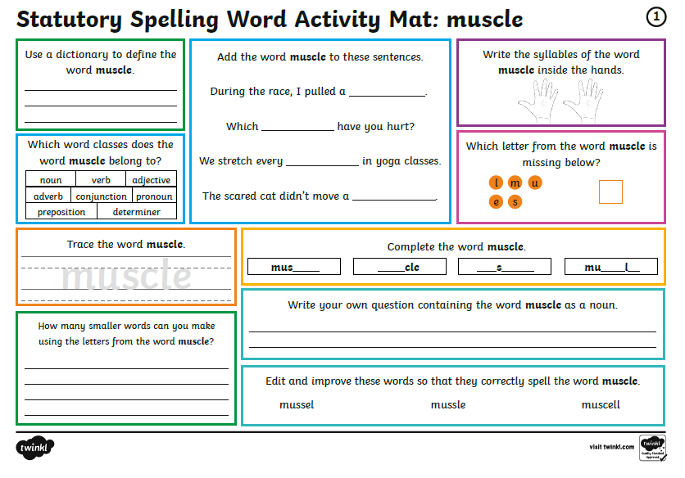
Spelling mat (you can work from the screen)

Slide 6
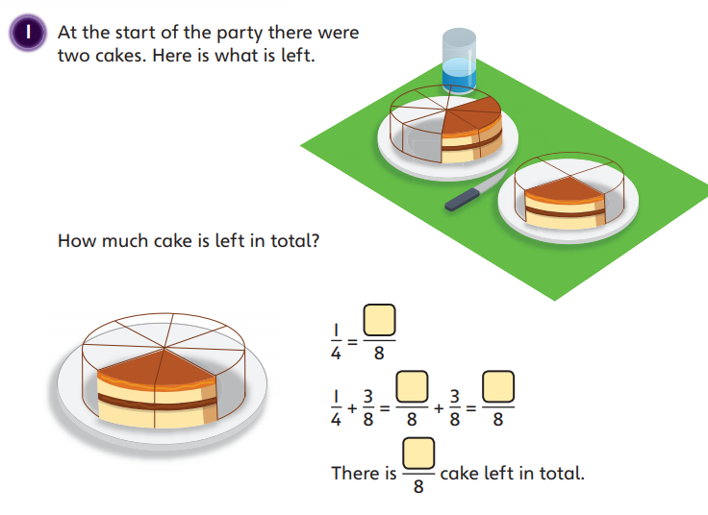
Add and subtract fractions within 1 https://www.bbc.co.uk/bitesize/articles/z42vgwx

Slide 7
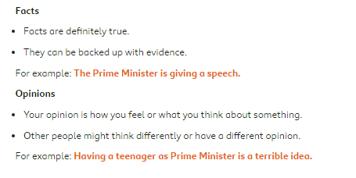
Fact and opinion https://www.bbc.co.uk/bitesize/articles/zkvg47h

Slide 8
TUESDAY
Spelling mat
Maths activity
English

Slide 9
Spelling mat (you can work from the screen)

Slide 10
Add 2 fractions where the answer could be greater than 1 https://www.bbc.co.uk/bitesize/articles/zdbmt39

Slide 11
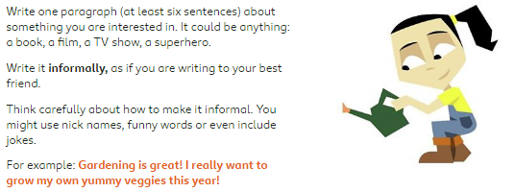
Formal and informal language https://www.bbc.co.uk/bitesize/articles/zmnvgwx

Slide 12
wednesDAY
Spelling mat
Maths activity
English

Slide 13
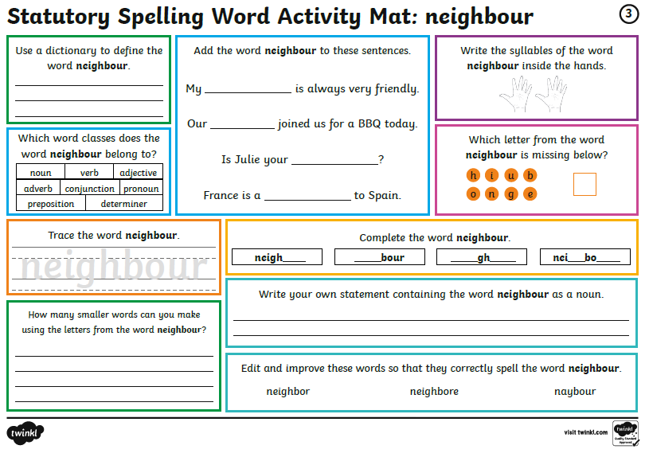
Spelling mat (you can work from the screen)

Slide 14
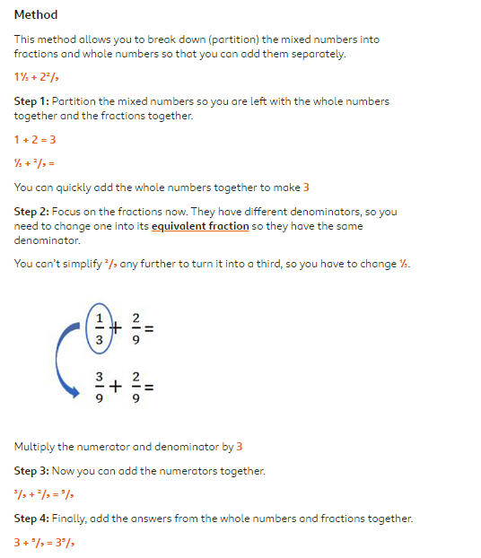
Adding 2 mixed numbers https://www.bbc.co.uk/bitesize/articles/zknvgwx

Slide 15
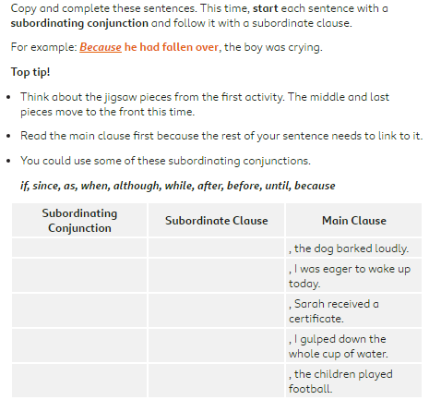
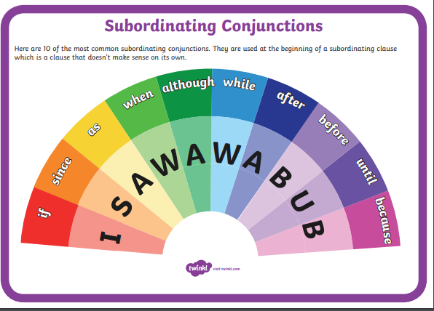
Using subordinating conjunctions https://www.bbc.co.uk/bitesize/articles/z6kj2sg

Slide 16
thursDAY
Spelling mat
Maths activity
English

Slide 17
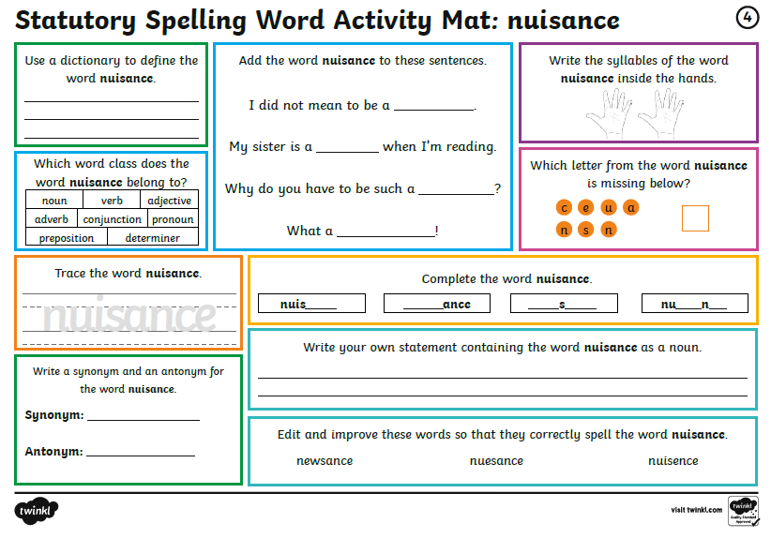
Spelling mat (you can work from the screen)

Slide 18
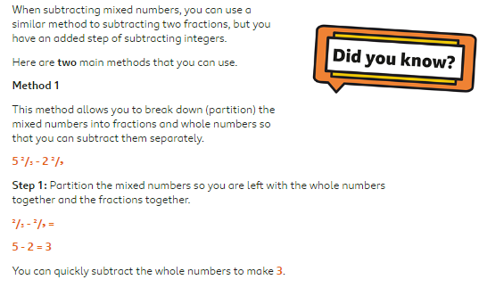
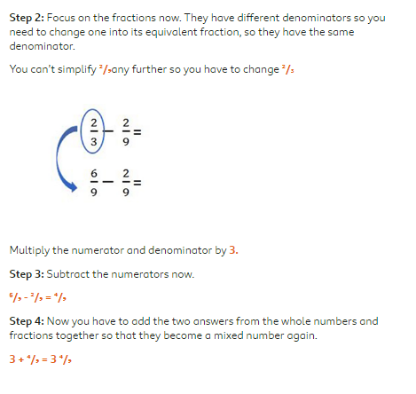
Subtract 2 mixed numbers https://www.bbc.co.uk/bitesize/articles/zhs9d6f

Slide 19
Creating a formal report https://www.bbc.co.uk/bitesize/articles/zrb48xs

Slide 20
friDAY
Spelling mat
Maths activity
English

Slide 21
Spelling mat (you can work from the screen)

Slide 22
Week 5 challenges https://www.bbc.co.uk/bitesize/articles/zd7j2sg

Slide 23
you’re a bad man, mr gum reading activity https://www.bbc.co.uk/bitesize/articles/zknnf4j
See the next slides for an extract and activity

Slide 24
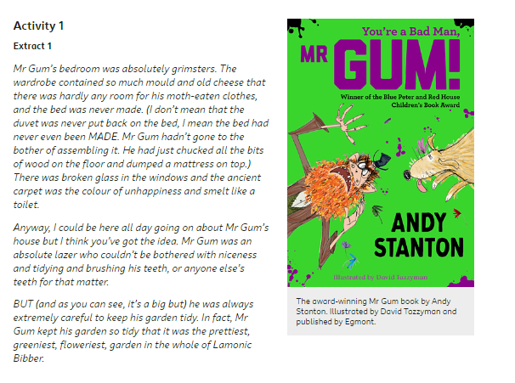
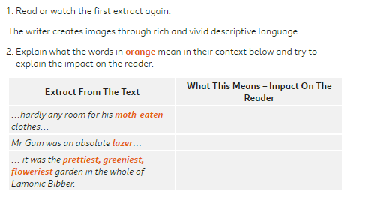

Slide 25
Have a great weekend!
Let me know how you got on
Chestnut.class@fernhill.kite.academy

