Slide 1
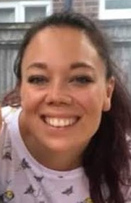
Welcome to Fernhill Primary School Meet the Teacher
Mrs Butler (Teacher) Year 5 – Maple class

Slide 2
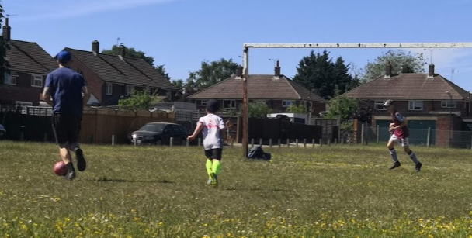
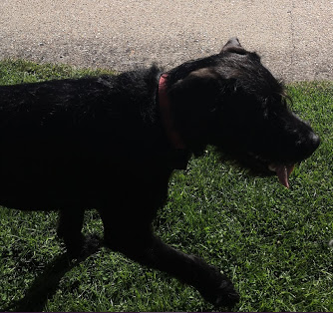
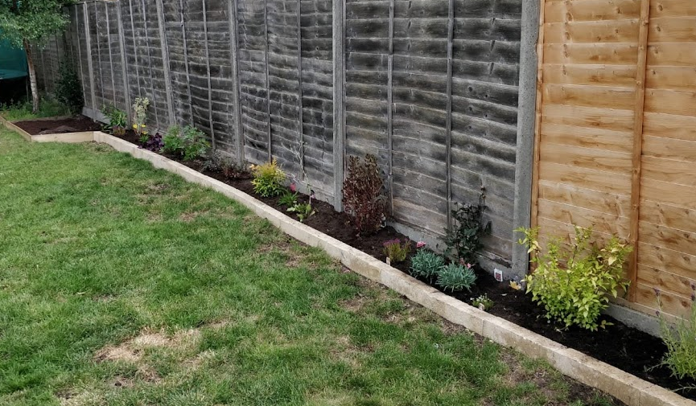
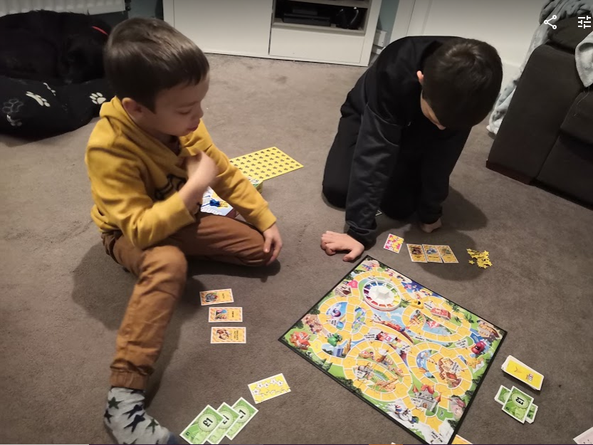
Meet the teacher…
My Favourites:
Colour - Purple
Season - Winter
Food – Mexican
Snack - Popcorn
Drink – Tea
Hobby – Jogging
Book – Matilda
Film – Toy Story
Game – Boggle
Music – All sorts – a bit of a mix!
Subject – Maths and Art
A little about me:
I live in Camberley with my husband and 2 sons, aged 6 and 10.
We have a dog, called Sampson, and we love to go on long walks together in the local woods. We enjoy going camping, to the beach, watching films, playing board games and seeing family and friends.
I enjoy being creative - making, baking or cooking and I try my best at gardening – I’m still learning!
I have my fingers crossed for my new vegetable patch and flowerbed.
Class Teacher: Mrs Butler

Slide 3
What to expect in Year 5:
High expectations – building increased responsibility, self organisation and independence
Active learners – ‘Be the best that you can be’
Collaboration - Maple class is a team – we work together in lots of ways!
Developing resilience – it’s ok to make mistakes or need help
Increased pace in lessons/ working to deadlines
Developing curiosity, imagination and creativity
Regular attendance:
“Missing 1 day a week regularly is the same as missing 1 whole school year.
Which year do you want to miss?”
Curriculum overviews can be found on our school website.

Slide 4
How can you help?
Preview learning – this information on what learning will be taking place in the coming week is to give your child a head start. This will be sent out each Friday.
Please try and do the preview learning with your child as often as possible - it will give your son or daughter a huge boost to their learning.
Times tables practise - Times Tables Rock Stars
If you are unsure of your child’s login, please let me know.

Slide 5
More ways to support your child
Encouraging your child to read is one of the best things you can do:
Hearing stories helps vocabulary grow.
The more words your child knows, the more they understand in science, history, geography and maths.
The more stories your child hears, the easier writing becomes
In addition to this, help with spelling practise:
Look, say, cover, write and check.
Illustrated spelling
Roll and spell (dice game)
Or there are a lot of spelling games available online e.g. https://www.topmarks.co.uk/english-games/7-11-years/spelling-and-grammar
Please take a look at the school website for further information
https://www.fernhillprimary.kite.academy/curriculum/curriculum-policies/

Slide 6
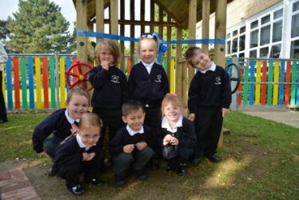
Reminders
Be prepared for your day in school. You should have everything you need with you e.g. a bottle of water, reading book and diary, a coat in the colder/wetter weather, kit for clubs.
Named uniform - school jumpers seem to have a mind of their own on PE day!
School shoes only - Black trainers are not permitted.
Only stud earrings in school and your child must be able to remove their own earrings for each PE lesson.
Full PE Kit must be kept in school weekly and should include white plain t-shirt/house t-shirt & black shorts. All children are expected to participate in PE unless there is a specified medical reason not to.

Slide 7
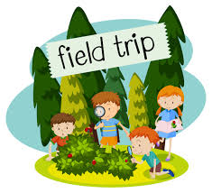
Trips & Workshops
We think trips and enrichment activities are very important and do our best to get out and about as often as possible.
We will be following government guidelines when trips become possible again in the future.

Slide 8
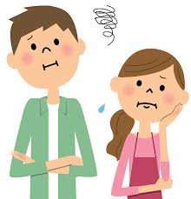
A worry or concern?
Always come and talk to me if you have a worry or a concern.
This can be either face to face, on the phone, by email or via a note in your child’s reading diary.
I am usually available straight after school, except on Mondays (staff meetings) or if I am running a club.
For longer appointments, please call the school office to arrange an appointment.

Slide 9
And finally….
Dear Maple Class,
I hope that you have a great summer break. Take time to enjoy being outside in the sunshine and, hopefully, meeting up safely with more of your family and friends.
I’m sorry I can’t see you in person now but I’m looking forward to meeting you in September. Until then, please follow the link to a short message and a favourite story that I have recorded, just for you.
See you soon,
Mrs Butler
https://kiteacademy.sharepoint.com/:v:/s/homelearning/EbNZdaMHRSFOpGzsbAxGdlABzUZIkk20zyARiQ__wsGLrw?e=ngs0ha

