Slide 1
Welcome to Fernhill Primary Academy Meet the Teacher Mr Thomas Year 3

Slide 2
Meet the teacher…
Class Teacher: Mr Thomas
A little about me:
I live in Farnborough and have two children, a son in year 6 and a daughter in year 3.
This will be my third year teaching at Fernhill Primary School.
When I was at school my favourite subjects were PE, Science and Maths.
I enjoy watching football (although as a West Ham fan perhaps I don’t enjoy it as much as I should).
My favourite children's book author is Frank Cottrell Boyce as his books are very funny.

Slide 3
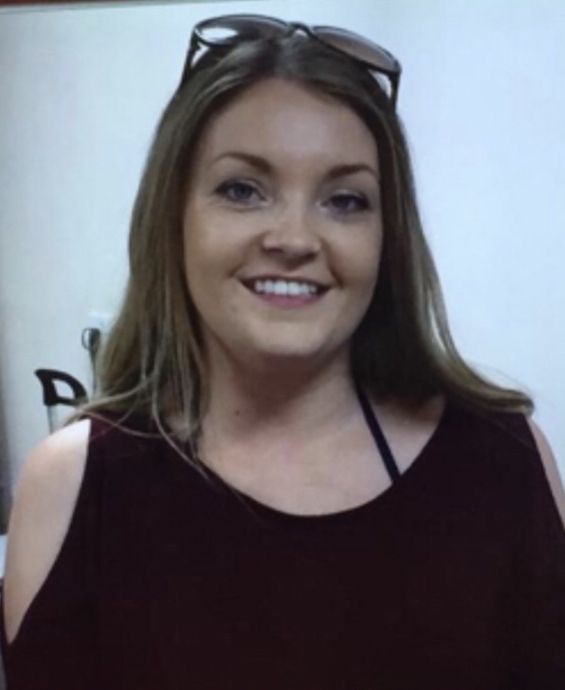
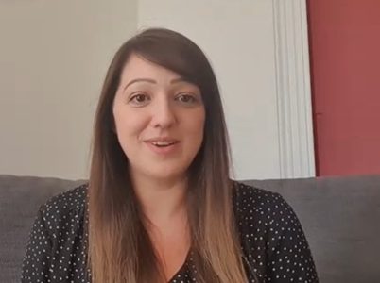
Welcome to Fernhill Primary School Other adults working with Year 3
Teaching Assistant: Mrs Cloherty SENCo: Ms Katie Ayre

Slide 4
What to expect in Year 3:
A lot of fun!
This is the first year of Key Stage 2
Learning becomes more formal but same subjects are covered: maths, English, spellings, guided reading, history, geography, IT, PE, RE,PSHE, art & DT. In addition, children begin to learn French as a modern foreign language.
Curriculum overviews can be found on our school website.

Slide 5
How can you help? Pre view Learning and Homework
Preview learning – a heads up on what the learning will be in the coming week to give your child a head start. This will be sent out each Friday. Please try and do the preview learning with your child as it will give your son or daughter a huge boost to their learning
Times tables practise (Times Tables Rock Stars)

Slide 6
More ways to support your child
Reading with and to your child is one of the best things you can do:
Hearing stories helps vocabulary grow.
The more words your child knows, the more they understand in science, history, geography and maths.
The more stories your child hears, the easier writing becomes.
In addition to this, help with spelling practise (there are a lot of spelling games available)
Please take a look at the school website for further information
https://www.fernhillprimary.kite.academy/curriculum/curriculum-policies/

Slide 7
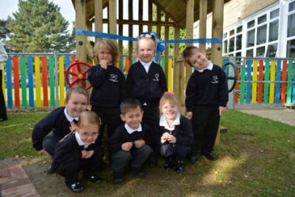
Reminder about uniform
School shoes only. Black trainers are not permitted.
Only stud earrings in school and your child must be able to remove their own earrings for each PE lesson
PE Kits: Stay in weekly and should include white plain t-shirt/house t-shirt & black shorts.
All children participate in PE unless there is a medical reason not to.

Slide 8
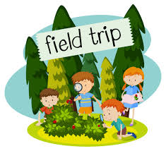
Trips & Workshops
We think trips and activities are very important and do our best to get out and about as often as possible.
We will be following government guidelines when trips are possible.

Slide 9
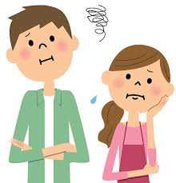
A worry or concern?
Always come and talk to us if you have a worry or a concern. This can be either face to face, on the phone or via a note in your child’s reading diary.
I’m usually available straight after school, except on Mondays (staff meetings) or if I am running a club.
For longer appointments, please call the school office to arrange an appointment.

Slide 10
And finally….
Dear Sycamore Class,
I’m sorry I can’t see most of you in person now but I’m looking forward to meeting you in September. Until then, follow the link to a story I have recorded just for you.
https://kiteacademy.sharepoint.com/:v:/s/homelearning/EWzL7zdntfhOthBqtrQfPsgBfm96p4NgRnuwn3xJjU2NMg?e=Q5dA48

