Slide 1
Mathematics
4th May 2020

Slide 2
Useful Websites https://whiterosemaths.com/homelearning/ https://www.bbc.co.uk/bitesize/dailylessons https://ttrockstars.com/login
Remember to click play on the power point and make the screen larger.
You can go back and watch the power point video as many times as you need.
Don’t forget to mark your answers when you have finished. If you have one you could use a green marking pen. Or any other colour that you have not been writing in.

Slide 3
Monday 4th May
Summer Week 2 – Lesson 1 – compare lengths
Remember to practise your TTRS and telling the time today.

Slide 4

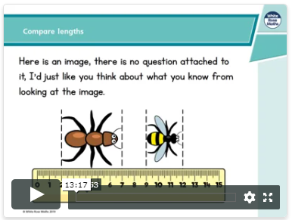
https://whiterosemaths.com/homelearning/year-2/
Click on the link to take you to the power point. Watch the power point before completing the activities. Remember you can watch this as many times as you need.
Now it is your turn. Have a go at the questions on the next page.
Lesson 1 – compare length

Slide 5
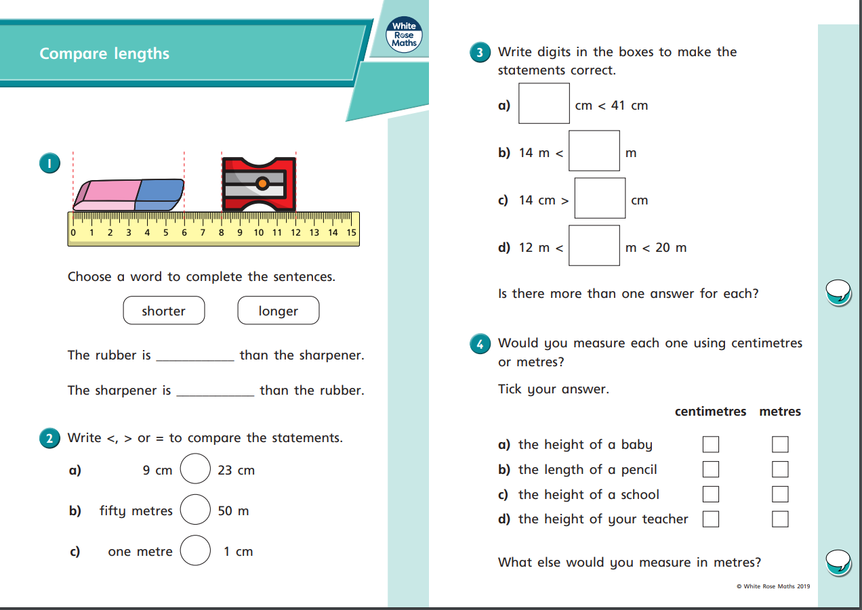
Remember you can answer these questions in your book, instead of having to print out the sheets.

Slide 6
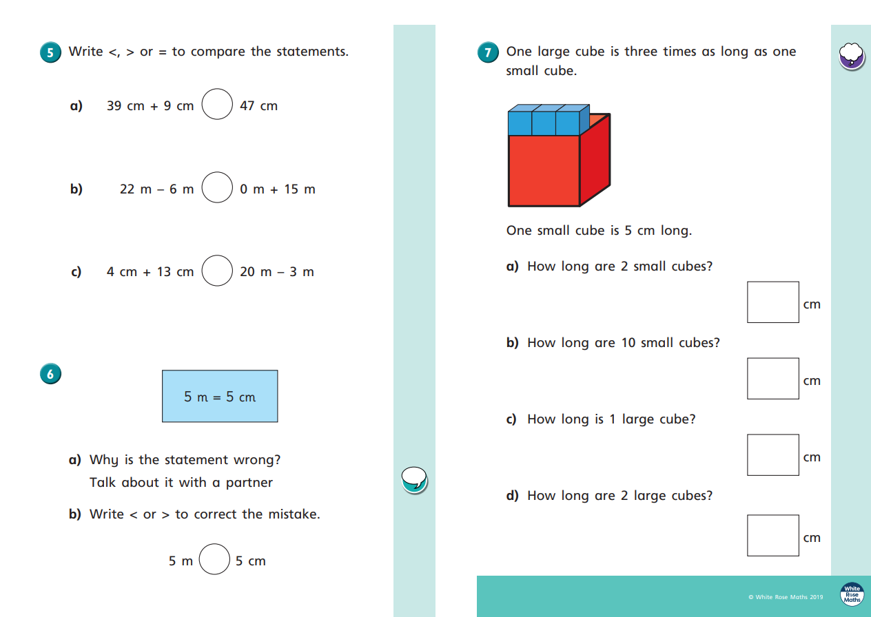
Challenge yourself to measure some of the objects around your home.

Slide 7
Tuesday 5th May
Summer Week 2 – Lesson 2 – order lengths
Remember to practise your TTRS and telling the time today.

Slide 8
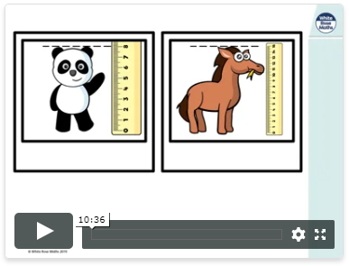
https://whiterosemaths.com/homelearning/year-2/
Click on the link to take you to the power point. Watch the power point before completing the activities. Remember you can watch this as many times as you need.
Now it is your turn. Have a go at the questions on the next page.
Lesson 2 - compare lengths

Slide 9
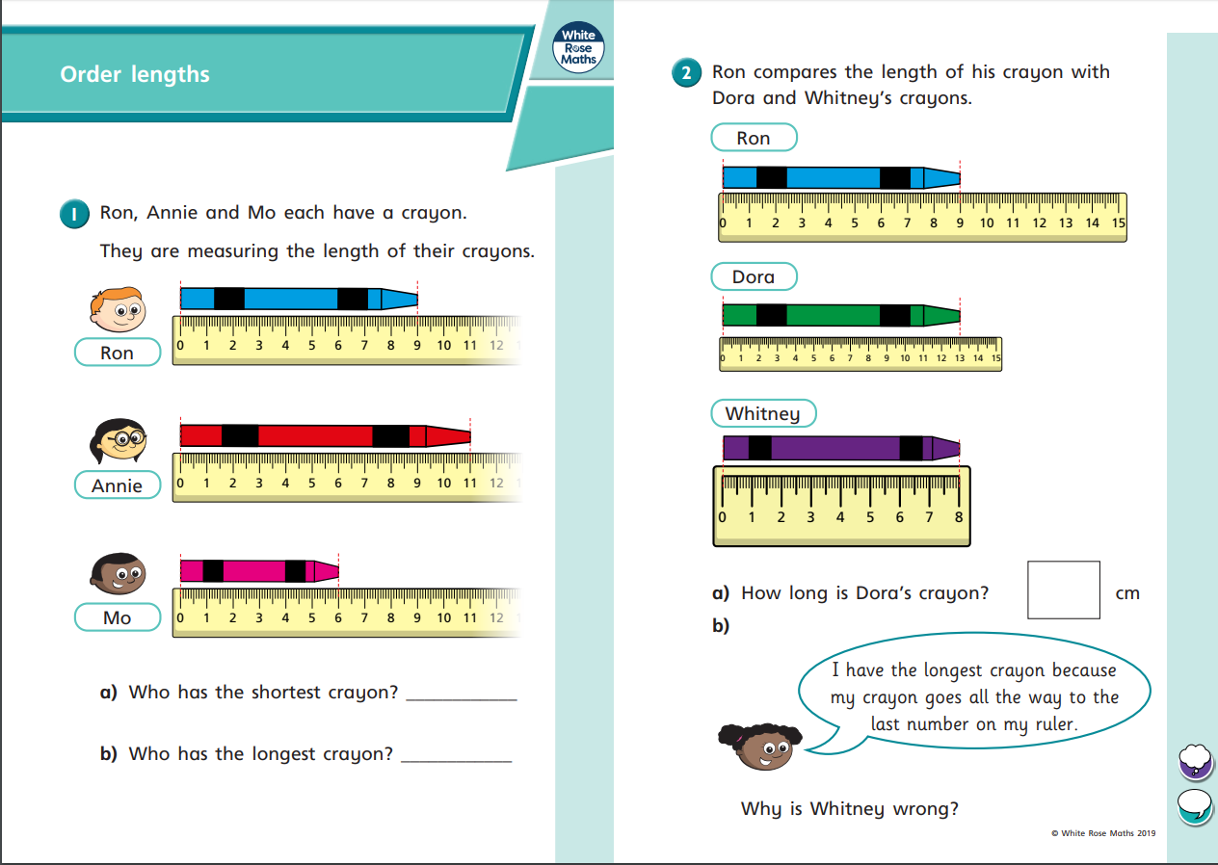
Remember you can answer these questions in your book, instead of having to print out the sheets.

Slide 10
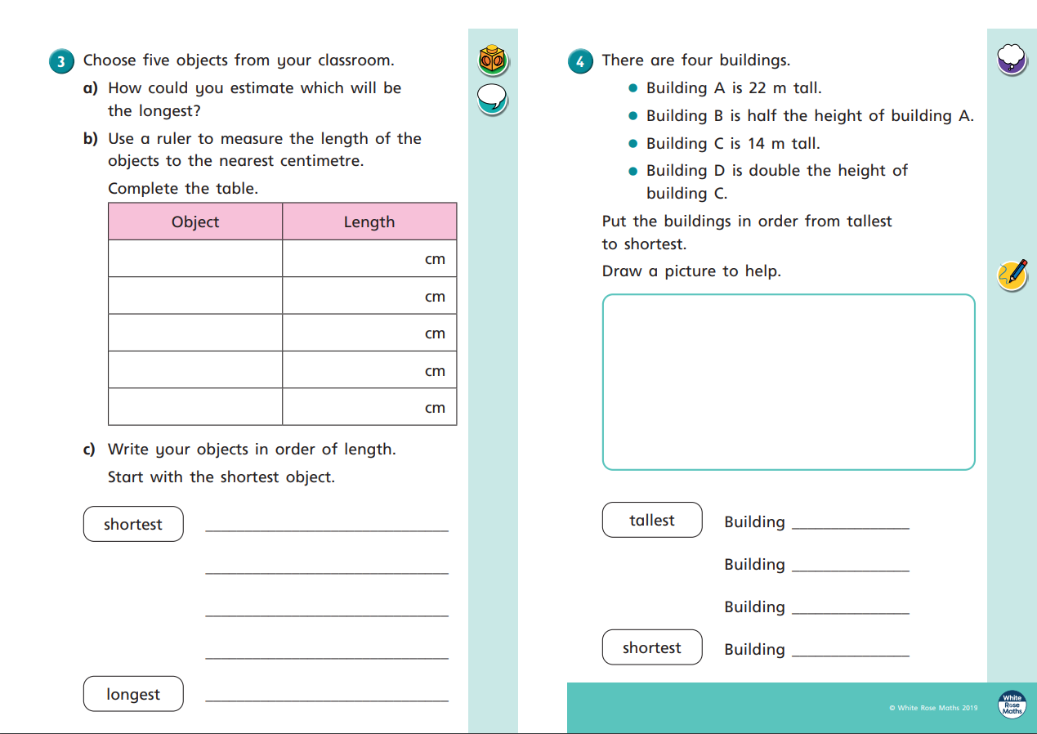

Slide 11
Wednesday 6th May
Summer Week 2 – Lesson 3 – four operations with length
Remember to practise your TTRS and telling the time today.

Slide 12
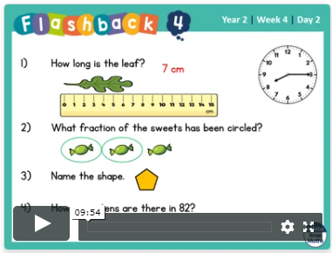
https://whiterosemaths.com/homelearning/year-2/
Click on the link to take you to the power point. Watch the power point before completing the activities. Remember you can watch this as many times as you need.
Now it is your turn. Have a go at the questions on the next page.
Lesson 2 - four operations with length

Slide 13
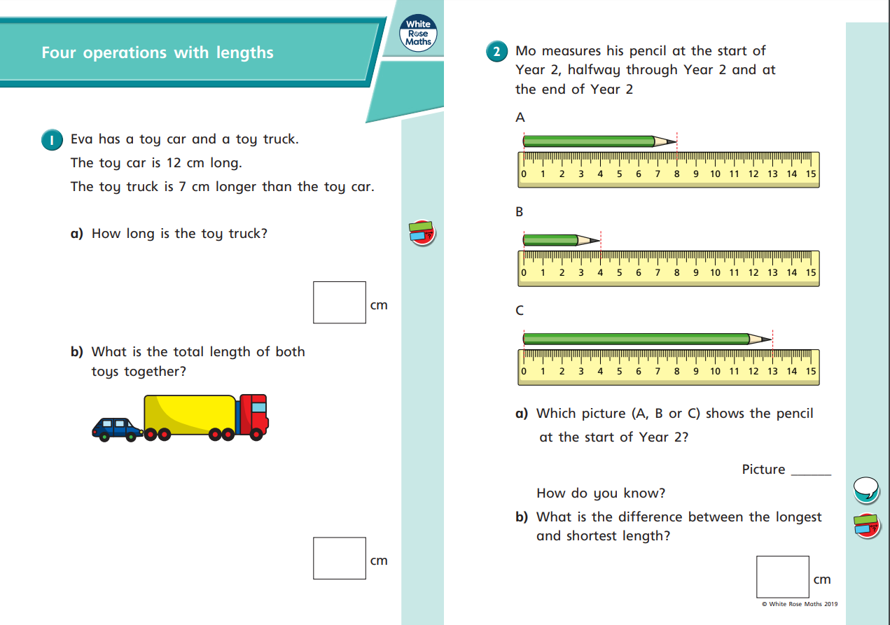

Slide 14
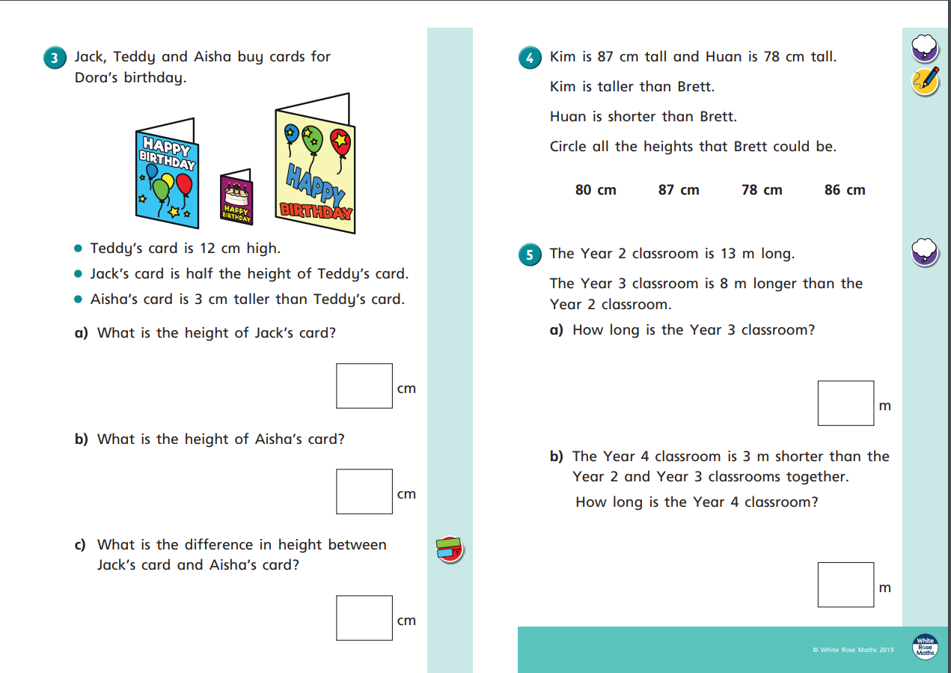

Slide 15
Thursday 7th May
Summer Week 2 – Lesson 4 – problem solving
Remember to practise your TTRS and telling the time today.

Slide 16
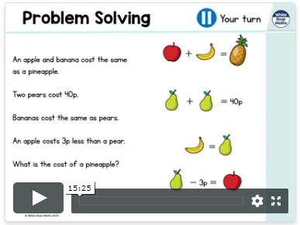
https://whiterosemaths.com/homelearning/year-2/
Click on the link to take you to the power point. Watch the power point before completing the activities. Remember you can watch this as many times as you need.
Now it is your turn. Have a go at the questions on the next page.
Lesson 2 - problem solving

Slide 17
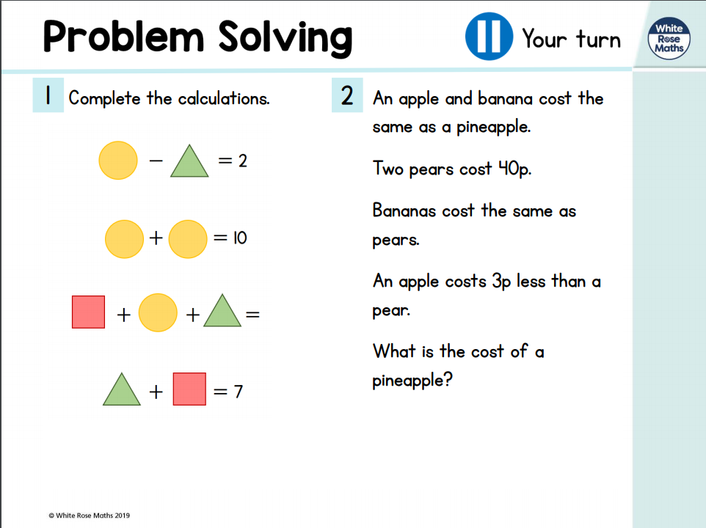

Slide 18
