Slide 1
Mathematics
4th May 2020

Slide 2
Useful Websites https://whiterosemaths.com/homelearning/ https://www.bbc.co.uk/bitesize/dailylessons https://ttrockstars.com/login
Remember to click play on the power point and make the screen larger.
You can go back and watch the power point video as many times as you need.
Don’t forget to mark your answers when you have finished. If you have one you could use a green marking pen. Or any other colour that you have not been writing in.

Slide 3
Monday 4th May
Summer Week 2 – Lesson 1 – find a half. (2)
Remember to practise your number bonds and telling the time today.

Slide 4

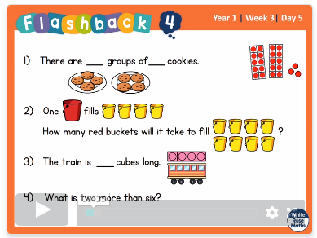
https://whiterosemaths.com/homelearning/year-1/
Click on the link to take you to the power point. Watch the power point before completing the activites. Remember you can watch this as many times as you need.
Now it is your turn. Have a go at the questions on the next page.
Lesson 1 – find a half (2)

Slide 5
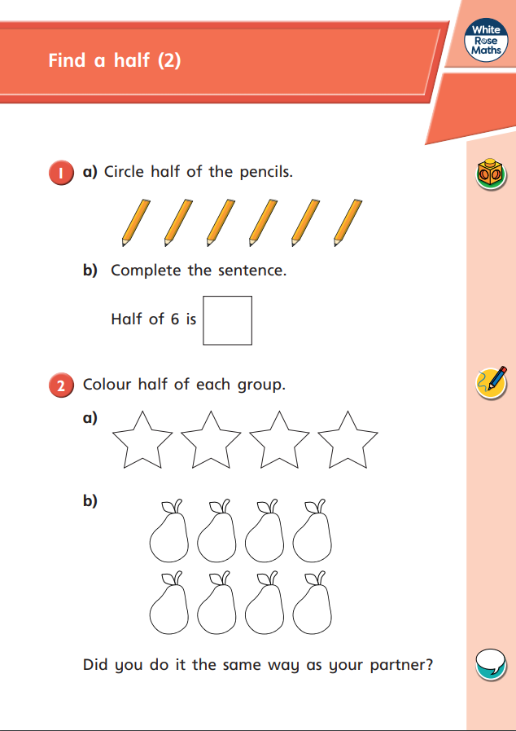
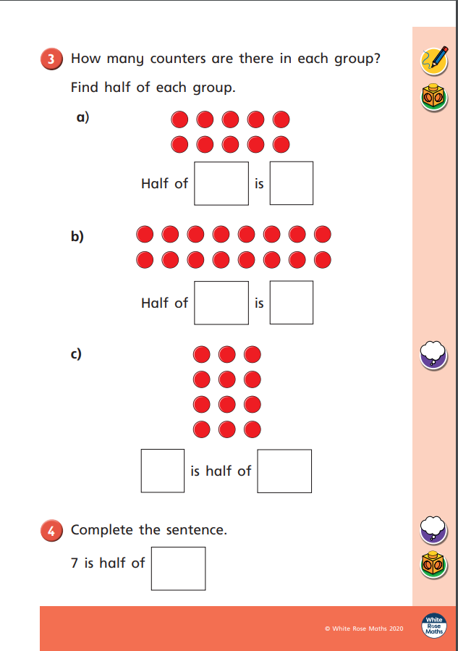
It might help to use some objects to help your count.

Slide 6
Tuesday 5th May
Summer Week 2 – Lesson 2 – find a quarter (1)
Remember to practise your number bonds and telling the time today.

Slide 7
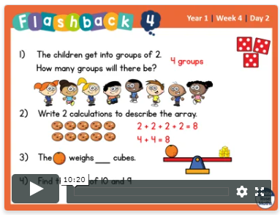
https://whiterosemaths.com/homelearning/year-1/
Click on the link to take you to the power point. Watch the power point before completing the activites. Remember you can watch this as many times as you need.
Now it is your turn. Have a go at the questions on the next page.
Lesson 2 - find a quarter.

Slide 8
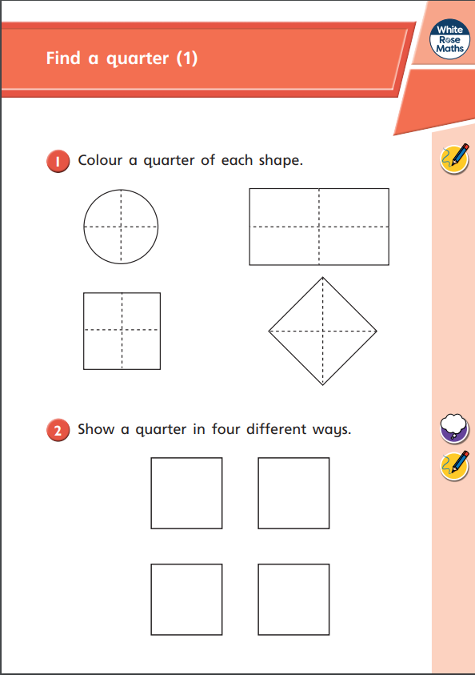
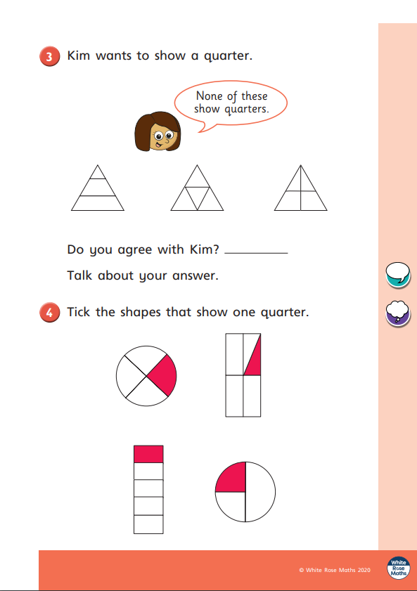
If you can’t print these sheets out have a go at drawing them in your books.

Slide 9
Wednesday 6th May
Summer Week 2 – Lesson 3 – find a quarter (2)
Remember to practise your number bonds and telling the time today.

Slide 10
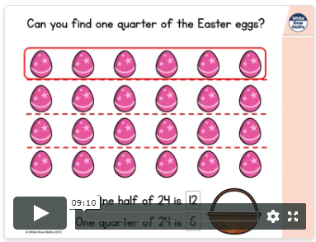
https://whiterosemaths.com/homelearning/year-1/
Click on the link to take you to the power point. Watch the power point before completing the activites. Remember you can watch this as many times as you need.
Now it is your turn. Have a go at the questions on the next page.
Lesson 2 - find a quarter (2)

Slide 11
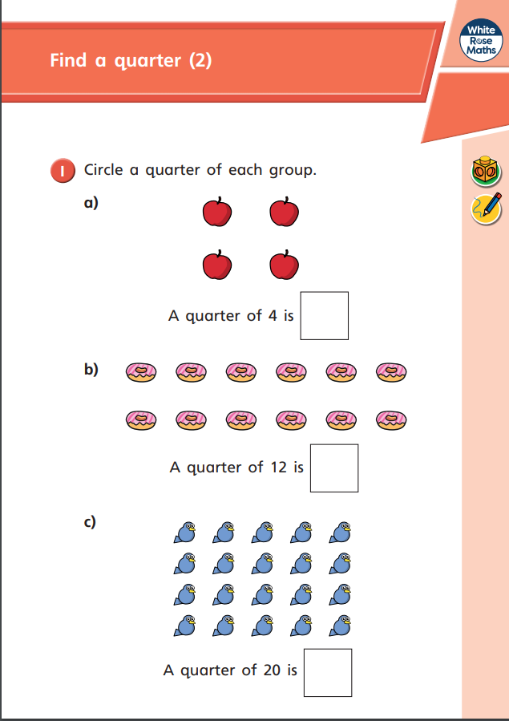
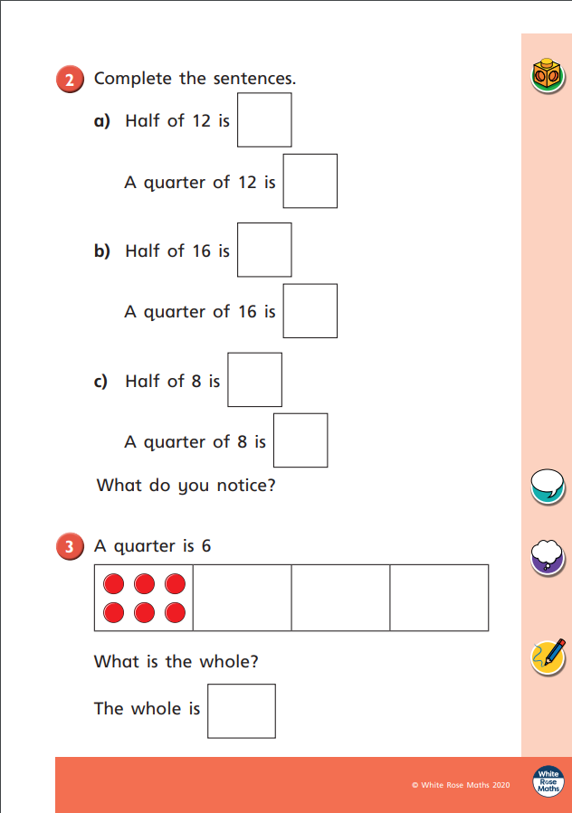
Challenge yourself to find a quarter of some of the objects in your home.

Slide 12
Thursday 7th May
Summer Week 2 – Lesson 4 – Problem solving
Remember to practise your number bonds and telling the time today.

Slide 13
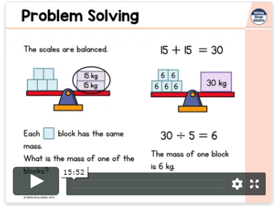
https://whiterosemaths.com/homelearning/year-1/
Click on the link to take you to the power point. Watch the power point before completing the activites. Remember you can watch this as many times as you need.
Now it is your turn. Have a go at the questions on the next page.
Lesson 2 - find a quarter (2)

Slide 14
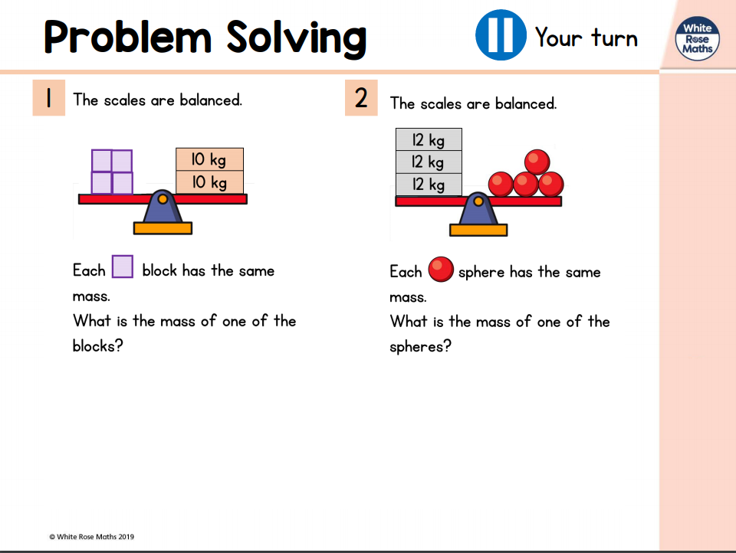

Slide 15
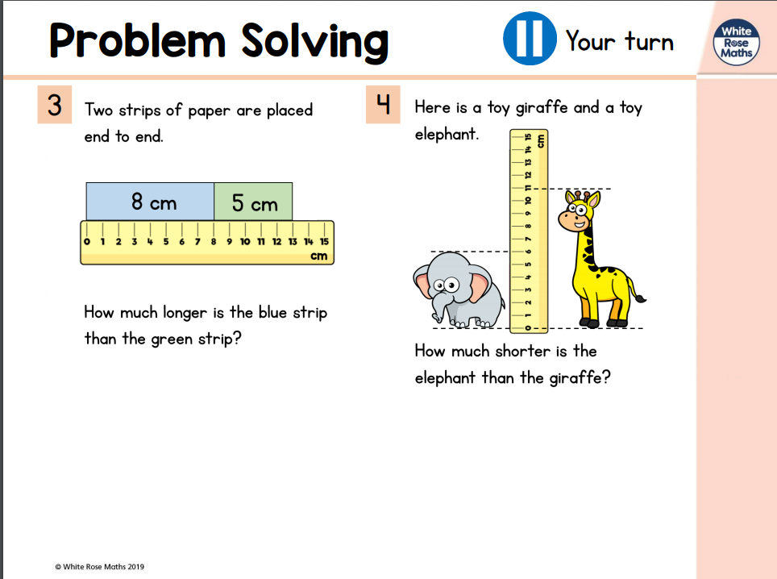

Slide 16
Friday 8th May
Summer Week 2 – Lesson 4 – Problem solving
Remember to practise your number bonds and telling the time today.

