Slide 1
Writing
Willow Class
4th May 2020

Slide 2
Daily handwriting practise

Slide 3
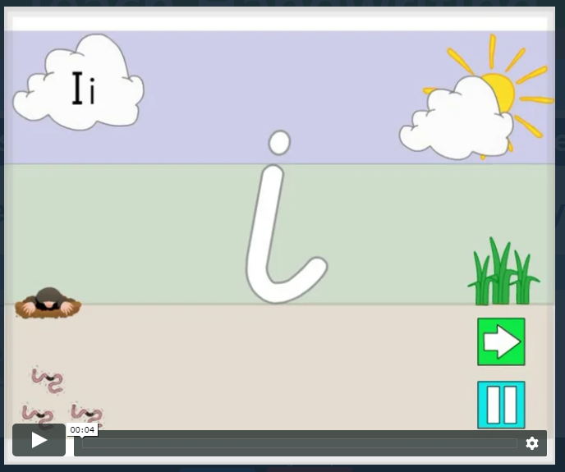
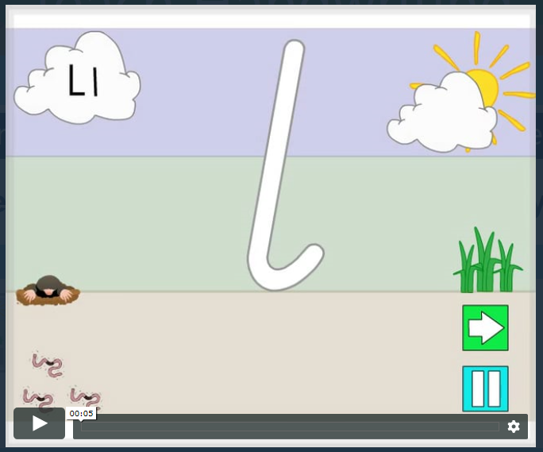
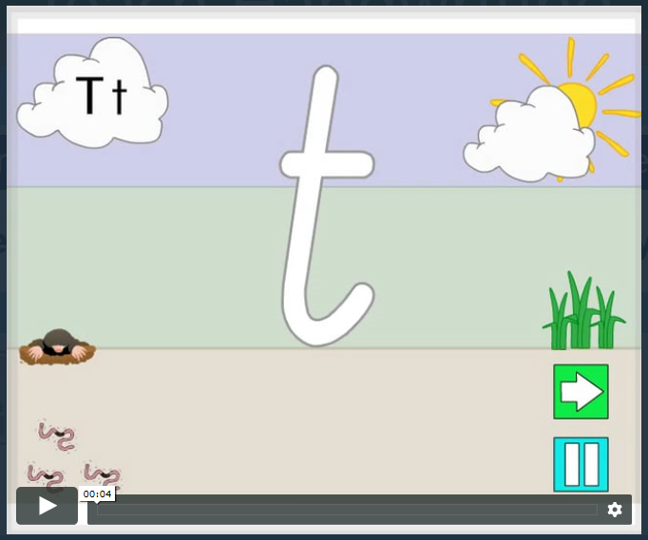
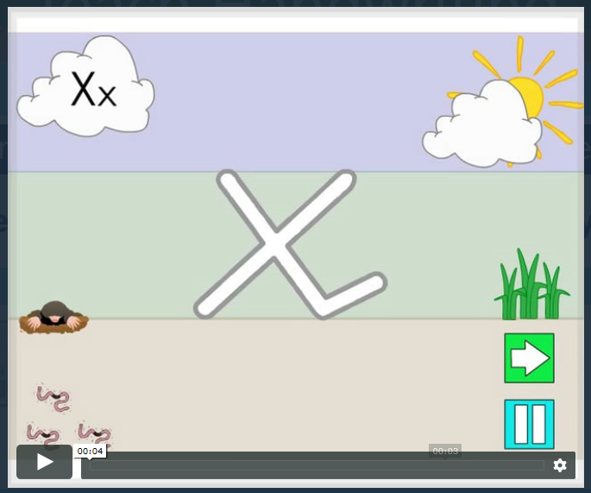
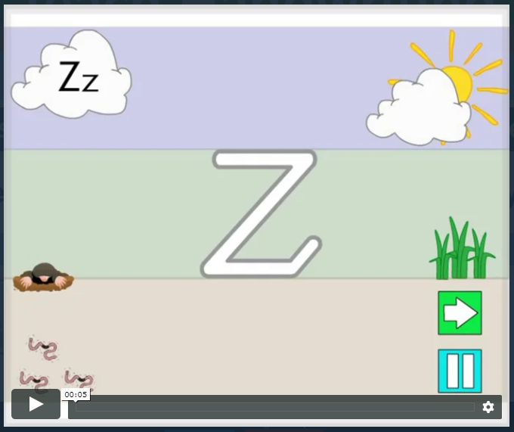
Daily handwriting practise. https://www.teachhandwriting.co.uk/cursive-letters-beginners-choice-2.html
This week I would like you to start each writing session by practising your handwriting. Remember to write just three letters and then check back with the video, to make sure that you are forming your letters correctly.
No more than half a line of each letter in a day!
Remember all of these letters belong to the same family.

Slide 4
Daily spelling practise

Slide 5

Spelling and phonics - Year 1
Please continue to watch the daily phonics videos.
https://www.youtube.com/channel/UCo7fbLgY2oA_cFCIg9GdxtQ
Remember we are working on Set 3 sounds.
Please learn to spell these words.
Monday
Tuesday
Wednesday
Thursday
Friday
Saturday
Sunday.

Slide 6
Spelling - Year 2
Please learn to spell these words.
station
fiction
motion
national
section
addition
subtraction
potion
option
introduction
All of these words containing the sound ‘tion’
When you are learning to spell these words it might be helpful to break them up.
So station can be broken in sta-tion
fiction becomes fic-tion
motion becomes mo-tion
This might help you to learn how to spell the words more easily.
Once you have learnt them see if you can find some other words containing the sound ‘tion’

Slide 7
Writing activities

Slide 8
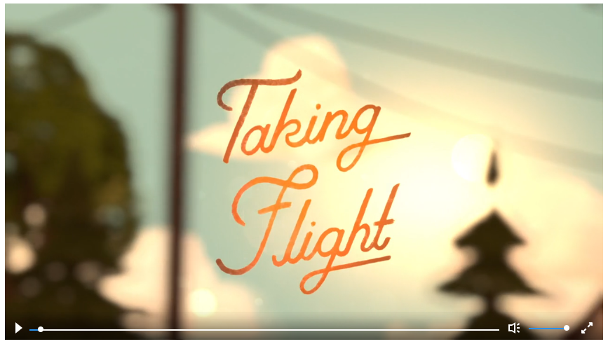
This week we will be basing our writing around this short film.
Start by clicking on the link below to watch the film.
https://www.literacyshed.com/takingflight.html

Slide 9
Monday 4th May
Writing activities

Slide 10
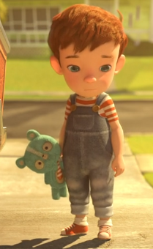
Let’s look at the story in a little more detail.
This is Tony. He is our main character and we are going to be telling the story from his viewpoint.
Each day we are going to be looking at just one part of the story. We will be writing just a couple of sentences to go with the plot point that we are looking at.
It is really important that you do not move on and go past the point that we are looking at each day.

Slide 11
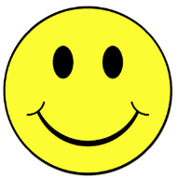
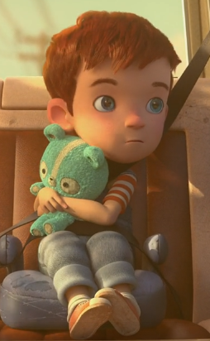
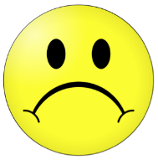
We are going to think carefully about how Tony is feeling at each point in the story.
Watch the story again, but stop at 2:10 minutes.
Today we are going to be thinking about this point in the story.
?
Plot point 2
?
Plot point 3
?
Plot point 4
?
Plot point 5
?
Plot point 1
I think that Tony is feeling a little bit sad and sorry for himself in this part of the story. So I am going to try and use vocabulary that makes me feel that way.

Slide 12


I’m going to start off telling my reader about when and what Tony was doing.
Later…
That morning…
On Tuesday afternoon
Before long…
After a while…
In the morning…
On Wednesday…
It was Thursday…
You can choose a word of you own or use the word bank.
It was early on Monday morning, Tony sat in the back of the car feeling upset. Dad was driving him to Grandpa’s house.
sad
long-faced
miserable
upset
dejected
glum
sorrowful
wretched
Now go and write some sentences of your own, before turning over the page.

Slide 13
My next sentence or two is going to tell the reader how Tony was feeling.
I’ve chosen to use sank down, rather than sat down as it adds to the sense of sadness.
You can choose a word of you own or use the word bank.
sad
long-faced
miserable
upset
dejected
glum
sorrowful
wretched
Dad left and Tony sank down onto the carboard box. He was feeling dejected, miserable and upset. It was going to be a long and boring day.
Now go and write some sentences of your own, before turning over the page.

Slide 14

In my next couple of sentences I want to describe how the helmet tumbled down. I want to include lots of words that make me think of action.
Here I’ve chosen to use old and musty to describe the boxes as that would add to the sadness of the sentence.
sad
long-faced
miserable
upset
dejected
glum
sorrowful
wretched
You can choose a word of you own or use the word bank.
Tony was bored. He glanced up at the shelf and clambered up a pile of old, musty boxes to take a closer look. Before long the pile collapsed. The boxes disintegrated and everything came plummeting to the ground.
tumbling
toppling
stumble
collapse
slide
plummet
disintegrate
Now go and write some sentences of your own, before turning over the page.

Slide 15
Tuesday 5th May
Writing activities

Slide 16
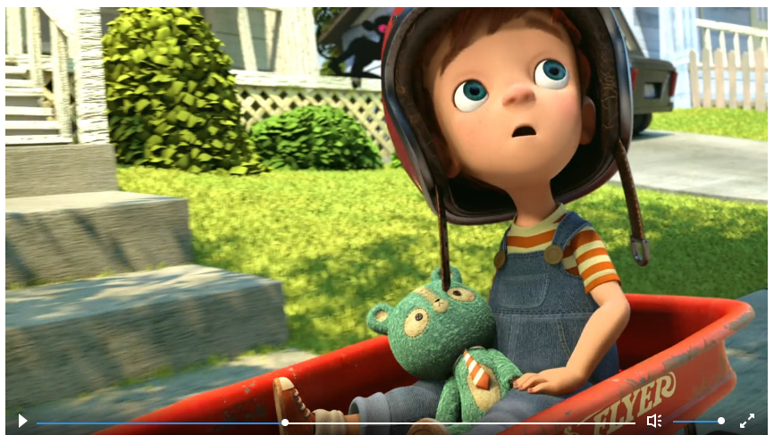
We are going to think carefully about how Tony is feeling at each point in the story.
Watch the story again. Start at 2:10 and watch until 2:50
Plot point 2
?
Plot point 3
?
Plot point 4
?
Plot point 5
?
Plot point 1
I think that Tony is beginning to feel a little bit better here. What do you think?

Slide 17

I want to use a sentence that includes a conjunction.
when
if
that
but
so
because
and
or
You can choose a word of you own or use the word bank.
Grandpa took Tony out on the shiny red cart.
He looked up at the trees. He thought he saw a monkey, but he wasn’t sure. Tony didn’t feel so glum anymore
sad
long-faced
miserable
upset
dejected
glum
sorrowful
wretched
Now have a go at writing a couple of sentences.

Slide 18
There is lots of action in this part of the story, so I want to use some words that show this.
running
racing
crashing
tumbling
falling
plummeting
plunging
You can choose a word of you own or use the word bank.
Before long, they were racing into the forest, The cart flew through the air and with a huge splash it landed in the water, narrowly missing a crocodile. Suddenly a water fall appeared in front of them and the cart went crashing over the top.
excited
elated
in high spirits
joyful
thrilled
ecstatic
overjoyed
full of happiness
full of excitement
on top of the world
Now have a go at writing a couple of sentences. Make sure one of them uses a conjunction.

Slide 19
Wednesday 6th May
Writing activities

Slide 20
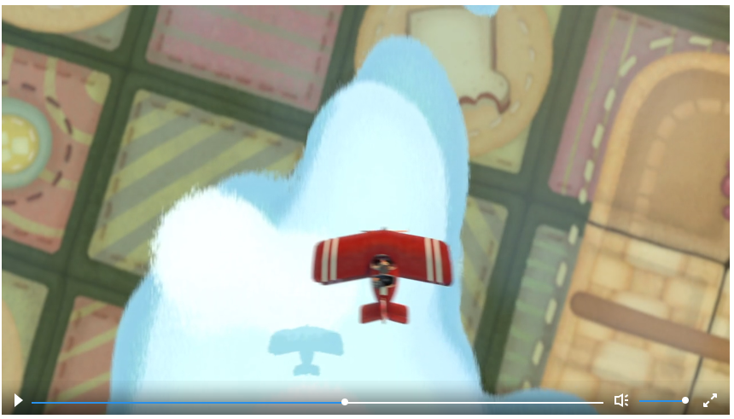
We are going to think carefully about how Tony is feeling at each point in the story.
Plot point 3
Watch the film again from 2:50 until 3:31
Plot point 2
?
Plot point 4
?
Plot point 5
?
Plot point 1
I think that Tony is feeling much happier now and is really beginning to enjoy himself. So I have moved the point to the happy side of the line.
Do you agree with me?

Slide 21
There is lots of action in this part of the story, so I want to use some words that show this.
running
racing
crashing
tumbling
falling
plummeting
plunging
gliding
soaring
You can choose a word of you own or use the word bank.
Falling, falling, falling the cart plummeted down, before swooping upwards into the clouds. They were in the air! Gliding, twisting and turning the plane travelled happily through the sky.
excited
elated
in high spirits
joyful
thrilled
ecstatic
overjoyed
full of happiness
full of excitement
on top of the world
Now have a go at writing a couple of sentences. Make sure one of them uses a conjunction.

Slide 22
In my next couple of sentences I really want to show the reader how happy Tony is now.
excited
elated
in high spirits
joyful
thrilled
ecstatic
overjoyed
full of happiness
full of excitement
on top of the world
You can choose a word of you own or use the word bank.
Tony was filled with a sense of excitement as they swooped through the clouds. The wind racing through his hair made him feel as if he was on top of the world.
Now have a go at writing a couple of sentences. Make sure one of them uses a conjunction.

Slide 23
Thursday 7th May
Writing activities

Slide 24
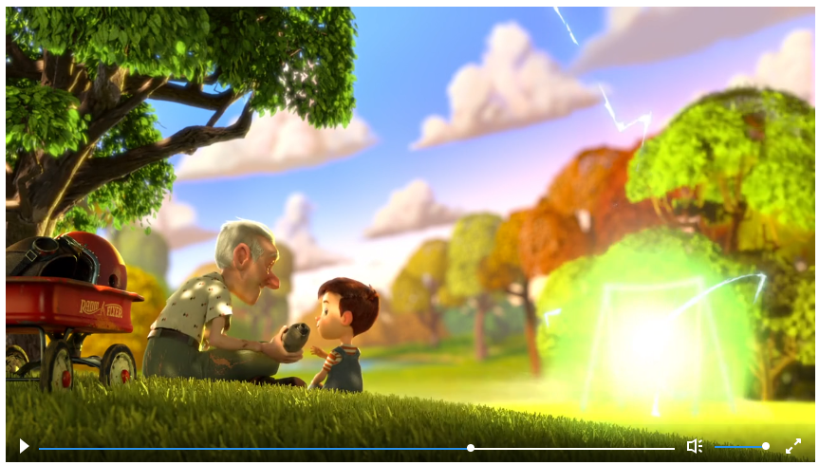
We are going to think carefully about how Tony is feeling at each point in the story.
Plot point 3
Plot point 4
Watch the film again from 3:31 to 4:07
Plot point 2
Plot point 5
?
Plot point 1
I think that Tony is feeling much happier now and is really beginning to enjoy himself. So I have moved the point to the happy side of the line.
Do you agree with me?

Slide 25
In my next couple of sentences I really want to show the reader how happy Tony is now.
excited
elated
in high spirits
joyful
thrilled
ecstatic
overjoyed
full of happiness
full of excitement
on top of the world
You can choose a word of you own or use the word bank.
In high spirits, Tony and Grandad sat down to have a delicious picnic in the park. All of a sudden, a lazer beam hit the swing. Grandpa and Tony were off again, racing through space.
Now have a go at writing a couple of sentences. Make sure one of them uses a conjunction.

Slide 26
I still want to show that Tony is happy and I want to use a conjunction in my next couple of sentences.
when
if
that
but
so
because
and
or
You can choose a word of you own or use the word bank.
Tony and Grandpa followed the aliens into space. Tony was a little bit scared but he soon forgot that as they chased the aliens. Tony felt elated as they raced through the stars.
excited
elated
in high spirits
joyful
thrilled
ecstatic
overjoyed
full of happiness
full of excitement
on top of the world
Now have a go at writing a couple of sentences. Make sure one of them uses a conjunction.

Slide 27
Friday 8th May
Writing activities

Slide 28
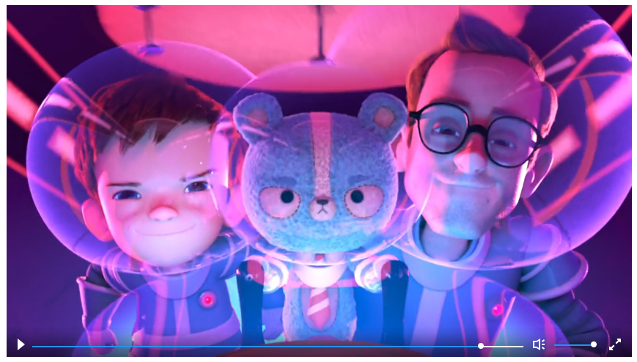
We are going to think carefully about how Tony is feeling at each point in the story.
Plot point 4
Plot point 5
Plot point 3
Watch the film again from 4:07 to the end.
Plot point 2
?
Plot point 1
I think that this is the point in the story where Tony is the happiest, because his Dad had come home and they are playing together.

Slide 29
I want to use ask a question in this section.
?
You can choose a word of you own or use the word bank.
Tony heard a car drive up. It was Dad. What was Dad going to do?
excited
elated
in high spirits
joyful
thrilled
ecstatic
overjoyed
full of happiness
full of excitement
on top of the world
Now have a go at writing a couple of sentences. Make sure one of them uses a conjunction.

Slide 30
It’s time to finish the story. Remember I want to let everyone know that Tony is really happy at this point in the story.
You can choose a word of you own or use the word bank.
Tony watched as Dad hopped into the space ship. He was filled with a sense of happiness as they set off again chasing the aliens through outer space.
excited
elated
in high spirits
joyful
thrilled
ecstatic
overjoyed
full of happiness
full of excitement
on top of the world
Now have a go at writing a couple of sentences. Make sure one of them uses a conjunction.

Slide 31
Now read through your story. Is there anything you would like to improve?
Email your finished stories to:
Willow.class@Fernhill.kite.academy

