Slide 1
Home Learning
01.06.2020

Slide 2
Welcome back Chestnuts!
I hope you had a great half term? My speaker is not recording this week I’m afraid so no voice message from me…
I have changed the maths this week and thought it would be fun to have a week of challenges…enjoy!

Slide 3
How it works
Complete the daily Maths investigations and challenges.
Complete the daily English activity
Don’t forget to play Times Tables Rockstars throughout the week
Spelling challenge question for each day
Read every day. Practise reading aloud, and in your head.

Slide 4
Monday

Slide 5
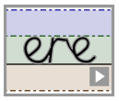
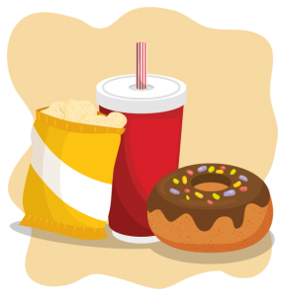
Handwriting It’s important to keep practising your handwriting… it’s a muscle like any other and needs to be exercised! This week we will focus on the letter formation: Watch the video then practice one line of this https://www.teachhandwriting.co.uk/cursive-joins-choice-2.html Then practice your cursive (joined up) handwriting by copying out the poem. https://www.poetry4kids.com/poems/we-ate-all-the-cheetos/
We Ate All the Cheetos
We ate all the Cheetos and all the Doritos and all of the chocolates and cheese. We still have some greens and a can of sardines and some pickles and parsnips and peas.
We swallowed the sweets, all the puddings and treats, and we finished the ice cream and jam. What’s left is a trout and a jarful of kraut and what looks like a turnip or yam.
We drank all the shakes and we ate all the cakes and the pies and the fries and the custard. And yet there’s a lime and a few sprigs of thyme and a half empty bottle of mustard.
It seems we were hasty in eating the tastiest snacks we had purchased before. Now all that’s on hand is the food we can’t stand. We might have to go to the store.
— Kenn Nesbitt

Slide 6
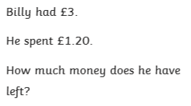
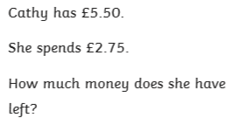
Three money questions today – children may need a hand!

Slide 7
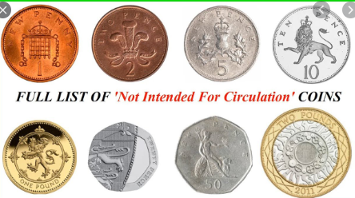

Slide 8
Can you spell the days of the week?
Check your answers on the next slide

Slide 9
Did you remember your capital letters?
Monday
Tuesday
Wednesday
Thursday
Friday
Saturday
Sunday

Slide 10
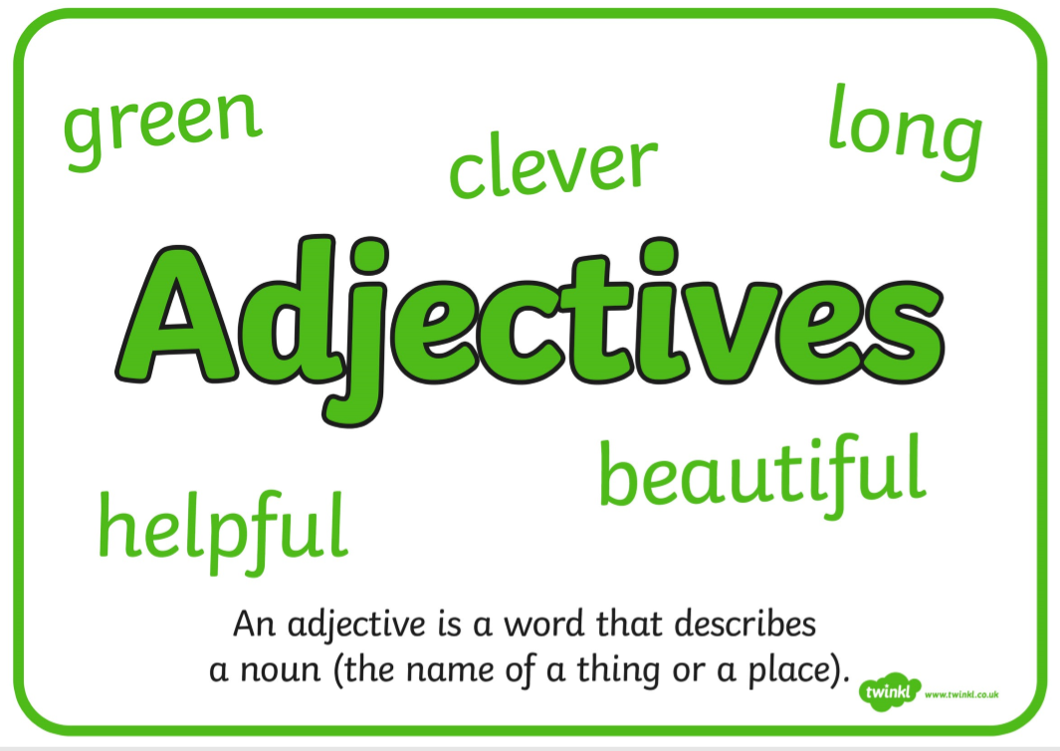
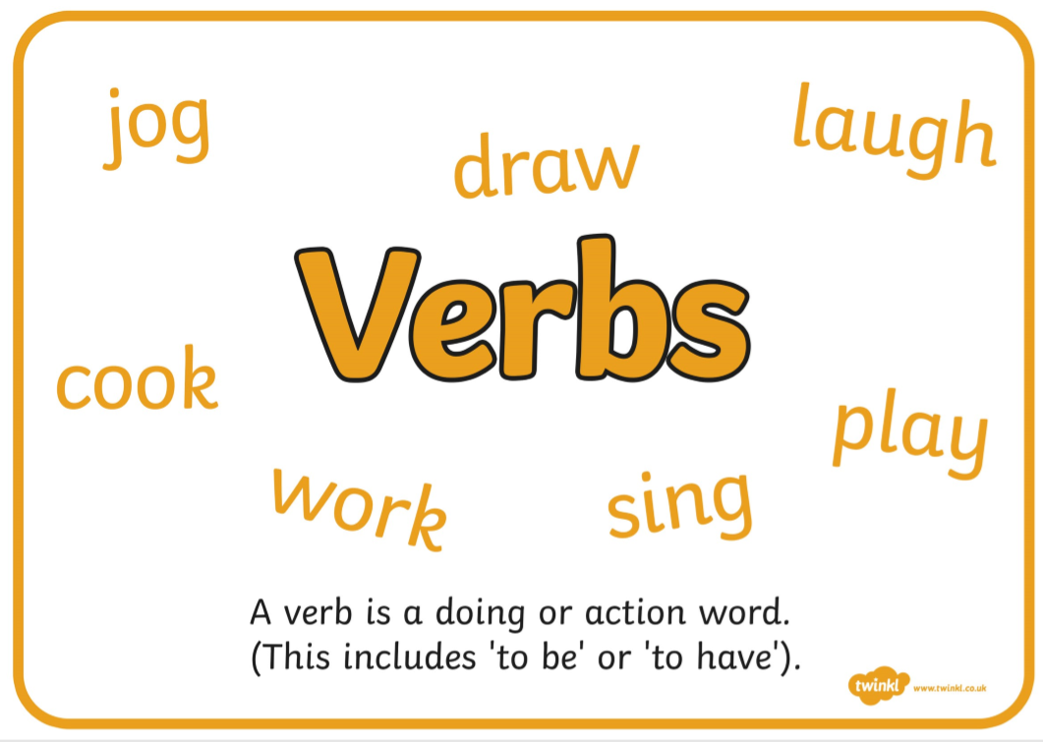
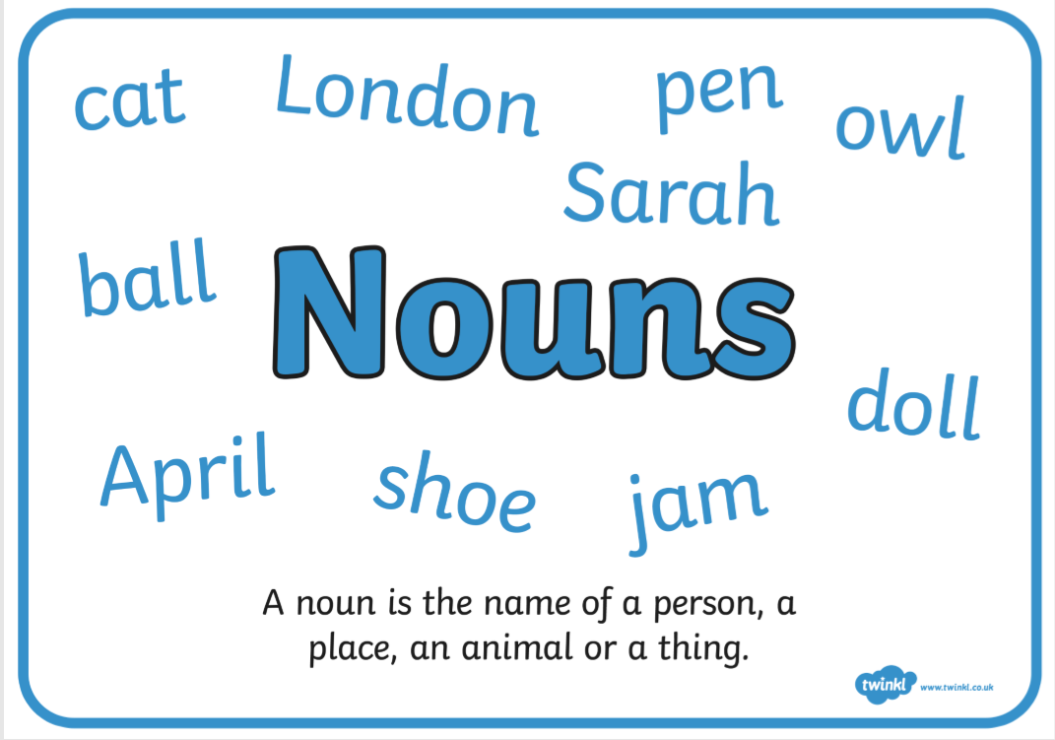
Todays activity uses different word types. Use this information to remind you of different word types…

Slide 11
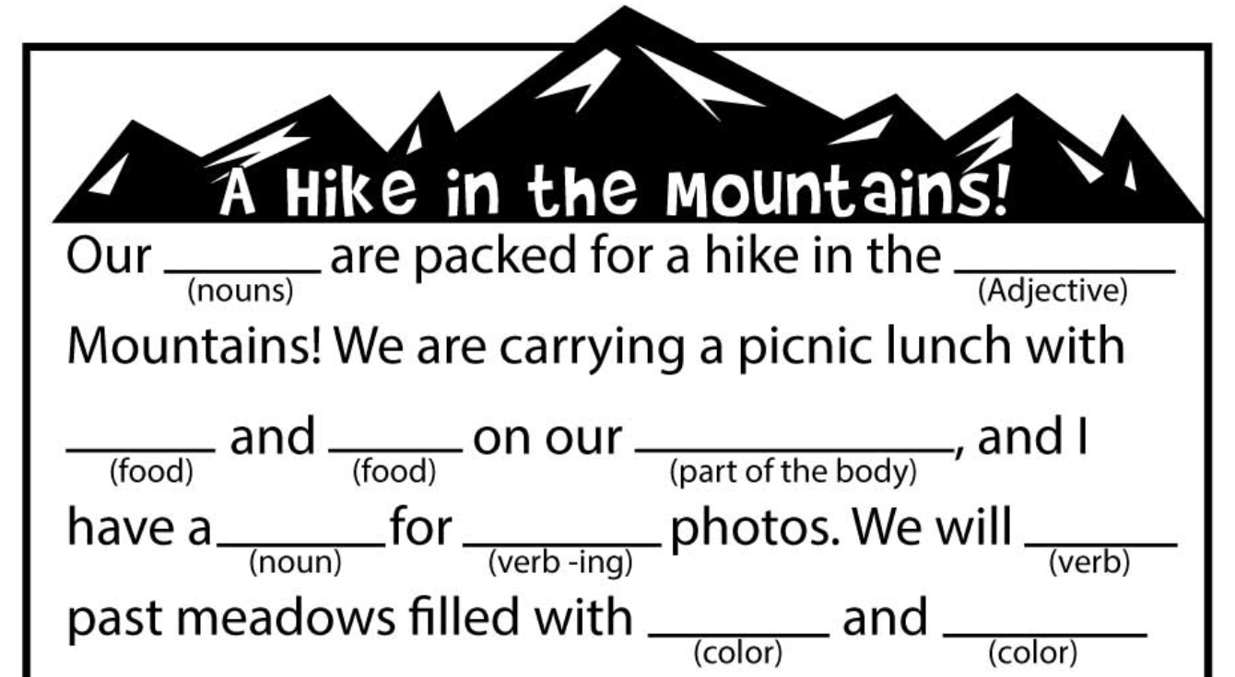
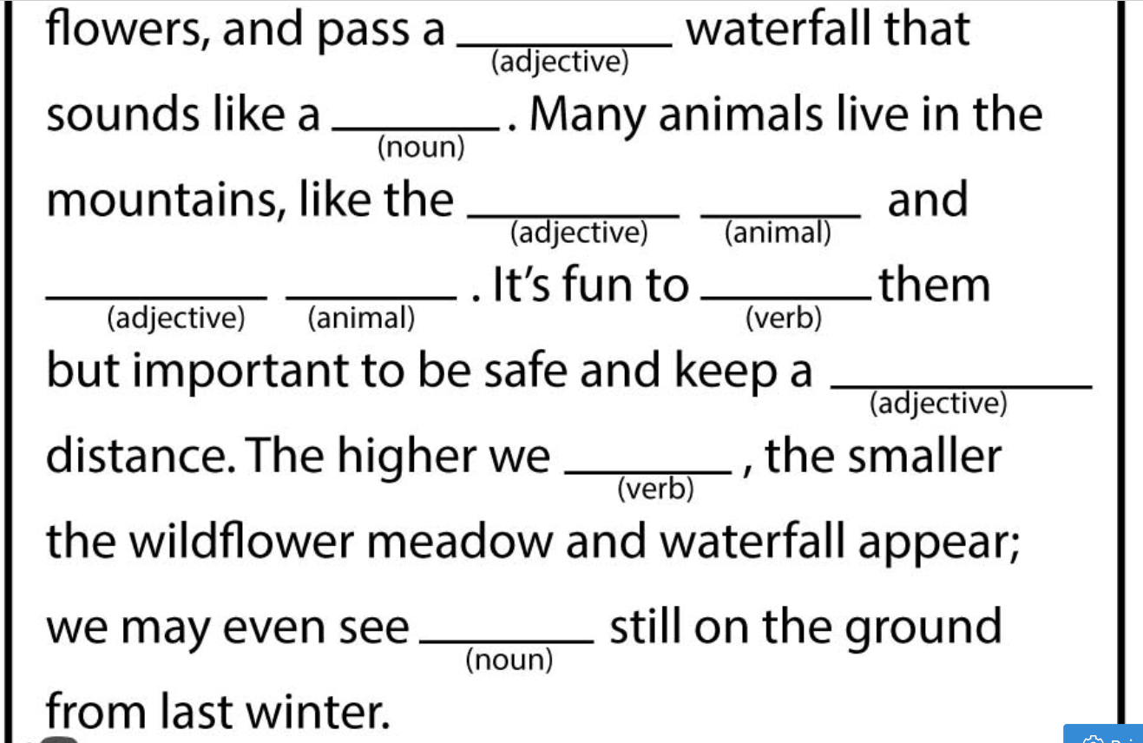
Verbal activity. This story has missing words. Look at the word type in brackets under each missing word. Can you fill it with your own word. Read the story out loud with your chosen words. Does it make sense?

Slide 12
On the next slide is another story with missing words. This time I am not going to show you the story until after you have chosen your words. On a scrap of paper or in your book write an example of each word in this order:
Place
Verb-ed
Vehicle
Number
Nouns
Animals
Verb-ing
Noun
Vehicle
Adjective
Place
Animals
Animals
Verb-ing
Noun
Adjective
Nouns
Adjective
Food
Adjective
Nouns
Nouns

Slide 13
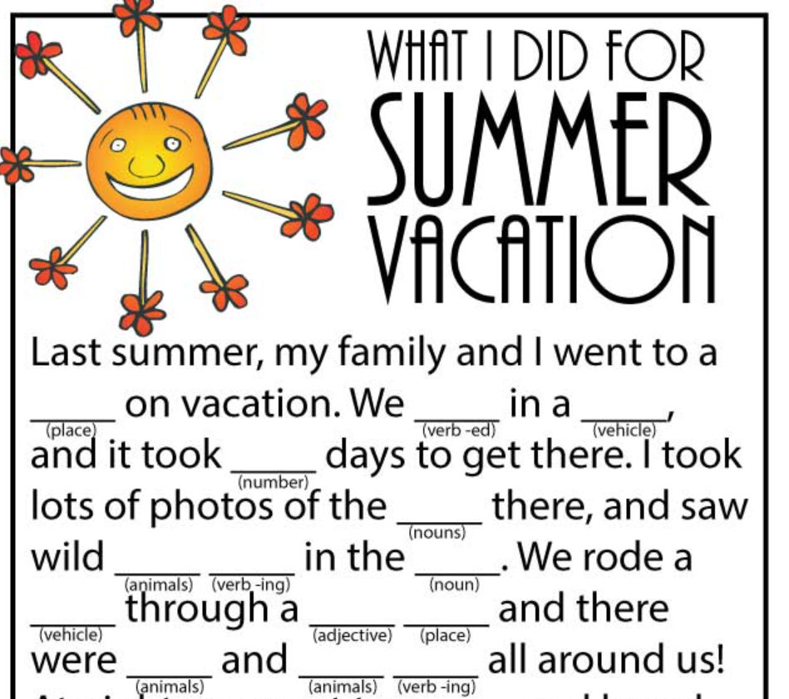
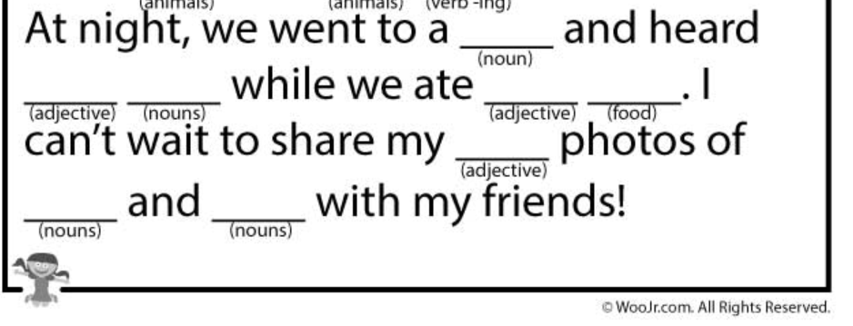
Now put your chosen words in to the story. Read it aloud…does it makes sense?

Slide 14
Would you like to write your own short story with missing words for your friends to complete? (Email it to your class teacher and we will share some in the following weeks) Remember to give the word type under each missing word! If you would like to do more of these click on the link for an online game (check with an adult first)
https://www.glowwordbooks.com/blog/category/kids-online-mad-libs/

Slide 15
Tuesday

Slide 16
The answer is one of the numbers in red!
Marvellous Me badges for those who email me the answer!!

Slide 17
Can you write the first 6 months of the year?
You will be able to check your answer on the next slide

Slide 18
Did you remember your capital letters?
January
February
March
April
May
June

Slide 19
Today you are going to write some quiz questions for your friends.
First complete the following quiz to give you of some ideas about how you might present your questions.
Then chose a subject you have enjoyed learning about in Year 4, 5 or 6.
Write up to 5 questions for your friends. We will choose as many as possible to send out in a quiz next week!
You may need to research your topic. (Ask an adult for help)
You will also need to find the answers to your questions.
Finally ask an adult to email your questions and answers to your class teacher.

Slide 21
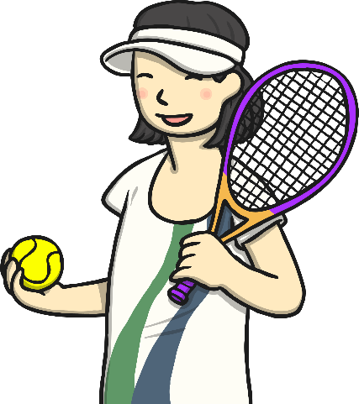
Q
Which sport is played at Queens and Wimbledon?
A
Tennis
Answer
Next

Slide 22
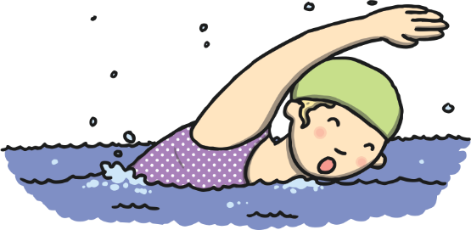
Q
Which of these is NOT a swimming stroke: caterpillar or butterfly?
A
Caterpillar
Answer
Next

Slide 23
Q
The Canadian flag is red and white and has a picture of what kind of leaf in the centre?
A
Maple
Answer
Next

Slide 24
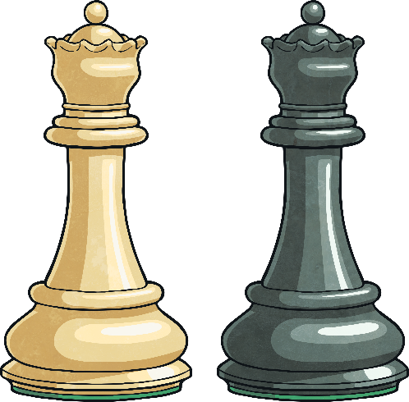
Q
Where would you find a rook, a bishop and a pawn?
A
Chess
Answer
Next

Slide 25
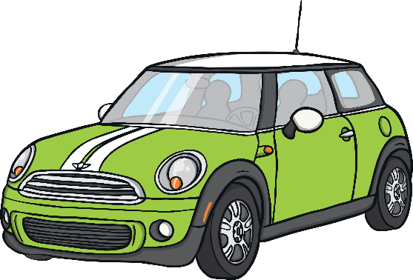
Q
What kind of car does Mr Bean drive?
A
A green Mini
Answer
Next

Slide 26
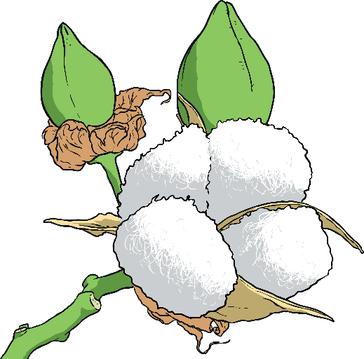
Q
Does cotton come from a plant, animal or mineral?
A
A plant
Answer
Next

Slide 27
Q
True or false: the slime eel is the only fish that can sneeze?
A
True!
Answer
Next

Slide 28
Q
What is the biggest planet in the solar system?
A
Jupiter
Answer
Next

Slide 29
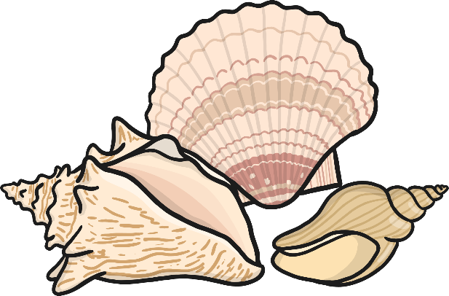
Q
Finish the tongue twister:
She sells seashells on the ...?
A
Seashore
Answer
Next

Slide 30
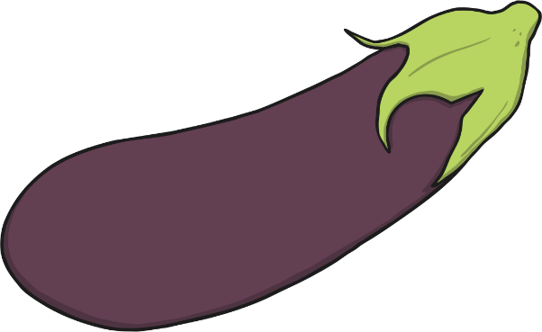
Q
What colour is an aubergine?
A
Dark purple
Answer
Next

Slide 32
Now it’s your turn to write some quiz questions for your friends.
First complete the following quiz to give you of some ideas about how you might present your questions.
Then chose a subject you have enjoyed learning about in Year 4, 5 or 6.
Write up to 5 questions for your friends. We will choose as many as possible to send out in a quiz next week!
You may need to research your topic. (Ask an adult for help)
You will also need to find the answers to your questions.
Finally ask an adult to email your questions and answers to your class teacher.

Slide 33
Wednesday

Slide 34
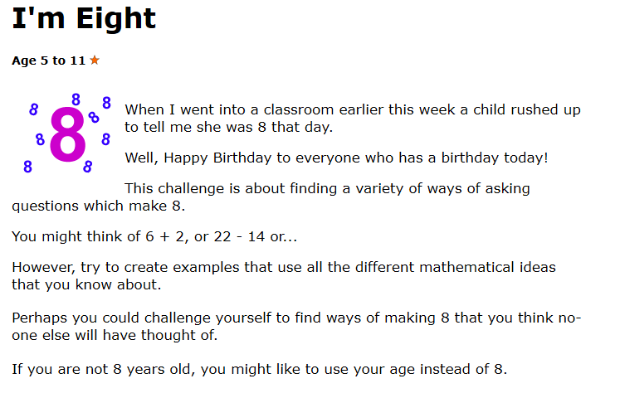
HINT – Think and challenge yourself to any times table or division where the answer is eight? Then do the same for your age?

Slide 35
Can you spell the last 6 months of the year?
You can check your spellings on the next slide.

Slide 36
Did you remember your capital letters?
July
August
September
October
November
December

Slide 37
Today, tomorrow and Friday we are going to focus on writing a newspaper report.
Think about a fairy-tale that you know and decide how you would report the story to someone else.
You could listen to The 3 Little Pig here if you need inspiration https://www.bbc.co.uk/cbeebies/radio/the-three-little-pigs?collection=cbeebies-on-stage
You may choose to write your report about the whole story or focus on one part
For example, if you were looking at the 3 Little Pigs you may include all the houses that get blown down or just choose to report on one house.
TODAY: Look through the following slides to help you decide how you will organise your report. You may want to write a few notes to help you remember.
Thursday we will focus on planning our report.

Slide 38
Work through the next slides, thinking about how you will use this information to report the main events of your chosen fairy tale. Make notes to help you plan your report tomorrow.

Slide 39
Headline
Headline and byline
For a good headline, you need to:
Catch the reader’s attention so they want to read the rest of the report;
Sum up the story in a few words;
Use powerful and interesting language;
Write in the present tense – even if the report is about an event that has already happened;
Include alliteration or wit at times.
Lead
Body
Tail

Slide 40
Byline
Headline and byline
Lead
For a good byline, you need:
The writer’s name;
The writer’s speciality (for example, Sports reporter, Food correspondent, Crime editor, Deputy politic editor, Senior fashion reporter);
A link to the writer’s Twitter account (for example, @dgoodman).
Body
Tail

Slide 41
Lead
Headline and byline
For a good lead paragraph, you need to;
Make the paragraph short and snappy so that it briefly explains what has happened;
Ensure that, even if the reader stopped reading at this point, they would still know roughly what happened;
Use past tense in most cases;
Make sure the first paragraph answers as many of these six questions as you can –
Who? What? Where? Why? When? How?
Lead
Body
Tail

Slide 42
Body
For a good body section, you need to:
Add more information and detail to your lead paragraph;
Include background information, evidence, facts and quotes from people involved in or connected to the event/story;
Continue to write in order of importance, putting the most important information in the first few paragraphs of the body section.
Headline and byline
Lead
Body
Having quotes from witnesses or experts
will make your report more credible and interesting.
Tail
Be sure to use correct punctuation for quotes!

Slide 43
Tail
For a good tail section:
Give the reader the opportunity to gain additional information if they are particularly interested in the topic of the news report;
Include links to previous news reports or useful websites;
Include a final quote from a witness or expert that helps to sum up the story or that could hint at what might happen next.
Headline and byline
Lead
This ‘Tail’ information can be useful but is not always needed. It tends to be the least important information in the report.
Body
Tail

Slide 44
Get It Right!
For a GREAT newspaper report you need to:
Keep your most important information near the top of the report;
Cut out the less important sections from the bottom of the report if it ends up being too long;
Keep your sentences short and punchy, so that the report is interesting to your reader;
Check your spelling and your facts…and check them again!

Slide 46
Thursday

Slide 47
https://nrich.maths.org/223
https://nrich.maths.org/223/solution
Web link to problem:-
Web link to answers:-

Slide 48
There are 4 seasons in a year, can you spell them?
You can check your answers on the next slide

Slide 49
Did you know you do not need capital letters for the seasons if they are not at the start of a sentence, or they are not a person’s name!
summer
autumn
winter
spring

Slide 50
Newspaper Report You may find these sheets helpful.

Slide 51
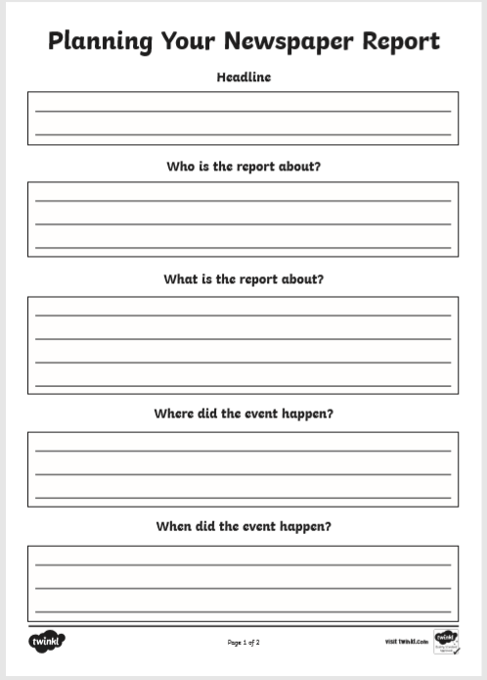
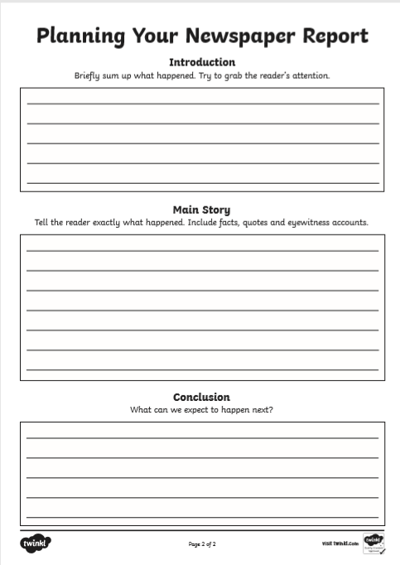
Now you know what you are writing about, use the newspaper report templates to write your report. ( You can copy the headings into your book if it helps.)

Slide 52
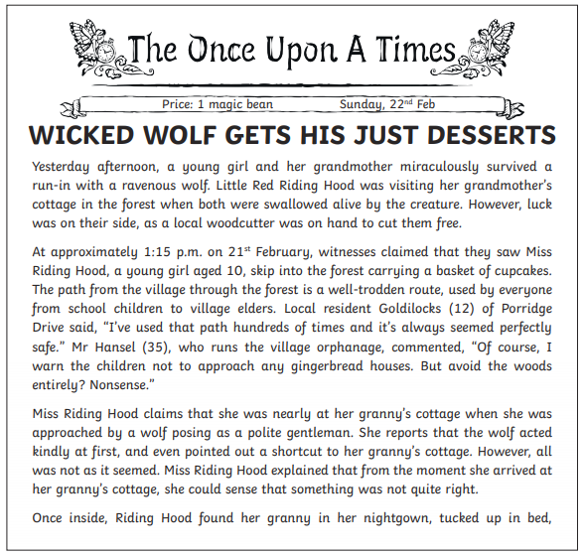
Example newspaper report

Slide 53
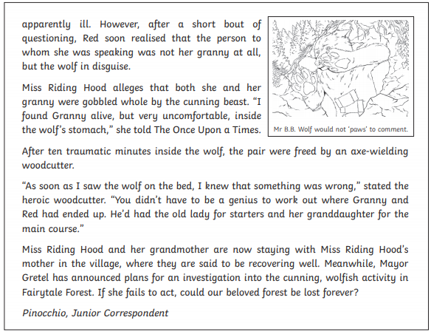

Slide 54
Friday

Slide 55
TIP- Use scrap paper for this one first before putting into books as it may need a few trial and error attempts!!

Slide 56
HINT – Children will have to draw their own v’s big enough for them to write the numbers in. You don’t have to move onto the bigger numbers if children find it hard.

Slide 57
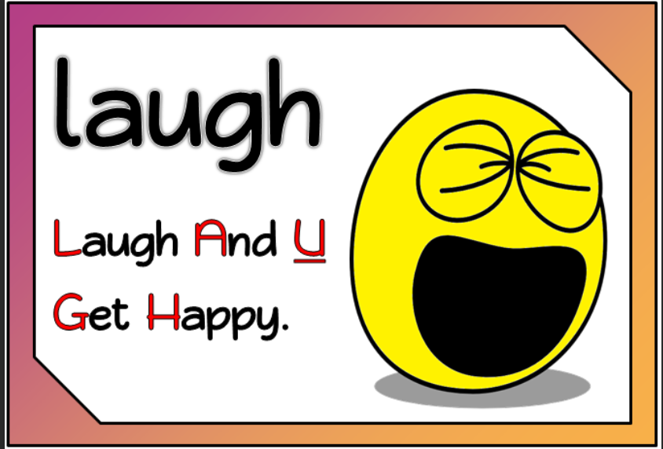
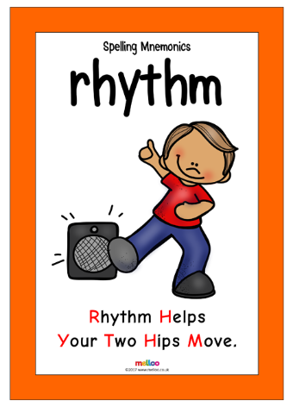

Slide 58
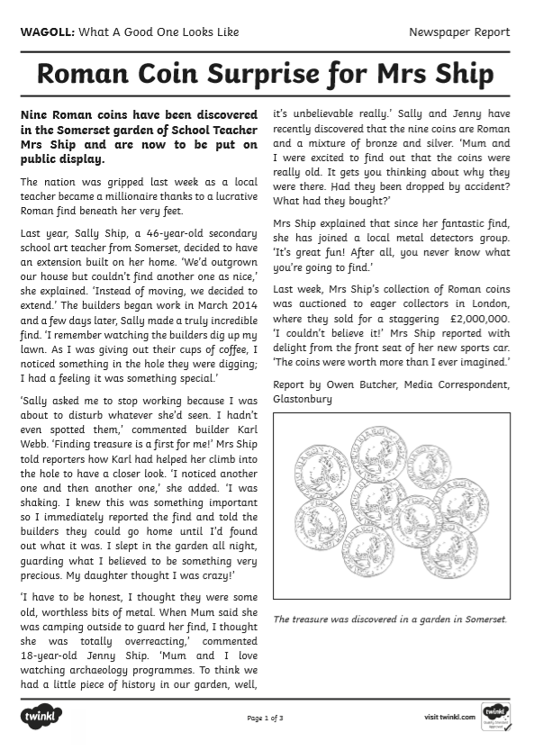
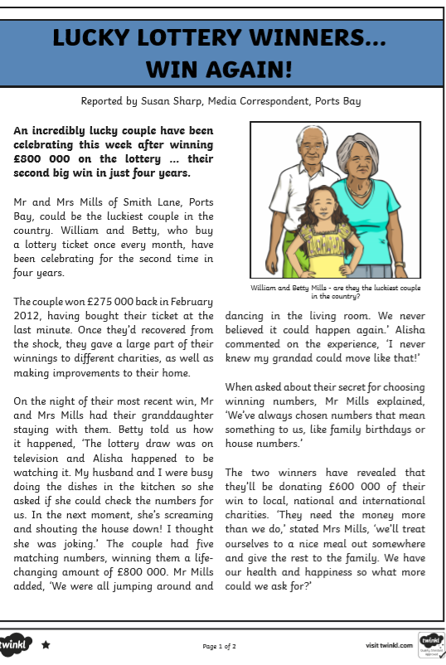
Publish your newspaper report
Use the examples above to remind you how to present your report.
Remember your catchy headline, and columns.

