Slide 1
Home Learning
Week commencing 1st June
Sycamore.class@fernhill.kite.academy

Slide 2
How it works:
Please complete one English and one Maths task each day. (Approximately 30 minutes on each). If your able to please send me examples of your learning.
The topic for this week is still ‘Fairy Tales’. This is on the school web site and will be sent by marvellous me (some of the activities may take more than a day to complete). Feel free to pick and choose from this list, don’t feel you need to do them all.

Slide 3
Overview of Topic
This week you will be focusing on FAIRY TALES.
There are lots of fun art and science activities to do.
See the ‘topic sheet’ for details
This will be sent to you via Marvellous Me or can be found on the school website.
ENJOY and don’t forget to send me examples of your work
Feel free to pick and choose from this list, don’t feel you need to do them all

Slide 4
Recommended, Free Web Sites
Maths – White Rose Maths
Maths Games – Topmarks
Reading Books – Oxford Owls
Writing – The Literacy Shed
Science – Purple Mash
Worksheets for all subjects - Twinkl

Slide 5
English Monday and spellings of the week
This week we are going to have a look at words that contain the prefix's ‘mis-’ and ‘re-’.
Remember that when we add the prefix ‘mis-’ or ‘re-’ in front of a word we make that word mean the opposite.
For example, look at these two sentences:-
They heard what their teacher had said.
They misheard what their teacher had said.
reappear
rebuild
replay
retake
misbehave
mistake
misread
mishear
Have a spelling practice of these words and re-write any words three times if you make a mistake.
If children get them all right – google the year 3 and 4 common exception words and choose four or five words from there.
CHALLENGE – Put any of these words into sentences.

Slide 6
English Monday = Handwriting https://www.youtube.com/watch?v=2NQ6uS8blwY
This week I would like you to start by practising your handwriting. Remember to write just four letters and then check back with the video, to make sure that you are forming your letters correctly.
No more than half a line of each letter in a day!
Remember that all of the letters must rest on the line and you should try to make them exactly the same size as each other.
This week let’s concentrate on d, g and q.

Slide 7
Maths Monday
Children need to become as quick as possible at recalling times tables. With that in mind lets practice again writing a list of multiplication and division facts for the 3 times tables.
Don’t forget to practice on
TT rockstars as well.

Slide 8
English Tuesday
This week we’re going to finish our story of the short film called ‘For The Birds’. Please click on the image or links to re-watch the film.
https://www.youtube.com/watch?v=nYTrIcn4rjg
https://www.literacyshed.com/for-the-birds.html
Notes:
https://www.youtube.com/watch?v=nYTrIcn4rjg

Slide 9
Tuesday English - continued

Slide 10
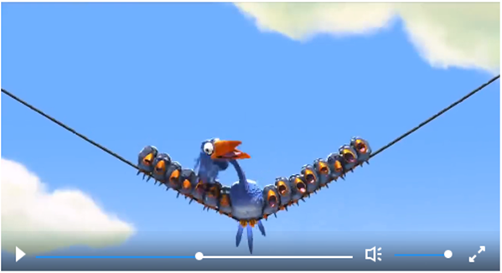
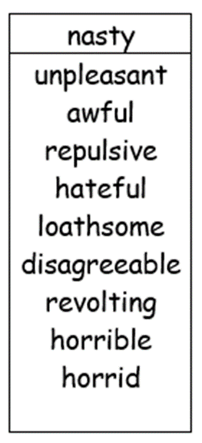
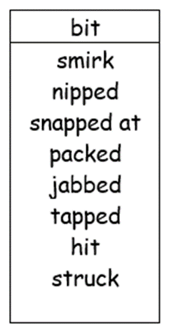
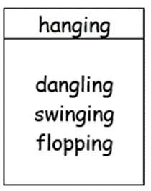
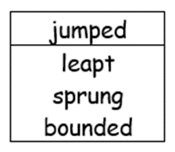
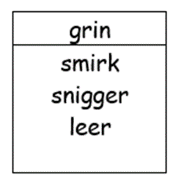
Tuesday English continued
Film clip 1:46 – 2:10

Slide 11
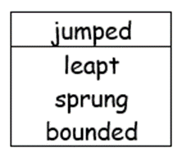
English Tuesday Continued
Film clip 1:46 – 2:10

Slide 12
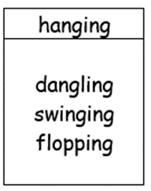
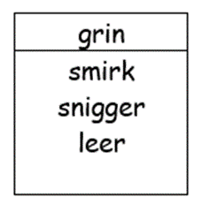
English Tuesday continued

Slide 13
Maths - Tuesday
Tip – children could write out the 3 and 7 times table to help them find the answers and don’t forget there is more than one of each creature.

Slide 14
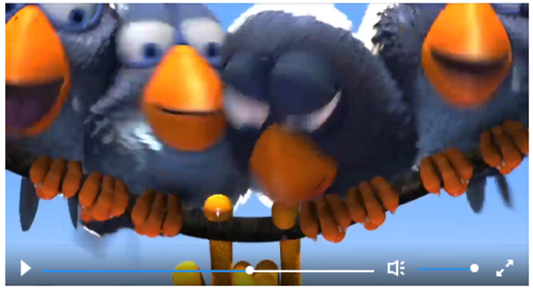
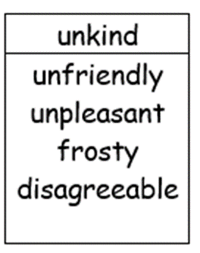
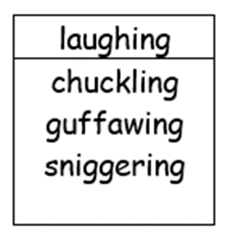
English Wednesday
In this sentence I want to use some adverbs to show how unkind the birds are being. An adverb is a word that adds more details to the action word. It is still going to be a negative sentence, because there are being really horrible to Peck. The birds are laughing I want to choose some words that will tell me how they are laughing.
Now have a go at writing your sentence.
Remember to stay in this part of the story!

Slide 15
Wednesday English continued
In this sentence I want to show that the tiny birds kept going and going and going. So I have chosen to repeat the word on. I’ve used it three times to show that the birds weren’t stopping.
Now have a go at writing your sentence.
Remember to stay in this part of the story!

Slide 16
Wednesday English continued
I would like this sentence to be a question sentence.
It might be a question where Peck or the birds are thinking about what will happen next.
I would like this sentence to be a question sentence.
It might be a question where Peck or the birds are thinking about what will happen next.
Remember you must put a question mark (?) at the end of a question sentence.

Slide 17
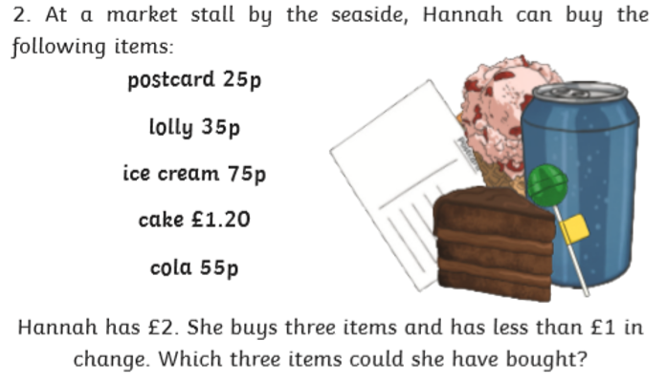
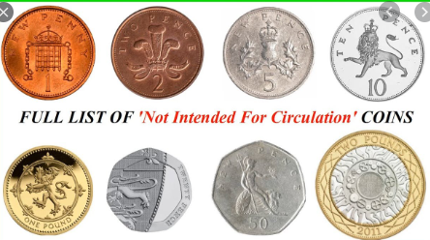
Maths Wednesday
How many different ways can you make the total of £2.95?
You can use the same value coin more than once.
What is the least amount of coins you could use
In year 3 children need to be familiar with money and practice finding different totals. They also need to practice working out how much change they may receive after they’ve bought something.

Slide 18
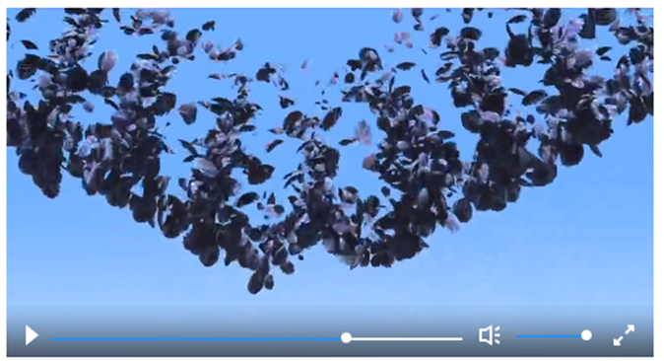
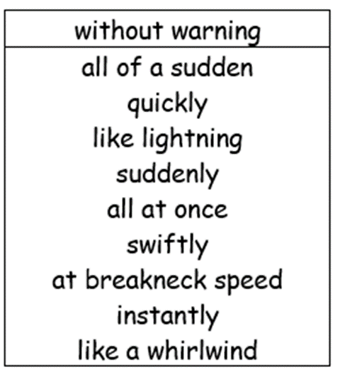
English Thursday
In this sentence I would like to choose some words to show, how quickly Peck’s toe came away from the telegraph pole. Remember I am going to also choose words that have a negative sound.
Now have a go at writing your sentence.
Remember to stay in this part of the story!

Slide 19
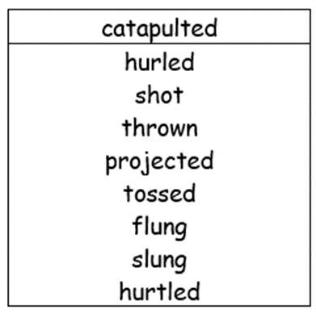
English Thursday Continued
I want to have some action in this sentence, showing how quickly the birds were thrown into the air.
Now have a go at writing your sentence.
Remember to stay in this part of the story!

Slide 20
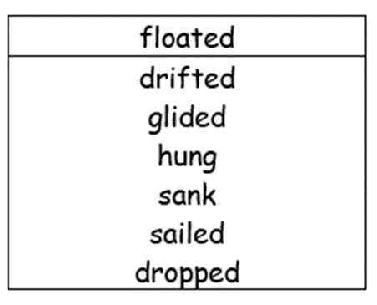
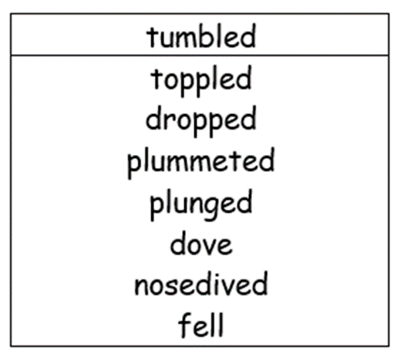
English Thursday - continued
This is another sentence where I want to show lots of action.
I have chosen the words tumbled and floated to show how things are moving.
Now have a go at writing your sentence.
Remember to stay in this part of the story!
Please don’t forget capital letters and full stops.

Slide 21
Maths Thursday
In year 3 children need to be familiar with money and practice finding different totals. They also need to practice working out how much change they may receive after they’ve bought something.

Slide 22
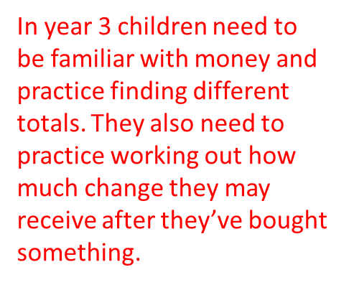
Maths Thursday continued

Slide 23
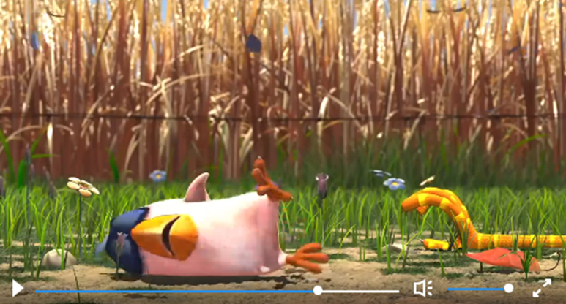
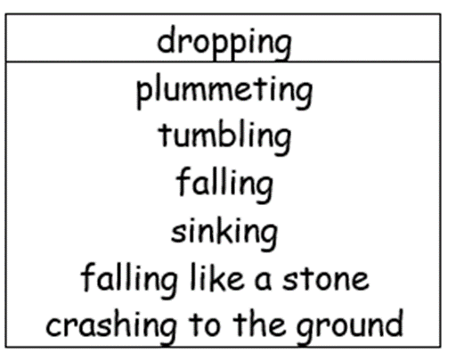
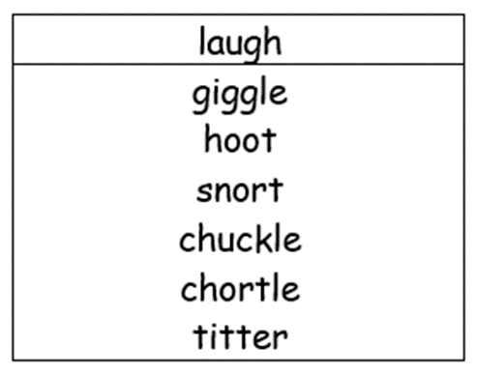
English Friday
The final part of the story becomes very positive for Peck, because the birds are no longer making fun of him. In fact they are getting a taste of their own medicine!
Now have a go at writing your sentence.
Remember to stay in this part of the story!
Please don’t forget capital letters and full stops.

Slide 24
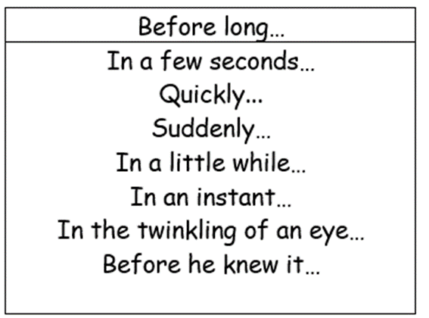
English Friday continued
In this sentence I want to tell the reader that it was only a short space of time before the rest of the birds came tumbling down.
This is my sentence.
Now have a go at writing your sentence.
Remember to stay in this part of the story.
Remember to use capital letters and full stops!

Slide 25
English Friday continued
I would like to have a question as my last sentence.
It would be good to let the reader know that Peck was now the one who was happy at the end.
Now have a go at writing your sentence.
Remember to stay in this part of the story!
Remember to put a question mark (?) at the end of the sentence.

Slide 26
Maths Friday

Slide 27
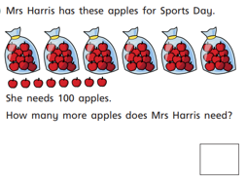
Maths Friday continued

